Slide 1

CPSC 875
John D. McGregor
C15 – Variation in architecture

Slide 2
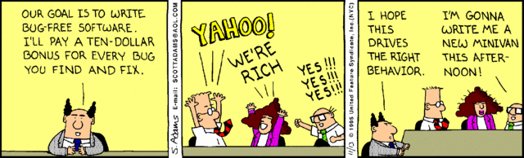
Managers, you’ve got to love them

Slide 3
https://www.google.com/url?sa=t&rct=j&q=&esrc=s&source=web&cd=5&ved=0CCsQFjAE&url=https%3A%2F%2Fitea3.org%2Fproject%2Fworkpackage%2Fdocument%2Fdownload%2F1202%2F10039-SAFE-WP-3-SAFED331a.pdf&ei=4EL4VLLgFcecNuLkgdgK&usg=AFQjCNFzblXBlmaVXsbZqghq4OLsxTOnqA&bvm=bv.87519884,d.eXY&cad=rja
Read first 7 sections

Slide 4
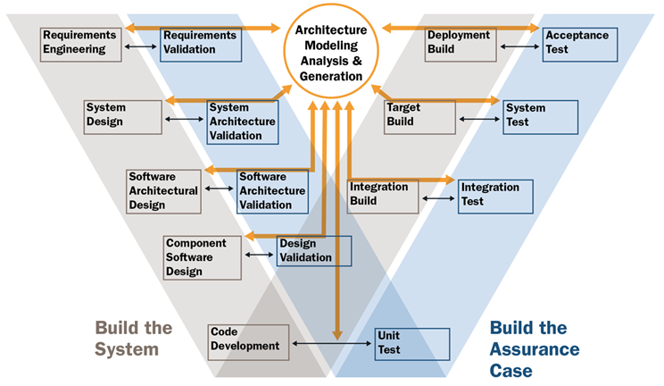

Slide 5
Hexagonal architecture
http://fideloper.com/hexagonal-architecture

Slide 6
Goal
The goal of variability in a software product line is to maximize return on investment (ROI) for building and maintaining products over a specified period of time or number of products.

Slide 7
Different kinds of product variation
Differentiation
Evolution
There is also data variation

Slide 8
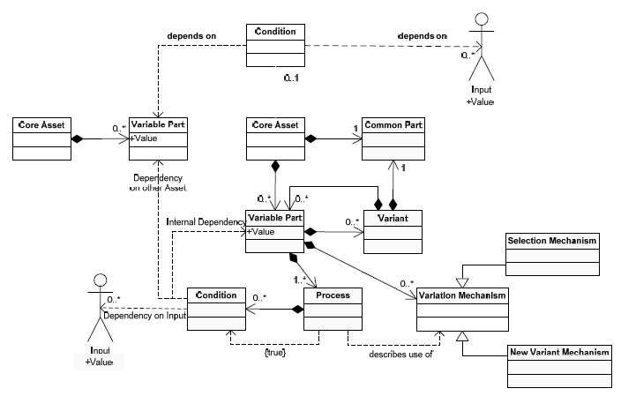
Management of variation

Slide 9
Software Product Line
Multiple products, each a bit different from the others
The differences are encapsulated in variation points
A variation point is not a single location in the code
Corresponds to a subset of the requirements

Slide 10
Variation mechanisms
An instance of the architecture resolves certain variations
Mechanisms
One system definition extends another
A system definition is included or excluded
Subprograms have parameters

Slide 11
Binding time
The reason that some variation is not resolved is because the binding time for the variation is after architecture instantiation time
The binding time is partially determined by the architect
To do this
Who will do the binding?
When do they touch the system?
For example, a marketing person decides a feature is included – can only happen at requirements time

Slide 12
Eliminating variability
Some apparent variability can be reduced to commonality
A standard interface can be placed between the commonality and the apparent variability with the result that we don’t care what is on the other side of the interface. The BlueTooth interface for example.

Slide 13
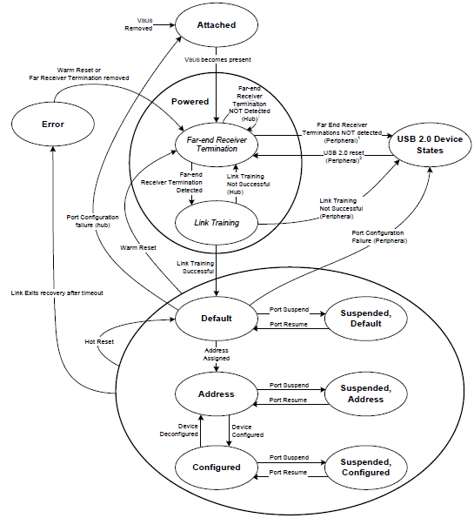
USB state machine from standard spec
We do worry about conformance
of the architecture to abstract
specifications such as standards.

Slide 14
Vehicle variations
Powertrain
Transmissions
Engines
Infotainment
Radios
Information package
GPS/navigation
Entertainment package

Slide 15
But what about variations in quality attribute levels?
One product needs to be airworthy certified but others do not
One needs real-time performance another does not
One must be secure another one does not

Slide 16
What to do?
Would you
Make everything meet the toughest standard?
Re-implement all the assets?
Tactic: reduce and isolate – encapsulate the section that differs among products; refactor when possible to reduce the area; hide behind interfaces

Slide 17
Use cross cutting techniques
Aspects as we have already discussed cut across the system decomposition
Other language idioms such as “mix-ins” also cross cut
Look for a technique where fragments are maintained separately

Slide 18
Feature model
http://wwwiti.cs.uni-magdeburg.de/iti_db/research/featureide/

Slide 19
Configuration editor

Slide 20
Multi-threaded design/programming
http://today.java.net/article/2010/03/03/rethinking-multi-threaded-design-priniciples
http://today.java.net/article/2010/04/14/rethinking-multi-threaded-design-principles-part-2

Slide 21
Complexity
http://resources.sei.cmu.edu/asset_files/presentation/2015_017_001_447399.pdf

