Slide 1

CPSC 875
John D. McGregor
C15 – Variation in architecture

Slide 2
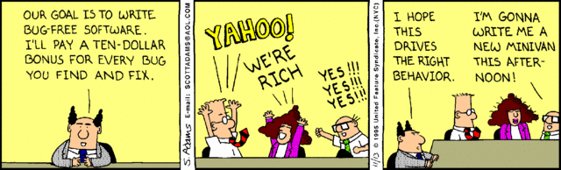
Managers, you’ve got to love them

Slide 3
https://www.google.com/url?sa=t&rct=j&q=&esrc=s&source=web&cd=5&ved=0CCsQFjAE&url=https%3A%2F%2Fitea3.org%2Fproject%2Fworkpackage%2Fdocument%2Fdownload%2F1202%2F10039-SAFE-WP-3-SAFED331a.pdf&ei=4EL4VLLgFcecNuLkgdgK&usg=AFQjCNFzblXBlmaVXsbZqghq4OLsxTOnqA&bvm=bv.87519884,d.eXY&cad=rja
Read first 7 sections

Slide 4
Its not just structure
Once the components and connectors are defined
Populate with properties
Include units where possible*****
Include the properties that will support analyses

Slide 5
Defining New Properties
Identify a construct of interest
Find/develop a theory behind it
Use a technique such as GQM to define specific metrics
Map into architecture characteristics (losing some precision)
Implement in AADL (or other ADL)
Conduct sanity tests

Slide 6
Analyzing using Properties
Write Resolute queries on the model
The model checker traverses the model and evaluates predicates
Result is true/false evaluation
Computations done as side effects
Can invoke Java or other programs

Slide 7
Attack surface of a product
Manadhata, P. and Wing, J.: An Attack Surface Metric. IEEE Trans. Software Eng. 37, 371–386, 2011.
http://reports-archive.adm.cs.cmu.edu/anon/isr2011/CMU-ISR-11-121.pdf
https://www.owasp.org/index.php/Attack_Surface_Analysis_Cheat_Sheet

Slide 8

Attack Surface Metric
Damage-Effort Ratio (DER)
An attacker will choose the target that can cause the most damage for the least effort
The access rights determine how hard it is to access the elements that will be compromised
M₁
M₂
A
D
B
E
C
F

Slide 9
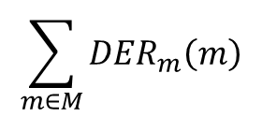
ChannelConnectors
Connector Type ChannelT = {
Property channelAccessRights : int;
Property channelProtocol : int;
}
Larger protocol values indicate larger chunks of data that can be passed making it easier to move programs
protocols
------------------
access rights
$$\sum_{m∈M}{{DER}_{m}\left(m\right)}$$

Slide 10

Port Type EntryExitPointT = {
Property entryExitPointPrivileges : int;
Property entryExitPointAccessRights : int;
}
Level of privileges determines the damage that can be done
Privileges
-------------------
Access rights
$$\sum_{c∈C}{{DER}_{c}\left(c\right)}$$

Slide 11
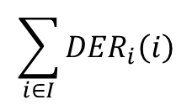
Component Type DataItemT = {
Property dataItemType : int;
Property dataItemAccessRights : int;
}
The less restrictive the data types are the easier it is for attackers to enter.
Data types
------------------
Access rights
$$\sum_{i∈I}{{DER}_{i}\left(i\right)}$$

Slide 12
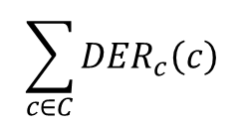
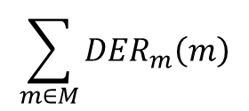
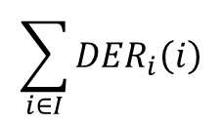
Complete Attack Surface
$$\sum_{m∈M}{{DER}_{m}\left(m\right)}$$
$$\sum_{c∈C}{{DER}_{c}\left(c\right)}$$
$$\sum_{i∈I}{{DER}_{i}\left(i\right)}$$
A transform is evaluated to determine its effect on the attack surface
Would using a feature group reduce the port vulnerability?
Would using a record to group data fields together make an attack easier/

Slide 13
Property set
property set securityProperties is
--access rights are scored based on the clearance required
--no clearance required => 1.0
--secret clearance required => 3.0
--top secret clearance required => 5.0
Channel_Protocol : aadlreal applies to (connection);
Channel_AccessRights: aadlreal applies to (connection);
entryExitPointPrivileges: aadlreal applies to (port);
entryExitPointAccessRights:aadlreal applies to (port);
dataItemType:aadlreal applies to (data);
dataItemAccessRights:aadlreal applies to (data);

Slide 14
--From SEI Tech Report CMU/SEI-2015-TR-01
-- properties to support documenting and analyzing security
-- Added property that supports access mode of data
AccessProtection: list of record
(
AccessMode: enumeration(r, w, rw, x);
AccessGroup: enumeration (CC, ABS);
) applies to (all);
end securityProperties;

Slide 15
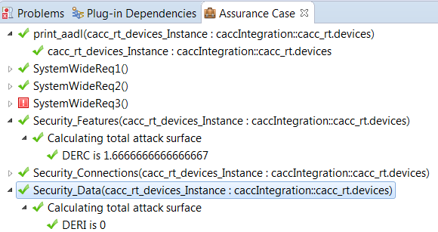
Results of Claim functions

Slide 16
Ports
features
sensed_speed:in data port data_types::speed{securityProperties::entryExitPointPrivileges=>5.0;securityProperties::entryExitPointAccessRights=>3.0;};
sensed_speed_limit:in data port data_types::speed{securityProperties::entryExitPointPrivileges=>5.0;securityProperties::entryExitPointAccessRights=>3.0;};

Slide 17
DER_{C}
Security_Features(self : component) <= **"Calculating total attack surface " **
let featureSet : {feature} = features(self);
let sumSurfaceC:real = sum({surfaceAreaC(t) for (t:featureSet)});
let sumAccessC:real = sum({surfaceAccessC(w) for (w:featureSet)});
Req5(sumSurfaceC/sumAccessC)
Req5(total:real)<= **"DERC is " total**true
surfaceAreaC(self:feature):real=
property(self,securityProperties::entryExitPointPrivileges,0.0)
surfaceAccessC(self:feature):real=
property(self,securityProperties::entryExitPointAccessRights,0.0)

Slide 18
Channel
connections
bus_radar: bus access this_bus<->radar_sensor.BA{securityProperties::Channel_Protocol=>9.0;securityProperties::Channel_AccessRights=>9.0;};
bus_camera: bus access this_bus<->camera_sensor.BA{securityProperties::Channel_Protocol=>9.0;securityProperties::Channel_AccessRights=>9.0;};

Slide 19
DER_{M}
Security_Connections(self : component) <= **"Calculating total attack surface " **
let connectionSet : {connection} = connections(self);
let sumSurfaceM:real = sum({surfaceAreaM(u) for (u:connectionSet)});
let sumAccessM:real = sum({surfaceAccessM(v) for (v:connectionSet)});
Req6(sumSurfaceM/sumAccessM)
Req6(total:real)<= **"DERM is " total**true
surfaceAreaM(self:connection):real=
property(self,securityProperties::Channel_Protocol,0.0)
surfaceAccessM(self:connection):real=
property(self,securityProperties::Channel_AccessRights,0.0)

Slide 20
Data
item:data simple{securityProperties::dataItemType=>7.0;
securityProperties::dataItemAccessRights=>5.0;};

Slide 21
DER_{I}
Security_Data(self : component) <= **"Calculating total attack surface " **
let dataSet : {component} = subcomponents(self);
let sumSurfaceI:real = sum({surfaceAreaI(u) for (u:dataSet)});
let sumAccessI:real = sum({surfaceAccessI(v) for (v:dataSet)});
Req7(sumSurfaceI/(sumAccessI))
Req7(total:real)<=**"DERI is " total**true
surfaceAreaI(self:data):real=
property(self,securityProperties::dataItemType,0.0)
surfaceAccessI(self:data):real=
property(self,securityProperties::dataItemAccessRights,0.0)

Slide 22
Sanitize Data at Entry/Exit Points
this transformation requires the architect to insert a component between an entry/exit point and the environment
Ports that previously served as entry/exit points should be moved to the sanitizer
have their privileges reduced by an order of magnitude to reflect the sanitizing function

Slide 23
Favor
Restricted Channels
Limiting the type of data transmitted over a channel can reduce the attack surface of the system by lessening the advantage gained by exploiting that channel
The protocol value should be lowered to reflect the more restrictive nature of the new protocol

Slide 24
Move Data Items to the Interior
Moving data items to the interior of a system shifts untrusted data items away from the system’s perimeter
Data items that cannot be moved to the interior of the system should be evaluated to determine if they are necessary and be eliminated if they are not

Slide 25
Attack surface properties in AADL
property set securityProperties is
Channel_Protocol : aadlinteger applies to (connection);
Channel_AccessRights: aadlinteger applies to (connection);
entryExitPointPrivileges: aadlinteger applies to (port);
entryExitPointAccessRights:aadlinteger applies to (port);
dataItemType:aadlinteger applies to (data);
dataItemAccessRights:aadlinteger applies to (data);
end securityProperties;

Slide 26
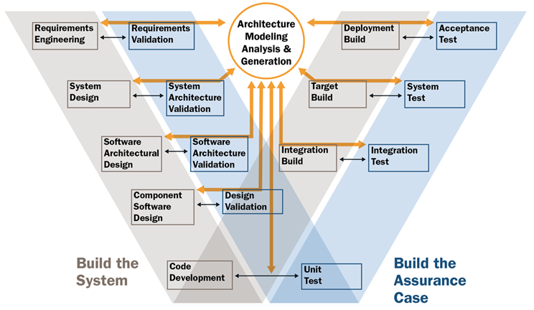

Slide 27
Goal
The goal of variability in a software product line is to maximize return on investment (ROI) for building and maintaining products over a specified period of time or number of products.

Slide 28
Different kinds of product variation
Differentiation
Evolution
There is also data variation

Slide 29
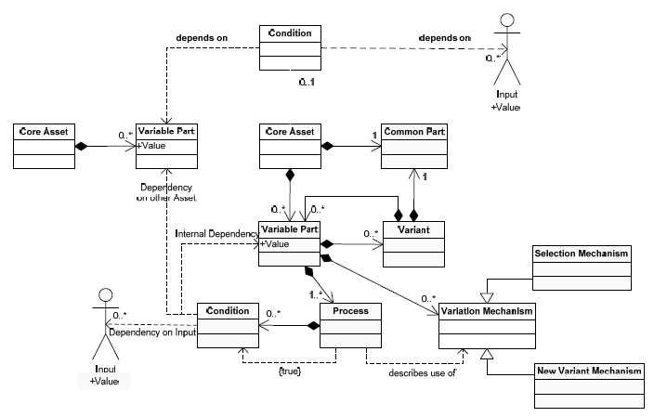
Management of variation

Slide 30
Software Product Line
Multiple products, each a bit different from the others
The differences are encapsulated in variation points
A variation point is not a single location in the code
Corresponds to a subset of the requirements

Slide 31
Variation mechanisms
An instance of the architecture resolves certain variations
Mechanisms
  One system definition extends another
  A system definition is included or excluded
  Subprograms have parameters

Slide 32
Binding time
The reason that some variation is not resolved is because the binding time for the variation is after architecture instantiation time
The binding time is partially determined by the architect
To do this
  Who will do the binding?
  When do they touch the system?
  For example, a marketing person decides a feature is included – can only happen at requirements time

Slide 33
Eliminating variability
Some apparent variability can be reduced to commonality
  A standard interface can be placed between the commonality and the apparent variability with the result that we don’t care what is on the other side of the interface. The BlueTooth interface for example.

Slide 34
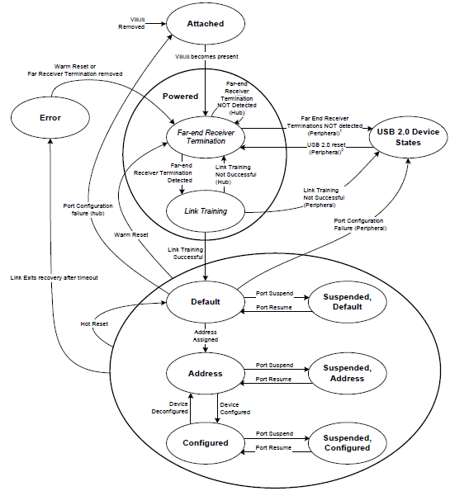
USB state machine from standard spec
We do worry about conformance
of the architecture to abstract
specifications such as standards.

Slide 35
Vehicle variations
Powertrain
  Transmissions
  Engines
Infotainment
  Radios
  Information package
  GPS/navigation
  Entertainment package

Slide 36
But what about variations in quality attribute levels?
One product needs to be airworthy certified but others do not
One needs real-time performance another does not
One must be secure another one does not

Slide 37
Define scope of pattern and attachments
A pattern may have disconnected parts
So a variation point may not be all in one physical location in the architecture description
For example, an Eclipse plug-in has menu items, editors, perspectives, etc.

Slide 38
What to do?
Would you
  Make everything meet the toughest standard?
  Re-implement all the assets?
Tactic: reduce and isolate – encapsulate the section that differs among products; refactor when possible to reduce the area; hide behind interfaces

Slide 39
Use cross cutting techniques
Aspects as we have already discussed cut across the system decomposition
Other language idioms such as “mix-ins” also cross cut
Look for a technique where fragments are maintained separately

Slide 40
Multi-threaded design/programming
http://today.java.net/article/2010/03/03/rethinking-multi-threaded-design-priniciples
http://today.java.net/article/2010/04/14/rethinking-multi-threaded-design-principles-part-2

