Slide 1

CPSC 875
John D. McGregor
C15.1 – Process/AUTOSAR

Slide 2
Requirements
Need is for an e-commerce system which presents catalog item descriptions and takes orders.
The system must be able to take advantage of mobile devices.
The system must be available internet wide.

Slide 3
Client server basic style
system
Client/server

Slide 4
Architectural style – N-Tiered e-commerce architecture
Client/server
client
presentation
business logic
database

Slide 5
Factors
Separate machines
Separate purposes
Scalability
Database latency becomes critical
Thin client
presentation
business logic
database

Slide 6
Decomposition of client side
model
controller
view
Thin client
presentation
business logic
database

Slide 7
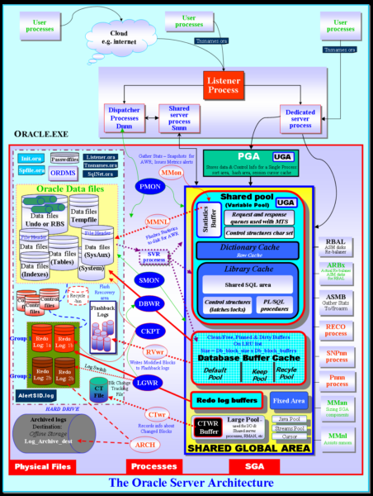
Use a Database Framework
model
controller
view
Thin client
presentation
business logic
database

Slide 8
Autosar

Slide 9
Rules for Interfaces

Slide 10
Layer Interactions

Slide 11
Error handling

Slide 12
Errors

Slide 17
Automation/Communication
Statements about values in the product
Assert invariants assumption: input < 20
Guarantees guarantee: output < 100
Statements about the structure of the system
connected(a : component, conn : connection, b : component) : bool = parent(source(conn)) = a and parent(destination(conn)) = b
memory_bound(logical : component, physical : component) : bool = has_property(logical, Deployment_Properties::Actual_Memory_Binding) and member(physical, property(logical, Deployment_Properties::Actual_Memory_Binding))
AGREE
Resolute

Slide 18
Here’s what you are going to do
Use AGREE and Resolute to illustrate the validity of your model.
Add statements to your model and evaluate them.
Submit the instrumented code and a couple of screen shots by 11:59PM on March 25th.

