Slide 1

CPSC 875
John D. McGregor
C16

Slide 2
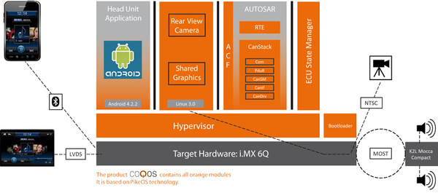
Partitions

Slide 3
Requirements
Need is for an e-commerce system which presents catalog item descriptions and takes orders.
The system must be able to take advantage of mobile devices.
The system must be available internet wide.

Slide 4
Client server basic style
system
Client/server

Slide 5
Architectural style – N-Tiered e-commerce architecture
Client/server
client
presentation
business logic
database

Slide 6
Factors
Separate machines
Separate purposes
Scalability
Database latency becomes critical
Rate of change of requirements
Thin client
presentation
business logic
database

Slide 7
Decomposition of client side
model
controller
view
Thin client
presentation
business logic
database

Slide 8
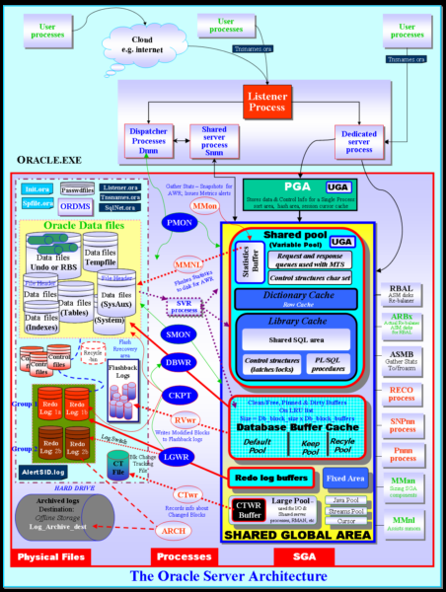
Use a Database Framework
model
controller
view
Thin client
presentation
business logic
database

Slide 9
Business Rules engine
model
controller
view
Thin client
presentation
business logic
database

Slide 10
Capturing requirements
We will use reqspec to capture requirements
And we will use a set of languages to define verification activities
These languages will make the process of V&V more robust and automated.
Given we are building the cruise control for a family of vehicles
We develop requirements first

Slide 11
Goal grammar
Goal ::=
goal Name ( : Title )?
( for TargetElement )?
[
( category ( <ReqCategory> )+ )?
( description Description )?
( ConstantVariable )*
( rationale String )?
( refines ( <Goal> )+ )?
( conflicts with ( <Goal> )+)?
( evolves ( <Goal> )+)?
( dropped )?
( stakeholder ( <Stakeholder> )+ )?
( see document requirement ( <Requirement> )+)?
( see document ( DocReference )+ )?
( issues (String)+ )?
( ChangeUncertainty )?
]
Title ::= String
TargetClassifier ::= <AADL Component Classifier>
TargetElement ::= <ModelElement>
DocReference ::= URI to an element in an external document

Slide 12
Stakeholder goals grammar
StakeholderGoals ::=
stakeholder goals NestedName ( : Title )?
for ( TargetClassifier | all )
( use constants <GlobalConstants>* )?
[
(description Description )?
(see document ( DocReference )+ )?
( ConstantVariable )*
( Goal )+
( issues (String)+ )?
]

Slide 13
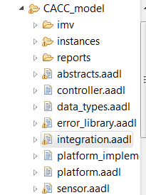

Specific goal
stakeholder goals caccGoals for integration::cacc_rt.devices [
goal g1 : "Safety" [
description "The system shall be safe."
rationale "This is a control system, whose failure affects lives. "
stakeholder cacc.rs
]]

Slide 14
Requirement Grammar
Requirement ::=
requirement Name ( : Title )?
( for TargetElement )?
[
( category ( <ReqCategory> )+ )?
( description Description )?
( Variable )*
( Predicate )?
( rationale String )?
( mitigates ( <Hazard> )+ )?
( refines ( <Requirement> )+)?
( decomposes ( <Requirement> )+)?
( evolves ( <Requirement> )+)?
( dropped )?
(development stakeholder ( <Stakeholder> )+ )?
( see goal ( <Goal> )+)?
( see document goal ( <Goal> )+)?
( see document requirement ( <Requirement> )+)?
( see document ( DocReference )+ )?
( issues (String)+ )?
( ChangeUncertainty )?
]

Slide 15
specific requirement
requirement specification caccreqs
for integration::cacc_rt.devices
[
val MaximumSpeed = 120.0 mph
requirement speed_R1 : "throttle cannot exceed the maximum setting"
[
description this " shall have a maximum reading that is less than or equal to maximum setting"
compute actualSpeed
assert value actualSpeed <= MaximumSpeed
rationale "The system might exceed the maximum safe speed"
mitigates "Invalid data sent by the speedometer"
//category [cc]
see goal caccGoals.g1
]

Slide 16
System Requirements Grammar
SystemRequirements ::=
System requirements NestedName ( : Title )?
for ( TargetClassifier | all )
( use constants <GlobalConstants>* )?
[
( description String )?
(see document ( DocReference )+ )?
( Variable )*
( Requirement )*
( issues (String)+ )?
]

Slide 17
Organization Grammar
Organization::=
organization Name
( Stakeholder )+
Stakeholder ::=
stakeholder Name
[
( full name String )?
( title String )?
( description String )?
( role String )?
( email String )?
( phone String )?
]

Slide 18
Specific organization
organization cacc
stakeholder rs [
full name "Roselane S. Silva"
]
stakeholder jdm [
full name "John D. McGregor"
]

Slide 19
Requirement Categories
RequirementCategories ::=
requirement categories
[
( RequirementCategory )+
]
RequirementCategory ::=
Name ( { <RequirementCategory>+ } )?

Slide 20
Specific categories
selection categories [cc acc cacc]

Slide 21
Variables and Constants
Variable ::= ConstantVariable | ComputedVariable
ConstantVariable ::=
val ( Type )? Name = Value
ComputedVariable ::= computed Name
Type ::= <any type from the Java type system>
constants Name
[ ConstantVariable+ ]

Slide 22
constants
Val string Logger_IP_Address= ” 192.0.2.235”
Computed_Braking_Distance real

Slide 23
Constants
GlobalConstants ::= constants Name
[ ConstantVariable+ ]
Constants Minimum_Separation = 2

Slide 24
Constants
GlobalConstans ::= constants Name
[ ConstantVariable+ ]
Constants Minimum_Separation = 2

Slide 25
Traceability
As we build the requirements model we have traceability in the form of references to the entity constrained by the requirement.
We also have traceability via requirements categories.

Slide 26
Agree model checking
An annex to AADL that allows the specification of guarantees and checks their correctness.
annex agree {**
guarantee ”dummy” : true ;
**};
Inserted into an AADL component specification
We need to replace dummy and true

Slide 27
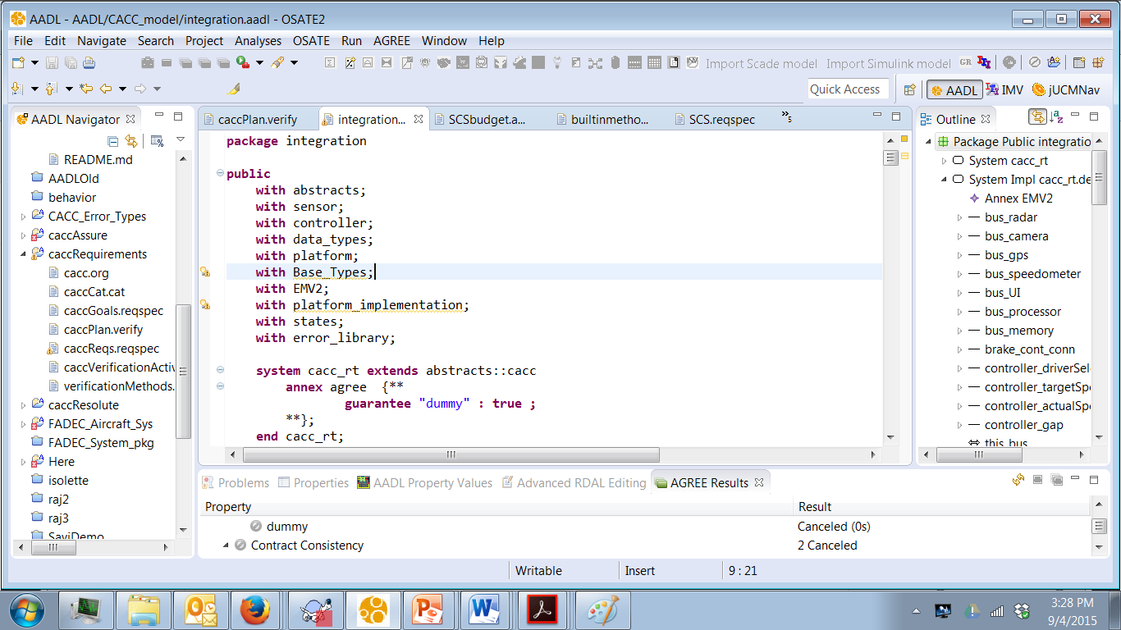
2. Select .impl and
right click and select
all levels
1. insert
3. Read results

Slide 28
Agree example-1
system top_level
features
Input: in data port Base_Types::Integer;
Output: out data port Base_Types::Integer;
annex agree {**
assume "System input range " : Input < 10;
guarantee "System output range" : Output < 50;
**};
end top_level;

Slide 29
Agree example-2
subcomponents
A_sub : system A ;
B_sub : system B ;
C_sub : system C ;
connections
IN_TO_A : port Input -> A_sub.Input
{Communication_Properties::Timing => immediate;};
A_TO_B : port A_sub.Output -> B_sub.Input
{Communication_Properties::Timing => immediate;};
A_TO_C : port A_sub.Output -> C_sub.Input1
{Communication_Properties::Timing => immediate;};
B_TO_C : port B_sub.Output -> C_sub.Input2
{Communication_Properties::Timing => immediate;};
C_TO_Output : port C_sub.Output -> Output
{Communication_Properties::Timing => immediate;};
end top_level.Impl;

Slide 30
Agree example-3
system A
features
Input: in data port Base_Types::Integer;
Output: out data port Base_Types::Integer;
annex agree {**
assume "A input range" : Input < 20;
guarantee "A output range" : Output < 2*Input;
**};
end A ;

Slide 31





Slide 32
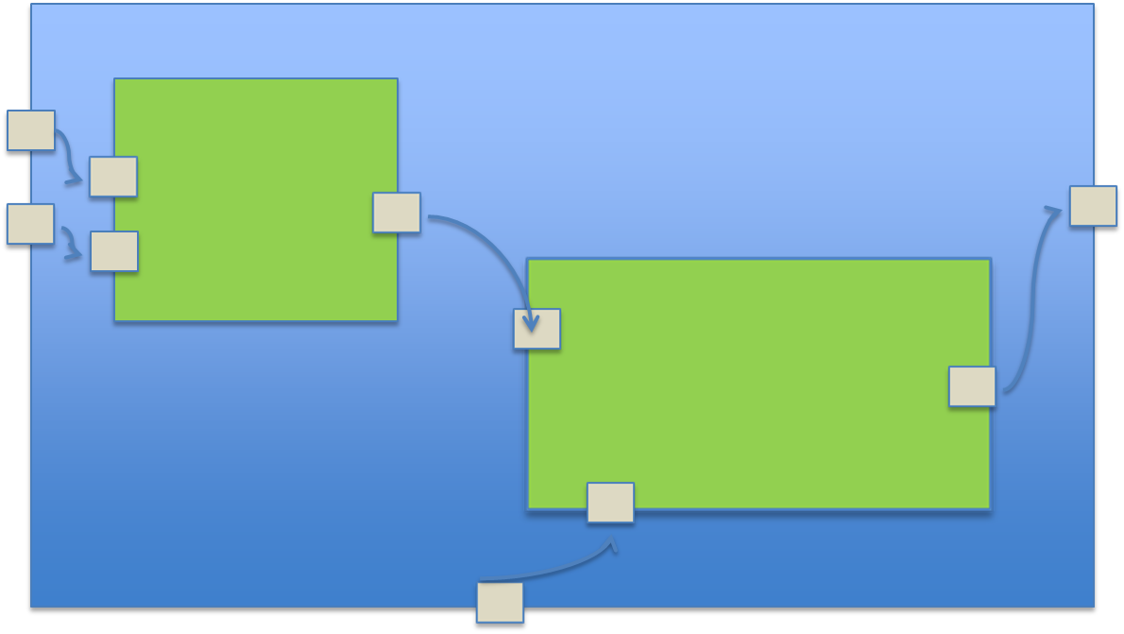


Slide 33
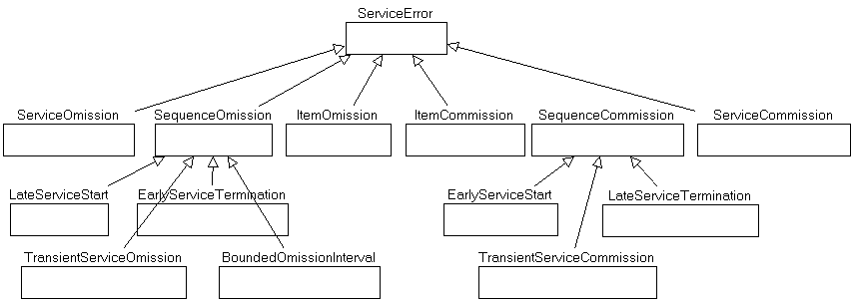
Error Ontology-1

Slide 34
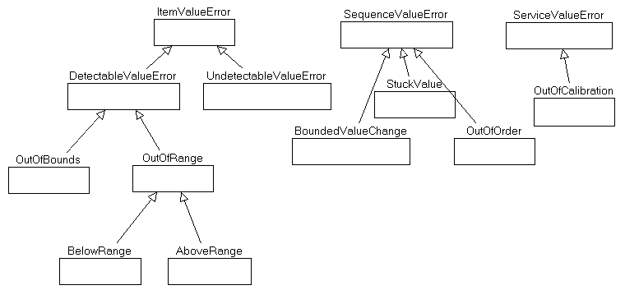
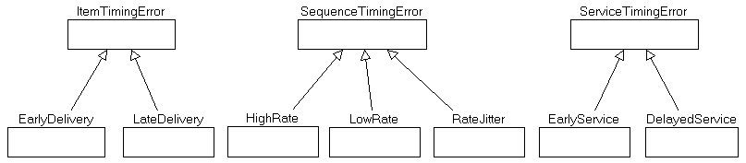
Error Ontology - 2

Slide 35
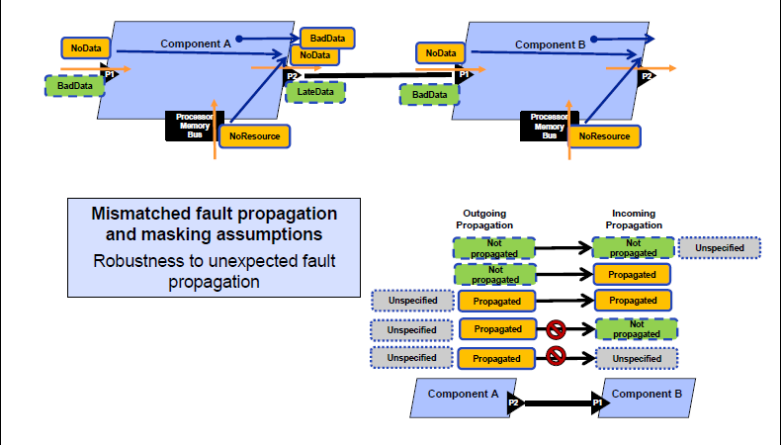
Error handling

Slide 36
Link the pieces together
assume "A input range" : Input < 20;
There should be an error model that covers any input values >= 20

Slide 37
Autosar

Slide 38
Rules for Interfaces

Slide 39
Layer Interactions

Slide 40
Error handling

Slide 41
Errors

Slide 46
Automation/Communication
Statements about values in the product
  Assert invariants assumption: input < 20
  Guarantees guarantee: output < 100
Statements about the structure of the system
  connected(a : component, conn : connection, b : component) : bool = parent(source(conn)) = a and parent(destination(conn)) = b
  memory_bound(logical : component, physical : component) : bool = has_property(logical, Deployment_Properties::Actual_Memory_Binding) and member(physical, property(logical, Deployment_Properties::Actual_Memory_Binding))
AGREE
Resolute

Slide 47
Project
A product line of cruise controls
Offers 3 different feature sets
Offers several configuration choices
  Feel of ride (smooth, economical, rough)
Set speed manually/sense speed limit automatically

Slide 48
Secondary controller
Friction, momentum, wind,…
Set setPoint
Set preferences
controller
model
actuators
sensors
Controlled process

Slide 49
Secondary controller
Friction, momentum, wind,…
Set speed
Set preferences
Make decision
model
Speedometer
Throttle
gps
brake
Engine

Slide 50
Agree example-1
system top_level
features
Input: in data port Base_Types::Integer;
Output: out data port Base_Types::Integer;
annex agree {**
assume "System input range " : Input < 10;
guarantee "System output range" : Output < 50;
**};
end top_level;

Slide 51
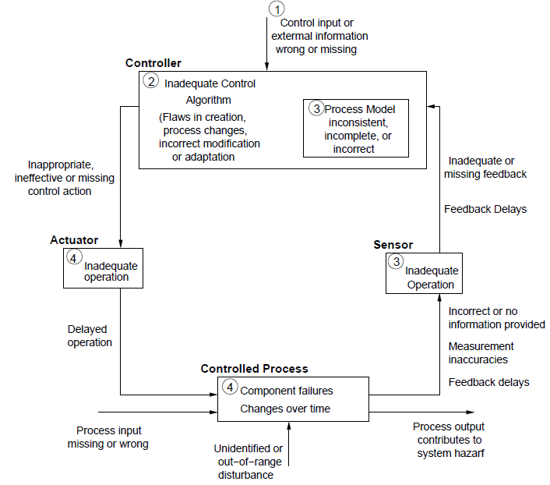
A start on safety analysis
Leveson pattern

Slide 52
Identify hazards
Jump start with standard information
  AADL Error ontology
  Reference architecture
When might the basic assumptions of the architecture be violated?
What unexpected events could happen that could cause significant disturbance

Slide 53
Identify exposure
Perspective – OEM or vehicle owner
Volume of instances
Estimated hours of operation
Software will always behave the same given exactly the same inputs in exactly the same context
But whether software fails is a function of the input it sees and the longer it executes the more likely it is to encounter a value it is unable to handle properly.

Slide 54
Start with pattern
Take “Feedback delay”
  How much delay?
  Can the protocol handle that much delay?
  What are the effects of the delay?
  How to mitigate this?
    Redesign
    Redundancy in communication channels

Slide 55
Component by component
Each port is typed
Type definitions are in a separate file
Each port has an AGREE contract that defines “legal” values
Each component has an error model that handles anything outside the contract

Slide 56
Component by component-2
What errors might this component
produce?
Use the error ontology to identify
error types.
failure to deliver a reading
deliver late
deliver a value out of range
With each error
can it be eliminated?
can it be mitigated?
sensor
object
temperature

Slide 57
Composite behavior
The container defines the composite error behavior that includes the sensor and its handler
container
Object
sensor
Object
handler

Slide 58
Rules
For every flow source there is a flow sink
For every port there is an AGREE contract

Slide 59
Here’s what you are going to do
Convert the use cases to reqspec requirements
Select the underlying architecture style
Show how you embellish/decompose this style into a useable architecture
Complete the structural architecture
There will be a slightly different commit process
Commit by 11:59PM on March 7th.

