Slide 1

CPSC 875
John D. McGregor
C18

Slide 2
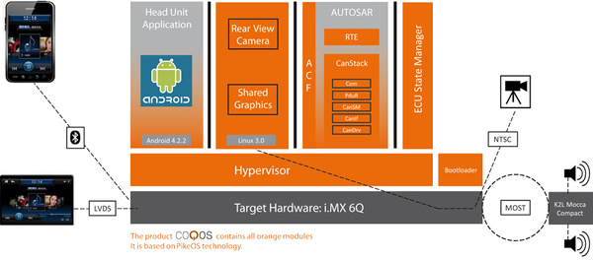
Partitions

Slide 3
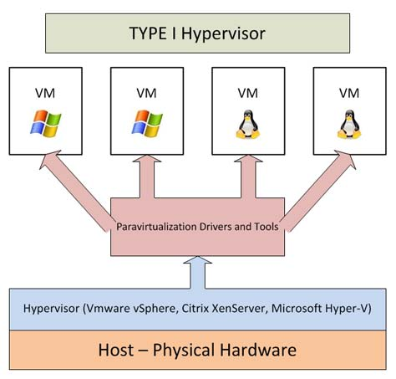
Bare metal hypervisor

Slide 4
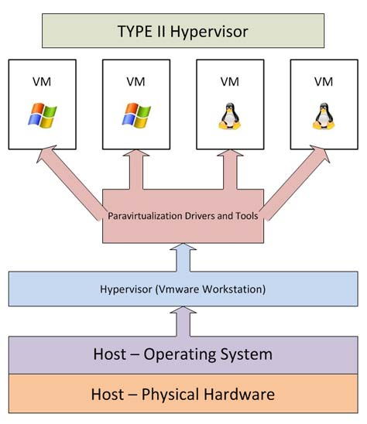
Hosted hypervisor

Slide 5
ARINC 653

Slide 6
Requirements
Need is for an e-commerce system which presents catalog item descriptions and takes orders.
The system must be able to take advantage of mobile devices.
The system must be available internet wide.

Slide 7
Client server basic style
system
Client/server

Slide 8
Architectural style – N-Tiered e-commerce architecture
Client/server
client
presentation
business logic
database

Slide 9
Factors
Separate machines
Separate purposes
Scalability
Database latency becomes critical
Rate of change of requirements
Thin client
presentation
business logic
database

Slide 10
Decomposition of client side
model
controller
view
Thin client
presentation
business logic
database

Slide 11
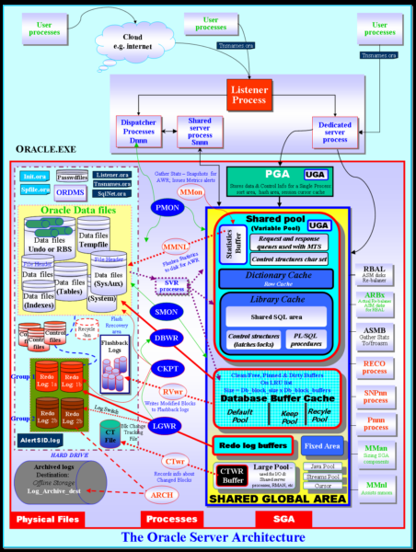
Use a Database Framework
model
controller
view
Thin client
presentation
business logic
database

Slide 12
Business Rules engine
model
controller
view
Thin client
presentation
business logic
database

Slide 13
Capturing requirements
We will use reqspec to capture requirements
And we will use a set of languages to define verification activities
These languages will make the process of V&V more robust and automated.
Given we are building the cruise control for a family of vehicles
We develop requirements first

Slide 14
Goal grammar
Goal ::=
goal Name ( : Title )?
( for TargetElement )?
[
( category ( <ReqCategory> )+ )?
( description Description )?
( ConstantVariable )*
( rationale String )?
( refines ( <Goal> )+ )?
( conflicts with ( <Goal> )+)?
( evolves ( <Goal> )+)?
( dropped )?
( stakeholder ( <Stakeholder> )+ )?
( see document requirement ( <Requirement> )+)?
( see document ( DocReference )+ )?
( issues (String)+ )?
( ChangeUncertainty )?
]
Title ::= String
TargetClassifier ::= <AADL Component Classifier>
TargetElement ::= <ModelElement>
DocReference ::= URI to an element in an external document

Slide 15
Stakeholder goals grammar
StakeholderGoals ::=
stakeholder goals NestedName ( : Title )?
for ( TargetClassifier | all )
( use constants <GlobalConstants>* )?
[
(description Description )?
(see document ( DocReference )+ )?
( ConstantVariable )*
( Goal )+
( issues (String)+ )?
]

Slide 16
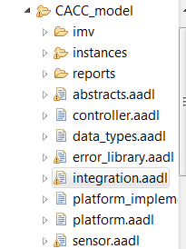

Specific goal
stakeholder goals caccGoals for integration::cacc_rt.devices [
goal g1 : "Safety" [
description "The system shall be safe."
rationale "This is a control system, whose failure affects lives. "
stakeholder cacc.rs
]]

Slide 17
Requirement Grammar
Requirement ::=
requirement Name ( : Title )?
( for TargetElement )?
[
( category ( <ReqCategory> )+ )?
( description Description )?
( Variable )*
( Predicate )?
( rationale String )?
( mitigates ( <Hazard> )+ )?
( refines ( <Requirement> )+)?
( decomposes ( <Requirement> )+)?
( evolves ( <Requirement> )+)?
( dropped )?
(development stakeholder ( <Stakeholder> )+ )?
( see goal ( <Goal> )+)?
( see document goal ( <Goal> )+)?
( see document requirement ( <Requirement> )+)?
( see document ( DocReference )+ )?
( issues (String)+ )?
( ChangeUncertainty )?
]

Slide 18
specific requirement
requirement specification caccreqs
for integration::cacc_rt.devices
[
val MaximumSpeed = 120.0 mph
requirement speed_R1 : "throttle cannot exceed the maximum setting"
[
description this " shall have a maximum reading that is less than or equal to maximum setting"
compute actualSpeed
assert value actualSpeed <= MaximumSpeed
rationale "The system might exceed the maximum safe speed"
mitigates "Invalid data sent by the speedometer"
//category [cc]
see goal caccGoals.g1
]

Slide 19
System Requirements Grammar
SystemRequirements ::=
System requirements NestedName ( : Title )?
for ( TargetClassifier | all )
( use constants <GlobalConstants>* )?
[
( description String )?
(see document ( DocReference )+ )?
( Variable )*
( Requirement )*
( issues (String)+ )?
]

Slide 20
Organization Grammar
Organization::=
organization Name
( Stakeholder )+
Stakeholder ::=
stakeholder Name
[
( full name String )?
( title String )?
( description String )?
( role String )?
( email String )?
( phone String )?
]

Slide 21
Specific organization
organization cacc
stakeholder rs [
full name "Roselane S. Silva"
]
stakeholder jdm [
full name "John D. McGregor"
]

Slide 22
Requirement Categories
RequirementCategories ::=
requirement categories
[
( RequirementCategory )+
]
RequirementCategory ::=
Name ( { <RequirementCategory>+ } )?

Slide 23
Specific categories
selection categories [cc acc cacc]

Slide 24
Variables and Constants
Variable ::= ConstantVariable | ComputedVariable
ConstantVariable ::=
val ( Type )? Name = Value
ComputedVariable ::= computed Name
Type ::= <any type from the Java type system>
constants Name
[ ConstantVariable+ ]

Slide 25
constants
Val string Logger_IP_Address= ” 192.0.2.235”
Computed_Braking_Distance real

Slide 26
Constants
GlobalConstants ::= constants Name
[ ConstantVariable+ ]
Constants Minimum_Separation = 2

Slide 27
Constants
GlobalConstans ::= constants Name
[ ConstantVariable+ ]
Constants Minimum_Separation = 2

Slide 28
Traceability
As we build the requirements model we have traceability in the form of references to the entity constrained by the requirement.
We also have traceability via requirements categories.

Slide 29
Agree model checking
An annex to AADL that allows the specification of guarantees and checks their correctness.
annex agree {**
guarantee ”dummy” : true ;
**};
Inserted into an AADL component specification
We need to replace dummy and true

Slide 30
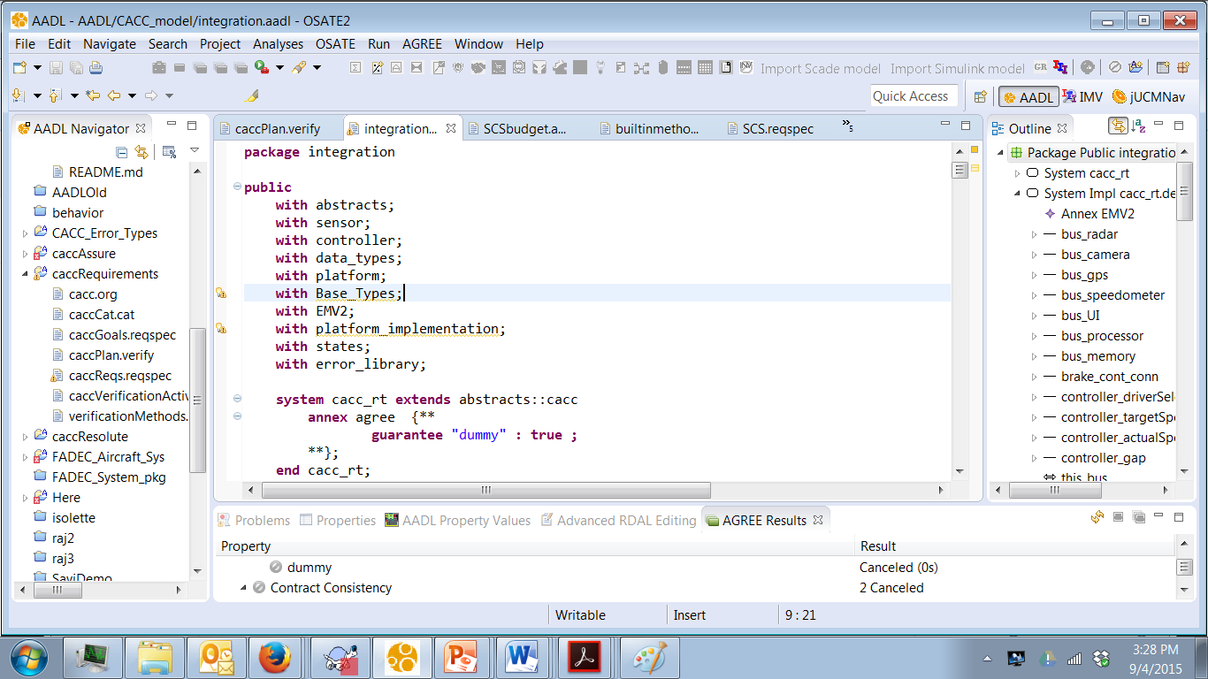
2. Select .impl and
right click and select
all levels
1. insert
3. Read results

Slide 31
Agree example-1
system top_level
features
Input: in data port Base_Types::Integer;
Output: out data port Base_Types::Integer;
annex agree {**
assume "System input range " : Input < 10;
guarantee "System output range" : Output < 50;
**};
end top_level;

Slide 32
Agree example-2
subcomponents
A_sub : system A ;
B_sub : system B ;
C_sub : system C ;
connections
IN_TO_A : port Input -> A_sub.Input
{Communication_Properties::Timing => immediate;};
A_TO_B : port A_sub.Output -> B_sub.Input
{Communication_Properties::Timing => immediate;};
A_TO_C : port A_sub.Output -> C_sub.Input1
{Communication_Properties::Timing => immediate;};
B_TO_C : port B_sub.Output -> C_sub.Input2
{Communication_Properties::Timing => immediate;};
C_TO_Output : port C_sub.Output -> Output
{Communication_Properties::Timing => immediate;};
end top_level.Impl;

Slide 33
Agree example-3
system A
features
Input: in data port Base_Types::Integer;
Output: out data port Base_Types::Integer;
annex agree {**
assume "A input range" : Input < 20;
guarantee "A output range" : Output < 2*Input;
**};
end A ;

Slide 34





Slide 35
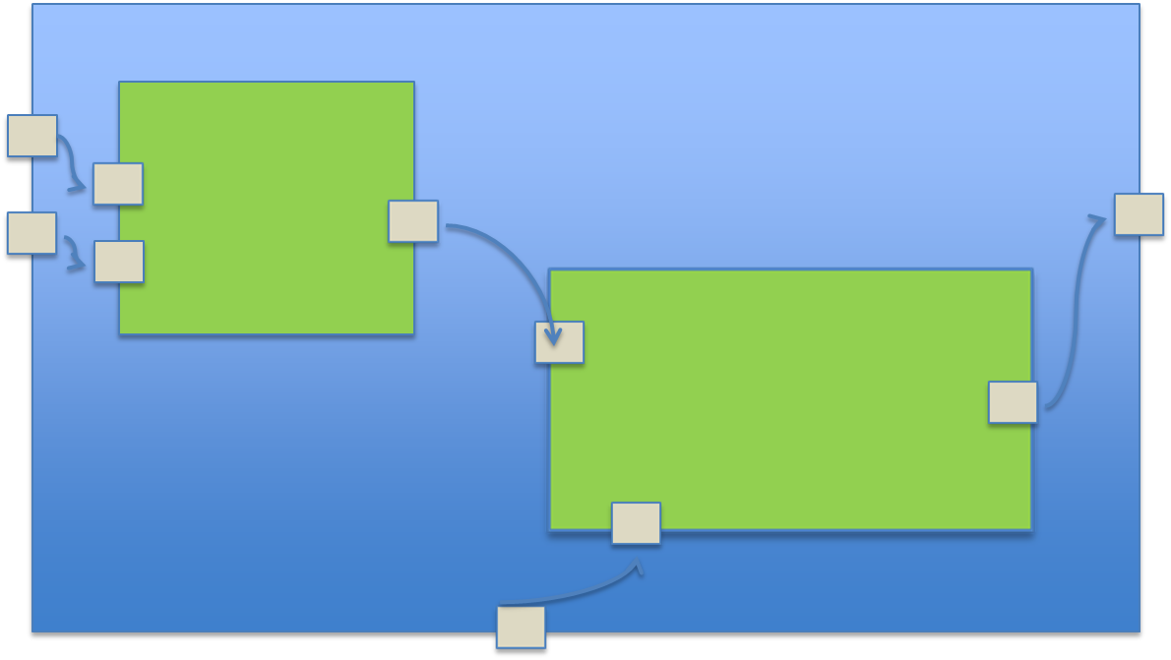


Slide 36
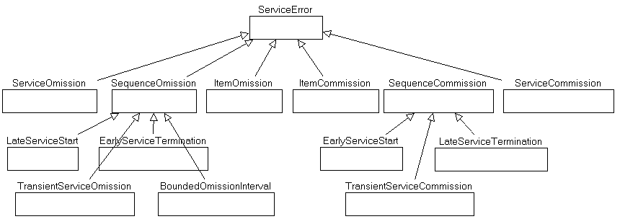
Error Ontology-1

Slide 37
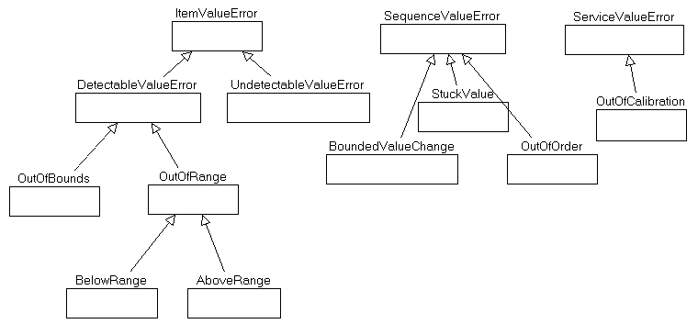
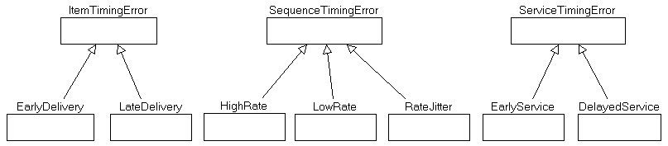
Error Ontology - 2

Slide 38
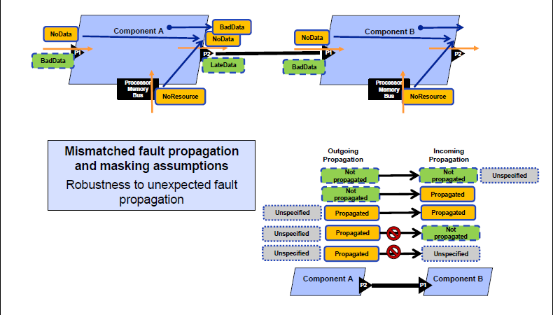
Error handling

Slide 39
Link the pieces together
assume "A input range" : Input < 20;
There should be an error model that covers any input values >= 20

Slide 40
Autosar

Slide 41
Rules for Interfaces

Slide 42
Layer Interactions

Slide 43
Error handling

Slide 44
Errors

Slide 49
Automation/Communication
Statements about values in the product
  Assert invariants assumption: input < 20
  Guarantees guarantee: output < 100
Statements about the structure of the system
  connected(a : component, conn : connection, b : component) : bool = parent(source(conn)) = a and parent(destination(conn)) = b
  memory_bound(logical : component, physical : component) : bool = has_property(logical, Deployment_Properties::Actual_Memory_Binding) and member(physical, property(logical, Deployment_Properties::Actual_Memory_Binding))
AGREE
Resolute

Slide 50
Project
A product line of cruise controls
Offers 3 different feature sets
Offers several configuration choices
  Feel of ride (smooth, economical, rough)
Set speed manually/sense speed limit automatically

Slide 51
Secondary controller
Friction, momentum, wind,…
Set setPoint
Set preferences
controller
model
actuators
sensors
Controlled process

Slide 52
Secondary controller
Friction, momentum, wind,…
Set speed
Set preferences
Make decision
model
Speedometer
Throttle
gps
brake
Engine

Slide 53
Agree example-1
system top_level
features
Input: in data port Base_Types::Integer;
Output: out data port Base_Types::Integer;
annex agree {**
assume "System input range " : Input < 10;
guarantee "System output range" : Output < 50;
**};
end top_level;

Slide 54
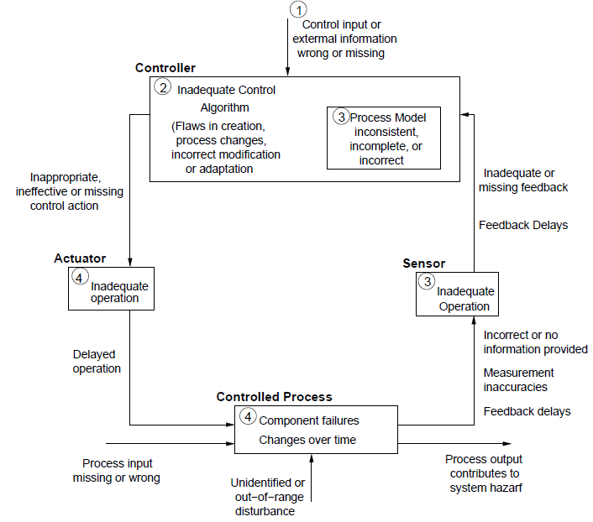
A start on safety analysis
Leveson pattern

Slide 55
Identify hazards
Jump start with standard information
  AADL Error ontology
  Reference architecture
When might the basic assumptions of the architecture be violated?
What unexpected events could happen that could cause significant disturbance

Slide 56
Identify exposure
Perspective – OEM or vehicle owner
Volume of instances
Estimated hours of operation
Software will always behave the same given exactly the same inputs in exactly the same context
But whether software fails is a function of the input it sees and the longer it executes the more likely it is to encounter a value it is unable to handle properly.

Slide 57
Start with pattern
Take “Feedback delay”
  How much delay?
  Can the protocol handle that much delay?
  What are the effects of the delay?
  How to mitigate this?
    Redesign
    Redundancy in communication channels

Slide 58
Component by component
Each port is typed
Type definitions are in a separate file
Each port has an AGREE contract that defines “legal” values
Each component has an error model that handles anything outside the contract

Slide 59
Component by component-2
What errors might this component
produce?
Use the error ontology to identify
error types.
failure to deliver a reading
deliver late
deliver a value out of range
With each error
can it be eliminated?
can it be mitigated?
sensor
object
temperature

Slide 60
Composite behavior
The container defines the composite error behavior that includes the sensor and its handler
container
Object
sensor
Object
handler

Slide 61
Rules
For every flow source there is a flow sink
For every port there is an AGREE contract

Slide 62
Here’s what you are going to do
Convert the use cases to reqspec requirements
Select the underlying architecture style
Show how you embellish/decompose this style into a useable architecture
Complete the structural architecture
There will be a slightly different commit process
Commit by 11:59PM on March 7th.

Slide 63
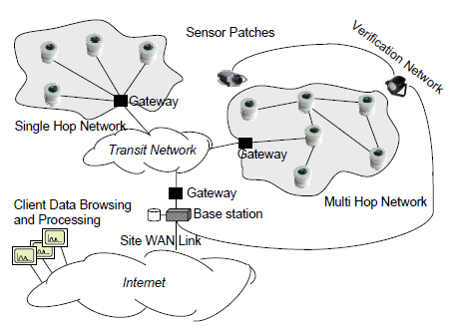
Sensor networks

Slide 64
AGREE guarantees
system multihop_burrow_mote extends burrow_mote
annex agree {**
guarantee "temperature will be greater than 0": data_set_out.temperature >= 0;
guarantee "occupants will be greater than 0": data_set_out.occupancy_count >= 0;
**};
end multihop_burrow_mote;

Slide 65
AGREE Asserts
system implementation multihop_burrow_mote.impl extends burrow_mote.impl
subcomponents
receiver: refined to process multihop_receiver.impl;
sender: refined to process multihop_sender.impl;
climate_occupancy_reader: refined to process multihop_climate_occupancy_reader.impl;
properties
PowerProperties::Draw_Period => 1000.0 second;
PowerProperties::Power_Draw => 118.0 millijoule;
PowerProperties::Battery_Amps => 1000.0 mAhr;
PowerProperties::Battery_Voltage => 3.6 V;
annex resolute {**
prove(SystemXWillLastForYDays(this, 80.0))
**};
annex agree {**
assert data_set_out.temperature = climate_occupancy_reader.data_set_out.temperature;
assert data_set_out.occupancy_count = climate_occupancy_reader.data_set_out.occupancy_count;
**};
end multihop_burrow_mote.impl;

Slide 66
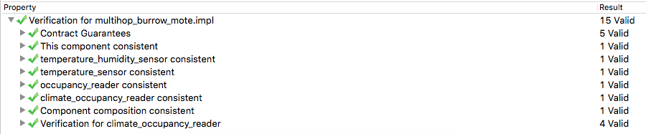
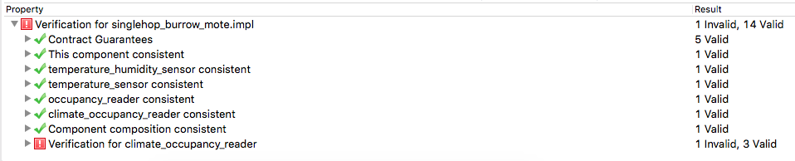
AGREE results

Slide 67
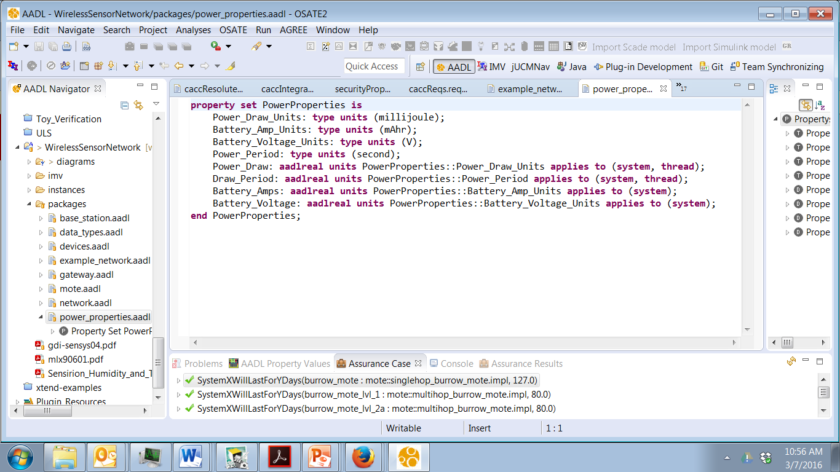
Resolute for checking rules

Slide 68
Use of properties
system implementation multihop_weather_mote.impl extends weather_mote.impl
subcomponents
  receiver: refined to process multihop_receiver.impl;
  sender: refined to process multihop_sender.impl;
  climate_reader: refined to process multihop_climate_reader.impl;
properties
  PowerProperties::Draw_Period => 1000.0 second;
  PowerProperties::Power_Draw => 118.0 millijoule;
  PowerProperties::Battery_Amps => 860.0 mAhr;
  PowerProperties::Battery_Voltage => 2.8 V;
annex resolute {**
prove(SystemXWillLastForYDays(this, 90.0))
**};

Slide 69
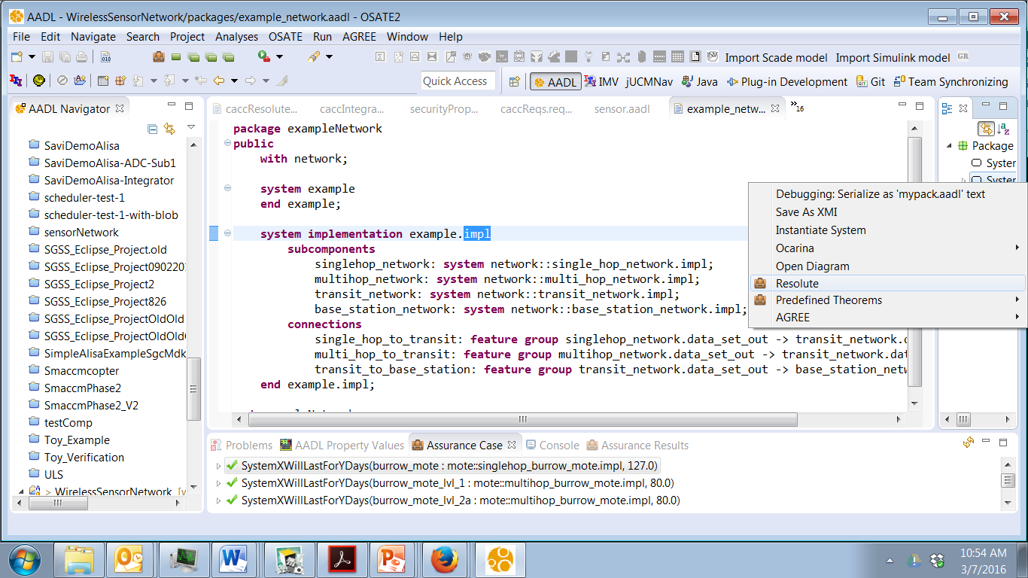
Resolute

Slide 70
Recursive function
maximum(x : {int}) : int =
let avg: int = sum(x) / length(x);
recursive_maximum(x, avg)
recursive_maximum(x : {int}, avg: int) : int =
let higher : {int} = {y for (y : x) | y > avg};
if length(higher) > 0 then
recursive_maximum(x, avg + 1)
else
avg

Slide 71
Recursive function-2
SystemXWillLastForYDays(x: component, y: real) <= **x " will survive for at least " y " days"**
let threads: {component} = CollectThreads(x);
CalculateDays(AveragePower(x, threads), y,
property(x, PowerProperties::Battery_Amps, 0.0),
property(x, PowerProperties::Battery_Voltage, 0.0)
)
CalculateDays(x: real, y: real, amps: real, volts: real) <= **"average power: " x ", days to last: " y ", milliamps: " amps ", volts: " volts **
WillLastForDays((amps / ((x * 0.000001) / volts)) / 1000 / 24, y)

Slide 72
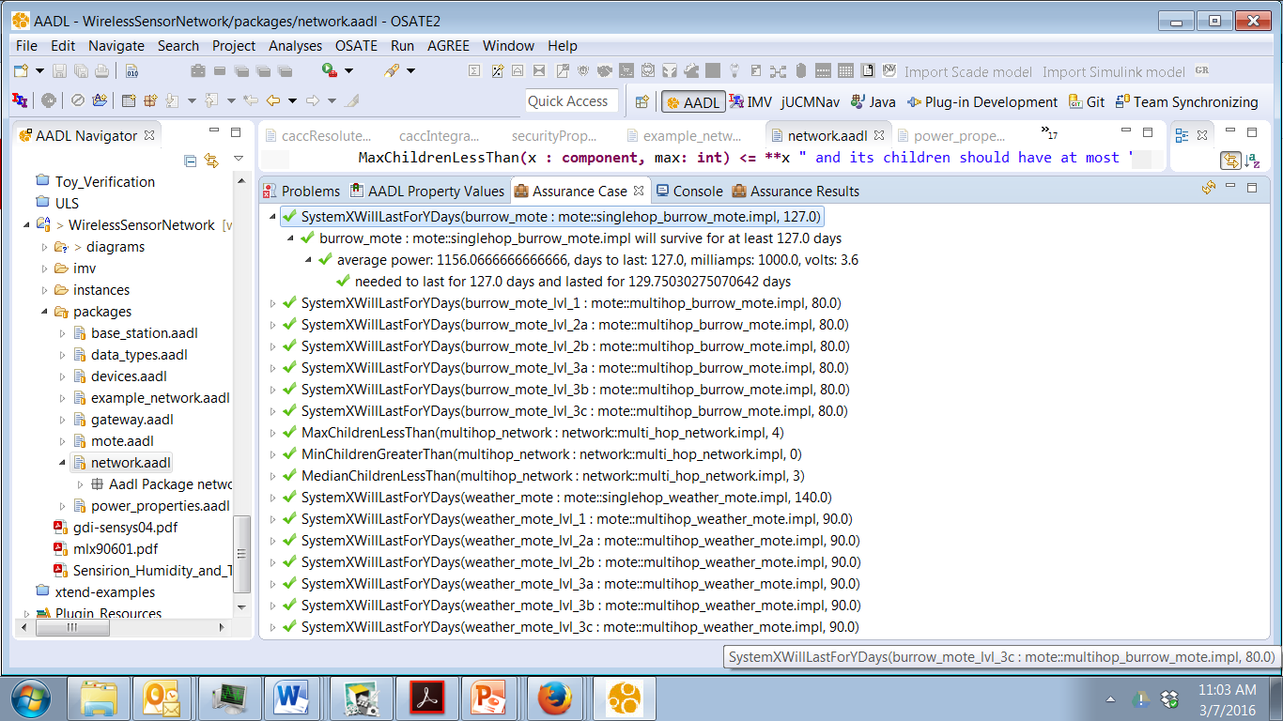
Conformance checking

Slide 73
Abstract weather mote
abstract weather_mote extends mote
end weather_mote;
abstract implementation weather_mote.impl extends mote.impl
subcomponents
  barometric_pressure_sensor: device devices::IntersemaMS5534A;
  ambient_light_sensor_1: device devices::TAOSTSL2550;
  ambient_light_sensor_2: device devices::TAOSTSL2550;
  incident_light_sensor_1: device devices::HamamatsuS1087;
  incident_light_sensor_2: device devices::HamamatsuS1087;
  climate_reader: abstract climate_reader.impl;
connections
  data_in_3: port temperature_humidity_sensor.temperature -> climate_reader.temperature;
  data_in_4: port temperature_humidity_sensor.humidity -> climate_reader.humidity;
  data_in_5: port barometric_pressure_sensor.barometric_pressure -> climate_reader.barometric_pressure;
  data_in_6: port ambient_light_sensor_1.light_intensity -> climate_reader.ambient_light_intensity_1;
  data_in_7: port ambient_light_sensor_2.light_intensity -> climate_reader.ambient_light_intensity_2;
  data_in_8: port incident_light_sensor_2.light_intensity -> climate_reader.incident_light_intensity_1;
  data_in_9: port incident_light_sensor_2.light_intensity -> climate_reader.incident_light_intensity_2;
  data_out_3: feature group climate_reader.data_set_out -> sender.data_set_in;
end weather_mote.impl;

Slide 74
Weather mote
system multihop_weather_mote extends weather_mote
end multihop_weather_mote;
system implementation multihop_weather_mote.impl extends weather_mote.impl
subcomponents
  receiver: refined to process multihop_receiver.impl;
  sender: refined to process multihop_sender.impl;
  climate_reader: refined to process multihop_climate_reader.impl;
properties
  PowerProperties::Draw_Period => 1000.0 second;
  PowerProperties::Power_Draw => 118.0 millijoule;
  PowerProperties::Battery_Amps => 860.0 mAhr;
  PowerProperties::Battery_Voltage => 2.8 V;
annex resolute {**
prove(SystemXWillLastForYDays(this, 90.0))

Slide 75
Reliability of a cyber-physical system
Cyber-Physical Systems or “smart” systems are co-engineered interacting networks of physical and computational components.
The differences between the physical and computational are bigger than most people think

Slide 76
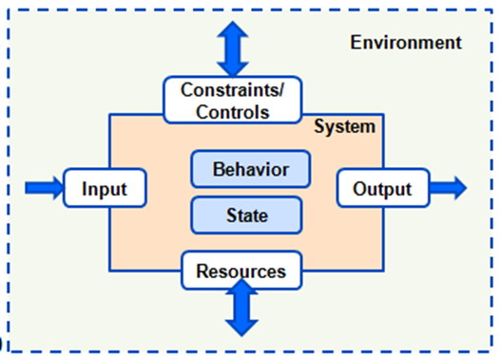
Repeatable context
If sufficiently constrained
Characterization of the input
spectrum – types,
magnitudes, distribution, …
High degree of integrity
Very small number of
anomalies
Hardware/OS signals

Slide 77
Cyber-Physical system
The system engineer becomes the key person because (s)he understands the interplay sw/hw
Different metrics for reliability, availability
computational
physical

Slide 78
Redundancy
Replication
  Multiple copies of single impl
Functional redundancy
  Same spec/different implementation
Analytic redundancy
  Same requirements/different spec and impl
  http://resources.sei.cmu.edu/library/asset-view.cfm?assetID=5193

Slide 79
Performance controller
Within boundary
Safety controller
model
model
outside boundary
controller
model
actuators
sensors
Controlled process

Slide 80
the Internet of Things (IoT) can be modeled as the hyper-scale, hyper-complex cyber-physical system
http://ubiquity.acm.org/article.cfm?id=2822885
The resiliency of a system is defined by its capability
  to resist external perturbances and internal failures;
  to recover and enter stable state(s); and
  to adapt its structure and behavior to constant change.

Slide 81
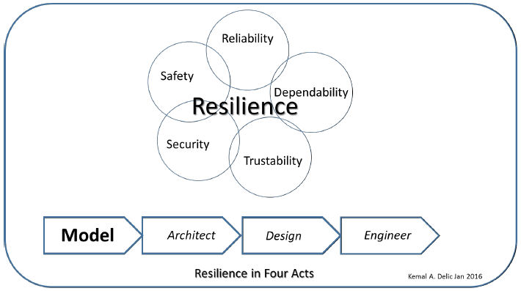
Resilience

Slide 82
Seven principles for building resilience in social-ecological systems:
Maintain diversity and redundancy
Manage connectivity
Manage slow variables and feed backs
Foster complex adaptive systems thinking
Encourage learning
Broaden participation
Promote polycentric governance systems
www.kharms.biology.lsu.edu/BWagner_Re_Holling.pptx

Slide 83
Four aspects of resilience:
Latitude: the maximum amount a system can be changed before losing it ability to recover
Resistance: the ease or difficulty of changing the system; how “resistant” it is to being changed
Precariousness: how close the current state of the system is to the limit
Panarchy: how the above three attributes are influenced by the state of dynamics of the system at scales above and below the scale of interest

Slide 84
Here’s what you are going to do:
Add more detail.
  Add specific data values to the properties.
  Add implementation details to the bottom of the implementation hierarchy
Add verification activities using Verify and Assure
  Use Verify to write test suites and to link the tests to the requirements and architecture
  Use resolute to compute test cases
  Develop a java class and execute a method
  Develop the assurance case for your product
Commit project by 11:59 March 21st

