Slide 1

CPSC 875
John D. McGregor
C19

Slide 2
Multiple environments
Even in a simple client/server architecture there are probably at least 2OS involved.
The client and server probably communicate using a single protocol.
Each connection has to be modeled separately

Slide 3
requirement speed_R1 : "throttle cannot exceed the maximum setting"
[
description this " shall have a maximum reading that is less than or equal to maximum setting"
rationale "fly by wire may introduce an electrical error beyond the physical throttle setting"
value predicate CurrentSpeed < MaximumSpeed
mitigates "Invalid data sent by the speedometer"
issues "need to recognize that physical subsystems can present issues for a digital system"
see goal caccStakeholderGoals.g1
category product.cc product.acc product.cacc
quality safety
uncertainty[
volatility 2
impact 3
]
]

Slide 4
requirement gap_R1
[
description this "the gap between cars will be greater than or equal to the gap limit in CACC mode"
rationale "maintains a gap based on the driver's risk tolerance"
value predicate gap > gapLimit
mitigates "getting too close to lead vehicle"
see document caccStakeholderGoals.g4
category product.acc product.cacc
quality safety
uncertainty[
volatility 3
impact 2
]
]

Slide 5
Composite qualities
Like a feature group that groups together a number of ports
Some words like dependable and resilient group a set of quality attributes
In most cases there is not universal agreement

Slide 6
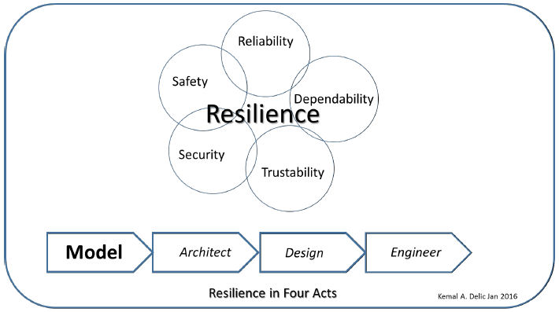
Resilience

Slide 7
Seven principles for building resilience in social-ecological systems:
Maintain diversity and redundancy
Manage connectivity
Manage slow variables and feed backs
Foster complex adaptive systems thinking
Encourage learning
Broaden participation
Promote polycentric governance systems
www.kharms.biology.lsu.edu/BWagner_Re_Holling.pptx

Slide 8
Four aspects of resilience:
Latitude: the maximum amount a system can be changed before losing it ability to recover
Resistance: the ease or difficulty of changing the system; how “resistant” it is to being changed
Precariousness: how close the current state of the system is to the limit
Panarchy: how the above three attributes are influenced by the state of dynamics of the system at scales above and below the scale of interest

Slide 9
Trustworthiness/Dependability
system that performs as intended for a specific purpose, when needed, with operational resiliency, and without unwanted side-effects, behaviors, or exploitable vulnerabilities
Two perspectives
Build high quality software
Secure the software

Slide 10
Product-based vs Process-based
Product-based uses test/analysis of the actual product or some representation of it
Architecture-led analysis and design
Process-based uses measures of the people who built it and the method they used
TSP
CMMI
https://samate.nist.gov/docs/toward-1119.pdf

Slide 11
Assurance case
claims,
subclaims ,
context,
arguments , and
evidence and evidence strength

Slide 12
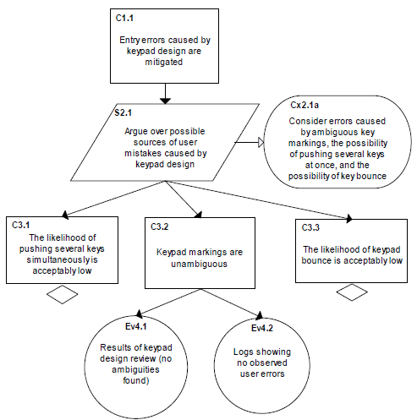
Assurance case notation

Slide 13
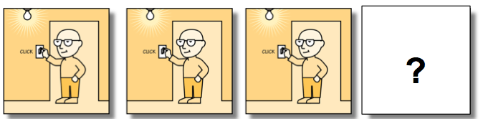
Eliminative induction
Bulb connected to electricity?
Bulb good?
http://insights.sei.cmu.edu/sei_blog/2014/01/eliminative-argumentation-a-means-for-assuring-confidence-in-safety-critical-systems.html

Slide 14
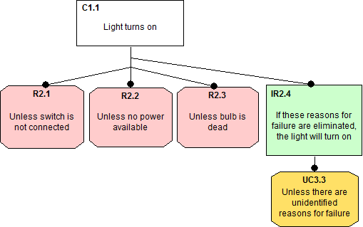
Confidence map
Every rebutting defeater that is eliminated increases confidence in the claim
Inference rule
Undercutting defeater

Slide 15
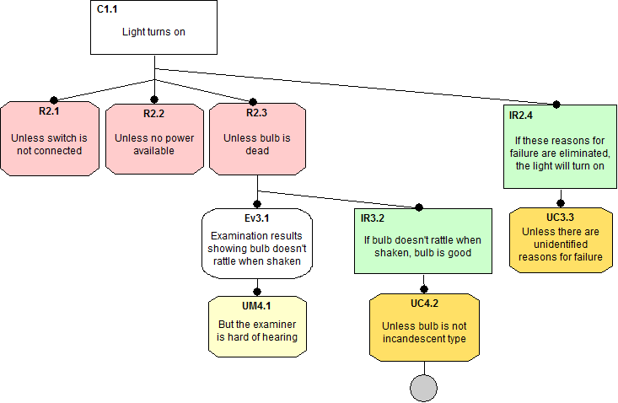
Evidence
Under mining defeater

Slide 16
Calculation of trustworthiness
With values of TI between “0”and “1” (“0”
being totally untrustworthy, and “1” being
completely trustworthy, so TI is “normalized”).
T_{I} = T_{actual}/T_{maximum},
[CNSS] Committee on National Security Systems (CNSS) “National Information
Assurance (IA) Glossary”, Instruction 4009, Revised June 2006. Available at
http://www.cnss.gov/Assets/pdf/cnssi_4009.pdf

Slide 17
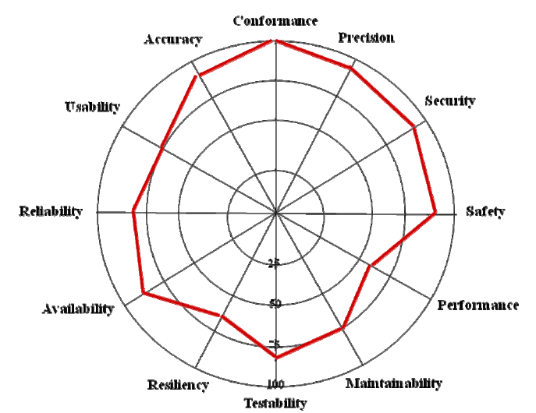

Slide 18
Trustworthiness attributes
Intrinsic
One quality attribute affects another
Performance metrics affect execution time
Extrinsic
One quality attribute trades-off with another
An increase in reliability often means a decrease in performance

Slide 19
Interactions
Trust interactions are usually pair-wise
Often between 2 individuals, but maybe between a human and a system, or between autonomous systems
Once a trusted relationship is established it may be possible to eliminate some barriers such as authentications or message meta-data
Communities of trust are designed to improve system designs

Slide 20
Complex adaptive systems
Remember a complex adaptive system is one that reconfigures dynamically
Can be guided by a closed set of modes so that a transition is from one known mode to another
Can be autonomous and new modes are created on the fly

Slide 21
Growth of Trustworthiness
Basic/initial trustworthiness
Experiential trustworthiness – the longer the system operates correctly, the more trust we have in it
But, in a dynamic adaptive system every reconfiguration resets our trust to a degree

Slide 22
Credibility
A contractor contributes to the trustworthiness by lending its credibility to the software
As we gain belief in software the more it runs, we gain belief in credibility the more correctly functioning products an organization delivers
Changes in ownership, changes in process, delivery of a faulty product can cause a loss of credibility

Slide 23
Dependability
http://se.inf.ethz.ch/~meyer/publications/lncs/dependability.pdf
Some see it as reliability which would include correctness, robustness, and security
Does how long software operates affect its reliability?

Slide 24
Context
Time is not as important as is the context
Given exactly the same context software will operate exactly the same, but that include s
The inputs
The interactions through shared resources

Slide 25
What are we doing about this
Traceability
Cross references
Linkages
for references that
link requirements to architecture
Link tests to requirements
…

Slide 26
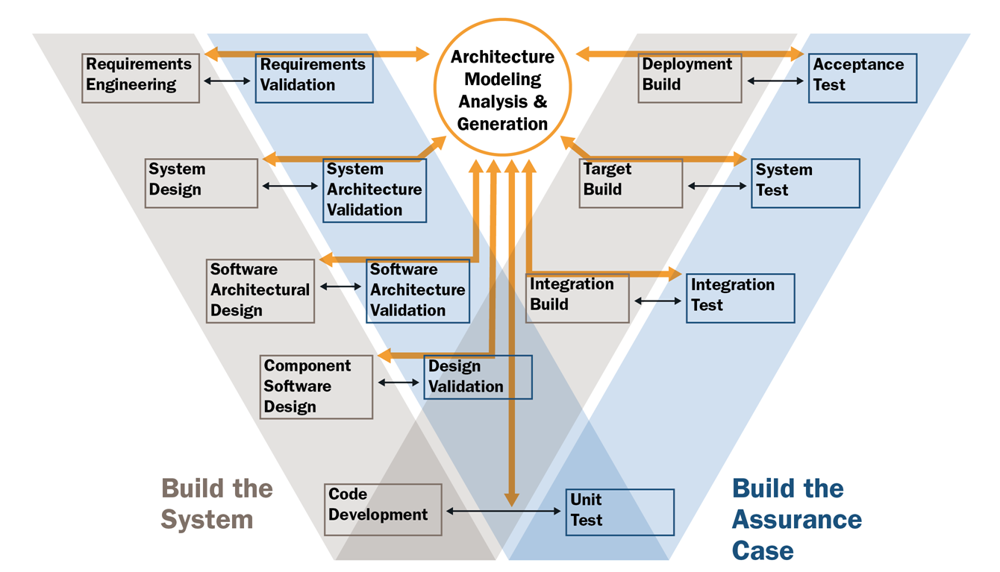
Architecture-led V model

Slide 27
Certification of safety critical systems using architecture-led development
Changes the basic approach
http://ac.els-cdn.com/S1571066109003624/1-s2.0-S1571066109003624-main.pdf?_tid=76cf170a-e661-11e5-836e-00000aacb360&acdnat=1457574378_fc25410424e1db21a5eae34bbce5b6d4

Slide 29
Safety case

