Slide 1

CPSC 875
John D. McGregor
Robotic Surgery

Slide 2
references
http://ieeexplore.ieee.org/stamp/stamp.jsp?tp=&arnumber=4543644&userType=inst

Slide 3
The Endoscopic Partial-Autonomous Robot (EndoPar) system is an experimental robotic surgical system, developed by the Robotics and Embedded Systems research group at the Technical University of Munich

Slide 4
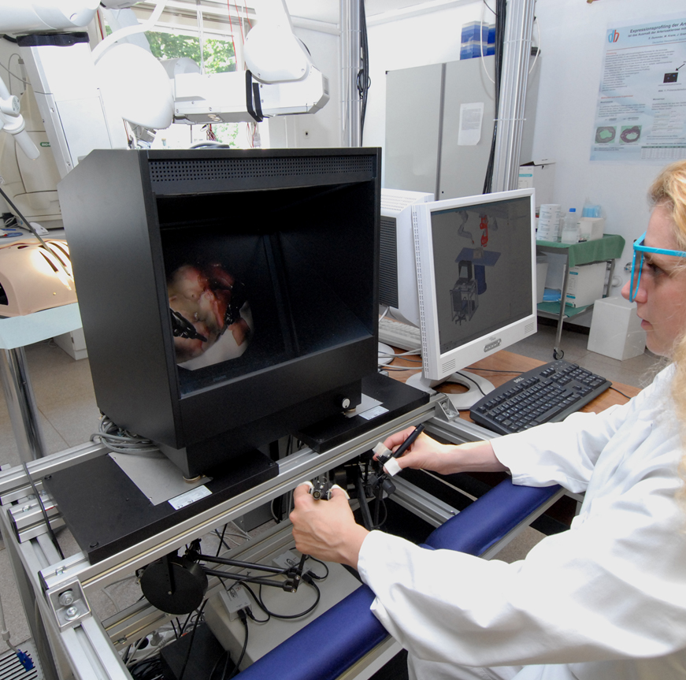
Master unit

Slide 5
Master description
The master console, often referred to as the medical workstation, offers doctors the ability to operate the system via two PHANToMR Premium 1.5 devices from Sensable Inc. A customized handle snap-on, which is similar to handling a pair of tweezers, replaces the original switch in order to replace the digital behavior of the micro-grippers at the distal end of the surgical tools with a continuous input option. The forefinger has to be fixed at a rocker, which is connected to a small DC motor with an integrated position sensor. The force-feedback capabilities of the employed haptic devices are used to display force information that is derived at the instrument tip. Feedback in all translational part is possible, but no torques can be fed back. Forces acting on the instruments are directly measured at the instrument tip by means of sensitive strain gauges sensors.

Slide 6
To achieve a high level of immersion of the operator, the master console provides high quality stereoscopic view of the scene. Image data is acquired with a stereo endoscope and displayed on a 3D display. The display system utilizes a semitransparent mirror to separate the views of two screens, each displaying the corresponding camera view for one eye. System interaction and switching between the different robot arms are made possible by several foot pedals.

Slide 7
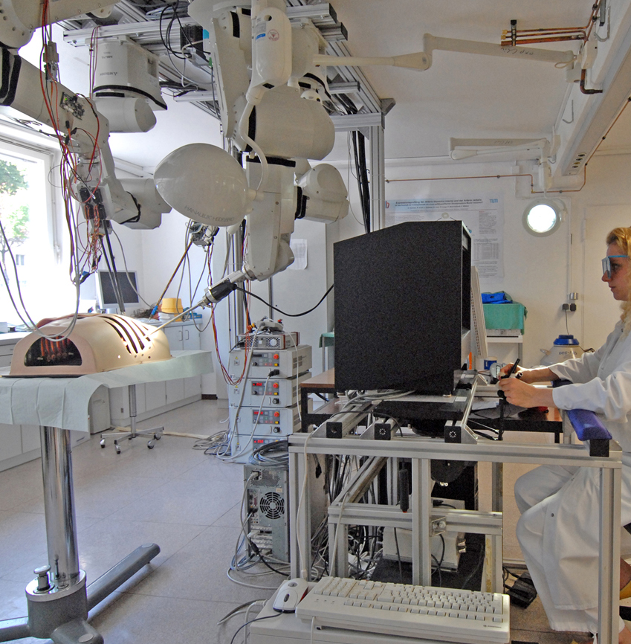
Slave unit

Slide 8
Slave description
The slave part of our system is composed of four ceiling mounted industrial robots with 6 degrees of freedom. Either surgical tools or the camera can be attached via a magnetic clutch with the manipulators. The coupling system includes a hot-plug show that identifies the instrument and bridges all necessary electrical connections. The surgical tools are the EndoWristTM instruments, originally deployed with the da VinciR system. All instruments are operated by means of trocar kinematics, which ensures the observance of the fulcrum.

Slide 9
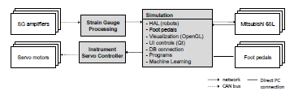
Part of old architecture

Slide 10
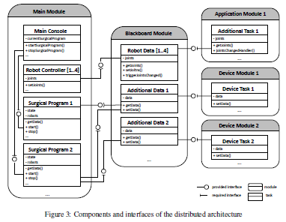
New architecture

Slide 11
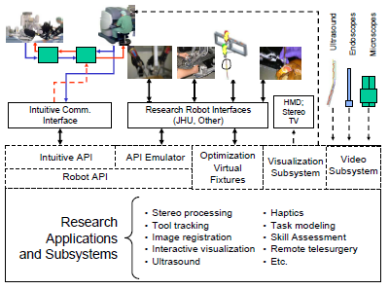
Different architecture

