Slide 1

CPSC 875
John D. McGregor
Vehicle Technologies

Slide 2
Modern vehicles – 10 years of effort
http://www.autosar.de/

Slide 3
Why?

Slide 4
Members of Autosar

Slide 5
Economics
Automotive software is economically relevant. The worldwide value creation in automotive electric/electronics (including software) amounts to an estimated € 127 billion in 2002 and an expected € 316 billion in 2015 according to a Mercer study [DK04].
Software makes up an estimated 40 percent of this value creation by 2010

Slide 6
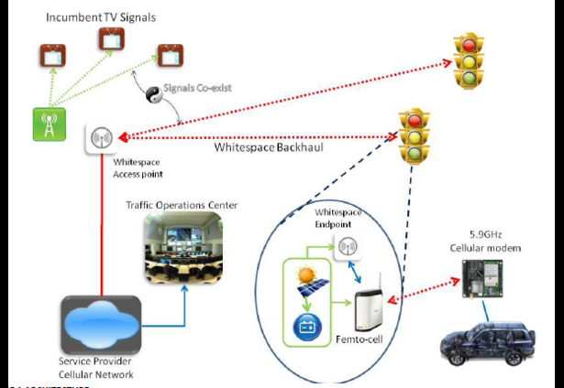

Slide 7
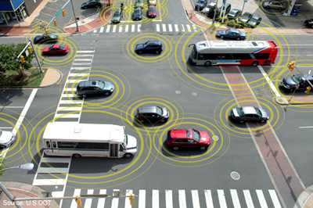
Connected vehicles
http://www.volpe.dot.gov/advanced-transportation-technologies/technology
-innovation-and-policy/connected-vehicle-policy

Slide 8
ECU architecture

Slide 9
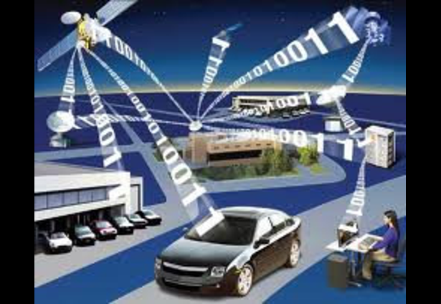
Communication

Slide 10
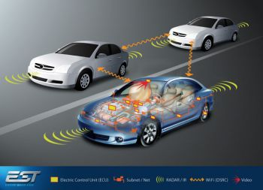
Connections
http://www.essetek.com/solutions.html

Slide 11
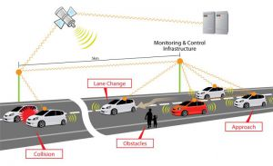
Infrastructure

Slide 12
Advanced types of systems
Cyber-Physical Systems
Systems of Systems

Slide 13
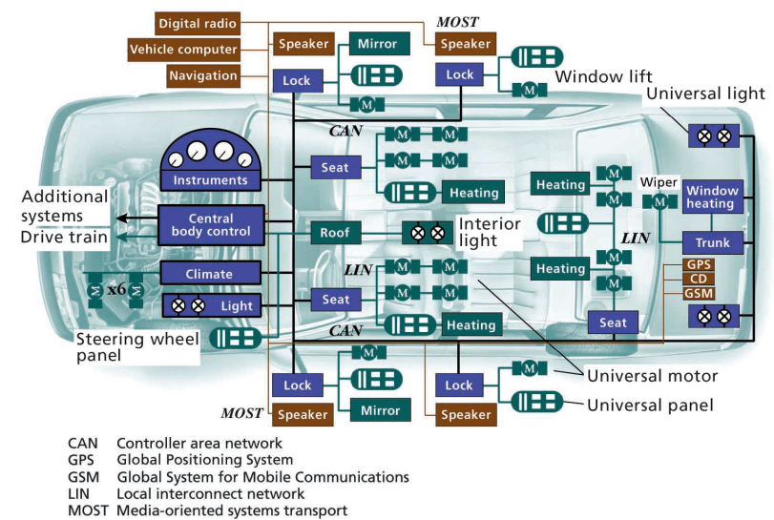
http://www.intechopen.com/books/vehicular-technologies-deployment-and-applications/smart-vehicles-technologies-and-main-applications-in-vehicular-ad-hoc-networks

Slide 14
Connected Vehicle Reference Implementation Architecture

Slide 15
Functional safety

Slide 16
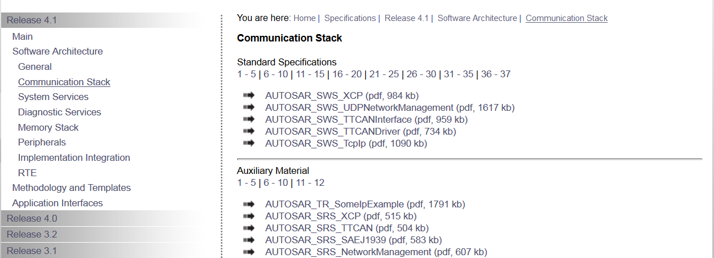
Autosar Architecture Specs

Slide 17
Cartoon of one specification

