Slide 1

CpSc 8750
John D. McGregor
ADD

Slide 2
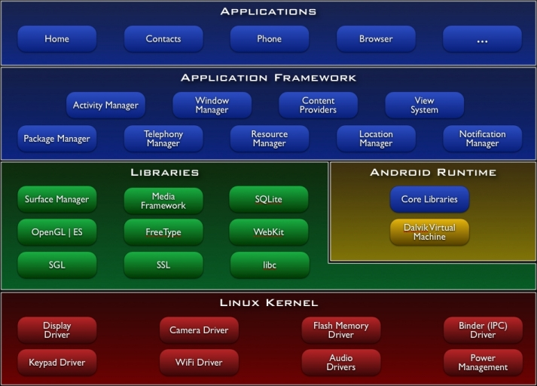
Example architecture cartoon – Android device
The fundamental unit is the “module.”
The primary structure is a “layer.”

Slide 3
Android cartoon, cont’d
Modules within a layer may reference each other but usually through an “interface.”

Slide 4
Android cartoon, cont’d
Code in a layer may only “know about” or “rely on” code in “lower” layers.
This allows the code to be “portable”.

Slide 5
Android cartoon, cont’d
A module should not be allowed to depend upon a module in the opposite direction.
Introduces “cycles” into the design.

Slide 6
A Problem
You have an “expensive” process that will be applied to customer data but require lots of cpu cycles or a “secret” process that you want to protect or …
You want to implement in an incremental manner and update production easily (Dev/Ops)
You want to easily update a catalog
You want to use a proprietary algorithm
You want to allow very small computers to provide access to sophisticated actions

Slide 7
Possible solution
It is more efficient to separate those special processing needs from ordinary interactions particularly human/computer interactions. The original process “delegates” some work to a process on another processor?
What issues/forces have to be considered to evaluate competing designs?

Slide 8
Issues
How much should be done in the local process and how much should be delegated?
How fast is the connection between processes.
Which parts of the system are changing fastest?
Degree of redundancy/security/….

Slide 9
Client/Server Architecture
Client
Server
Action begins in the client. The server only acts when it receives a request.
The client must know where to find the server.

Slide 10
Important reading
This slide set is based on:
Attribute-Driven Design (ADD), Version 2.0
By Rob Wojcik, Felix Bachmann, Len Bass, Paul Clements, Paulo Merson, Robert Nord, and Bill Wood
An SEI Technical Report: CMU/SEI-2006-TR-023

Slide 11
Functional/non-functional
If all we cared about were functional requirements then no structure would be needed. The box below would represent the architecture of the product.

Slide 12
Functions
We could just throw in some functions and connect them on the sequence we need them. And for 3 sequential functions that works OK but even in CpSc 1010 you need more.
F(x)
G(y)
H(z)

Slide 13
Modularity
Dividing the box into two pieces results in more modularity and an easier to understand and maintain system but it may result in a slower, less secure system. ADD gives a technique for knowing what attributes are important.
G(y)
F(x)
H(z)

Slide 14
Transformation
One design is transformed into another design by applying an operator
“decompose” is an operator
A transformation makes specific changes to specific attributes of a design but leaves other attributes unchanged. One module becomes 2.
Decompose does not destroy anything it simply repackages it.

Slide 15
Requirements
A functional requirement is a statement of something the system must be able to do to be considered “complete.”
A module implements a functional requirement.

Slide 16
Quality attributes
A “non-functional” requirement is a constraint on a “quality attribute”.
There is no one piece of code that satisfies the non-functional requirement.
Modularity is a quality attribute
“Must be able to locate and repair a defect in 2 days” is a non-functional constraint on modularity

Slide 17
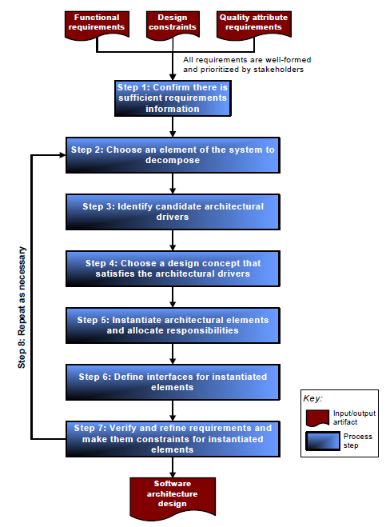
Steps

Slide 18
Inputs to ADD
Inputs to ADD are
functional requirements,
design constraints, and
quality attribute (non-functional) requirements that system stakeholders have prioritized according to business and mission goals.
The architect leads the effort to prioritize quality attributes, many of which contradict each other.

Slide 19
Outputs from ADD
The output of ADD is a design in terms of the roles, responsibilities, properties, and relationships among software elements. The following terms are used throughout this document:
software element: a computational or developmental artifact that fulfills various roles and responsibilities, has defined properties, and relates to other soft-ware elements to compose the architecture of a system [Bass 03]
role: a set of related responsibilities [Wirfs-Brock 03]
responsibility: the functionality, data, or information that a software element provides
property: additional information about a software element such as name, type, quality attribute characteristic, protocol, and so on [Clements 03]
relationship: a definition of how two software elements are associated with or interact with one another

Slide 20
Step 1: Confirm There Is Sufficient Requirements Information
make sure that the system’s stakeholders have prioritized the requirements according to business and mission goals.
Later we will see a way to do this during architecture definition
confirm that there is sufficient information about the quality attribute requirements to proceed

Slide 21
Requirements
The model describes what the system must do from an abstract perspective.
requirement Availability_R3 : "Proficiency"
[
description this "the system proficiency as measured over a year" Proficiency
rationale "The system communicates with a fleet of satellites "
mitigates "Leaving satellites without control"
issues "what types of outages does this cover"
]
requirement ResponseTime_R1 : "Response Time"
[
description this "the system response time for responding to a message" ResponseTime
rationale "The system communicates with a fleet of satellites "
mitigates "Leaving satellites without control"
issues "what has to happen during processing"]

Slide 22
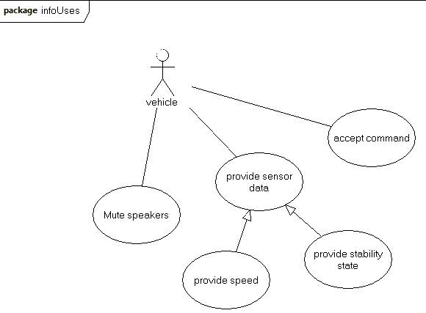
Use cases
Use cases restate requirements from the user’s perspective.
A use case has a many-to-many relationship with requirements

Slide 23
Scenarios
Each use case has several related scenarios
Normal (sunny day) scenarios
Error (rainy day) scenarios
Exceptional scenarios
A scenario is a dialog
The actor: | The system responds by:

Slide 24
Example
The actor: | The system responds by:
Inserts a DVD into the slot | Beginning to show the video on the currently selected screens
Adjusts the volume on the console screen | Adjusting the output of the speaker system

Slide 25
Reqspec: Stakeholder goals
stakeholder goals PACEgoals : "Pacemaker stakeholder goals" for system [
description "This document contains the stakeholder requirements for the Simple Control System (SCS).
PACE provides control for a relatively simple device (SD).
PACE consists of software, hardware, and humans."
goal g1 : "Reliability" [
description "The simple controller (SC) shall provide relible control of PACE."
rationale "PACE is a safety critical device that cannot tolerate unreliable behavior."
stakeholder pace.jdm
category Quality.Safety
uncertainty[
volatility 2
impact 3
]
]

Slide 26
requirement
requirement speed_R1 : "throttle cannot exceed the maximum setting"
[
description this " shall have a maximum reading that is less than or equal to maximum setting"
rationale "fly by wire may introduce an electrical error beyond the physical throttle setting"
value predicate CurrentSpeed < MaximumSpeed
mitigates "Invalid data sent by the speedometer"
issues "need to recognize that physical subsystems can present issues for a digital system"
see goal caccGoals.g1
category cc acc cacc
quality safety
uncertainty[
volatility 2
impact 3
]
]

Slide 27
C³
The requirements model should be:
Complete
Nothing could be added
Correct
Corresponds to expert judgment
Consistent
No contradictions
But it will not be those things immediately

Slide 28
Iterative & Incremental
Iterative
Initially few details
Each iteration adds more detail
First specification then implementation
Incremental
Sets of requirements are worked together
Often a form of user interface and then the persistence subsystem

Slide 29
Who determines priorities
Business goals – set by a dictator or by a consensus building process which sets a high-level direction
Stakeholders
Users
Customers
Suppliers
Developers
Testers
Etc.

Slide 30
What do we use to determine priorities
The Scenarios from the use cases can be used
In most cases there are so many that only the sunny day scenarios are used
The discussion during this exercise often results in rewordings, refactorings, adding and deleting use cases

Slide 31
How do we determine priorities
Decide on the relative importance of each stakeholder
Hold a stakeholder meeting
Assign a number of votes to each stakeholder that reflects their importance
Allow each stakeholder to assign their votes to the use cases
Tally to find ordering

Slide 32
Driving requirements
The highest vote getters are the driving requirements.
Often these are the only ones we will have time to consider as we make design decisions.

Slide 33
Next steps
For now, a deeper look at the domain for the example.
Read the sources found on the resources page and in slides from first class.
Find at least two more.
Create at least 15 use cases with scenarios

Slide 34
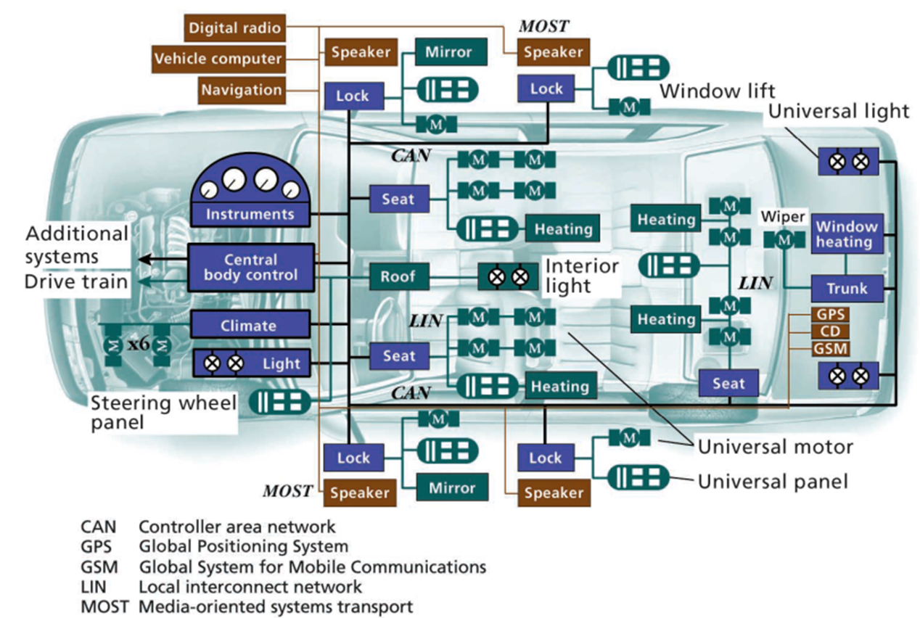
Subsystem target

Slide 35
Infotainment system requirements
Actor driver
The actor uses Bluetooth to connect a new device with the vehicle.
The system responds by
Performing pairing
Establishing a piconet connection
Displaying the bluetooth symbol on the notification panel
Adding the device id to the connected list
Begins to listen for events from the device

Slide 36
2 paths

Slide 37
Step 2: Choose an Element of the System to Transform
1. current knowledge of the architecture
− if it is the only element you can choose (e.g., the entire system or the last element left)
− the number of dependencies it has with other elements of the system (e.g., many or few dependencies)
2. risk and difficulty
− how difficult it will be to achieve the element’s associated requirements
− how familiar you are with how to achieve the element’s associated requirements
− the risk involved with achieving the element’s associated requirements
3. business criteria
− the role the element plays in incremental development of the system
− the role it plays in incremental releases of functionality (i.e., subsetability)
− whether it will be built, purchased, licensed, or used as open source
− the impact it has on time to market
− whether it will be implemented using legacy components
− the availability of personnel to address a component
4. organizational criteria
− the impact it has on resource utilization (e.g., human and computing re-sources)
− the skill level involved with its development
− the impact it has on improving development skills in the organization
− someone of authority selected it

Slide 38
Step 2: Choose an Element of the System to Transform
Infotainment system
Bluetooth hardware and software
Everything else
Everything else

Slide 39
Step 3: Identify Candidate Architectural Drivers
We have an element to decompose
We evaluate the requirements that apply to this element
They are ranked (high,medium,low) on two criteria
First, how important is the requirement to the success of the system
Second, how much of an impact will this requirement have on the structure of the architecture
The requirements that are ranked (H,H) are referred to as “architecture drivers”

Slide 40
Step 3:Identify Candidate Architectural Drivers
The actor uses Bluetooth to connect a new device with the vehicle.
Everybody does it, how hard can it be? How likely is it that this feature will attract buyers?
The actor streams a live webcast on the vehicle information screen.
Can the network connection handle all of the connectivity needs? Will the throughput be sufficient for smooth video?

Slide 41
Step 4: Choose a Design Concept That Satisfies the Architectural Drivers
1. Identify the design concerns that are associated with the candidate architectural drivers. For example, for a quality attribute requirement regarding avail-ability, the major design concerns might be fault prevention, fault detection, and fault recovery [Bass 03].
2. For each design concern, create a list of alternative patterns that address the concern.6 Patterns on the list are derived from
− your knowledge, skills, and experience about which patterns might be appropriate
− known architectural tactics for achieving quality attributes [Bass 03] If a candidate architectural driver concerns more than one quality attribute, multiple tactics may apply.
− other sources such as books, papers, conference materials, search engines, commercial products, and so forth
For each pattern on your list, you should
- a. identify each pattern’s discriminating parameters to help you choose among the patterns and tactics in the list. For example, in any restart pattern (e.g., warm restart, cold restart), the amount of time it takes for a restart is a discriminating parameter. For patterns used to achieve modifiability (e.g., layering), a discriminating parameter is the number of dependencies that exist between elements in the pattern.
- b. estimate the values of the discriminating parameters

Slide 42
3. Select patterns from the list that you feel are most appropriate for satisfying the candidate architectural drivers. Record the rationale for your selections. To decide which patterns are appropriate
a. Create a matrix (as illustrated in Table 1) with patterns across the top and the candidate architectural drivers listed on the left-hand side. Use the matrix to analyze the advantages/disadvantages of applying each pattern to each candidate architectural driver. Consider the following:
− What tradeoffs are expected when using each pattern?
− How well do the patterns combine with each other?
− Are any patterns mutually exclusive (i.e., you can use either pattern A or pattern B but not both)?
b. Choose patterns that together come closest to satisfying the architectural drivers.

Slide 43
4. Consider the patterns identified so far and decide how they relate to each other. The combination of the selected patterns results in a new pattern.
a. Decide how the types of elements from the various patterns are related.8
b. Decide which types of elements from the various patterns are not related.
c. Look for overlapping functionality and use it as an indicator for how to combine patterns.
d. Identify new element types that emerge as a result of combining patterns.
e. Review the list of design decisions at the end of this section and confirm that you have made all the relevant decisions.
5. Describe the patterns you’ve selected by starting to capture different architectural views, such as Module, Component-and-Connector, and Allocation views. You don’t need to create fully documented architectural views at this point. Document any information that you are confident in or that you need to have to reason about the architecture (including what you know about the properties of the various element types). Ideally, you should use view tem-plates to capture this information [Clements 03].

Slide 44
6. Evaluate and resolve inconsistencies in the design concept:
a. Evaluate the design against the architectural drivers. If necessary, use models, experiments, simulations, formal analysis, and architecture evaluation methods.
b. Determine if there are any architectural drivers that were not considered.
c. Evaluate alternative patterns or apply additional tactics, if the design does not satisfy the architectural drivers.
d. Evaluate the design of the current element against the design of other elements in the architecture and resolve any inconsistencies. For exam-ple, while designing the current element, you may discover certain prop-erties that must be propagated to other elements in the architecture.

Slide 45
Design decisions
• You have decided on an overall design concept that includes the major types of elements that will appear in the architecture and the types of relationships among them.
• You have identified some of the functionality associated with the different types of elements (e.g., elements that ping in a Ping-Echo pattern will have ping functionality).
• You know how and when particular types of software elements map to one another (i.e., either statically or dynamically).
• You have thought out communication among the various types of elements (both internal software elements and external entities) but perhaps deferred decisions about it.
You have reasoned about software elements and system resources but perhaps deferred decisions about them.

Slide 46
Design decisions - 2
You have thought out dependencies between the various types of internal software elements but perhaps deferred decisions about them.
You have also considered—and perhaps deferred decisions about—the following:
− the abstraction mechanisms used
− what system elements know about time
− what process/thread model(s) will be employed
− how quality attribute requirements will be addressed

Slide 47
Step 4:Choose a Design Concept That Satisfies the Architectural Drivers
Hardware implications – separate GPU from basic display processor, faster GPU, more memory
Software implications – increased buffering
HTTP Dynamic Streaming (HDS) enables on-demand and live adaptive
bitrate video delivery of standards-based MP4 media over regular HTTP
connections. HDS lets you leverage existing cache infrastructures and
provides tools for integration of content preparation into existing
encoding workflows
http://tools.ietf.org/html/draft-pantos-http-live-streaming-12

Slide 48
Step 5: Instantiate Architectural Elements and Allocate Responsibilities
1. Instantiate one instance of every type of element you chose in Step 4. These instances are referred to as “children” or “child elements” of the element you are currently decomposing (i.e., the parent element).
2. Assign responsibilities to child elements according to their type. For example, ping-type elements are assigned responsibilities including ping functionality, ping frequency, data content of ping signals, and the elements to which they send ping signals.
3. Allocate responsibilities associated with the parent element among its children according to the rationale and element properties recorded in Step 4. For ex-ample, if a parent element in a banking system is responsible for managing cash distribution, cash collection, and transaction records, then allocate those responsibilities among its children. Note that all responsibilities assigned to the parent are considered at this time regardless of whether they are architecturally significant. At this point, it may be useful to consider use cases that systems typically address—regardless of whether they were given explicitly as requirements. This exercise might reveal new responsibilities (e.g., resource management). In addition, you might discover new element types and wish to create new in-stances of them. These use cases include
− one user doing two tasks simultaneously
− two users doing similar tasks simultaneously
− startup
− shutdown
− disconnected operation
− failure of various elements (e.g., the network, processor, process)

Slide 49
4. Create additional instances of element types in these two circumstances:
a. A difference exists in the quality attribute properties of the responsibilities assigned to an element. For example, if a child element is responsible for collecting sensor data in real time and transmitting a summary of that data at a later time, performance requirements associated with data collection may prompt us to instantiate a new element to handle data collection while the original element handles transmitting a summary.
b. You want to achieve other quality attribute requirements; for example, you reassign the functionality of one element to two elements to promote modifiability.
At this point, you should review the list of design decisions listed at the end of this section and confirm that you made all the relevant decisions.
5. Analyze and document the design decisions you have made during step 5 using various views such as these three:
a. Module views are useful for reasoning about and documenting the non-runtime properties of a system (e.g., modifiability).
b. Component-and-Connector views are useful for reasoning about and documenting the runtime behaviors and properties of a system (e.g., how elements will interact with each other at runtime to meet various requirements and what performance characteristics those elements should exhibit).
c. Allocation views are useful for reasoning about the relationships between software and non-software (e.g., how software elements will be allocated to hardware elements).

Slide 50
Design decisions
how many of each type of element will be instantiated and what individual properties and structural relations they will possess
• what computational elements will be used to support the various categories of system use
• what elements will support the major modes of operation
• how quality attribute requirements have been satisfied within the infrastructure and applications
• how functionality is divided and assigned to software elements including how functionality is allocated across the infrastructure and applications

Slide 51
- how software elements map to each other
− how system elements in different architectural structures map to each other (e.g., how modules map to runtime elements and how runtime elements map to processors)
− whether the mapping of one system element to another is static or dynamic (i.e., when the mapping is determined—at build time, deployment, load time, or runtime)
• communication among the various elements, both internal software elements and external entities
− which software elements need to communicate with each other
− what mechanisms and protocols will be used for communication between software elements and external entities
− the required properties of mechanisms that will be used for communication between software elements and external entities (e.g., synchronous, asynchronous, hybrid coupling)
− the quality attribute requirements associated with the communication mechanisms
− the data models on which communication depends
− what computational elements support the various categories of system use
− how legacy and COTS components will be integrated into the design

Slide 52
• internal software elements and system resources
− what resources are required by software elements
− what resources need to be managed
− the resource limits
− how resources will be managed
− what scheduling strategies will be employed
− what elements are stateful/stateless
− the major modes of operation
• dependencies between the internal software elements
− what execution dependencies exist among elements
− how and where execution dependencies among elements are resolved
− the activation and deactivation dependencies among software elements
• which abstraction mechanisms are used
• how much system elements know about time
• what process/thread model(s) will be employed
• how quality attribute requirements will be addressed

Slide 53
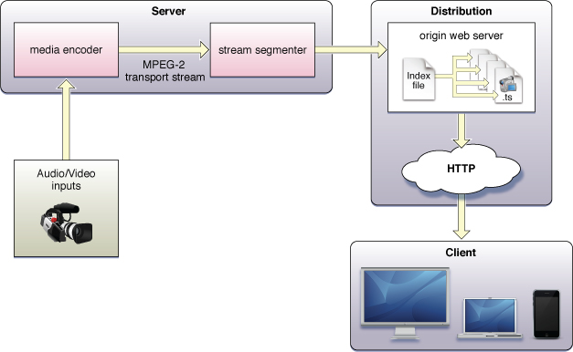
Step 5: Instantiate Architectural Elements and Allocate Responsibilities
Compute next frame
transmit
Assemble each frame
Maybe add another instance of the MOST network to exclusively handle
the HD media.

Slide 54
Step 6: Define Interfaces for Instantiated Elements
Define the services and properties required and provided by the software elements in our design.
These services and properties are referred to as the element’s interface.
Interfaces describe the PROVIDES and REQUIRES assumptions that software elements make about one another. An interface might include any of the following:
• syntax of operations (e.g., signature)
• semantics of operations (e.g., description, pre- and post-conditions, restrictions)
• information exchanged (e.g., events signaled, global data)
• quality attribute requirements of individual elements or operations
• error handling

Slide 55
Exercise the functional requirements that involve the elements you instantiated in Step 5.
Observe any information that is produced by one element and consumed by another. Consider the interfaces from the perspective of different views. For example, a Module view will allow you to reason about information flow; a Concurrency view will allow you to reason about performance and availability; and a Deployment view will allow you to reason about security and availability.
Record your findings in the interface documentation for each element.

Slide 56
Design decisions
• the external interfaces to the system
• the interfaces between high-level system partitions
• the interfaces between applications within high-level system partitions
• the interfaces to the infrastructure

Slide 57
Step 7: Verify and Refine Requirements and Make Them Constraints for Instantiated Elements
1. Verify that all functional requirements, quality attribute requirements, and design constraints assigned to the parent element have been allocated to one or more child elements in the decomposition.
2. Translate any responsibilities that were assigned to child elements into functional requirements for the individual elements.
3. Refine quality attribute requirements for individual child elements as necessary.

Slide 58
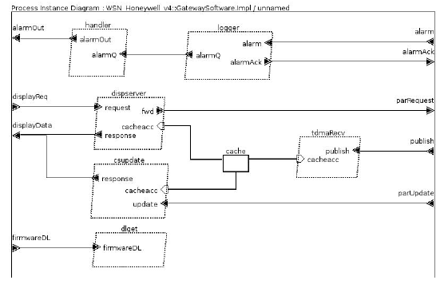
Analysis

Slide 59
Step 8: Repeat Steps 2 through 7 for the Next Element of the System You Wish to Decompose
Once you have completed Steps 1–7, you have a decomposition of the parent element into child elements. Each child element is a collection of responsibilities, each having an interface description, functional requirements, quality attribute requirements, and design constraints. You can now return to the decomposition process in Step 2 where you select the next element to decompose.

Slide 60
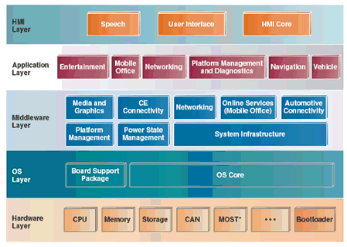
Infotainment architecture

Slide 61
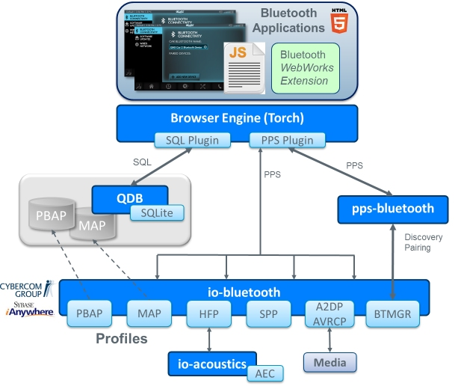
Bluetooth top to bottom
http://www.qnx.com/developers
/docs/qnxcar2/index.jsp?topic=
%2Fcom.qnx.doc.qnxcar2.system
_architecture%2Ftopic%2FMDG
_bluetooth.html

Slide 62
Here is what you are going to do:
Use the pacemaker example-given in:
http://sqrl.mcmaster.ca/_SQRLDocuments/PACEMAKER.pdf
And an AADL model – distributed via email last Sunday
Use the simple version of the pacemaker example
Work through the example to understand (1) the structure of the architecture and (2) the syntax of AADL. Understand the connections among entities and the flows through the system
hand in screen shots of the model
By 11:59 pm Monday Jan 29th – you will receive email on how to commit your work

