Slide 1

CPSC 875
John D. McGregor
C20 – Data Analytics/Technical Debt

Slide 2
http://www.oracle.com/technetwork/articles/cloudcomp/jimerson-ha-arch-cloud-1669855.html

Slide 3
Data Analytics Architecture - Conceptual

Slide 4
Architecture Principles
Accommodate All Forms of Data
Consistent Information and Object Model
Integrated Analysis
Insight to Action

Slide 5
Logical View

Slide 6
Information Management in the Logical view

Slide 7
Real-time analytics in the Logical model

Slide 8
Intelligent Process part of Logical View

Slide 9
Oracle products mapped onto model

Slide 10
http://www.pentaho.com/assets/pdf/CqPxTROXtCpfoLrUi4Bj.pdf
data layer: structured data in an RDBMS, NoSQL, Hbase, or Impala; unstructured data in Hadoop MapReduce; streaming data from the web, social media, sensors and operational systems; and limited capabilities for performing descriptive analytics. Tools such as Hive, HBase, Storm and Spark
analytics layer: includes a production environment for deploying real-time scoring and dynamic analytics; a development environment for building models; and a local data mart
integration layer: the end-user applications and analytics engines together, and it usually includes a rules engine or CEP engine, and an API for dynamic analytics
decision layer: it can include end-user applications such as desktop, mobile, and interactive web apps, as well as business intelligence software.

Slide 11
5 steps
data distillation,
model development,
validation and deployment,
real-time scoring, and
model refresh.

Slide 12
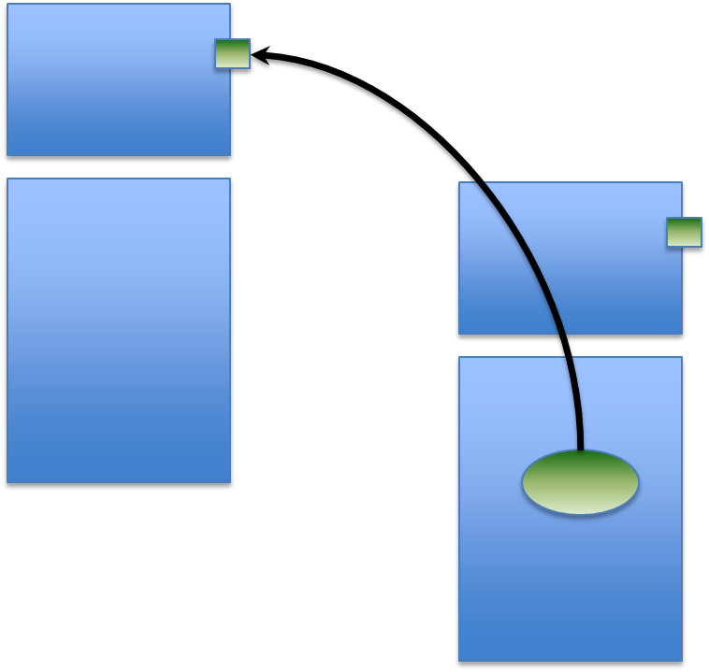
Dependencies
Explicit
Direct
Manageable

Slide 13


Dependences
Implicit, but
a common source of failure
a synchronization point

Slide 14
Indirect dependency
Implicit, there may be no machine readable link
limits
License

Slide 15
Influences
Implicit
A change in one component results in other changes

Slide 16
relationship Dependences
explicit
A class definition depends on another class definition

Slide 17
Dependences

Slide 18
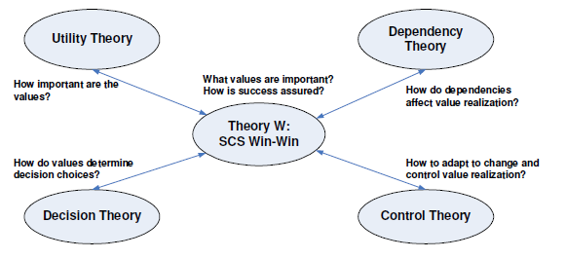
Value-based SE
SCS – success-critical stakeholder

Slide 19
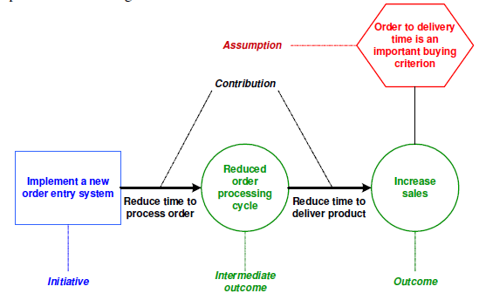
A process

Slide 20
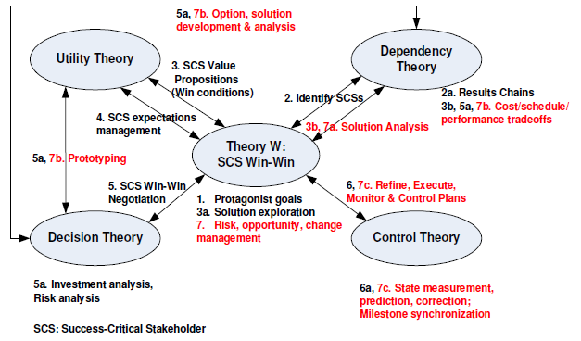
Value-based result

Slide 21
We don’t have time to upgrade our compiler version for now, we’ll do it later.
We should probably use this design but it will takes 6 months compared to this reasonable one which will take 2 months.
We’re reaching some crash after a 100 hours stress run. No customer will go that far, let’s ship it for now !
Our code doesn’t comply with industry standards. Let’s ship it anyway and will fix it later.
http://www.fredberinger.com/avoid-bankruptcy-manage-your-technical-debt/
if it actually took them 5 days but they think it would have taken them 3 days with a clean system, then you paid 2 days of effort as interest on your technical debt

Slide 22
Technical debt
Shipping first time code is like going into debt. A little debt speeds development so long as it is paid back promptly with a rewrite… The danger occurs when the debt is not repaid. Every minute spent on not-quite-right code counts as interest on that debt. Entire engineering organizations can be brought to a stand-still under the debt load of an unconsolidated implementation, object-oriented or otherwise.

Slide 23
Technical debt - 2
Ongoing development in the upstream project can increase the cost of “paying off the debt” in the future. A team should take opportunities, on a regular basis, to pay back (or pay off) this debt. Either reserve a percentage of your development cycle or dedicate an entire cycle to complete this work. If you don’t, it will come back to haunt you. If your kludge of a solution doesn’t come back to bite the development team, it will probably haunt the help desk, support team, or someone else downstream.
http://thecriticalpath.info/2011/01/16/technical-debt/

Slide 24
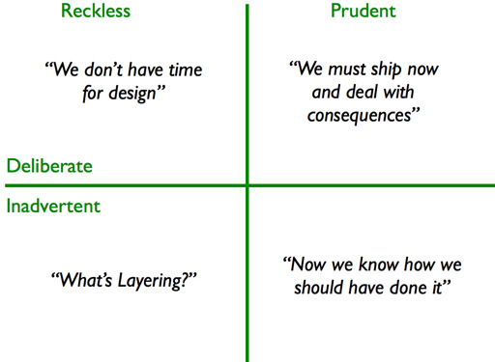
Classes of debt

Slide 25
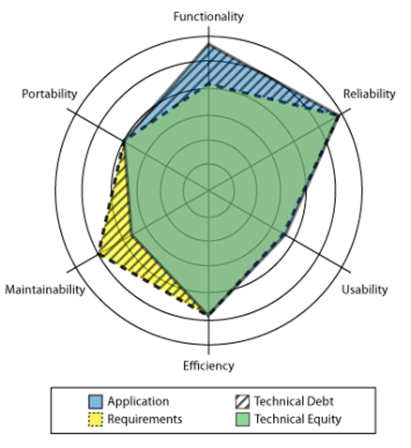
Technical debt is a gap

Slide 26
The metaphor
To date, technical debt has been used as a metaphor and rhetorical device within the agile community with increasingly recognized utility for technical communication and for communication between engineers and executives. The technical debt concept is gaining traction as a way to focus on the long-term management of accidental complexities created by short-term compromises.
http://www.sei.cmu.edu/community/td2011/upload/foser076-brown.pdf

Slide 27
Why debt?
There is an optimization problem where optimizing for the short-term puts the long-term into economic and technical jeopardy when debt is unmanaged.
Design short-cuts can give the perception of success until their consequences start slowing projects down.
Development decisions, especially architectural ones, need to be actively managed and continuously analyzed quantitatively as they incur cost, value, and debt.

Slide 28
Debt, costs, and value
You are allowed to run up debt until the lender questions your ability to repay
Periodically, you need to pay off some debt in order to be able to borrow again when you need to.
That means planning for time in the development process to pay back.

Slide 29
Properties of debt
Visibility. Significant problems arise when debt is not visible. In many cases, it is (or was) known to some people but it is not visible enough to others who eventually have to pay for it.
Value. In its financial use, debt when managed correctly is a device to create value
Present value. In addition to the overall potential system value enabled by technical debt, the present value of the costs incurred as a result of the debt, including the time-to impact and uncertainty of impact, must be mapped to the overall cost-benefit analysis.

Slide 30
Properties of debt - 2
Debt accretion. Debt does not necessarily combine additively, but super-additively in the sense that taking on too much debt leads a system into a bad, perhaps irreparable state
Environment. In software engineering projects, debt is relative to a given or assumed environment.
Origin of debt. It is important to distinguish sharply between strategic debt, taken on for some advantage, and unintentional debt, that is taken on either through poor practices or simply because the environment changed in a way that created a mismatch that reduces system value.

Slide 31
Properties of debt - 3
Impact of debt. The locality (or lack thereof) of debt is important: are the elements that need to be changed to repay a debt localized or widely scattered?

Slide 32
Assessing Technical Debt
Complexity
Code Duplication
Documentation Debt
Testing Debt
Architectural Debt

Slide 33
Research issues
Refactoring
Architectural issues
Identifying dominant sources of debt
Measurement issues
Non-functional artifacts
Monitoring
Process issues

Slide 34
Architecture technical debt
Dependencies that exist in the current architecture but that should not exist are technical debt.
reference architecture
meta-architecture
enterprise architecture

Slide 35
Entropy reduction
Use code tags.
Establish a rhythm.
Time-box the ER activity
Don’t ship the result
Choose your language carefully
Use ER to reinforce other values you deem important
Don’t commit unless you can deliver.

Slide 36
Why no-one repays technical debt
Business people don’t see technical debt.
Perceived low ROI.
Developers don’t like repaying technical debts.
Development processes don’t focus on it.

Slide 37
http://innovationgames.com/wp-content/uploads/2010/04/entropy-reduction.pdf

