Slide 1

CPSC 875
John D. McGregor
C21 – A Platform Strategy

Slide 2
Strategy
A strategy is a plan to achieve long-term objectives
A tactic is a plan to achieve short-term objectives
We have already examined a number of tactics

Slide 3
Platform strategy
A platform strategy assumes that multiple products will be built.
It may be part of a software product line where the platform is a prime asset.
It may be part of an ecosystem environment in which a number of organizations are collaborating to define the platform and then each organization will use the platform for specific products.

Slide 4
Simple platform – Apple IPhone
Apple’s strategy is to package common functionality
Aims are “vendor lock-in” and “synergy”
Application
Application
Application
interface
Platform
Hardware

Slide 5
Vendor lock-in
The use of frameworks and platforms increases the reliance on the owners of those assets.
Even if the platform is open source if all our products reply on it a simple upgrade ripples through the inventory.

Slide 6
Synergy
The Tom Sawyer Effect
Strong ties, among vendors and even customers

Slide 7
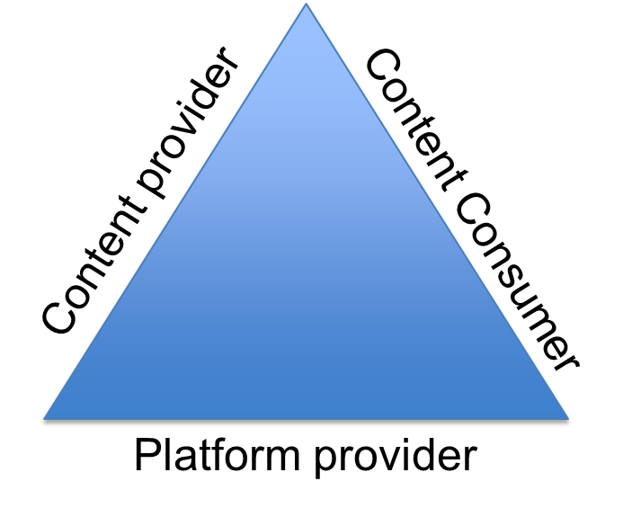
Open source but who cares?
free
King/Candy Crush Saga
Players
free
Google/Android

Slide 8
Monetize the platform.. Now everyone cares
King/Candy Crush Saga
Players
Buy time, tokens, etc.
Google/Android

Slide 9
Multiple platform deployments
King/Candy Crush Saga
Account holder
Facebook
King/Candy Crush Saga
Players
King/Candy Crush Saga
Device owner
Common
code
Google/Android
iOS

Slide 10
Software Product Line Strategy
The extension adds a new product to the product line.
May only use one product
out of a product line
The content providers develop
a product and own part of the
asset base.
Content provider
Content Consumer
Platform provider
The platform consists of
some core assets.

Slide 11
Challenges
Feature Teams Versus Component Teams
Team Autonomy
Business Value Thinking
Code And Product Ownership Thinking
Agility Versus Stability
http://www.infoq.com/articles/challenges-building-sw-platforms-with-agile

Slide 12
Challenge categories
Business
Competing goals
Dominating products
Organizational
Communication
Structure
Culture
Standardization
http://ac.els-cdn.com/S0950584912000547/1-s2.0-S0950584912000547-main.pdf
?_tid=c1f55438-aa45-11e3-916c-00000aab0f02&acdnat=1394670413_329ba295a
5e003a294911b7720208ff5

Slide 13
Challenge categories
Technical
Commonality and variability
Design complexity
Code contribution
Practices
People
Resisting change
Technical competence
Domain knowledge

Slide 14
Autosar
Autosar is a reference architecture that could be the basis of several platforms.
An automotive organization can use Autosar to develop a set of similar products.

Slide 15
Roles
Grand visionary
Chief architect
Architecture review board

Slide 16
Conformance
The architecture review board may enforce consistency with the architecture
Or the architecture may simply be a guideline

Slide 17
Business value
First to market wins
But innovation can disrupt anything and capture value
(new Nokia phone has a disruptive camera)
“value” is truly in the eye of the beholder – something ‘s value is based on what people will pay for it or do for it
Value and cost are very different things

Slide 18
Variation management
Extensibility
Unknown changes
Flexibility
Known changes
Variations may be represented as branches in the version control system or as independent generalization trees

Slide 19
Configuration management
A configuration is a product instance
Includes basic version control per file
Each product is defined by a configuration file
The configuration file is a description of the components and rules about which versions to select.
Maybe a unit of certification

Slide 20
AADL in a platform strategy
Map reference architecture to AADL model
Architecture model may be an AADL system, device, etc

Slide 21
http://ceur-ws.org/Vol-1233/acvi14_submission_5.pdf

