Slide 1

Cloud architectures
John D. McGregor
johnmc@clemson.edu

Slide 2
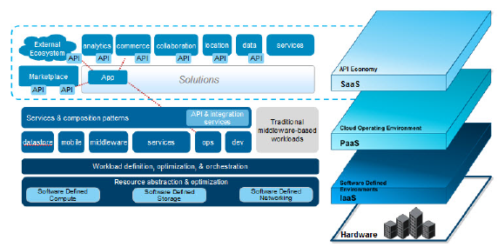

Slide 3
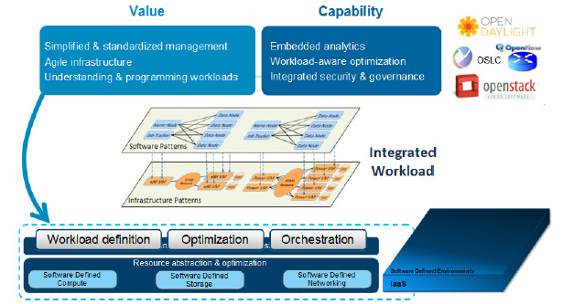

Slide 4
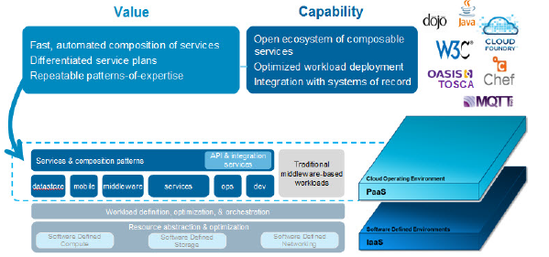

Slide 5
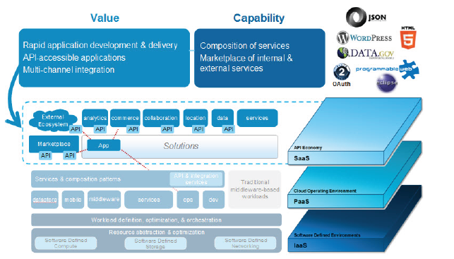

Slide 7
Amazon web architecture

Slide 8
MQTT
MQTT is a machine-to-machine (M2M)/"Internet of Things" connectivity protocol.
MQTT-SN is designed to be as close as possible to MQTT, but is adapted to the peculiarities of a wireless communication environment such as low bandwidth, high link failures, short message length, etc

Slide 9
Types of nodes

Slide 10
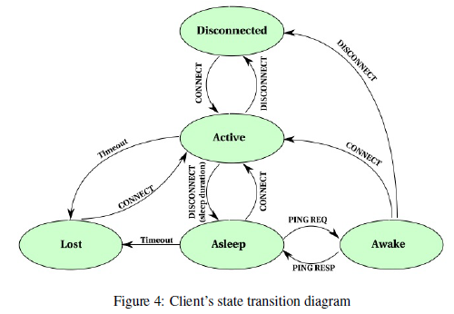
State machine for client

Slide 11
http://www.ibm.com/developerworks/cloud/library/cl-open-architecture/cl-open-architecture-pdf.pdf
http://www.oracle.com/technetwork/articles/cloudcomp/jimerson-ha-arch-cloud-1669855.html
http://mqtt.org/

Slide 12
Here’s what you are going to do…
Revise your architecture and its AADL model based on the results of the ATAM
And include an analysis of how your design would connect to the cloud. If there is no direct connection (such as brake assembly) explain in English how the cloud would affect your design.
Take two design principles and explain how they apply to your design
Take one principle that you think you have done well and one that you think you have not done well.
Due March 25th at 6am

