Slide 1

CPSC 875
John D. McGregor
C22 - Architecture evolution

Slide 2
Roles and Failure Patterns
Roles
  Initial designer
  Extender
  Sustainer
Failure patterns
  Wraparound – from sustainer to initial designer
  Rising star – steps in late to a successful project
  Overprotected parent – initial designer holds on
https://insights.sei.cmu.edu/sei_blog/2016/03/three-roles-and-three-failure-patterns-of-software-architects.html

Slide 3
Implementation should be changing faster than the architecture
But both will change because
  Requirements change
  Product goals change
  New patterns are discovered

Slide 4
Types of Maintenance
Adaptive
  Add new features
  Add support for new platforms
Corrective
  Fix bugs, misunderstood requirements
Perfective
  Performance tuning
Preventive
  Restructure code, “refactoring”, legacy wrapping, build interfaces

Slide 5
Lehman’s Laws
Continuing change — An E-type program that is used must be continually adapted else it becomes progressively less satisfactory.
Increasing complexity — As a program is evolved, its complexity increases unless work is done to maintain or reduce it.
Self regulation — The program evolution process is self-regulating with close to normal distribution of measures of product and process attributes.

Slide 6
Lehman’s Laws - 2
Invariant work rate — The average effective global activity rate on an evolving system is invariant over the product lifetime.
Conservation of familiarity — During the active life of an evolving program, the content of successive releases is statistically invariant.
Continuing growth — Functional content of a program must be continually increased to maintain user satisfaction over its lifetime.

Slide 7
Lehman’s Laws - 3
Declining quality — E-type programs will be perceived as of declining quality unless rigorously maintained and adapted to a changing operation environment.
Feedback system — E-type programming processes constitute multi-loop, multi-level feedback systems and must be treated as such to be successfully modified or improved.

Slide 8
Change scenario
A use case that is not currently a requirement but is likely to be in the future
  Next version
  Next extended product
The actor may be a new actor
The use may extend an existing use or add a new use
Example: The vehicle will support both conductive and inductive charging

Slide 9
Eclipse
Launched in 2001
Eclipse Foundation 2004
Over 170 companies
Almost 1000 committers
Originally ran on Linux and Windows
Now a dozen platforms

Slide 10
Plug-ins
A plug-in is a jar with a manifest
<?xml version="1.0" encoding="UTF-8"?> <plugin id="org.eclipse.ui" name="%Plugin.name" version="2.1.1" provider-name="%Plugin.providerName" class="org.eclipse.ui.internal.UIPlugin"> <runtime> <library name="ui.jar"> <export name="*"/> <packages prefixes="org.eclipse.ui"/> </library> </runtime> <requires> <import plugin="org.apache.xerces"/> <import plugin="org.eclipse.core.resources"/> <import plugin="org.eclipse.update.core"/> : : : <import plugin="org.eclipse.text" export="true"/> <import plugin="org.eclipse.ui.workbench.texteditor" export="true"/> <import plugin="org.eclipse.ui.editors" export="true"/> </requires> </plugin>

Slide 11
Extension points
<extension-point id="actionSets" name="%ExtPoint.actionSets" schema="schema/actionSets.exsd"/> <extension-point id="commands" name="%ExtPoint.commands" schema="schema/commands.exsd"/> <extension-point id="contexts" name="%ExtPoint.contexts" schema="schema/contexts.exsd"/> <extension-point id="decorators" name="%ExtPoint.decorators" schema="schema/decorators.exsd"/> <extension-point id="dropActions" name="%ExtPoint.dropActions" schema="schema/dropActions.exsd"/> =

Slide 12
Add a menu item
<extension point="org.eclipse.ui.actionSets"> <actionSet label="Example Action Set" visible="true" id="org.eclipse.helloworld.actionSet"> <menu label="Example &Menu" id="exampleMenu"> <separator name="exampleGroup"> </separator> </menu> <action label="&Example Action" icon="icons/example.gif" tooltip="Hello, Eclipse world" class="com.example.helloworld.actions.ExampleAction" menubarPath="exampleMenu/exampleGroup" toolbarPath="exampleGroup" id="org.eclipse.helloworld.actions.ExampleAction"> </action> </actionSet> </extension>

Slide 13
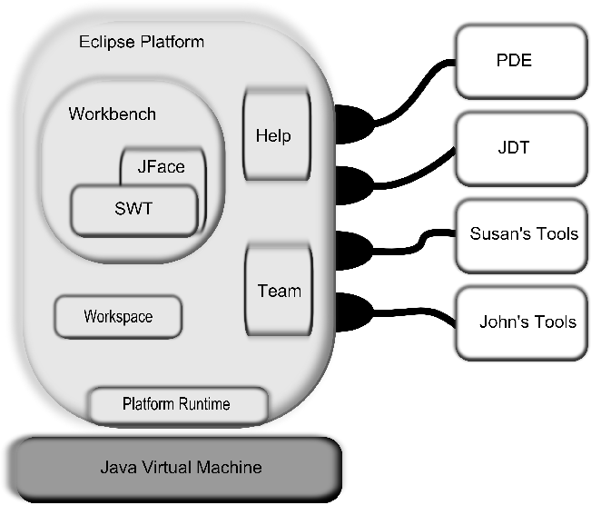

Slide 14
Views and perspectives
View – presents specific information in a manner that speaks to a stakeholder
Perspective – an arrangement of views, editors that are related

Slide 15
Eclipse 3.0
Plug-ins were to be replaced by a new component model – OSGi bundles
This was the new runtime architecture
Chose Service Management Framework (SMF) as the framework implementation
Provided a compatibility layer for existing plug-ins

Slide 16
OSGi bundles
An OSGi bundle runs in a container
It is possible to start, stop, and pause actions in the container without restarting the entire container
Can have more than one version of a module running at the same time.

Slide 17
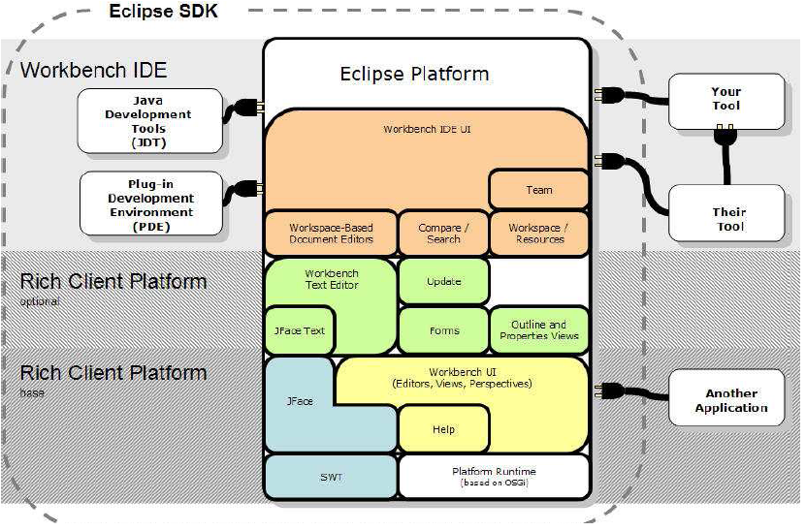

Slide 18
Bundle has
Activator
package com.javaworld.sample.helloworld; import org.osgi.framework.BundleActivator; import org.osgi.framework.BundleContext;
public class Activator implements BundleActivator { public void start(BundleContext context) throws Exception { System.out.println("Hello world"); } public void stop(BundleContext context) throws Exception { System.out.println("Goodbye World"); }
}

Slide 19
Bundle has
Manifest
Manifest-Version: 1.0
Bundle-ManifestVersion: 2
Bundle-Name: HelloWorld Plug-in
Bundle-SymbolicName: com.javaworld.sample.HelloWorld
Bundle-Version: 1.0.0
Bundle-Activator: com.javaworld.sample.helloworld.Activator
Bundle-Vendor: JAVAWORLD
Bundle-Localization: plugin
Import-Package: org.osgi.framework;version="1.3.0"

Slide 20
OSGi container
An OSGi container allows some classes in some bundles to be visible
OSGi has its own class loader so no need to maintain a separate one

Slide 21
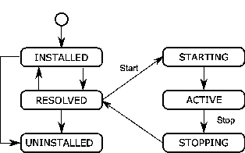
Bundle life cycle
Supports lazy activation which can be either an advantage or disadvantage.

Slide 22
Rich Client Platform
People were using Eclipse – which was intended to be an IDE builder as an application builder.
To support the RCP modules had to be reconfigured.
They were split to narrow the functionality that had to be loaded.

Slide 23
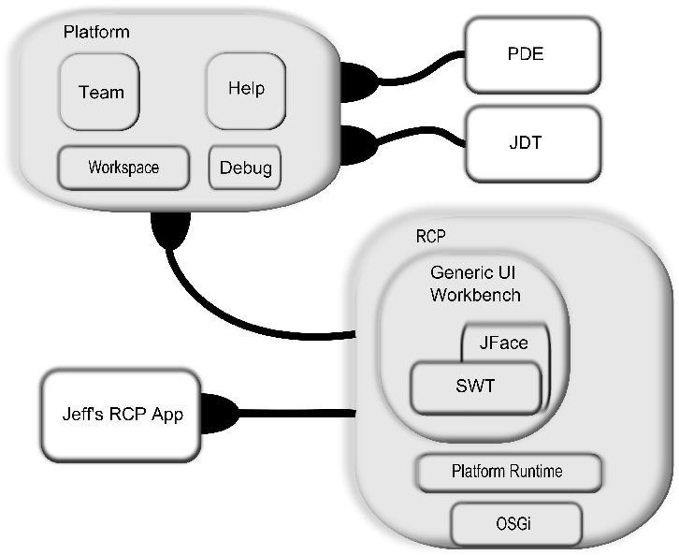
RCP and Platform after reconfigure

Slide 24
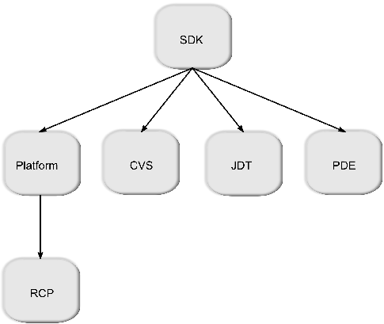
Dependencies

Slide 25
Feature.xml
<?xml version="1.0" encoding="UTF-8"?>
<feature id="org.eclipse.rcp" label="%featureName"
version="3.7.0.qualifier" provider-name="%providerName"
plugin="org.eclipse.rcp" image="eclipse_update_120.jpg">
<description> %description </description>
<copyright> %copyright </copyright>
<license url="%licenseURL"> %license </license>
<plugin id="org.eclipse.equinox.launcher" download-size="0"
install-size="0" version="0.0.0" unpack="false"/>
<plugin id="org.eclipse.equinox.launcher.gtk.linux.x86_64"
os="linux" ws="gtk" arch="x86_64"
download-size="0" install-size="0" version="0.0.0" fragment="true"/>

Slide 26
Features
Features contain features
Features contain bundles

Slide 27
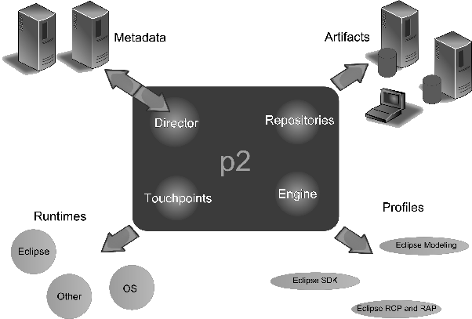
P2 as a solution for updates

Slide 28
p2
P2 uses installation units
Meta-data describes artifacts
Artifacts are the building blocks
Profiles allow user to pull from the repository the installed units at a point in time

Slide 29
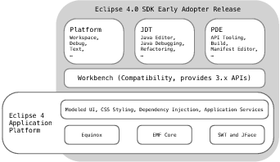
Eclipse 4
4 was another major build
Goals:
  Simplified programming model
  Attract new committers
  Take advantage of new web technologies

Slide 30
Eclipse 4
Separation of model from generation of the view
Eclipse 4.0 uses dependency injection to provide services to clients. Dependency injection in Eclipse 4.x is through the use of a custom framework that uses the concept of a context that serves as a generic mechanism to locate services for consumers. The context exists between the application and the framework. Contexts are hierarchical. If a context has a request that cannot be satisfied, it will delegate the request to the parent context. The Eclipse context, called IEclipseContext, stores the available services and provides OSGi services lookup.

Slide 31
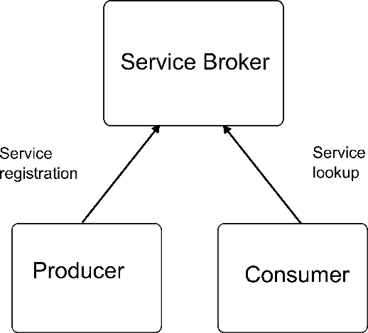
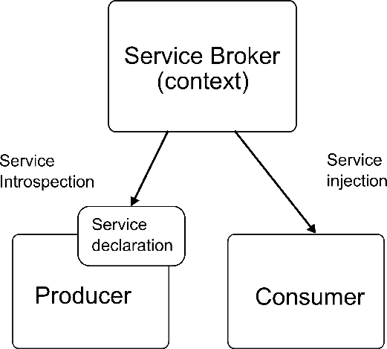
3.X -> 4.x
getViewSite().getActionBars().getStatusLineManager().setMessage(msg);
@Inject StatusLineManager statusLine; statusLine.setMessage(msg);

Slide 32
Acyclic Design Principle
No cycles in a design
Not even indirect cycles

Slide 33
Stable Dependencies Principle
If A depends on B then B should be more stable than A

Slide 34
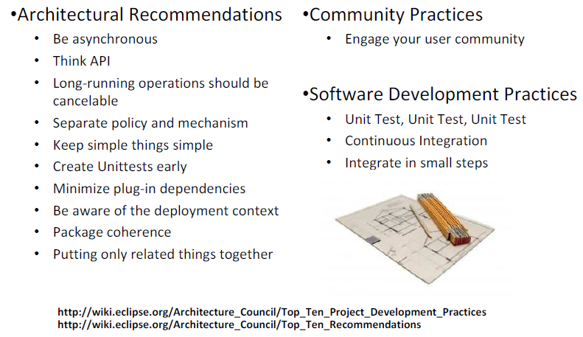

Slide 35
Here’s what you are going to do
Conduct an ATAM and receive your evaluation
Write a couple of change scenarios based on the evaluation for your system that will happen in the near term
Revise your architecture to accommodate the changes
Write one change scenario for your system that will happen in the long term
Submit the scenarios and the revised architecture by 11:59pm Monday , April 4th

