Slide 1

CPSC 875
John D. McGregor
C23 - Architecture evolution/organization/safety analysis and product lines

Slide 2
Creating a metric
Goal – manage the evolution of an architecture
Question – How much has changed? How fast is it changing?
Metric – velocity = ; acceleration =

Slide 3
Velocity/Aceleration of Evolution

Slide 4
Safety analysis
Problem – what is static and what is dynamic?
What is knowable when?
IaaS,PaaS,SaaS

Slide 5
Self-organizing network
What is fixed, what is constrained, what is dynamic?

Slide 6
Safety analysis and product lines
Composition of error propagations

Slide 7
domain
Engineering
Scientific
Technology
Business
Mature
Emerging
Exploratory

Slide 8
Development process style
Agile
Spiral
Iterative
Incremental
Waterfall

Slide 9
Team structure
Strict hierarchy
Matrix
Self-organizing
team
requirements
coding
architecture
testing

Slide 10
ASM—Acquisition Strategy Meeting
CDR—Critical Design Review
CERR—Critical Events Readiness Review
DR—Decommissioning Review
FAD—Formulation Authorization Document
FRR—Flight Readiness Review
KDP—Key Decision Point
LRR—Launch Readiness Review
MRR—Mission Readiness Review
ORR—Operational Readiness Review
PCA—Program Commitment Agreement
PDR—Preliminary Design Review
PFAR—Post-Flight Assessment Review
PIR—Program Implementation Review
PLAR—Post-Launch Assessment Review
SARSystem Acceptance Review
SDR—System Definition Review
SIR—System Integration Review
SMSR—Safety and Mission Success Review
SRB—Standing Review Board
SRR—System Requirements Review

Slide 11
Single person
Chief architect model
Team model
-----------------
Their emphasis
Technical
Business

Slide 12
Program manager
Product manager
Project manager
Team manager
Software architect

Slide 13
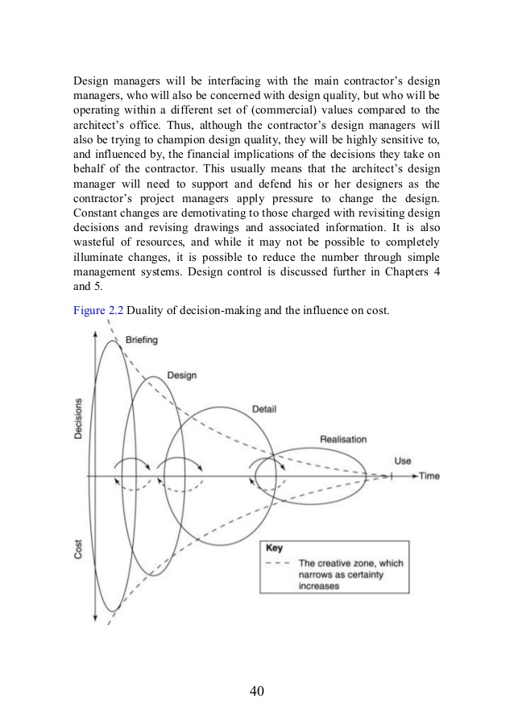

Slide 14
Here’s what you are going to do
Assemble a package of everything.
Write a summary about your project and the process of creating it.
Use metrics to argue why your architecture is “good”.
Submit everything by 11:59pm Monday , April 11th

