Slide 1

CPSC 875
John D. McGregor
C24

Slide 2
Master/Slave
Master initiates interaction
Slave returns results such as errors or signals from successful completion
Master
Slave

Slide 3
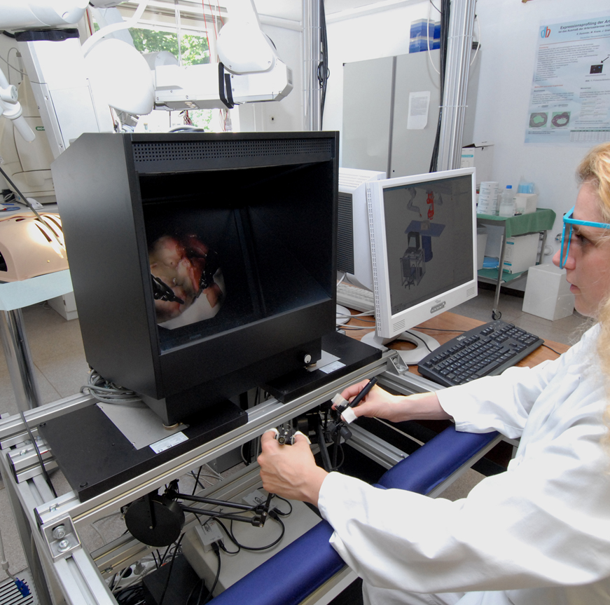
Master

Slide 4
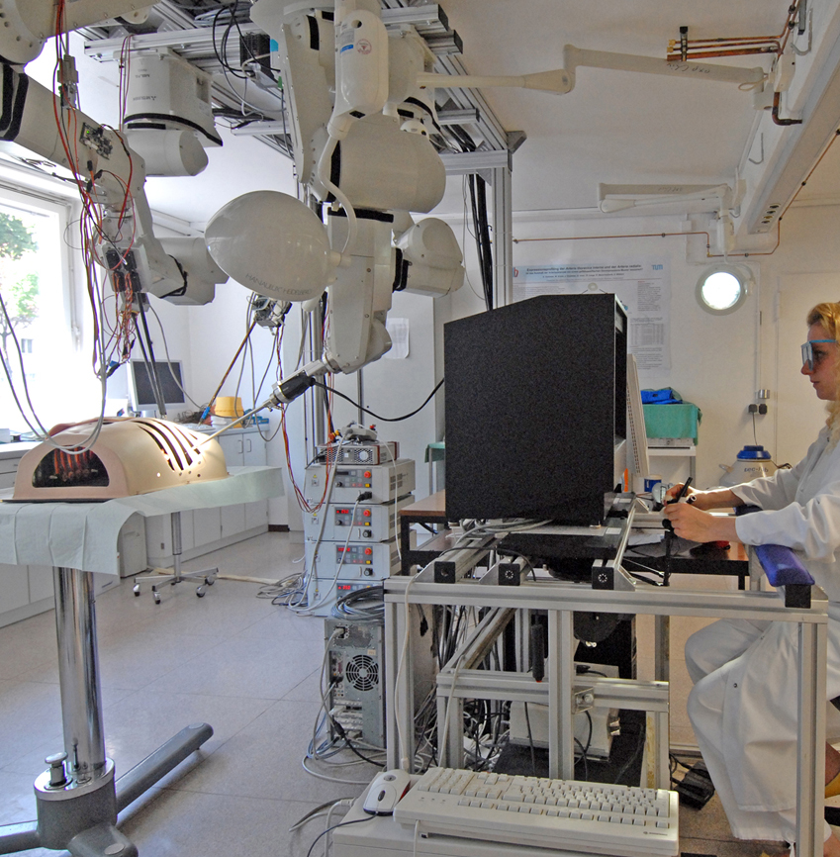
Slave

Slide 5
Master
The master console, often referred to as the medical workstation, offers doctors the ability to operate the system via two PHANToMR Premium 1.5 devices from Sensable Inc. A customized handle snap-on, which is similar to handling a pair of tweezers, replaces the original switch in order to replace the digital behavior of the micro-grippers at the distal end of the surgical tools with a continuous input option. The forefinger has to be fixed at a rocker, which is connected to a small DC motor with an integrated position sensor. The force-feedback capabilities of the employed haptic devices are used to display force information that is derived at the instrument tip. Feedback in all translational part is possible, but no torques can be fed back. Forces acting on the instruments are directly measured at the instrument tip by means of sensitive strain gauges sensors.

Slide 6
Slave
The slave part of our system is composed of four ceiling mounted industrial robots with 6 degrees of freedom. Either surgical tools or the camera can be attached via a magnetic clutch with the manipulators. The coupling system includes a hot-plug show that identifies the instrument and bridges all necessary electrical connections. The surgical tools are the EndoWristTM instruments, originally deployed with the da VinciR system. All instruments are operated by means of trocar kinematics, which ensures the observance of the fulcrum.

Slide 7
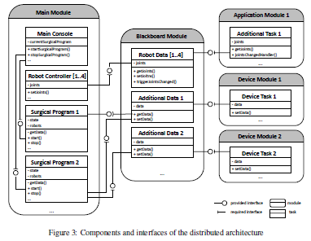
Architecture

Slide 8
New attribute
Understand the attribute
Define a property set
Define resolute set

Slide 9
Security
Attack surface calculation
Threat modeling
Concepts
Trust
Inside/outside
Flow
Time

Slide 10
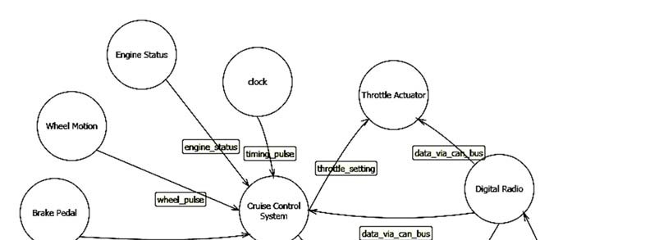
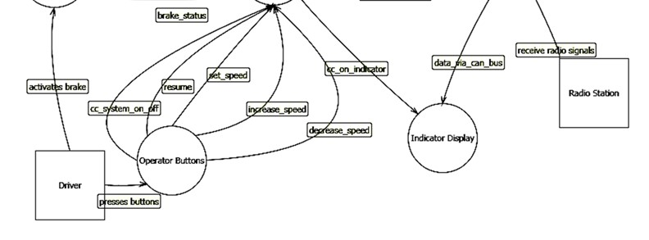
Dataflow diagram for CC

Slide 11
Hazards and risks
 | Hazards | Health Risks
Software | Environmental | Overdose Trauma
Operational | Mechanical | Air embolism Exsanguination
Electrical | Hardware | Infection Electric shock
Biological and chemical | Use | Allergic response Underdose
All |  | Delay of therapy

Slide 12
Element | Interactors | Data Flows | Data Stores | Software Processes
Spoofing | ◊ |  |  | ◊
Information disclosure |  | ◊ | ◊ | ◊
Tampering with data | ◊ |  |  | ◊
Repudiation |  | ◊ | ◊ | ◊
Denial of service |  | ◊ | ◊ | ◊
Elevation of privilege |  |  |  | ◊

Slide 13
STRIDE
Spoofing
Authentication: the process of determining whether someone or something is, in fact, who or
what it is declared to be
Tampering
Integrity: maintaining the consistency, accuracy, and trustworthiness of data over its entire
lifecycle
Repudiation
Non-repudiation: Users can’t perform an action and later deny performing it.
Information disclosure
Confidentiality: Data access is restricted to those authorized to view the data in question.
Denial of service
Availability: Systems are ready when needed and perform acceptably.
Elevation of privilege
Authorization: the process of adding or denying individual user access to a computer network
and its resource

Slide 14
Activities
Create information flows for use cases.
Gather a list of external dependencies.
Define the security assumptions.
Determine the threat types.
Identify the threats to the system.
Determine risk.
Plan mitigations.
Create external security notes.

Slide 15
Resolute
only_receive_decrypt(x : component) <= ** "The component " x " only receives messages that pass Decrypt" ** forall (c : connection). (parent(destination(c)) = x) => is_sensor_data(c) or only_receive_decrypt_connection(c)
only_receive_decrypt_connection(c : connection) <= ** "The connection " c " only carries messages that pass Decrypt" ** let src : component = parent(source(c)); unalterable_connection(c) and (is_decrypt(src) or only_receive_decrypt(src))

Slide 16
system CompleteSystem end CompleteSystem;
system implementation CompleteSystem.Impl
subcomponents
WheelSpeed: device WheelRotationSensor;
CruiseControlApp: system CruiseControl;
connections
c1: port WheelRotationSensor.WheelRotationSpeed -> CruiseControlApp.CruiseControl;
annex Resolute {**
prove (SC1c(this)) –- Prove the complete TrustLevel Rule
prove (SC1(this)) -- For illustrative purposes, prove each subrule
prove (SC1a(this))
**};
end CompleteSystem.Impl;

Slide 17
--
-- Rule SC1 checks that the data component on sending side of a logical connection has a trustlevel equal to or greater than that of the data component of the receiving component.
--
SC1(self:component) <=
** "Confidentality security level is met on " self **
forall (c1 : component) (conn : connection) (c2 : component) . (connected
(c1, conn, c2)) and (has_property (c1, Security_Trust::TrustLevel)) and
(has_property (c2, Security_Trust::TrustLevel))
=>
property (c1, Security_Trust::TrustLevel) <= property (c2, Security_Trust::TrustLevel)

Slide 18
-- Rule SC1a checks if the components on either side of the logical ----connection have the same Group Membership
SC1a(self:component) <=
** "Group membership criteria is met " self **
forall (c1 : component) (conn : connection) (c2 : component) . (connected
(c1, conn, c2)) and (has_property (c1, Security_Trust::GroupMembership)) and
(has_property (c2, Security_Trust::GroupMembership))
=>
property (c1, Security_Trust::GroupMembership) = property (c2,
Security_Trust::GroupMembership)

Slide 19
-- Rule SC1s is the logical and of security rules SC1 and SC1a e.g. that each component belongs to the same group and the data confidentiality is maintained between the components.
SC1c(self:component) <=
** "Composite Check_ " self **
SC1(self) and SC1a(self)

