Slide 1

CPSC 875
John D. McGregor
C25
Safety Analysis
http://resources.sei.cmu.edu/asset_files/TechnicalReport/2016_005_001_484836.pdf

Slide 2
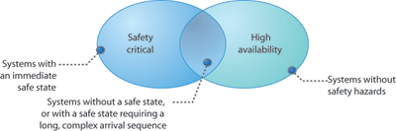
Safety critical systems
Taken from: http://www.embedded.com/design/prototyping-and-development/4006464/
Architecture-of-safety-critical-systems

Slide 3
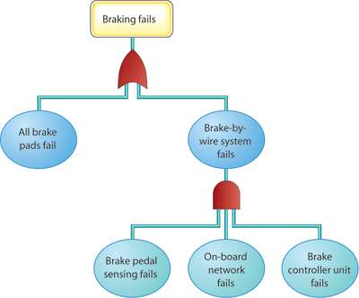
Fault Tree Analysis

Slide 4
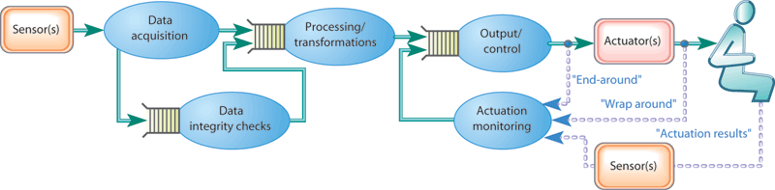
A different view

Slide 5
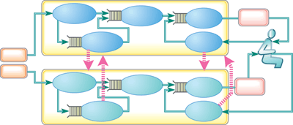
Fail over

Slide 9
Risk
We define a safety risk in the sense of a risk described by Gluch, where a risk is a value judgment (concern and likelihood) made upon the potential implications of current conditions that suggests a possible transition into an undesirable condition (consequence)” [Gluch 1994].

Slide 10
Risk - 2
For a safety risk, current conditions are hazards and potential consequences are accidents.

Slide 11
Safeth Analysis Outline

Slide 25
system pilot_cockpit
extends Top_Level_Pkg::Pilot_Cockpit
annex EMV2{**
use types FADEC_Error_Library;
error propagations
PLA_Cmd: out propagation {No_Data,Bad_Data,Late_Data};
autopilot_control: out propagation {No_Data,Bad_Data,Late_Data};
speed_feedback: in propagation {No_Data,Bad_Data,Late_Data,AsymmetricSpeedFeedback};
end propagations;
**};
end pilot_cockpit;

Slide 26
package FADEC_Error_Library
public
with ErrorLibrary;
annex EMV2{**
error types extends ErrorLibrary with
No_Flow_Cmd: type extends ServiceOmission;
No_Data: type extends ItemOmission;
Bad_Flow_Cmd: type extends BadValue;
Bad_Data: type extends BadValue;
Default_Data: type ;
Late_data: type;
-- type sets
AsymmetricSpeedFeedback: type set {AsymmetricValue,AsymmetricOmission,
AsymmetricTiming};
end types;

Slide 27
error behavior Engine_System_esm
use types ErrorLibrary, FADEC_Error_Library;
events
failure_event: error event;
repair_event: repair event;
states
nominal: initial state;
ineffective_thrust: state;
no_thrust: state;
too_little: state;
too_much: state;
cmd_response_errors: state;
LOTC: state;
end behavior;

