Slide 1

CpSc 875
John D. McGregor
Quality attributes

Slide 2
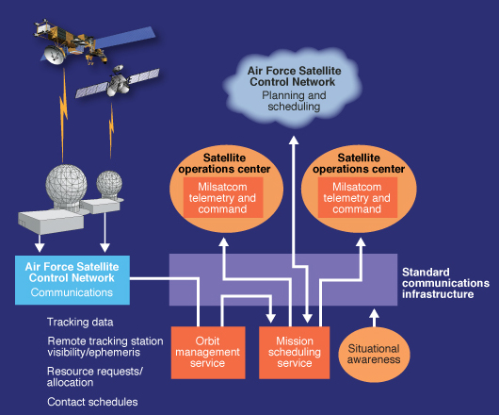
Ground station
Relays signals between satellites and ground controllers
It has to be: very fast and very reliable.
But, how fast is “very” fast?

Slide 3
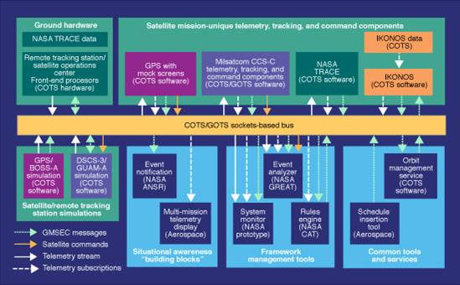
Example bus architecture
Satellite ground station
Bus architecture
Any module on the bus can communicate with any other
Modifiability +

Slide 4
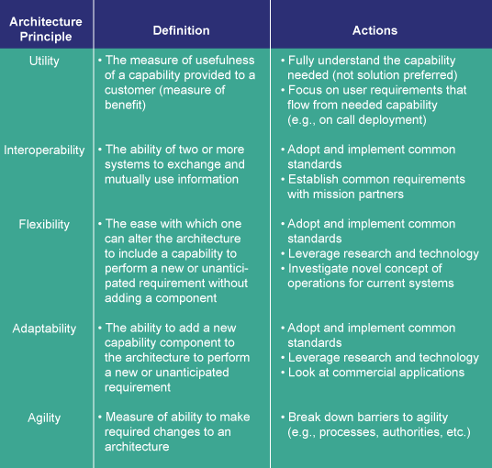
Ground station design principles
One look at qualities
But there are more formal ones.

Slide 5
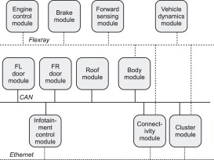
AUTOSAR network architecture

Slide 6
Non-functional/quality attribute
A quality attribute is a property of some aspect of the architecture.
A non-functional requirement sets a constraint on the value of a quality attribute.
Latency is a property of a sequence of computation instructions.
“The algorithm will compute a new value in 5 milliseconds” is a requirement on the value of the latency property.

Slide 7
Quality attributes
IEEE Std. 1061 subfactors:
Efficiency Portability
• Time economy • Hardware independence
• Resource economy • Software independence
Functionality • Installability
• Completeness • Reusability
• Correctness Reliability
• Security • Non-deficiency
• Compatibility • Error tolerance
• Interoperability • Availability
Maintainability Usability
• Correctability • Understandability
• Expandability • Ease of learning
• Testability • Operability
• Comunicativeness
http://en.wikipedia.org/wiki/ISO/IEC_9126

Slide 8
abstract generic_sensor
features
sensor_data_out: out data port;
flows
sensor_source : flow source sensor_data_out;
properties
latency => 1 ms .. 3 ms applies to sensor_source;
SEI::PowerBudget=> 5.0W;
annex EMV2 {**
use types error_library;
error propagations
  sensor_data_out : out propagation {NoValue};
  flows
ef0 : error source sensor_data_out{NoValue};
end propagations;
properties
  emv2::hazards =>
  ([failure => "Novalue";
  description => "No data from the sensor";
  ])
  applies to sensor_data_out.novalue;
**};
end generic_sensor;

Slide 9
Qualities
Trade-offs - a trade off is when enhancing one quality results in the degradation of another quality
  Testability & modifiability
  Performance and modularity
Develop a catalog of trade-offs during this course

Slide 10
Perspectives on quality
The executive
The customer
The developer
The tester

Slide 11
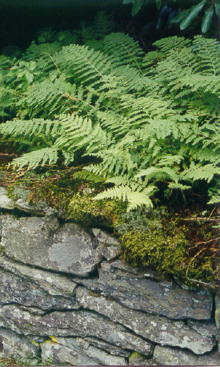
Quality without a name
Naming something denotes certain properties more than others. By not putting into words what we see or feel about this scene we allow each viewer to emphasize what is important to them.

Slide 12
Standard architecture structures
Module structures
  Which piece is responsible for what
Component and connector structures
  How do the major pieces interact at runtime
Allocation structures
  Associates pieces of the architecture with pieces of the external environment

Slide 13
Module structures
Decompose – module into sub modules. Pieces related to the whole
Uses – one module expects another to be present
Layered – decomposition in which there is an ordering
Class – specialization relationships
module
decomposition
class
uses
layered

Slide 14
Decomposition
Taking one big thing and making it into several smaller things
The relationships among these pieces determines what qualities the design enhances and which it degrades.
Other operations such as combination also affect the product qualities.

Slide 15
Component and Connector
Client/server – multiple modules go to a common module for the same action
Concurrency – logical threads
Process – actual threads/ processes of the system
Shared Data – how is data stored and accessed
Component and Connector
Client/server
Shared data
process
concurrency

Slide 16
Allocation structures
work assignment– module assigned to a team
deployment – which processor has which threads
implementation – where in CM are the files for this module
allocation
Work
assignment
implementation
deployment

Slide 17
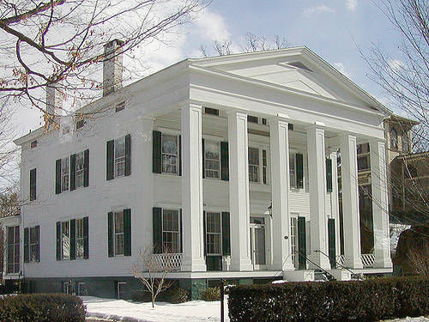
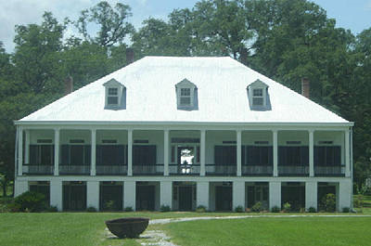
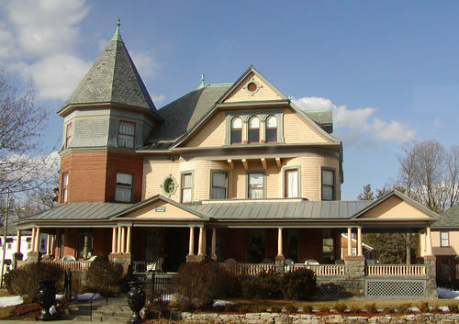
Architecture Styles
Greek Revival
French Colonial
Queen Anne

Slide 18
Architectural styles
Set of element types
  Pipes and filters
A topological layout
  A pipe connects two filters
Set of semantic constraints
  A filter transforms its inputs to create its outputs
Set of interaction mechanisms
  The output of a filter is carried in a pipe to another filter

Slide 19
Client/server
Server provides some service that we wish to keep centralized.
Many clients may all go to the same source for a function
Client
Server

Slide 20
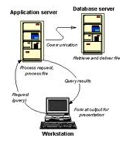
c/s example
User in one place
Code in another

Slide 21
Layered style
Functionality is divided into buckets
The buckets are arranged in a hierarchy
Data and control can flow up and down the hierarchy
Functionality in a bucket may only invoke functionality in a “lower” bucket, where
Lower means closer to something than the bucket initiating the action

Slide 22
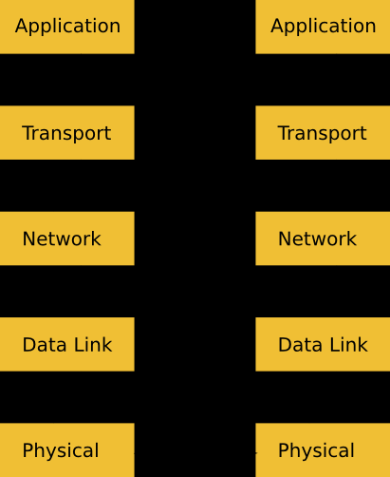
Layered style
Example: OSI network protocol stack
each layer provides a specific type of network service. It illustrates why groups of related protocols are frequently called protocol stacks
“lower” means closer to physical environment

Slide 23

Pipe and filter style
"The Pipes and Filters architectural pattern provides a structure for systems that process a stream of data. Each processing step is encapsulated in a filter component. Data [are] passed through pipes between adjacent filters. Recombining filters allows you to build families of related filters." [Buschmann]
Example: ray tracer

Slide 24
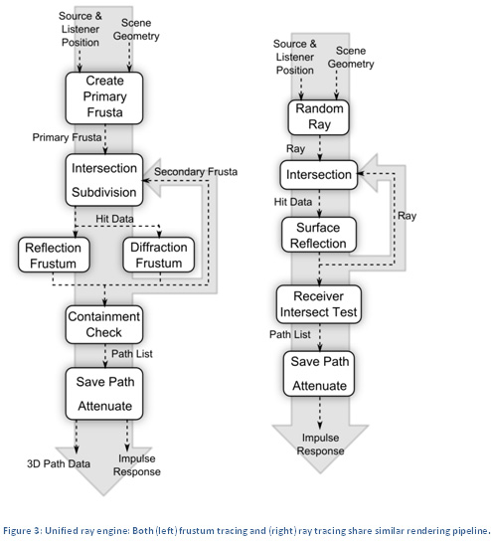
Ray tracing architecture
Each step has a specific purpose
Each step can be developed independently
Each step can be replaced or modified independently (assuming the results are the same type of information)

Slide 25
Similar
The layered and pipe and filter styles are very similar
What could be different between them?
It isn’t geometry obviously

Slide 26
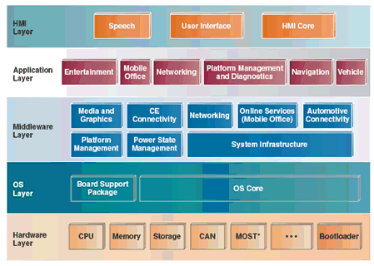
Layered vs pipeline

Slide 27
In the beginning
There were “green screen” terminals with space bars and arrow keys
Then there was memory mapped displays with pointing devices
Then there was multiple windows

Slide 28
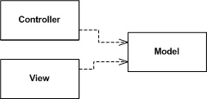
GUI design
Separates the data model from the means of viewing it
Interaction is handled by the controller(s)
Data is presented in the view(s)
Multiple views can register with the model. The model does not know how many views are registered.
There is one or more controllers associated with each view.
http://martinfowler.com/eaaDev/uiArchs.html

Slide 29
Model-View-Controller
View and Controller are used to create specialized Views and Controllers which can be polymorphically substituted
Reading is the model of a reading from some sensor
Mouse
Pen
Controller
View
Model
TableView
ListView

Slide 30
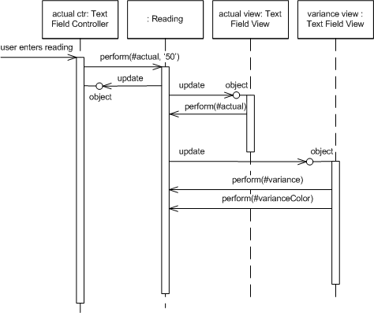
Model-View-Controller
This shows normal operation
Update – is the way Reading notifies Views when new data is available
Perform – the Views are asking the Model to do some standard action

Slide 31
Cartoon of the Pacemaker system

