Slide 1

CPSC 875
John D. McGregor
What do you do first?/ Architecture evolution

Slide 2
What do I do first?
Suppose you arrive at work and find you have been assigned to a new project to build the navigation engine for an autonomous vehicle. You are assigned to be the architect.
What do you do first?
http://ieeexplore.ieee.org/stamp/stamp.jsp?tp=&arnumber=4290285
http://www.sciencedirect.com/science/article/pii/S0736584509000994

Slide 3
Look for domain information such as reference architectures

Slide 4
AGV system
Developing an AGV system requires, at least, catering for some of the following topics: navigation and guidance, routing, traffic management, load transfer and system management. Navigation and guidance allows the vehicle to follow a route. Routing [3] is the vehicle’s ability to make decisions along the guidance path in-order to select optimum routes to specific destinations. Traffic management [4] is a system or vehicle ability to avoid collisions with other vehicles. Load transfer is the pickup and delivery method for an AGV system, which may be simple or integrated with other subsystems. Management system [5] is the method of system control used to dictate system operation

Slide 5
Requirements
Understand the user requirements that are available
Define new development requirements based on input from developers
Conduct a QAW.
Add new requirements based on the priorities of the QAs

Slide 6
Safety analysis
Use safety analysis to identify additional requirements
Create an error model for each component as the component is defined (use ADD to define new components)
Integrate the error models via propagations as the components are wired together
Generate requirements that mitigate the hazards identified during the creation of the error models

Slide 7
As you go
Define a complete specification for each component – in/out ports – error propagations
When you decompose a component split its specification
When you implement a component by inserting a component within another, link in ports of the outer component to in ports of the inner component

Slide 8
As you go
Insert constraints about structure and behavior
Where do these come from?
The specification of the component defines “assumes” and “guarantees”
Limitations on quantities, rates
Consistencies and completeness issues

Slide 9
In the end
We have a machine-readable model
That can be queried in many ways
And is amenable to modification because modifications are local
And there really is no end, the architecture evolves as the product matures

Slide 10
Incremental, compositional
Our techniques are incremental in that we can first define only a specification and then later define an implementation.
Our techniques are compositional in that we define individual components and then wire them together.

Slide 11
Evolution
Implementation should be changing faster than the architecture
But both will change because
  Requirements change
  Product goals change
  New patterns are discovered

Slide 12
Types of Maintenance
Adaptive
  Add new features
  Add support for new platforms
Corrective
  Fix bugs, misunderstood requirements
Perfective
  Performance tuning
Preventive
  Restructure code, “refactoring”, legacy wrapping, build interfaces

Slide 13
Lehman’s Laws
Continuing change — An E-type program that is used must be continually adapted else it becomes progressively less satisfactory.
Increasing complexity — As a program is evolved, its complexity increases unless work is done to maintain or reduce it.
Self regulation — The program evolution process is self-regulating with close to normal distribution of measures of product and process attributes.

Slide 14
Lehman’s Laws - 2
Invariant work rate — The average effective global activity rate on an evolving system is invariant over the product lifetime.
Conservation of familiarity — During the active life of an evolving program, the content of successive releases is statistically invariant.
Continuing growth — Functional content of a program must be continually increased to maintain user satisfaction over its lifetime.

Slide 15
Lehman’s Laws - 3
Declining quality — E-type programs will be perceived as of declining quality unless rigorously maintained and adapted to a changing operation environment.
Feedback system — E-type programming processes constitute multi-loop, multi-level feedback systems and must be treated as such to be successfully modified or improved.

Slide 16
Change scenario
A use case that is not currently a requirement but is likely to be in the future
  Next version
  Next extended product
The actor may be a new actor
The use may extend an existing use or add a new use
Example: The vehicle will support both conductive and inductive charging

Slide 17
Eclipse
Launched in 2001
Eclipse Foundation 2004
Over 170 companies
Almost 1000 committers
Originally ran on Linux and Windows
Now a dozen platforms

Slide 18
Plug-ins
A plug-in is a jar with a manifest
<?xml version="1.0" encoding="UTF-8"?> <plugin id="org.eclipse.ui" name="%Plugin.name" version="2.1.1" provider-name="%Plugin.providerName" class="org.eclipse.ui.internal.UIPlugin"> <runtime> <library name="ui.jar"> <export name="*"/> <packages prefixes="org.eclipse.ui"/> </library> </runtime> <requires> <import plugin="org.apache.xerces"/> <import plugin="org.eclipse.core.resources"/> <import plugin="org.eclipse.update.core"/> : : : <import plugin="org.eclipse.text" export="true"/> <import plugin="org.eclipse.ui.workbench.texteditor" export="true"/> <import plugin="org.eclipse.ui.editors" export="true"/> </requires> </plugin>

Slide 19
Extension points
<extension-point id="actionSets" name="%ExtPoint.actionSets" schema="schema/actionSets.exsd"/> <extension-point id="commands" name="%ExtPoint.commands" schema="schema/commands.exsd"/> <extension-point id="contexts" name="%ExtPoint.contexts" schema="schema/contexts.exsd"/> <extension-point id="decorators" name="%ExtPoint.decorators" schema="schema/decorators.exsd"/> <extension-point id="dropActions" name="%ExtPoint.dropActions" schema="schema/dropActions.exsd"/> =

Slide 20
Add a menu item
<extension point="org.eclipse.ui.actionSets"> <actionSet label="Example Action Set" visible="true" id="org.eclipse.helloworld.actionSet"> <menu label="Example &Menu" id="exampleMenu"> <separator name="exampleGroup"> </separator> </menu> <action label="&Example Action" icon="icons/example.gif" tooltip="Hello, Eclipse world" class="com.example.helloworld.actions.ExampleAction" menubarPath="exampleMenu/exampleGroup" toolbarPath="exampleGroup" id="org.eclipse.helloworld.actions.ExampleAction"> </action> </actionSet> </extension>

Slide 21
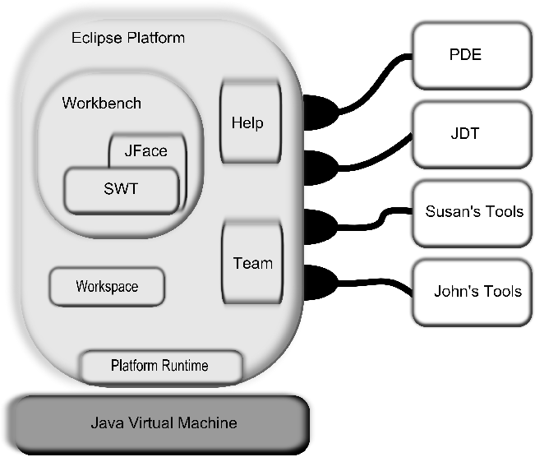

Slide 22
Views and perspectives
View – presents specific information in a manner that speaks to a stakeholder
Perspective – an arrangement of views, editors that are related

Slide 23
Eclipse 3.0
Plug-ins were to be replaced by a new component model – OSGi bundles
This was the new runtime architecture
Chose Service Management Framework (SMF) as the framework implementation
Provided a compatibility layer for existing plug-ins

Slide 24
OSGi bundles
An OSGi bundle runs in a container
It is possible to start, stop, and pause actions in the container without restarting the entire container
Can have more than one version of a module running at the same time.

Slide 25
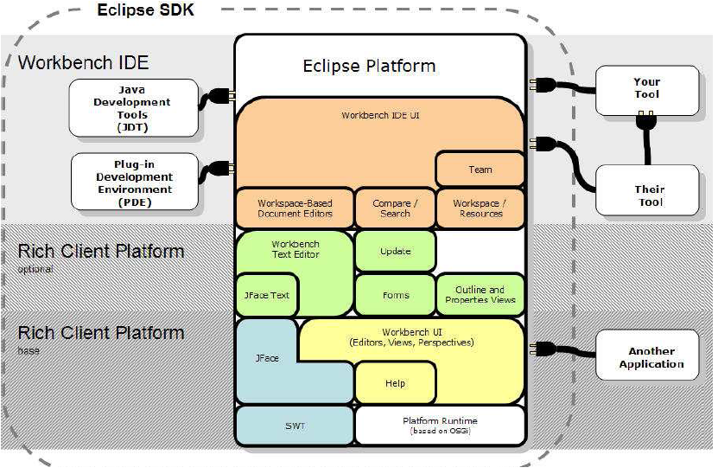

Slide 26
Bundle has
Activator
package com.javaworld.sample.helloworld; import org.osgi.framework.BundleActivator; import org.osgi.framework.BundleContext;
public class Activator implements BundleActivator { public void start(BundleContext context) throws Exception { System.out.println("Hello world"); } public void stop(BundleContext context) throws Exception { System.out.println("Goodbye World"); }
}

Slide 27
Bundle has
Manifest
Manifest-Version: 1.0
Bundle-ManifestVersion: 2
Bundle-Name: HelloWorld Plug-in
Bundle-SymbolicName: com.javaworld.sample.HelloWorld
Bundle-Version: 1.0.0
Bundle-Activator: com.javaworld.sample.helloworld.Activator
Bundle-Vendor: JAVAWORLD
Bundle-Localization: plugin
Import-Package: org.osgi.framework;version="1.3.0"

Slide 28
OSGi container
An OSGi container allows some classes in some bundles to be visible
OSGi has its own class loader so no need to maintain a separate one

Slide 29
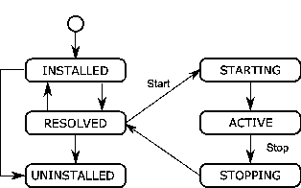
Bundle life cycle
Supports lazy activation which can be either an advantage or disadvantage.

Slide 30
Rich Client Platform
People were using Eclipse – which was intended to be an IDE builder as an application builder.
To support the RCP modules had to be reconfigured.
They were split to narrow the functionality that had to be loaded.

Slide 31
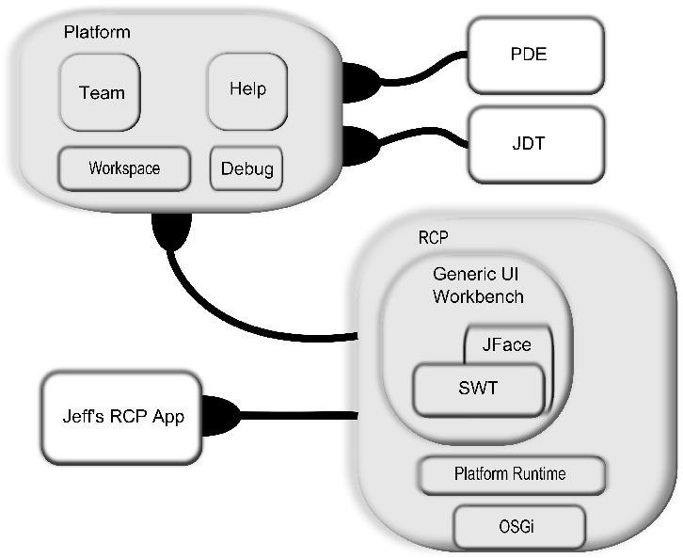
RCP and Platform after reconfigure

Slide 32
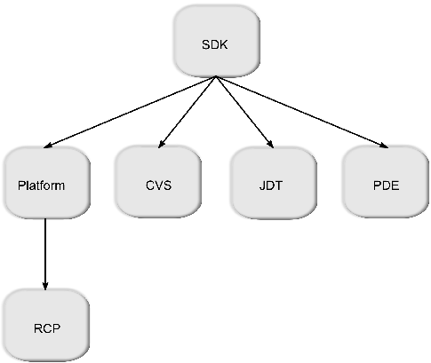
Dependencies

Slide 33
Feature.xml
<?xml version="1.0" encoding="UTF-8"?>
<feature id="org.eclipse.rcp" label="%featureName"
version="3.7.0.qualifier" provider-name="%providerName"
plugin="org.eclipse.rcp" image="eclipse_update_120.jpg">
<description> %description </description>
<copyright> %copyright </copyright>
<license url="%licenseURL"> %license </license>
<plugin id="org.eclipse.equinox.launcher" download-size="0"
install-size="0" version="0.0.0" unpack="false"/>
<plugin id="org.eclipse.equinox.launcher.gtk.linux.x86_64"
os="linux" ws="gtk" arch="x86_64"
download-size="0" install-size="0" version="0.0.0" fragment="true"/>

Slide 34
Features
Features contain features
Features contain bundles

Slide 35
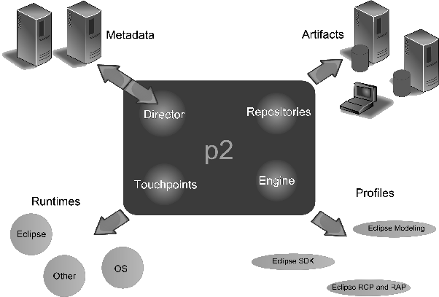
P2 as a solution for updates

Slide 36
p2
P2 uses installation units
Meta-data describes artifacts
Artifacts are the building blocks
Profiles allow user to pull from the repository the installed units at a point in time

Slide 37
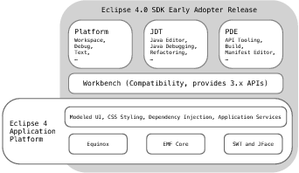
Eclipse 4
4 was another major build
Goals:
  Simplified programming model
  Attract new committers
  Take advantage of new web technologies

Slide 38
Eclipse 4
Separation of model from generation of the view
Eclipse 4.0 uses dependency injection to provide services to clients. Dependency injection in Eclipse 4.x is through the use of a custom framework that uses the concept of a context that serves as a generic mechanism to locate services for consumers. The context exists between the application and the framework. Contexts are hierarchical. If a context has a request that cannot be satisfied, it will delegate the request to the parent context. The Eclipse context, called IEclipseContext, stores the available services and provides OSGi services lookup.

Slide 39
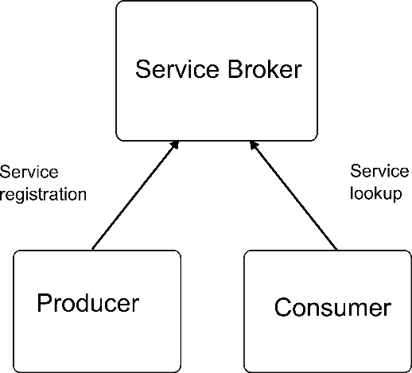
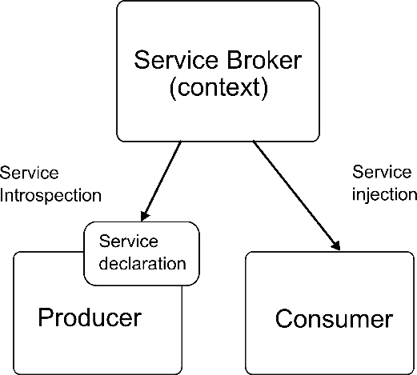
3.X -> 4.x
getViewSite().getActionBars().getStatusLineManager().setMessage(msg);
@Inject StatusLineManager statusLine; statusLine.setMessage(msg);

Slide 40
Acyclic Design Principle
No cycles in a design
Not even indirect cycles

Slide 41
Stable Dependencies Principle
If A depends on B then B should be more stable than A

Slide 42
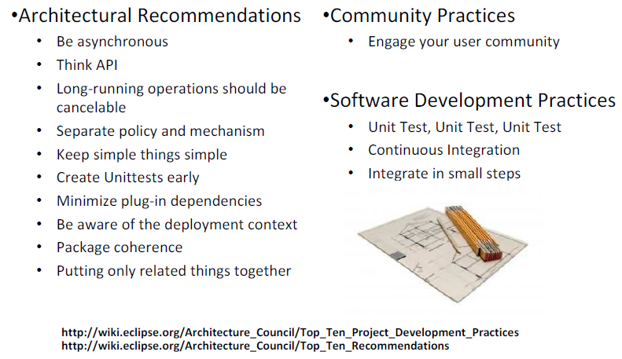

Slide 43
Here’s what you are going to do
Define the interface between the navigation unit and the CACC
Revise your architecture to accommodate the interaction with the navigation unit.
Add AGREE and Resolute statements to test the interface’s completeness and consistency.
Submit the revised architecture by 11:59pm Wednesday , April 1st

Slide 44
View on slideshare:
http://www.slideshare.net/lenbass/what-is-dev-ops-for-review
http://www.slideshare.net/lenbass/02-team-practcies-and-overall-architecture
http://www.slideshare.net/lenbass/03-build-structure-and-testing

