Slide 1

CpSc 875
John D. McGregor
Class 4 – Driving requirements

Slide 2
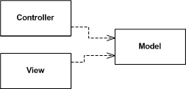
Interactive computing
Separates the data model from the means of viewing it
Interaction is handled by the controller(s)
Data is presented in the view(s)
Multiple views can register with the model. The model does not know how many views are registered.
There is one or more controllers associated with each view.
http://martinfowler.com/eaaDev/uiArchs.html

Slide 3
Model-View-Controller
http://developer.apple.com/library/mac/#documentation/General/Conceptual/DevPedia-CocoaCore/MVC.html
http://www.dossier-andreas.net/software_architecture/mvc.html
As anti-pattern
http://broadcast.oreilly.com/2008/10/mvc-as-anti-pattern.html
Controller
View
Model

Slide 4
Model-View-Controller
View and Controller are used to create specialized Views and Controllers which can be polymorphically substituted
Reading is the model of a reading from some sensor
Mouse
Pen
Controller
View
Model
TableView
ListView

Slide 5
Model-View-Controller
View and Controller are used to create specialized Views and Controllers which can be polymorphically substituted
Reading is the model of a reading from some sensor
Mouse
Pen
Controller
View
Model
TableView
ListView

Slide 6
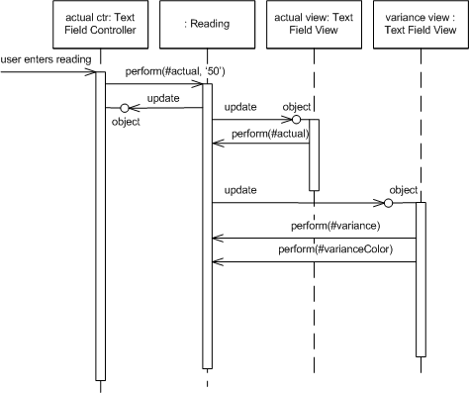
Model-View-Controller
This shows normal operation
Update – is the way Reading notifies Views when new data is available
Perform – the Views are asking the Model to do some standard action

Slide 7
Next level
Decompose View
Functional decomposition
Controller
Controller
Controller
Controller
Data Editor
Model
View
Model
System menu
Properties editor

Slide 8
Controller
Controller
Controller
Data Editor
Model
System menu
Properties editor
Controller
Controller
Controller
Controller
Data Editor
System Model
System menu
Editor Model
Properties editor

Slide 9
Controller
Controller
Controller
Controller
Data Editor
System Model
System menu
Editor Model
Properties editor
Controller
Controller
Controller
Controller
Data Editor
System Model
DataBase
System menu
Editor Model
Properties editor

Slide 10
What are the essentials?
Separation of data from presentation
Have multiple views
Separation of control from presentation
Have multiple controllers
Attributes
Extensible

Slide 11
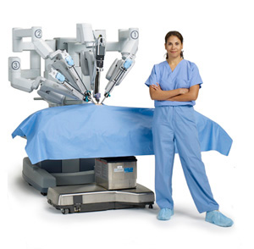
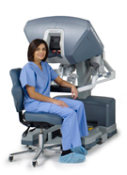
Master/Slave
http://hudson-ci.org/docs/HudsonArch-Execution.pdf

Slide 12
Master drives the system
Master
Slave

Slide 13
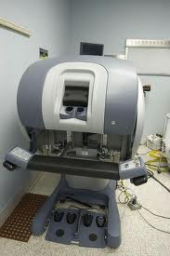
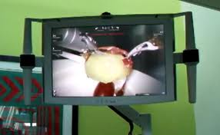
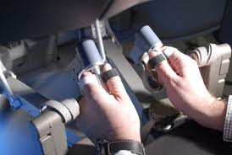

MVC

Slide 14
Master
Slave
Controller
View
Model

Slide 15
NOAA architecture document
This paper presents a software architecture for the Integrated Hydrologic Forecast System (IHFS). The IHFS goal is to support the Hydrologic Research Laboratory mission and vision by the providing a more effective system of tools and techniques for use at River Forecast Centers (RFCs), Weather Forecast Offices (WFOs), and supporting Headquarters Offices to allow the easy introduction of new science that costs less to enhance and maintain.
http://www.nws.noaa.gov/oh/hrl/ihfs/architecture_doc/ihfscnts.php
The next couple of slides give an overview

Slide 16
Table of Contents
Section 1 Introduction
1.1 Purpose
1.2 Characterization of the IHFS Architecture
1.2.1 Interactive Interface Layer
1.2.2 IHFS Applications Layer
1.2.3 IHFS Infrastructure Layer
1.2.4 AWIPS Layer
Section 2 IHFS Architectural Requirements
2.1 Driving Requirements
2.2 Architectural Constraints
2.3 Architectural Requirements
Section 3 Target IHFS Architecture
3.1 Interactive Interface Layer
3.2 IHFS Infrastructure Layer Architecture.
3.2.1 Application Control Services
3.2.2 Application Communication Services
3.2.3 Data Access Services
3.3 IHFS Applications Layer Architecture

Slide 17
Table of Contents
Section 4 Transitional IHFS Architectures and Strategies
4.1 IHFS Infrastructure
4.2 IHFS Interactive Interface
4.3 IHFS Applications
Section 5 Implementation Technologies and Standards
Section 6 Architecture Requirements Satisfaction
Section 7 Open Issues Section
8 Currently Defined IHFS Services Interfaces
8.1 IHFS Infrastructure Layer APIs for Data Access Services
8.2 IHFS Infrastructure Layer APIs for Application Control and Communication
Section 9 Discussion of Other Options Considered
9.1 Data Structure Storage and Synchronization: RFC and WFO
9.2 D2D Architectural Issues
9.3 Informix Architectural Issues
9.4 Application Data Access Services Function Interface
9.4.1 Data Retrieval
9.4.2 Data Storage
9.4.3 Logical Data Storage Organization

Slide 18
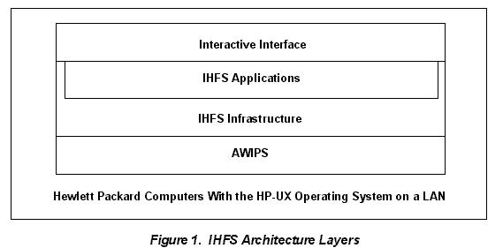
Architecture
At the top level the dominant structure is layers
Driving Requirements
1. Provide for easy and cost-effective enhancement and maintenance of systems used for river forecasting.
2. Support efficient operations and information sharing between the RFCs and WFOs.
3. Support the current functions of NWSRFS, WHFS, and other functions supporting hydrologic analysis and forecasting.
4. Preserve the current NWSRFS science.
5. Simplify the addition of new science and techniques.

Slide 19
Context
We are going to build a system which initially uses wireless technologies to interact with a configurator.
Initially we might use a low powered configurator but eventually could be monitored using WiFi or cellular technologies.

Slide 20
Driving requirements
There are always too many requirements for the team to consider.
The driving requirements are those things that are most important to the most important stakeholders.
We will look at a specific technique: the Quality Attribute Workshop.

Slide 21
QAW - 1
QAW Steps Description
Step 1 – QAW Presentation and Introductions
QAW facilitators describe the motivation for the QAW and explain
each step of the method. Next, the facilitators introduce themselves
and the stakeholders do likewise, briefly stating their background,
their role in the organization, and their relationship to the system
being built.
Step 2 – Business/Programmatic Presentation
A stakeholder representing the business and/or programmatic
concerns presents the system’s business/programmatic context, highlevel
functional requirements, constraints, and quality attribute
requirements.

Slide 22
QAW - 2
Step 3 – Architectural Plan Presentation
A technical stakeholder presents the system architectural plans
including (1) plans and strategies for how key
business/programmatic requirements will be satisfied; (2) key
technical requirements, risks, and constraints—such as mandated
operating systems, hardware, middleware, and standards—that will
drive architectural decisions; (3) existing context diagrams, high-level
system diagrams, and other written descriptions; (4)
operational and system architectures, and architectural frameworks,
tools, and architectural life-cycle processes being used; and (5) the
prototyping and engineering studies underway to mitigate known
risks.

Slide 23
QAW - 3
Step 4 – Identification of Architectural Drivers
The facilitators share their list of key architectural drivers that
include high-level requirements, business drivers, constraints, and
quality attributes.
Step 5 – Scenario Brainstorming
The facilitators ask the stakeholders to brainstorm scenarios that are
operationally meaningful with respect to the stakeholders’ individual
roles.
Step 6 – Scenario Consolidation
Similar scenarios are consolidated when reasonable.

Slide 24
QAW - 4
Step 7 – Scenario Prioritization
Stakeholders vote to establish the priorities of the scenarios.
Step 8 – Scenario Refinement
The high-priority scenarios are refined in more detail.
Facilitators further elaborate each one, documenting the following: the six parts of the scenario, the business/programmatic goals that are affected by this scenario, the relevant quality attributes associated with this scenario, and the questions and issues regarding the scenario.

Slide 25
Each team takes on the identity of one of the stakeholders for the product (automotive engineer, developer, project manager, architect). Each team creates a list of quality attributes in priority order based on your role.

Slide 26
IEEE Std. 1061 subfactors: Efficiency Portability • Time economy • Hardware independence • Resource economy • Software independence Functionality • Installability • Completeness • Reusability • Correctness Reliability • Security • Non-deficiency • Compatibility • Error tolerance • Interoperability • Availability Maintainability Usability • Correctability • Understandability • Expandability • Ease of learning • Testability • Operability • Comunicativeness

Slide 27
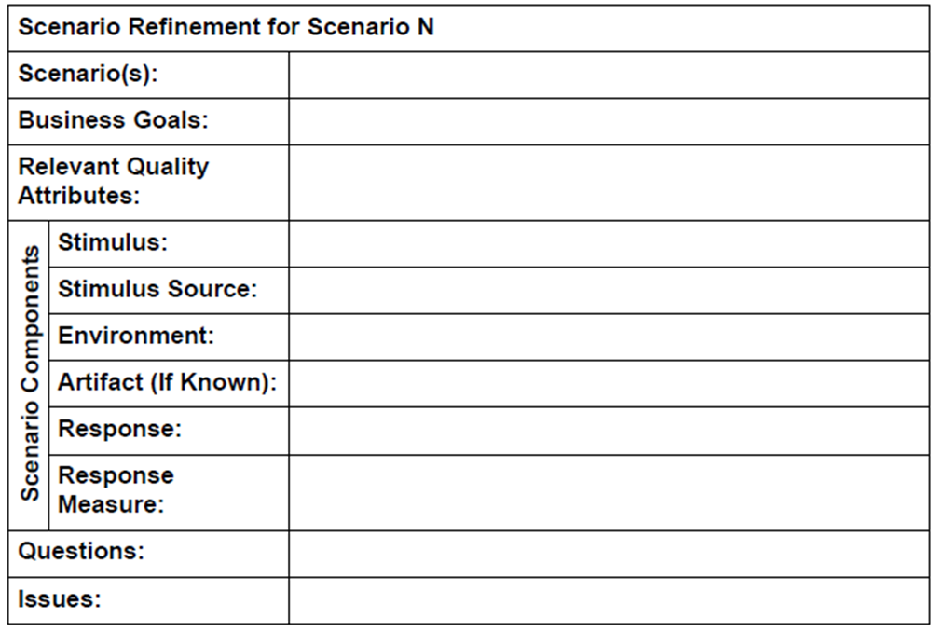
QA Scenario

Slide 28
Output from QAW
a list of architectural drivers
the raw scenarios
the prioritized list of raw scenarios
the refined scenarios

Slide 29
QAW Roles
QAW lead: The lead ensures that the steps of the method are carried out during the workshop.
The lead facilitates discussions, and ensures that the method is carried out in a timely fashion and that the required QAW artifacts are produced.
QAW scribe: The scribe captures the raw scenarios, their prioritization, the refined scenarios, and any relevant issues that emerge during the workshop. The scribe uses the standard
QAW template shown below as a guide during the workshop to ensure that the appropriate information is captured in a consistent manner.

Slide 30
The executive
The executive is trying to achieve business goals
The architecture (and the product) are tools
The executive wants customers satisfied and few repairs because the warranty makes the company liable for the first few years

Slide 31
The architect
The architect wants to keep everyone happy (and quiet).
Wants trade-offs to be explicit and widely communicated
Reduces complexity everywhere including desk and home
Wants input but also wants authority

Slide 32
The developer
The developer wants to make progress quickly, to stay interested
Wants to turn out a quality product that will not need lots of testing and debugging
Wants clear direction so that it can be once and done
Wants to focus on new, interesting design problems, not yet another …

Slide 33
The customer
Our customer is the vehicle purchaser
They want to choose from several models with different features and different price points
After the features, the most important attribute is reliability
They want to be able to customize easily and cheaply.

Slide 34
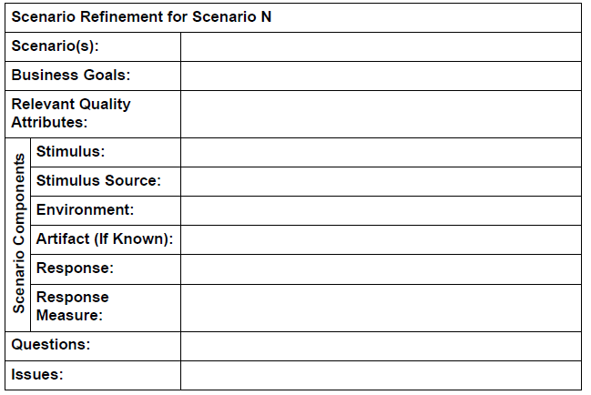
Scenario
Format for a scenario

Slide 35
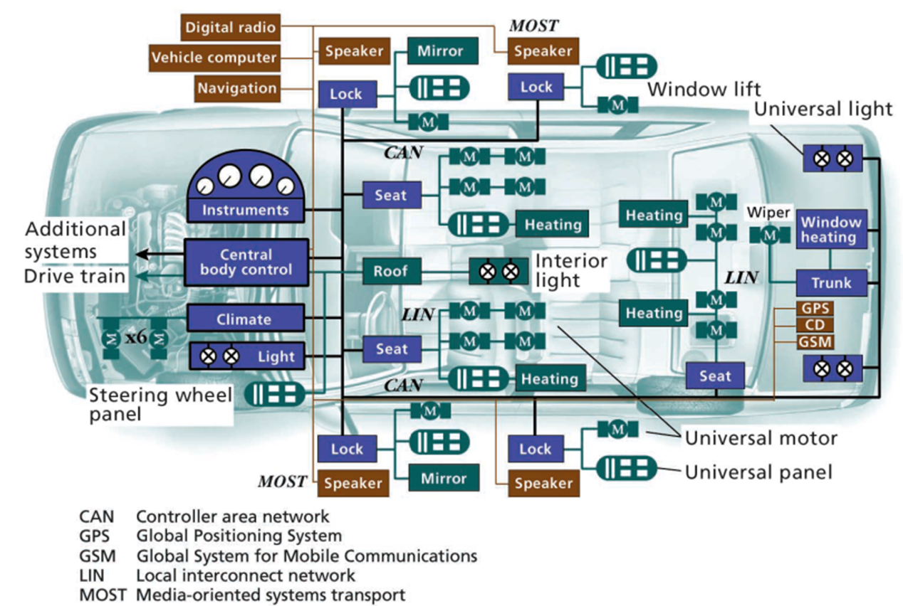

Slide 36
Parking lot

Slide 37
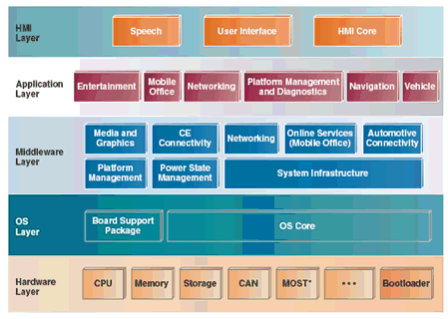
Infotainment architecture

Slide 38
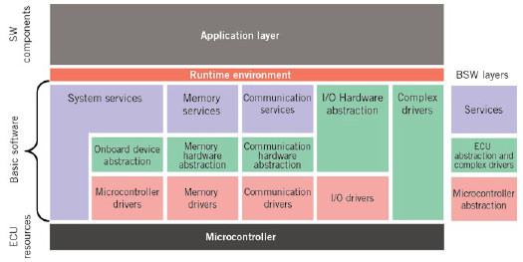

Slide 39
QAW
Lets do this
We will divide into teams of 4 or 5.
Each team member assumes one of the perspectives (user, customer, etc)
By next class:
Find information about your perspective
Create a couple of QA scenarios

Slide 40
We will go through a QAW exercise in the next class where we will
Create additional QA scenarios
Vote on QAs
By Wednesday Feb 7th at 11:59pm
Have a prioritized list of QAs with one sentence about each QA and why it is where it is in the list
A set of scenarios
Submit your work

Slide 42
Next steps
Read about the Quality Attribute Workshop
http://www.sei.cmu.edu/reports/04tn017.pdf
http://www.sei.cmu.edu/reports/03tr016.pdf
http://www.es.mdh.se/pdf_publications/1829.pdf

