Slide 1
Standards
John D. McGregor

Slide 2
But first…
http://www.acq.osd.mil/se/webinars/2009-07-07-SECIE-Safety-in-Software-and-Human-Intensive-Systems-Leveson-brief.pdf

Slide 3
Domain standards
ISO 26262 - Functional Safety – Road Vehicles
IEC 61508 -> ISO 26262
IEC 61508 was not cancelled which means that users of 26262 need to be familiar with 61508

Slide 4
Definitions
Skill is the learned capacity to carry out pre-determined results
Competence is the power to:
manage
make decisions
issue instructions
represent the organization
Qualification is proven by the relevant certificate.

Slide 5
Digression – architecture competence
manage – the architecture and the architecture process
make decisions – architectural decisions
issue instructions – to requirements people and implementation people
represent the organization – to other business units, customers, and the profession

Slide 6
Safety
Safety manager – cooperates with other team members to assure that processes are defined by the appropriate people in a project
Safety assessor – evaluates projects and process definitions from the outside to check for compliance; documents equivalences and exceptions

Slide 7
Requirements of the standard
information related to functional safety is identifiable
  Automotive Safety Integrity Level (ASIL)
Requirements that logically belong together should be arranged closely to one another
Documentation could be formal, semi-formal or informal
Use cases for example are semi-formal

Slide 8
Requirements of the standard - 2
ID – The specific ID number for each requirement is automatically generated by DOORS.
State – The state indicates the maturity of each individual requirement. Rational DOORS enables the maturity level to be chosen from a picklist.
ASIL – The Automotive Safety Integrity Level (ASIL) shows the safety rating of a function, requirement or architectural element. These rating definitions can also be chosen from a picklist.

Slide 9
Standards outline processes

Slide 10
Inter-relationships among items
Boundary of the item and the item's interfaces
Assumptions concerning the effects of the item's behavior on other items or elements
Requirements either received from other items, or elements, or environmental conditions
Requirements on other items, elements and the environment
The allocation and distribution of functions among the systems and elements involved
Operating scenarios for each item, in case they impact the items ́ functionality

Slide 11
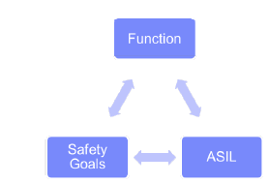
Safety goals
Safety goals can be defined fairly simple. In most cases they are the opposite of a hazard. Let’s assume you drive at night. A sudden loss of all headlights would be hazardous. So, the safety goal may look like this:
  At night the headlights must not go off unintended while driving.

Slide 12
Hierarchical process

Slide 13
Software Systems Engineering
ISO 15026 - System and Software Assurance
“System and software assurance focuses on the management of risk and assurance of safety, security, and dependability within the context of system and software life cycles.”

Slide 14
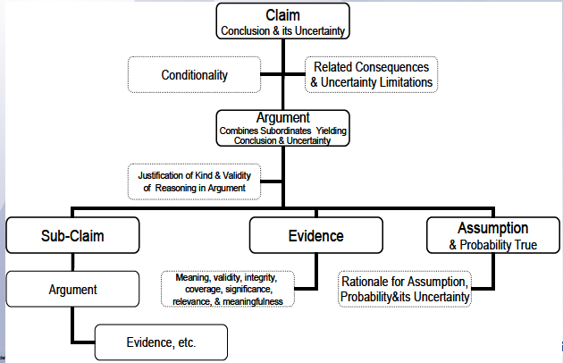
Meta-model

Slide 15
Notations
Goal Structuring Notation (GSN) – University of York
Claims-Argument-Evidence (CAE) – Adelard
Both used most widely in safety assurance

Slide 16
GSN

Slide 17
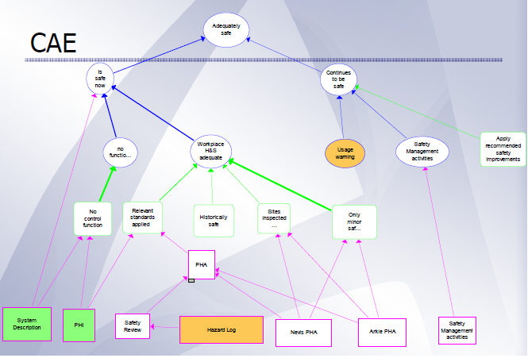
Claims, Argument, and Evidence

Slide 18
Internal standards
In this case at Microsoft
http://apparchguide.codeplex.com/wikipage?title=Chapter%203%20-%20Architecture%20and%20Design%20Guidelines

Slide 19
http://public.dhe.ibm.com/common/ssi/ecm/en/ral14048usen/RAL14048USEN.PDF
http://www.adelard.com/asce/user-group/05-Nov-2008/Standards_update_OMG_15026.pdf
http://ulir.ul.ie/bitstream/handle/10344/3124/Finnegan_2013_process.pdf?sequence=2

Slide 20
DevOps
http://www.slideshare.net/lenbass/design-consequences-of-dev-ops-practices?related=2

Slide 21
Here’s what you are going to do…
Slide 4 introduces architecture competence
Map each of the 4 items to activities we have done in this course. Submit a brief summary.
Redesign your CACC model to fit the constraints of Ocarina. Submit screen prints of the petri net.
Delivered via email by 11:59pm April 8th

