Slide 1

CPSC 875
John D. McGregor
Metrics

Slide 2
Scope/variability
Agile
Safety-critical

Slide 3
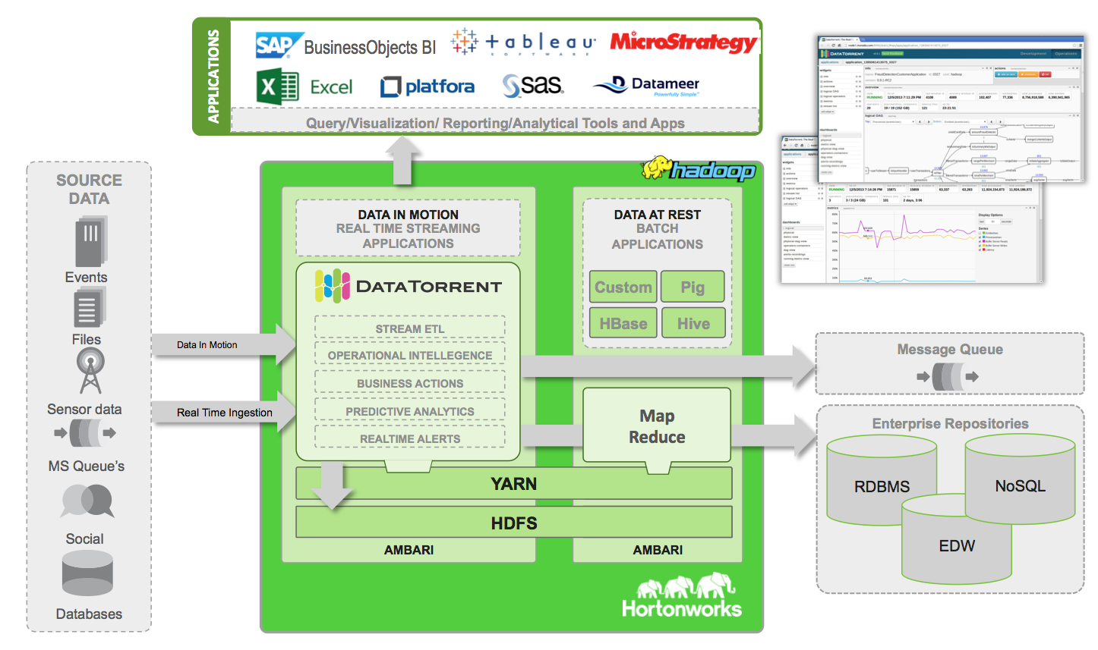

Slide 4
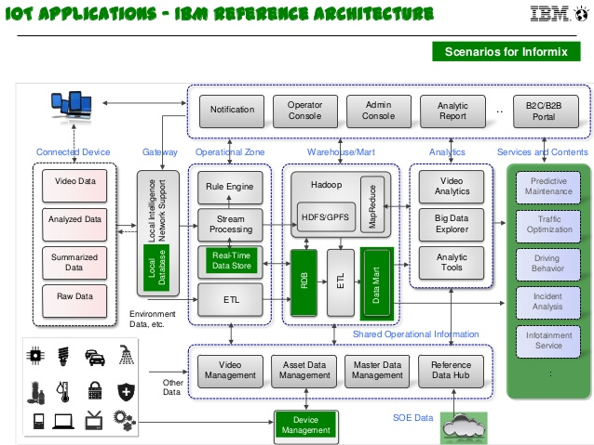

Slide 5
Readings
Stephan Sehestedt, Chih-Hong Cheng, and Eric Bouwers. 2014. Towards quantitative metrics for architecture models. In Proceedings of the WICSA 2014 Companion Volume (WICSA '14 Companion). ACM, New York, NY, USA, , Article 5 , 4 pages. DOI=10.1145/2578128.2578226 http://doi.acm.org/10.1145/2578128.2578226
http://ieeexplore.ieee.org/stamp/stamp.jsp?tp=&arnumber=1509302
http://ieeexplore.ieee.org/stamp/stamp.jsp?tp=&arnumber=5959722
http://www.jaist.ac.jp/~s0820002/presentations/CKMetrics/img4.html

Slide 7
4C’s
1) Completeness of the architecture model
2) Consistency of the architecture model
3) Correctness of the architecture model
4) Clarity of the architecture model

Slide 8
Inputs
Architecture Model
Architecture decisions
Requirements specification

Slide 10
Metrics and Measures
A metric is a procedure for making measurements on a piece of software
GM (Goal – Questions – Metrics) is an approach to defining metrics
Goal: Our reason for wanting the metric
Questions: What questions could we ask to meet the goal?
Metrics: specific procedure to collect the data needed to answer the questions

Slide 11
Goal
To be able to identify portions of the architecture that require more attention
Might be called analyzeability

Slide 12
Questions
What embodies the basic properties of the architecture?
How can these structures be counted in a way that reveals properties?
How do the connections fit into that?

Slide 13
Metrics
What is the size of each module? In terms of (1) requirements covered;
(2) ports in and out;
(3) connections between modules
Count the number of associations between requirements and modules
Average number of requirements per module

Slide 14
Population of systems
One way to look at the average number is to then look at deviation from that average – the standard deviation
Another way to look at it is as an average over a set of products
Take a set of systems from a domain (say scientific computing) and compute the average for each system and then compute the average and SD for that set.

Slide 15
Executability
A metric can be either prescriptive or descriptive
A descriptive metric just provides a value that can be used to place a system in a classification scheme. # of modules can be used to identify small, medium, and large systems
A prescriptive metric can initiate action.
A too big module can be decomposed

Slide 16
What’s too big?
The biggest modules could be decomposed
OR
Sample from many systems and find the “usual” or “average” module size

Slide 17
Rationale
Requirements rationale
An explanation of why something is a requirement
Allows domain knowledgeable architects to question
Design decision rationale
Already used this in the 2 volume documentation

