Slide 1

CPSC 875
John D. McGregor
A product line of safety-critical cyber_physical systems
Notes based on:http://citeseerx.ist.psu.edu/viewdoc/download?
doi=10.1.1.92.2359&rep=rep1&type=pdf

Slide 2
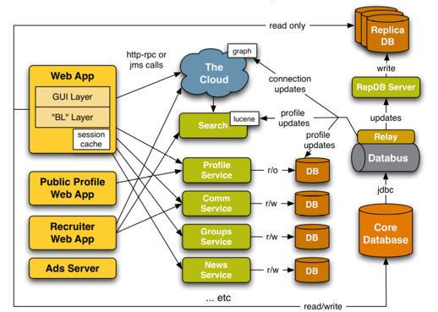

Slide 3
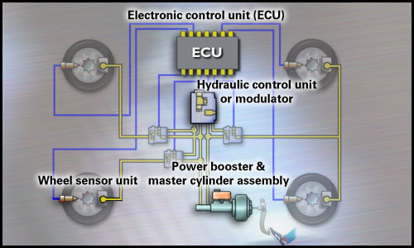
Cyber_Physical
hardware
software
Each copy
slightly different
Each copy exactly
The same
Wears continuously
And gradually
Wears in discrete
steps
http://www.cdxetextbook.com/brakes/brake/abs/abscomponents.html

Slide 4
Product line organization structure
Core asset development
Reference architecture
Asset
implementations
requirements
Feature model
constraints
More constraints
Specific product development
Product architecture
product
Select from the feature tree
Asset composition

Slide 5
Commonality/Variability analysis

Slide 6
risks
High risk variabilities may lead to new requirements
For example, having instances of two variants at the same time is seen as hazardous so insert a new constraint preventing that.

Slide 7
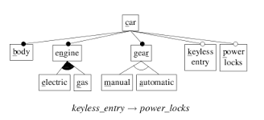
http://en.wikipedia.org/wiki/User:Rafalotufo/Feature_model

Slide 8
Composing assets
a
b
a’
b
A
B
A’
A’’
B’
B’’

Slide 9
Resolute
Reference architecture
Requirement checking
Product architecture
Consistency
Resolute is structural
a
b
Prove a and b are consistent
wrt type, direction, etc.

Slide 10
Safety analysis
Software fault tree analysis
Software Failure Modes, Effects, and Criticality Analysis

Slide 11
software fault tree analysis
http://citeseerx.ist.psu.edu/viewdoc/download?doi=10.1.1.92.2359&rep=rep1&type=pdf

Slide 12
Hazards to failures

Slide 14
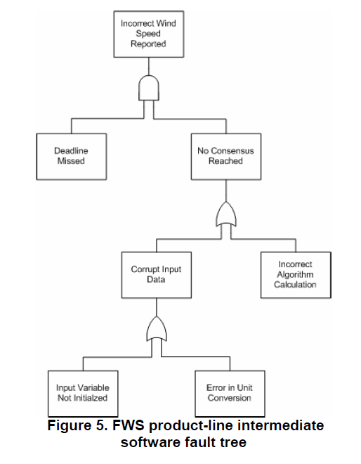
Fault tree

Slide 15
Implement features
Aadl model captures behavior in impl
Agree assume/guarantee in each AADL module
Agree is behavioral
Are the assume/guarantees composable?
Would limit the binding time of the variation
a
b
Is the behavior of a followed by b as expected?

Slide 16
Build application
Select features from feature model
Modules linked to features
Instantiate components from modules
Components must be configured
Check that constraints are satisfied
Proofs naturally integrated?

Slide 17
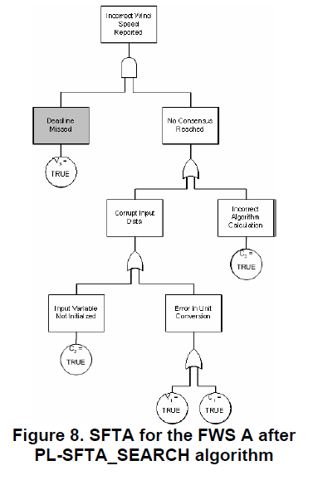
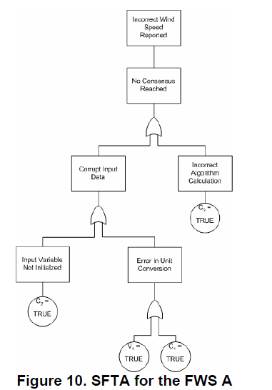
Pruning via asset selection

Slide 18
Here’s what you are going to do…
Take at least 5 of the metrics from the sources we examined.
Use them to take measurements of your architecture.
Write-up the results including what changes should be made to the architecture to make it better.
Submit by 11:59pm April 16th

