Slide 1

CPSC 875
John D. McGregor
Security-2

Slide 2
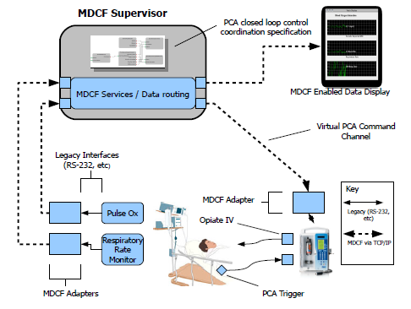
A medical platform

Slide 3
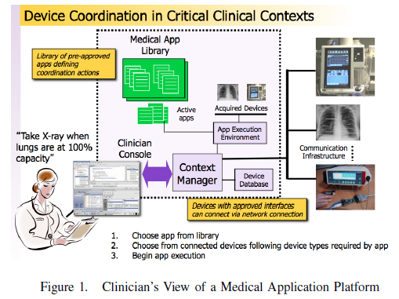
System boundaries

Slide 4
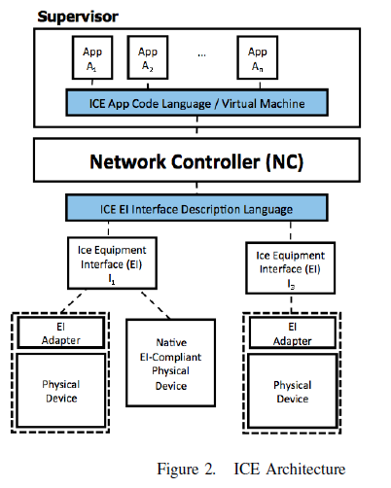
Integrated Clinical Environment

Slide 5
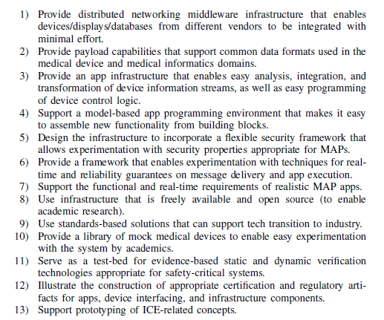

Slide 6
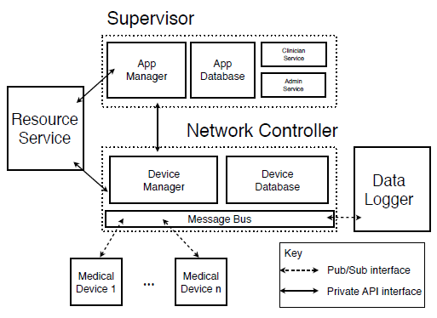
Actual architecture

Slide 7
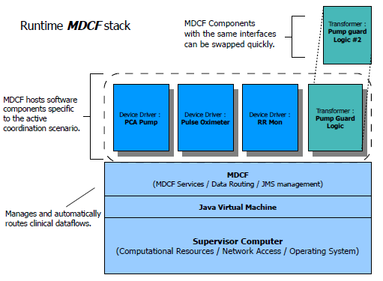
Different view

Slide 8
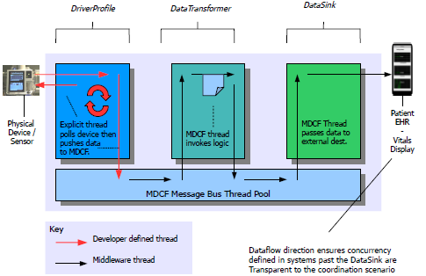
Threads

Slide 9
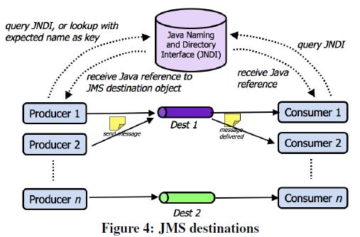
Producer/Consumer with directory

Slide 10
In the context of
Quality attributes must be understood in the context of its use
It is not realistic to expect the same depth of analysis in financial software as in aircraft navigation

Slide 11
With respect to
Even within the same context the quality attribute value may vary from one part of the architecture to another
For example a piece of software may be secure with respect to one type of attack but not with respect to another
Risk and cost are used to factors in deciding the breadth of the verification

Slide 12
As complexity goes up
As complexity goes up so does the probability of a vulnerability being inserted
Security is a system property but has to be addressed at the module level before the complexity gets too great

Slide 13
Security system hierarchy

Slide 14
NEAT criteria
Non-bypassable—security functions cannot be circumvented.
Evaluatable—the size and complexity of the security functions allow them to be verified and evaluated.
Always invoked—security functions are invoked each and every time without exceptions. The reference monitor concept can be used by the system architecture to enforce this for critical applications.
Tamperproof—subversive code cannot alter the function of the security functions by exhausting resources, overrunning buffers, or other forms of making the security software fail.

Slide 15
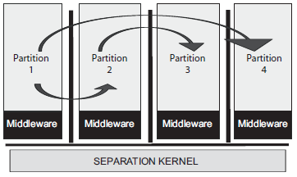
Multiple Independent Levels of Security (MILS) architecture

Slide 16
Levels of security
SLS—Single-Level Secure component; only processes data at one security level
MSLS—Multiple Single-Level Secure component; processes data at multiple levels, but maintains separations between classes of data
MLS—Multi-Level Secure component; processes data at multiple levels simultaneously

Slide 17
Security policies
Data isolation – data is local to a partition
Control of information flow – the source of information from one partition to another is authenticated
Periods processing – no leaking of information from CPU to outside
Fault isolation – no propagation into another partition

Slide 18
Hierarchical control structure
Distractions
Driver (controller)
Ramussen Model
Human Mental Model
CACC (controller)
STPA Model
actuators
sensors
Vehicle speed and acceleration
Weather
conditions
Hazard (Hit vehicle)

Slide 19
Multiple system boundaries
Driver (controller)
CACC (controller)
actuators
sensors
Vehicle speed and acceleration
Hazard (Hit vehicle)

Slide 20
http://psas.scripts.mit.edu/home/wp-content/uploads/2015/03/2015-Procter-Using-STPA-for-RM-in-Interoperable-Medical-Systems.pdf

Slide 21
Here’s what you are going to do…
Put everything together in one neat package. Fix it up based on in-class discussions.
There have been 11 assignments at 1 point a piece. This final turn in will count 14 points.
Submit zip via usual route plus mail an additional copy to johnmc@clemson.edu
Submit by Wednesday, April22 at 11:59pm.

Slide 22
Feedback/control loop
Driver (controller)
CACC (controller)
actuators
sensors
Vehicle speed and acceleration
Hazard (Hit vehicle)

Slide 23
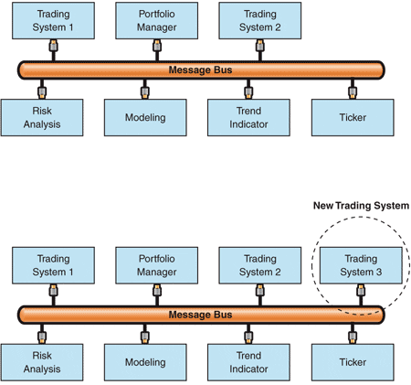
Message Bus

Slide 24
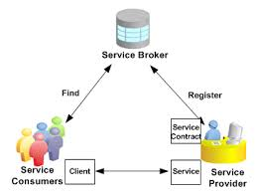
Service Oriented Architecture
https://docs.oracle.com/cd/E18727_01/doc.121/e12064/T291171T509748.htm

Slide 25
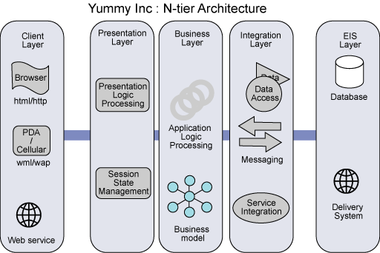
N-tier architecture
http://www.ibm.com/developerworks/rational/library/05/0816_Louis/

Slide 26
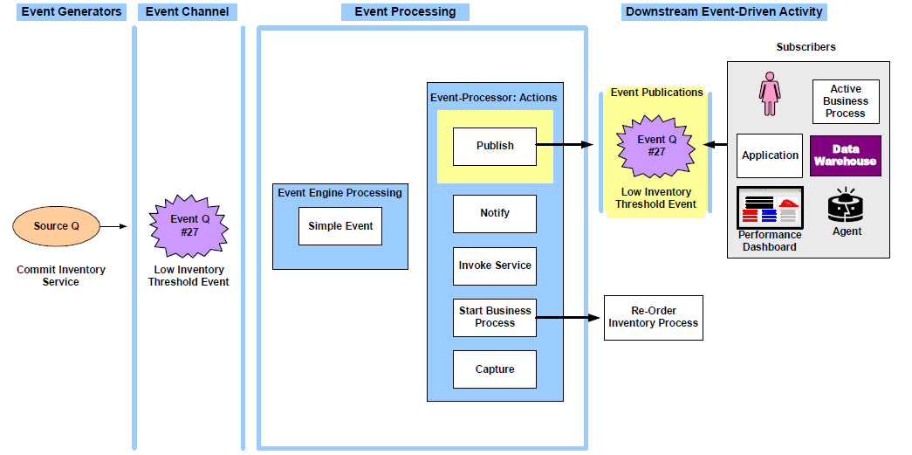
Event-driven

Slide 27
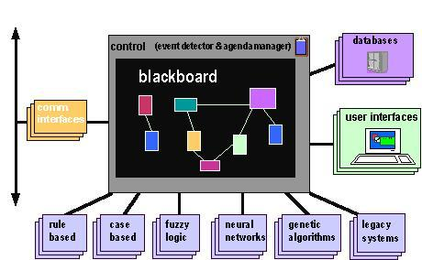
Blackboard
http://mupumb.com/blackboard-architectural-design-pattern/

