Slide 1

CPSC 875
John D. McGregor
Wrap-up

Slide 2
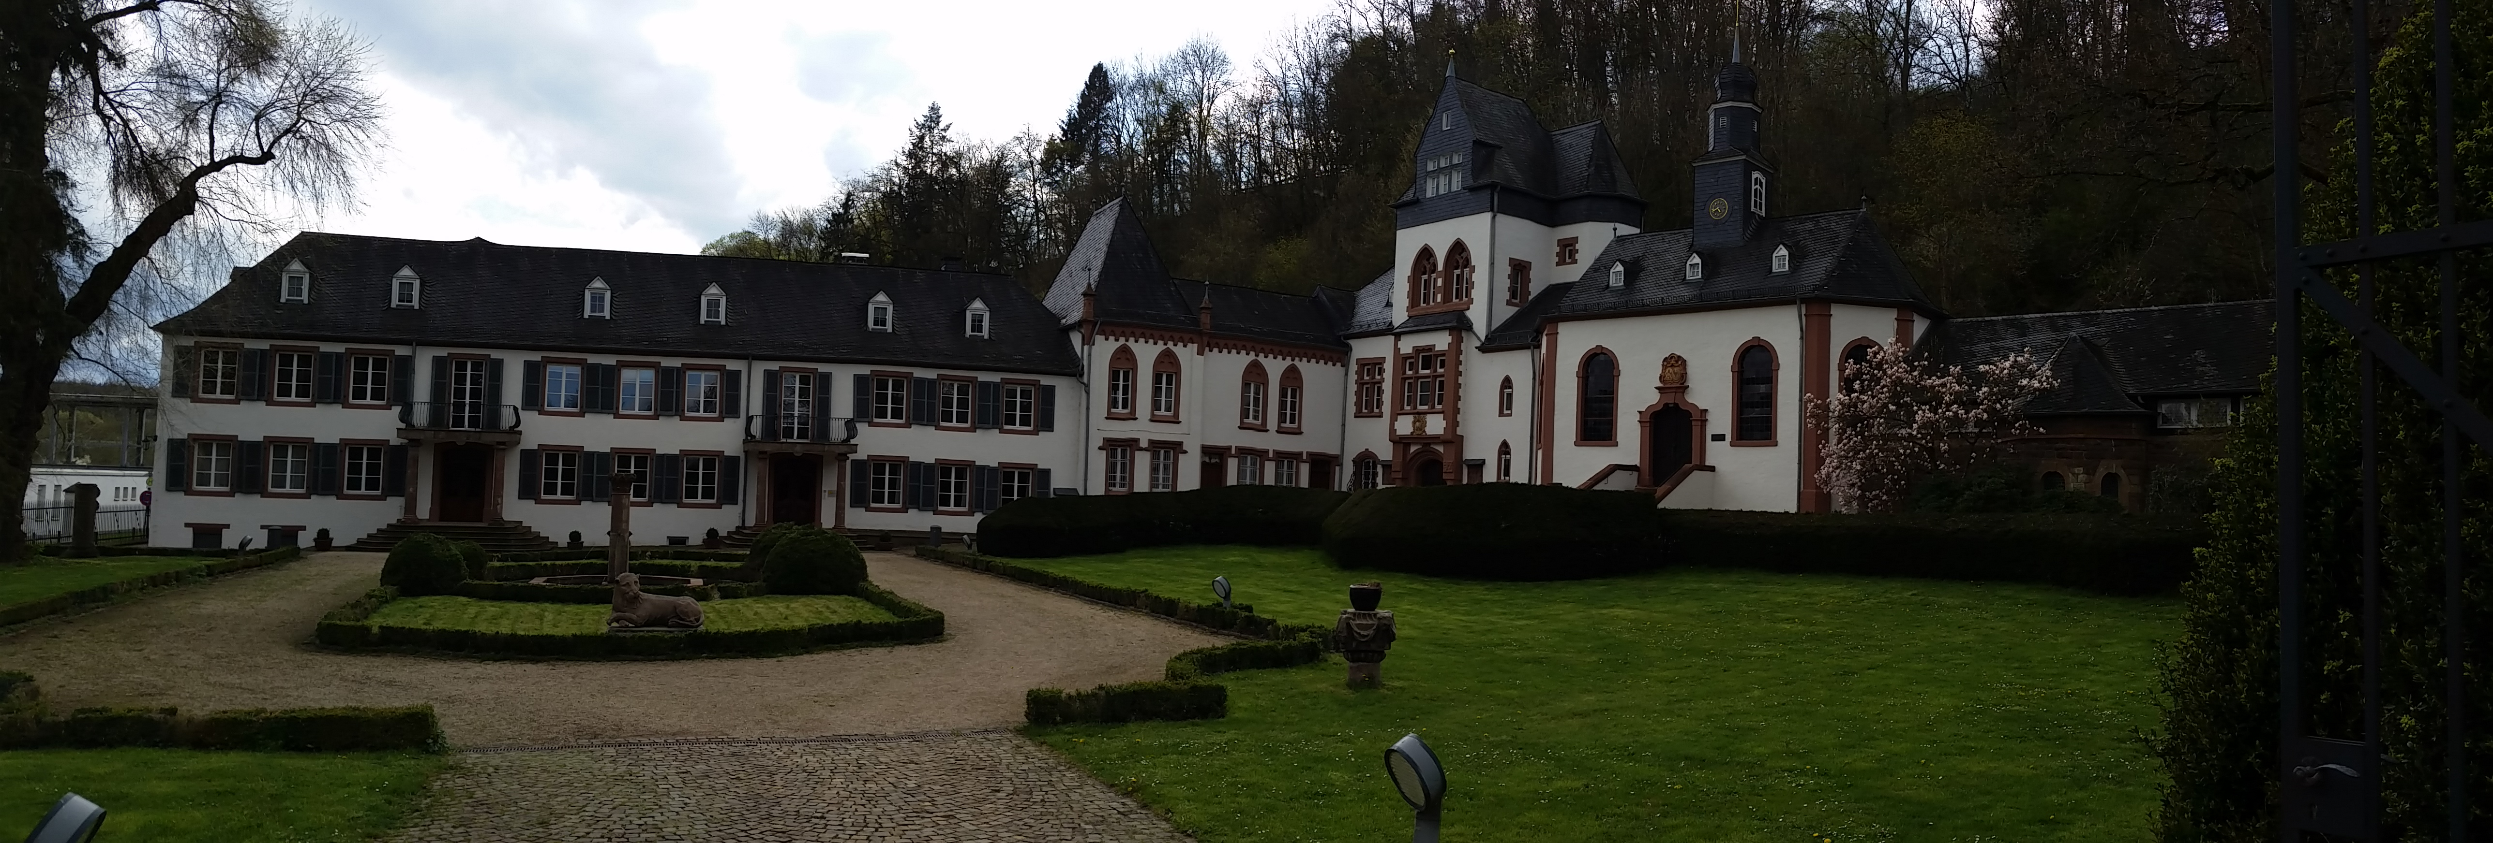

Slide 3
Ultimate goal
Encapsulate uncertainty, risk, and change
We analyze and measure to determine where to form modules or to refactor modules

Slide 4
Architecture definition
The software architecture of a program or computing system is the structure or structures of the system, which comprise software elements, the externally visible properties of those elements, and the relationships among them.
Structure
static
Behavior
Dynamic
Relationships
Flows and connections
constraints

Slide 5
Types of architectures
Software architecture
System architecture
Reference architecture
Enterprise architecture
Logical/physical
Definitional/operational

Slide 6
Activities
Analysis
understanding problems
Design
defining solutions
Verification and validation
Is the product correct?
Is this the correct product?

Slide 7
Requirements
Functional
Non-functional
Rationale
Traceability
Reqspec
Use cases
Scenarios

Slide 8
Reqspec
requirement speed_R1 : "throttle cannot exceed the maximum setting"
[
description this " shall have a maximum reading that is less than or equal to maximum setting"
rationale "fly by wire may introduce an electrical error beyond the physical throttle setting"
value predicate CurrentSpeed < MaximumSpeed
mitigates "Invalid data sent by the speedometer"
issues "need to recognize that physical subsystems can present issues for a digital system"
see goal caccStakeholderGoals.g1
category cc acc cacc
quality safety
uncertainty[
volatility 2
impact 3
]
]

Slide 9
Architecture Description
Cartoons
Languages
Multi-scale
Support analysis
Strongly typed
Environment
OSATE
Performs analysis
Flexible

Slide 10
Process
Specify
Design
Implement
Verify
These phases are inter-related. Which techniques are used in one phase influence what can be used in another phase.

Slide 11
Specification
Start with requirements
Reqspec provides a machine readable model
It has links into the AADL design model
Also, languages such as Agree can be used to both specify and verify
assume "time greater than 0": left_toggle_enabled_at >= 0 and left_button_enabled_at >= 0 and right_button_enabled_at >= 0 and right_toggle_enabled_at >= 0;
guarantee "launch will not occur if either button is not active": launch = false or (launch = true and left_button_enabled = true and right_button_enabled = true);

Slide 12
Quality attribute workshop
Between requirements and design
Prioritizes quality attributes
Quality attribute scenarios
Context
Stakeholder input

Slide 13
State machine
Engine off
CC On
Recalculate
pedal
position
Set current
speed
timerElapsed
Maintain
current speed
Engine on
CC off
initial
resume
engage
apply brake
Inactive
speed set
Resume [setSpeed – currentSpeed< 5mph]/accelerate

Slide 14
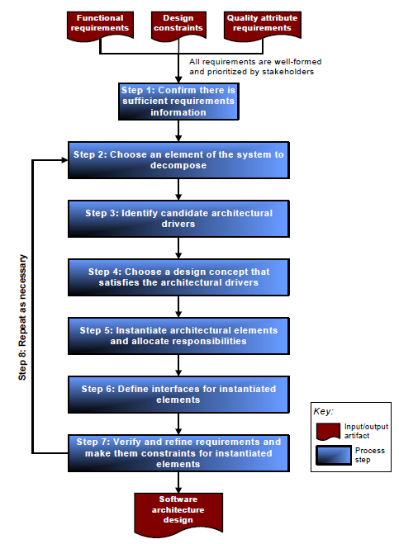
Design Process
Attribute-driven design
Multiple alternatives can
be compared
Consider both definition
and instantiation

Slide 15
Standard structures
Module structures
Which piece is responsible for what
Component and connector structures
How do the major pieces interact at runtime
Allocation structures
Associates pieces of the architecture with pieces of the external environment

Slide 16
Baldwin’s Modularity Operators
Any system
Splitting
Substitution
Assumes a modular system
Augmenting
Excluding
Inversion
Porting

Slide 17
Design, implementation and verification
We used AADL partially because there is a modular, evolving environment
An analyzable model scales well.
Multi-scale models allow teams to work asynchronously much of the time
xText provides the ability to define languages such as Reqspec, Verify, and Assure

Slide 18
Variation
The goal of variability in a software product line is to maximize return on investment (ROI) for building and maintaining products over a specified period of time or number of products.
An instance of the architecture resolves certain variations
Mechanisms
One system definition extends another
A system definition is included or excluded
Subprograms have parameters

Slide 19
Documentation
Views and Beyond
Viewpoint
View
ViewPacket
Views for all stakeholders
Portions of the AADL model can eliminate the need for lots of text in the technical parts of the document

Slide 20
Verification
Resolute can verify that specified structure is present
It is linked to the Verify activities
annex Resolute {**prove(instantiation_is_reachable(this, instances(EventHandler::button_event_thread)))**};

Slide 21
Safety analysis
Look for hazards
Emerging from associated hardware
Propagated from upstream modules
Mitigate hazards
Manage flow (propagation)
Define error handlers

Slide 22
Safety and security
“System and software assurance focuses on the management of risk and assurance of safety, security, and dependability within the context of system and software life cycles.”
Assured by checking explicitly how hazards are being handled.
Reuse of error design information such as the hazards in the feedback control loop

Slide 23
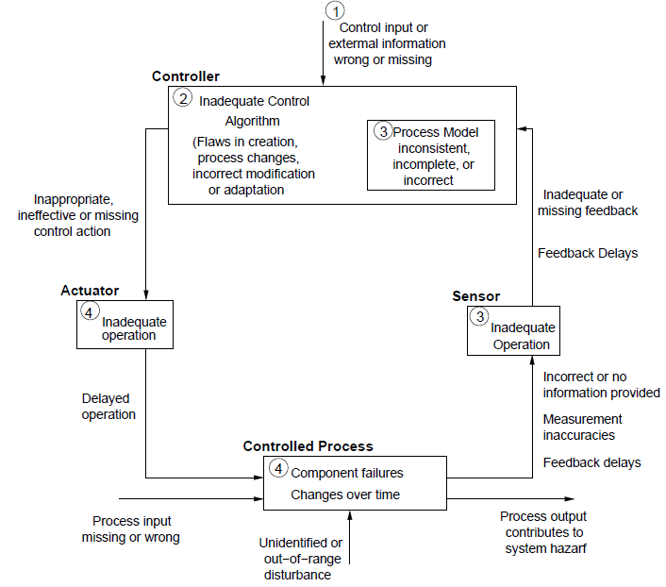
http://ocw.mit.edu/courses/aeronautics-and-astronautics/16-63j-system-safety-fall-2012/
lecture-notes/MIT16_63JF12_Class10STPA.pdf

Slide 24
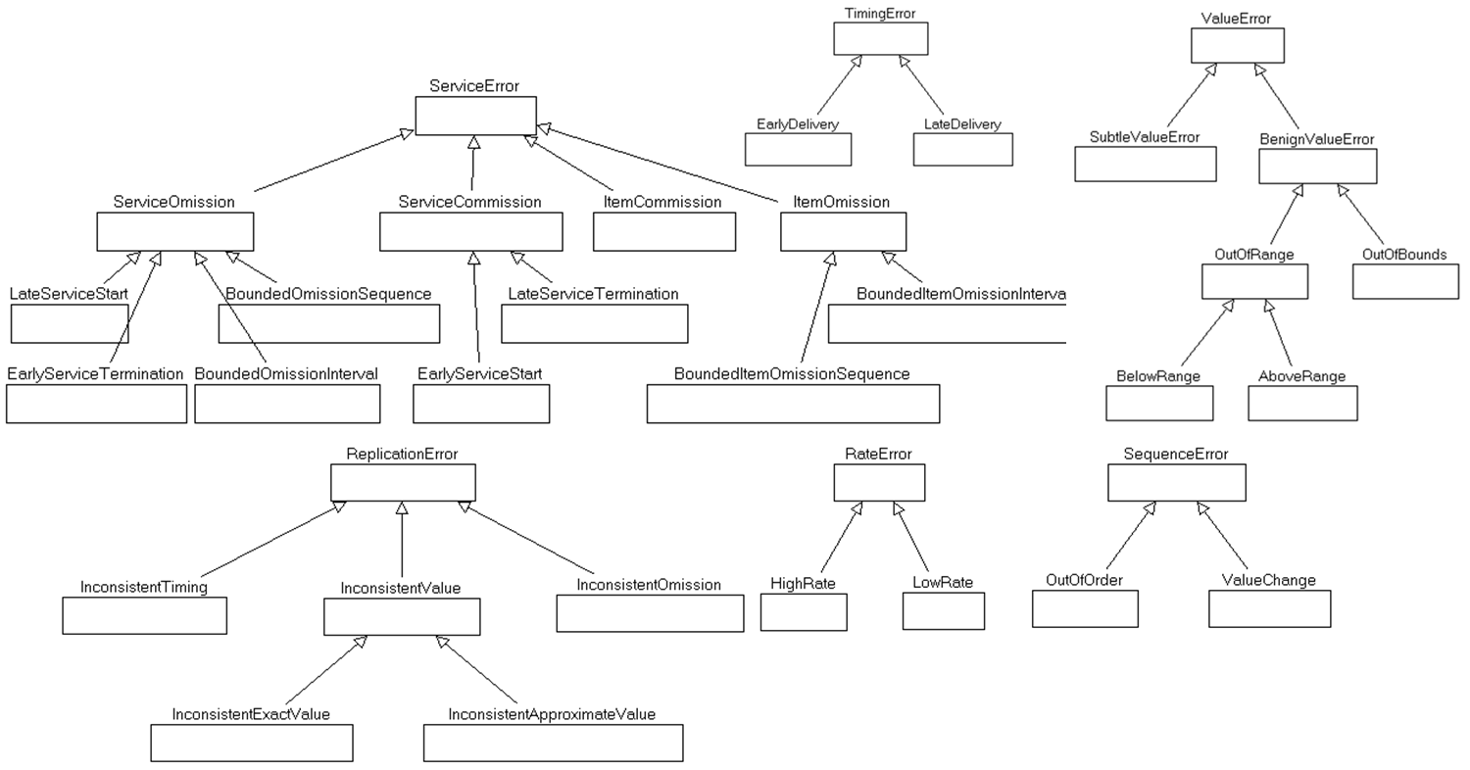
Error ontology

Slide 25
Security
Security is the capability of a system to prevent malicious or accidental actions outside of the designed usage, and to prevent disclosure or loss of information. A secure system aims to protect assets and prevent unauthorized modification of information.
Confidentiality
Integrity
Availability

Slide 26
Security
Size of attack surface

Slide 27
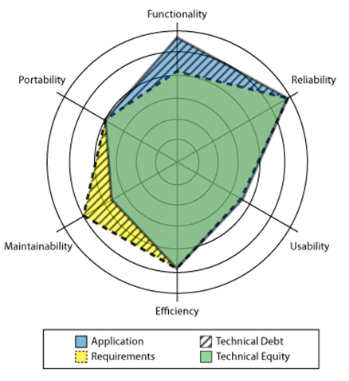
Technical debt
The amount of less than perfect development artfacts grows if not
explicitly addressed. Particularly in situations where certain quality
requirements is difficult to meet techical debt can have a huge impact.

Slide 28
ISO 26262 - Functional Safety – Road Vehicles
IEC 61508 -> ISO 26262
IEC 61508 was not cancelled which means that users of 26262 need to be familiar with 61508

Slide 29
Some architecture styles

Slide 30
Feedback/control loop – cyber-physical systems
Driver (controller)
CACC (controller)
actuators
sensors
Vehicle speed and acceleration
Hazard (Hit vehicle)

Slide 31
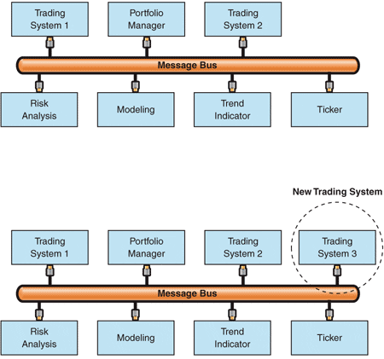
Message Bus-data production systems

Slide 32
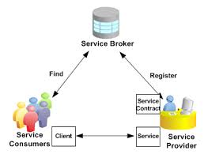
Service Oriented Architecture – looselly coupled systems
https://docs.oracle.com/cd/E18727_01/doc.121/e12064/T291171T509748.htm

Slide 33
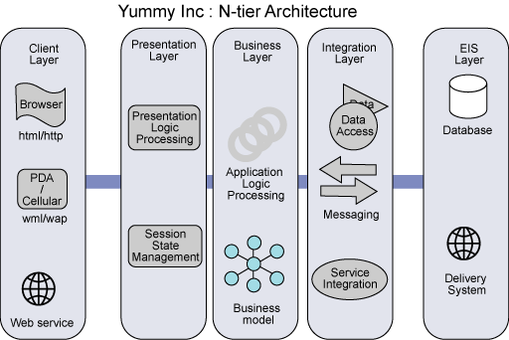
N-tier architecture-distributed systems
http://www.ibm.com/developerworks/rational/library/05/0816_Louis/

Slide 34
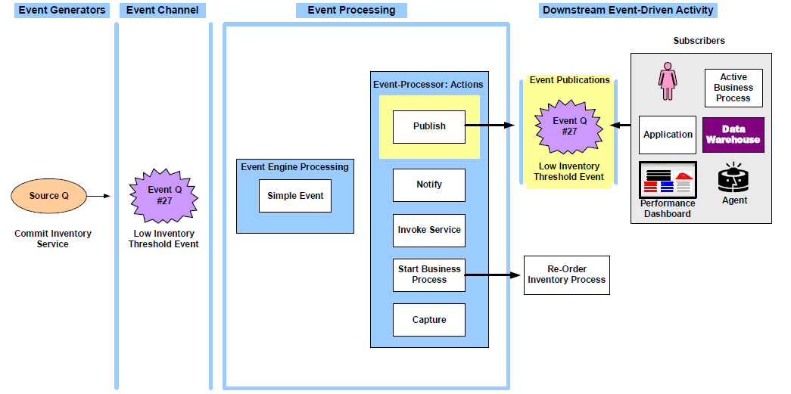
Event-driven – when events are sporadic

Slide 35
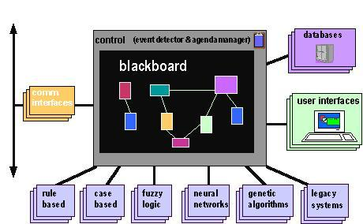
Blackboard – planning or design systems
http://mupumb.com/blackboard-architectural-design-pattern/

Slide 36
Integrating
Using basic tactics and operators, these basic styles are combined to form architectures
AGREE contracts are checked for alignment
Resolute constraints are evaluated to ensure
Error propagations are checked for continuity

Slide 37
The end
I hope this semester has helped you to better understand the issues about and the methods for structuring software-intensive systems.
Watch for existing architectures that we did not have time to discuss and for new structures emerging in new types of systems.

