Slide 1

CPSC 8750
John D. McGregor
Design Concept
C5

Slide 2
Reference architecture

Slide 3
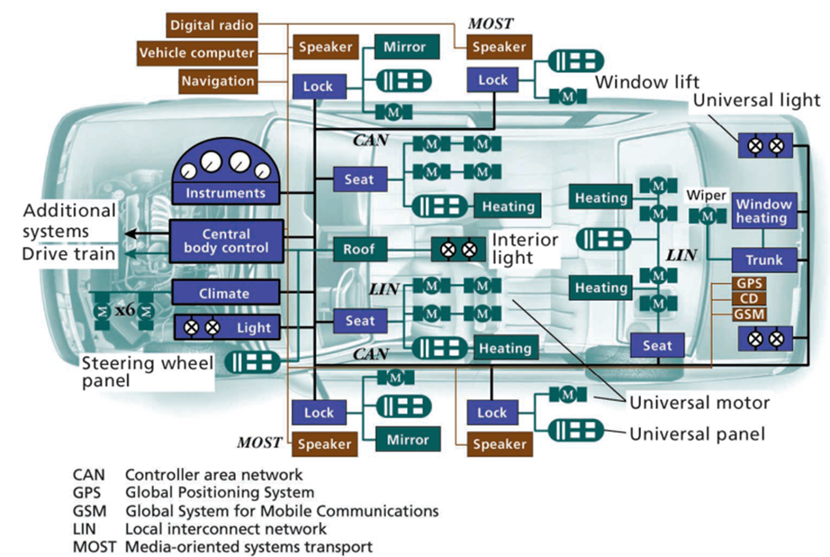

Slide 4
Logical/Physical
Separate processes
Separate hardware
Usually have multiple processes on single hardware element
Seldom have single process on multiple hardware
Start at the logical level
Then conform to physical deployment environment

Slide 5
Static/Dynamic
Structures\component definitions are static
Component instances are dynamic
Flow definitions are static
Flow instances are dynamic
Modularity is a property of the static
Latency is a property of the dynamic

Slide 6
Utility tree
http://arnon.me/2012/04/utility-trees-quality-attributes/
A utility tree lists a set of prioritized quality attributes, scenarios about each quality attribute, and a rating for the risk and criticality

Slide 7
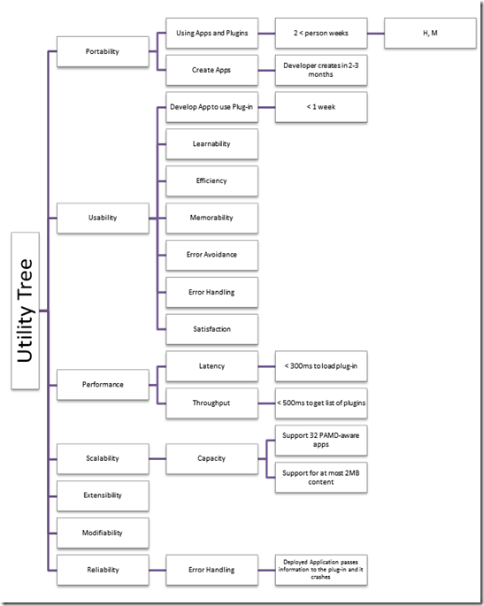

Slide 8
Specifications and Interfaces
A specification determines what a module can do but nothing about how it does it.
a detailed precise presentation of something or of a plan or proposal for something —usually used in plural

Slide 9
Software specifications
Usually uses data types as the basic vocabulary
Defines operations in terms related to the domain

Slide 10

A wave is the interface of ocean, land, air, and sunlight.

Slide 11
Interfaces
An interface is a boundary across which two independent entities meet and interact or communicate with each other.
After all, they are not simply the final layer of, say, a piece of metal or liquid in contact with air, but an exceedingly thin region with properties distinct from those of the bulk material on either side. “
As waves reach the shore, the energy in front of the wave slows down due to friction with the shallow bottom.

Slide 12
Principles
All elements have interfaces.
An element’s interface contains view-specific information.
Interfaces are two way.

Slide 13
Signatures
A signature deals with the syntactic part of documenting an interface. When an interface’s resources are invokable procedures, each comes with a signature that names the procedure and defines its parameters.

Slide 14
APIs
An API, or application programming interface, is a vaguely defined term that people use in various ways to convey interface information about an element.
Usually used to refer to a set of signatures

Slide 15
Interface specification
An interface specification is a statement of what an architect chooses to make known about an element in order for other entities to interact or communicate with it.

Slide 16
Element Interface Specification
Section 1. Interface identity
Section 2 Resources provided
Section a. Resource syntax
Section b. Resource semantics
Section c. Resource usage restrictions
Section 3. Locally defined data types
Section 4. Error handling
Section 5. Variability provided
Section 6. Quality attribute characteristics
Section 7. What the element requires
Section 8. Rationale and design issues
Section 9. Usage guide

Slide 17
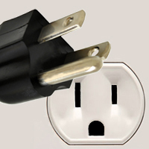
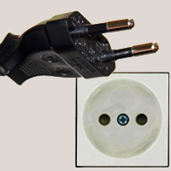
Standard Interfaces
Agreement on voltages, pin configurations, grounded or not…

Slide 18
thread receiver
features
inp: in data port int;
flows
fsink: flow sink inp ;
properties
Latency => 2ms..3ms applies to fsink;
Dispatch_Protocol => Periodic;
Period => 50 ms;
Deadline => 10ms; -- The deadline less than the flow spec latency is the latency contribution if schedulable.
Compute_Execution_Time => 3 ms .. 7 ms;
end receiver;

Slide 19
process psender
features
outp: out data port int;
flows
fsource: flow source outp;
end psender;
process implementation psender.i
subcomponents
task1: thread sender;
connections
c1: port task1.outp -> outp;
flows
fsource : flow source task1.fsource -> c1 -> outp;
end psender.i;

Slide 20
processor core
end core;
processor implementation core.i
end core.i;
system multi_core
end multi_core;
system implementation multi_core.dual
subcomponents
cores : processor core.i[2];
end multi_core.dual;

Slide 21
system implementation multi_core.quad
subcomponents
cores : processor core.i[4];
end multi_core.quad;
thread task
features
pin : in event port;
pout : out event port;
end task;
thread implementation task.i
end task.i;

Slide 22
process partition
features
pin : in event port;
pout : out event port;
end partition;
process implementation partition.i
subcomponents
thr : thread task.i;
connections
c0 : port pin -> thr.pin;
c1 : port thr.pout -> pout;
modes
normal : initial mode;
redundant : mode;
end partition.i;

Slide 23
system main
end main;
system implementation main.normal
subcomponents
partitions : process partition.i[2];
cpu : system multi_core.dual;
connections
c0 : port partitions.pout -> partitions.pin;
properties
Allowed_Processor_Binding => (reference (cpu.cores[1])) applies to partitions[1];
Allowed_Processor_Binding => (reference (cpu.cores[2])) applies to partitions[2];
end main.normal;

Slide 24
system implementation main.redundant
subcomponents
partitions : process partition.i[2];
cpu : system multi_core.dual;
modes
normal : initial mode;
redundant : mode;
properties
Allowed_Processor_Binding => (reference (cpu.cores[1]), reference (cpu.cores[2])) applies to partitions[1];
Allowed_Processor_Binding => (reference (cpu.cores[1]), reference (cpu.cores[3])) applies to partitions[2];
Actual_Processor_Binding => (reference (cpu.cores[1])) in modes (normal) applies to partitions[1];
Actual_Processor_Binding => (reference (cpu.cores[2])) in modes (redundant) applies to partitions[1];
Actual_Processor_Binding => (reference (cpu.cores[3])) in modes (normal) applies to partitions[2];
Actual_Processor_Binding => (reference (cpu.cores[4])) in modes (redundant) applies to partitions[2];
end main.redundant;

Slide 25
https://resources.sei.cmu.edu/library/asset-view.cfm?assetid=5939

Slide 26
aadl tutorial
http://aadltutorial.com/introduction-to-aadl-and-osate
http://www.openaadl.org/post/2013/04/15/aadl-tutorial/
rtg.cis.upenn.edu/hasten/hces04/AADL%20ARO2.ppt

Slide 27
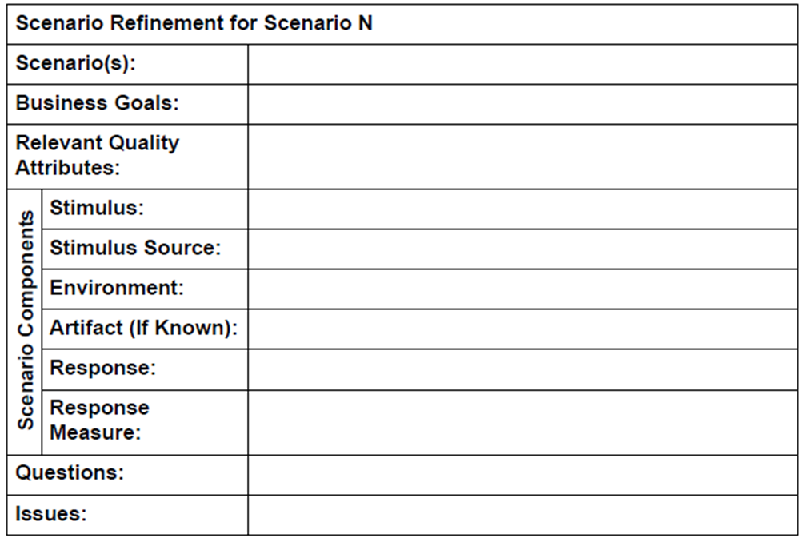
QA Workshop

Slide 28
IEEE Std. 1061 subfactors: Efficiency Portability • Time economy • Hardware independence • Resource economy • Software independence Functionality • Installability • Completeness • Reusability • Correctness Reliability • Security • Non-deficiency • Compatibility • Error tolerance • Interoperability • Availability Maintainability Usability • Correctability • Understandability • Expandability • Ease of learning • Testability • Operability • Comunicativeness

Slide 29
Here is what you are going to do
Identify a domain on which you would like your project to be based
Search out reference architectures for that domain
Build an AADL model of one of those architectures
Include all constraints
Submit your team’s work by 11:59 pm, Feb 6th.

