Slide 1

CPSC 8750
John D. McGregor
Design Concept
C5

Slide 2
Reference architecture

Slide 3
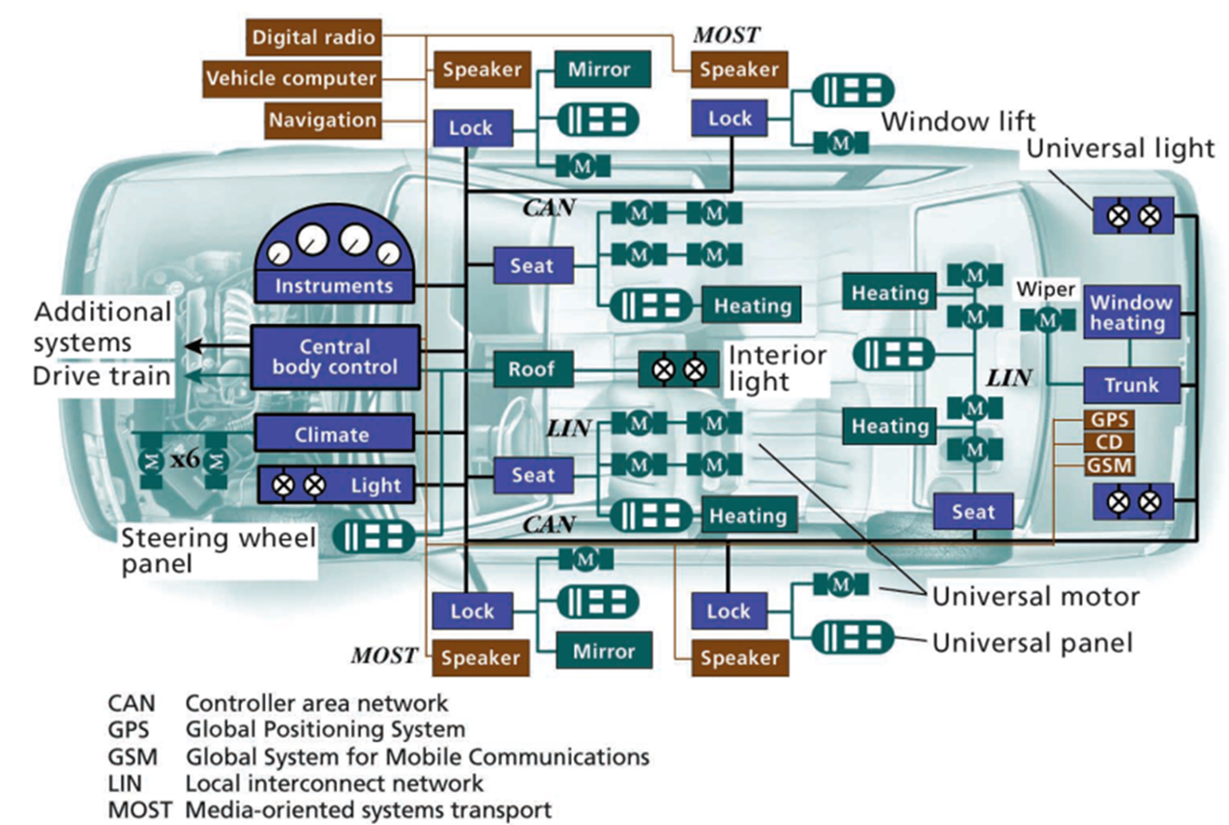

Slide 4
Logical/Physical
Separate processes
Separate hardware
Usually have multiple processes on single hardware element
Seldom have single process on multiple hardware
Start at the logical level
Then conform to physical deployment environment

Slide 5
Static/Dynamic
Structures\component definitions are static
Component instances are dynamic
Flow definitions are static
Flow instances are dynamic
Modularity is a property of the static
Latency is a property of the dynamic

Slide 6
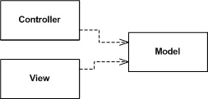
Interactive computing
Separates the data model from the means of viewing it
Interaction is handled by the controller(s)
Data is presented in the view(s)
Multiple views can register with the model. The model does not know how many views are registered.
There is one or more controllers associated with each view.
http://martinfowler.com/eaaDev/uiArchs.html

Slide 7
Model-View-Controller
http://developer.apple.com/library/mac/#documentation/General/Conceptual/DevPedia-CocoaCore/MVC.html
http://www.dossier-andreas.net/software_architecture/mvc.html
As anti-pattern
  http://broadcast.oreilly.com/2008/10/mvc-as-anti-pattern.html
Controller
View
Model

Slide 8
Next level
Decompose View
Functional decomposition
Controller
Controller
Controller
Controller
Data Editor
Model
View
Model
System menu
Properties editor

Slide 9
Controller
Controller
Controller
Data Editor
Model
System menu
Properties editor
Controller
Controller
Controller
Controller
Data Editor
System Model
System menu
Editor Model
Properties editor

Slide 10
Controller
Controller
Controller
Controller
Data Editor
System Model
System menu
Editor Model
Properties editor
Controller
Controller
Controller
Controller
Data Editor
System Model
DataBase
System menu
Editor Model
Properties editor

Slide 11
What are the essentials?
Separation of data from presentation
  Have multiple views
Separation of control from presentation
  Have multiple controllers
Attributes
  Extensible

Slide 12
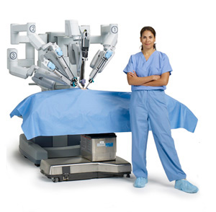
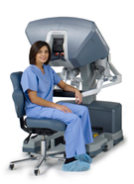
Master/Slave
http://hudson-ci.org/docs/HudsonArch-Execution.pdf

Slide 13
Master drives the system
Master
Slave

Slide 14
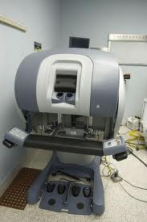
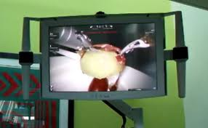
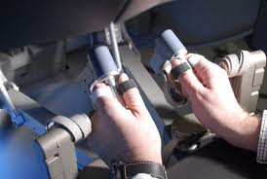

MVC

Slide 15
Master
Slave
Controller
View
Model

Slide 17
Model-View-Controller
http://developer.apple.com/library/mac/#documentation/General/Conceptual/DevPedia-CocoaCore/MVC.html
http://www.dossier-andreas.net/software_architecture/mvc.html
As anti-pattern
  http://broadcast.oreilly.com/2008/10/mvc-as-anti-pattern.html

Slide 18
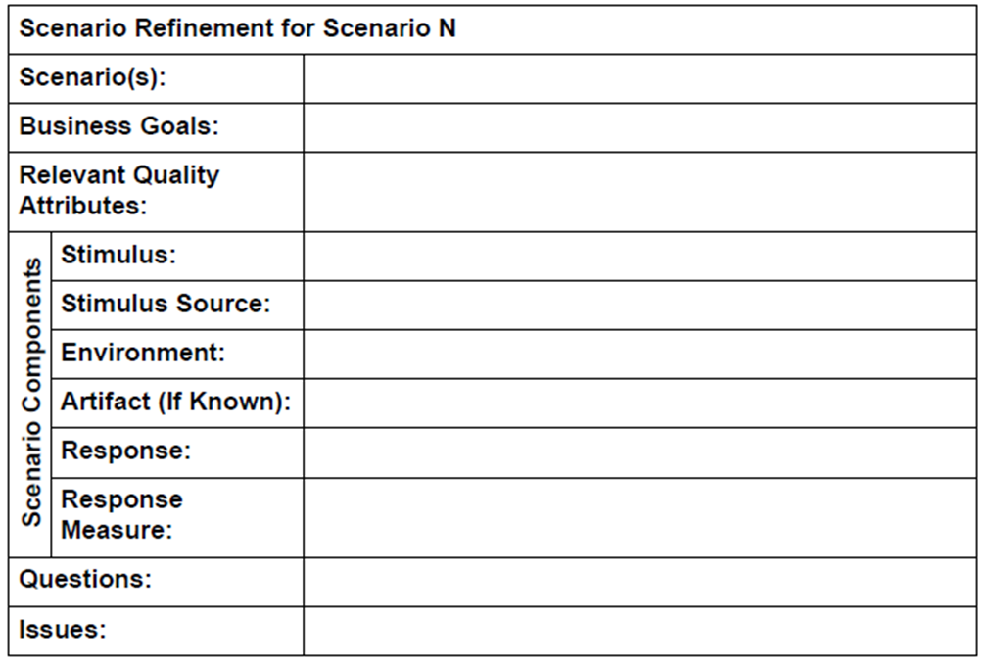
QA Workshop

Slide 19
IEEE Std. 1061 subfactors:
Efficiency Portability
• Time economy • Hardware independence
• Resource economy • Software independence
Functionality • Installability
• Completeness • Reusability
• Correctness Reliability
• Security • Non-deficiency
• Compatibility • Error tolerance
• Interoperability • Availability
Maintainability Usability
• Correctability • Understandability
• Expandability • Ease of learning
• Testability • Operability
• Comunicativeness

Slide 20
Utility tree
http://arnon.me/2012/04/utility-trees-quality-attributes/
A utility tree lists a set of prioritized quality attributes, scenarios about each quality attribute, and a rating for the risk and criticality

Slide 21
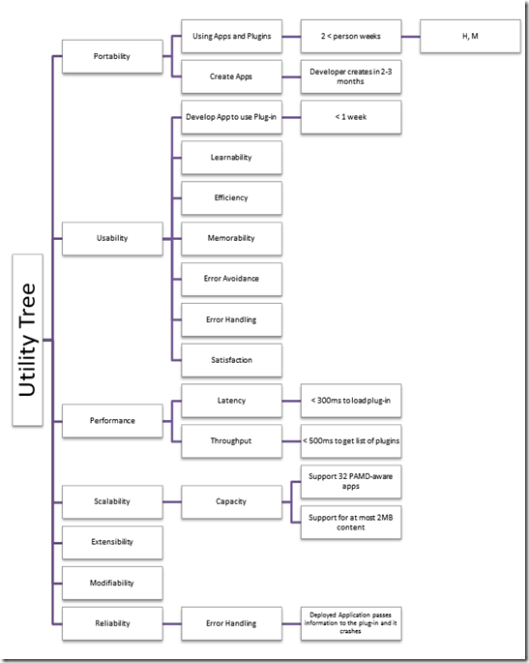

Slide 22
aadl tutorial
http://aadltutorial.com/introduction-to-aadl-and-osate
http://www.openaadl.org/post/2013/04/15/aadl-tutorial/
rtg.cis.upenn.edu/hasten/hces04/AADL%20ARO2.ppt

Slide 23
Here is what you are going to do
Identify the style associated with your system
Identify a reference architecture for your system
Draw a utility tree for your system
Use AADL to express the fundamentals of the style and reference architecture
Submit project by 11:59 pm, Feb 12th.

