Slide 1

CPSC 875
John D. McGregor
Cyber-physical systems
Class 7

Slide 2
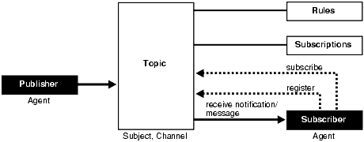
Publish/Subscribe
https://docs.oracle.com/cd/E11882_01/appdev.112/e41502/adfns_publish.htm#ADFNS014

Slide 3
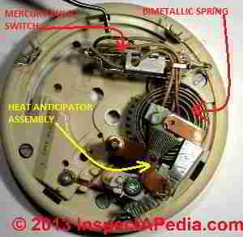

Analog thermostat
Metal coil changes shape as temperature changes
This tilts a vial of mercury to make contact
Heat expands metal
continuously.

Slide 4
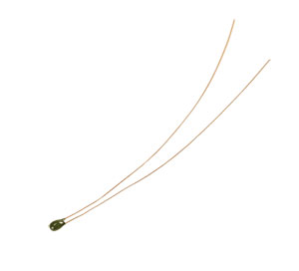
Digital thermostat
A thermistor is a resistor with variable resistance depending on the temperature
Requires power, more sensitive
Flow of electricity turns on heat
Response curve is so steep
it is nearly continuous
Heat changes resistance
So rapidly it seems discrete.

Slide 5
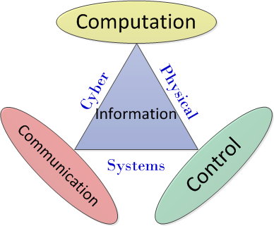
Cyber-physical systems
Physical and cyber systems come together
Continuous vs discrete
Continuous is simulated by periodic sampling and approximations

Slide 6
Generic feedback loop
disturbance
set point
Control
actuators
sensors
Process

Slide 7
Pacemaker
interference,…
Set mode
Determine rhythm
pulse
Beat sensor
Heart

Slide 8
Overrun/underrun
Choose frequency and magnitude of Pulse
If sampling misses a beat, may pulse too soon
If sampling reads in between beats the software may deduce the wrong magnitude

Slide 9
Feedforward control
disturbance
Set point
Control
Feedforward
actuators
sensors
Process

Slide 10
feedforward
Uses information that seems to obviously point to a decision
Autonomous vehicle approaches another vehicle from the rear
The fact that the vehicle is getting closer says “slow down”
That is fed forward to the actuators while the main feedback loop determines how much to slow down

Slide 11
Adaptive cruise control
disturbance
Set point
Control engine
Feedforward
Throttle/brake
Speedometer/radar
engine

Slide 12
Architecture refinement
disturbance
Set point
Control engine
Merge
planner
Lane
selector
fusion
Feedforward
Distance keeper
Throttle/brake
Speedometer/radar
engine
https://www.ri.cmu.edu/pub_files/2009/6/IV09_Final.pdf

Slide 13
Infusion pump
http://rtg.cis.upenn.edu/gip.php3

Slide 14
Model structure
Look at the isolette model
Modules - combined nominal and error
Cross-module - data definitions, properties

Slide 15
Isolette
An isolette is a “box” into which a newborn baby is placed when it needs a controlled temperature.
The nurse sets the desired temperature. The box turns on a heater if the temperature is below that value otherwise it does nothing. Periodically a sensor measures the temperature in the isolette and feeds that to the controller. The controller turns on the heat, turns off the heat, or does nothing as is appropriate.
https://github.com/osate/examples/blob/master/isolette/project/isolette/isolette.aadl

Slide 16
process receiver
features
inevent : in event port;
modes
nominal : initial mode;
recovery: mode;
end receiver;
process implementation receiver.i
subcomponents
thr1 : thread thr_receiver.i in modes (nominal,recovery);
thr2: thread thr_receiver.i in modes (recovery);
internal features
triggerrecovery: event;
triggernormal: event;
connections
c1 : port inevent -> thr1.inevent;
c2 : port inevent -> thr2.inevent;
modes
nominal-[triggerrecovery]->recovery;
recovery-[triggernormal]->nominal;
end receiver.i;
Modes

Slide 17
Properties
property set Iso_Properties is
with Isolette, --AADL components that use the properties herein
Physical_Properties, --AADL property types
EMV2, --error modeling annex V2 predeclared properties
Timing_Properties;
Initialization_Timeout : Timing_Properties::Time => 1 sec
applies to (all);
InterfaceFailureRate : constant EMV2::DistributionSpecification =>
[ProbabilityValue => 1.0E-7; Distribution => Fixed;];

Slide 18
Error modeling

Slide 19
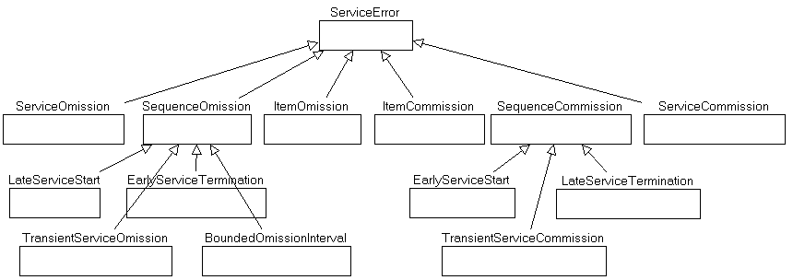
Error ontology

Slide 20
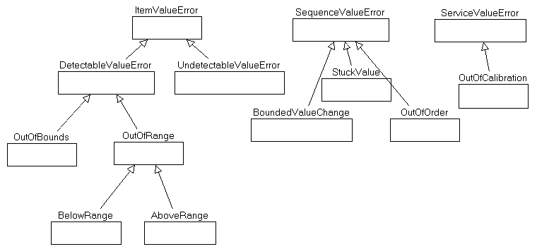
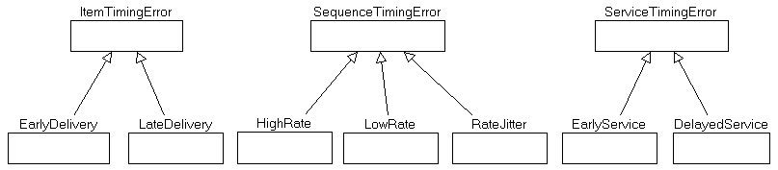
Error Ontology

Slide 21
Error annex
device detect_regulator_failure
features
internal_failure : out data port Base_Types::Boolean;
annex EMV2
{**
use types ErrorLibrary;
use behavior isolette::FailStop;
error propagations
internal_failure: out propagation {ServiceOmission};
flows --model error in detection and reporting
inf: error source internal_failure{ServiceOmission};
end propagations;
properties --set occurrence of detection failure
EMV2::OccurrenceDistribution => Iso_Properties::DetectionRegulatorFailureRate
applies to inf;
--set failure rate for regulator
EMV2::OccurrenceDistribution => Iso_Properties::RegulatorFailureRate
applies to fail;
**};

Slide 22
Data definitions
data monitor_mode
properties
Data_Model::Data_Representation => Enum;
Data_Model::Enumerators => ("INIT","NORMAL","FAILED");
end monitor_mode;

Slide 23
Multiple Instances of multiple architectures
Specifications
Implementations

Slide 24
Architecture refinement
Start with high-level/abstract
  shipment
Add detail – features and attributes
  Air freight shipment
  One-day, Priority, Standard
Iterative approach
  Basic concept
  Errors and error flows
  Special case flows

Slide 25
Here’s what you are going to do
Provide a set of reqspec requirements that define your project
Relate the requirements to your reference architecture
Provide a set of milestones that lead to a fully specified, fully analyzed, and evaluated architecture
The last milestone should be a presentation on or about April 24, 2019.
This assignment is due by 11:59PM, Wed, February 13, 2019

