Slide 1

CPSC 875
John D. McGregor
Service Oriented Architecture
c7

Slide 2
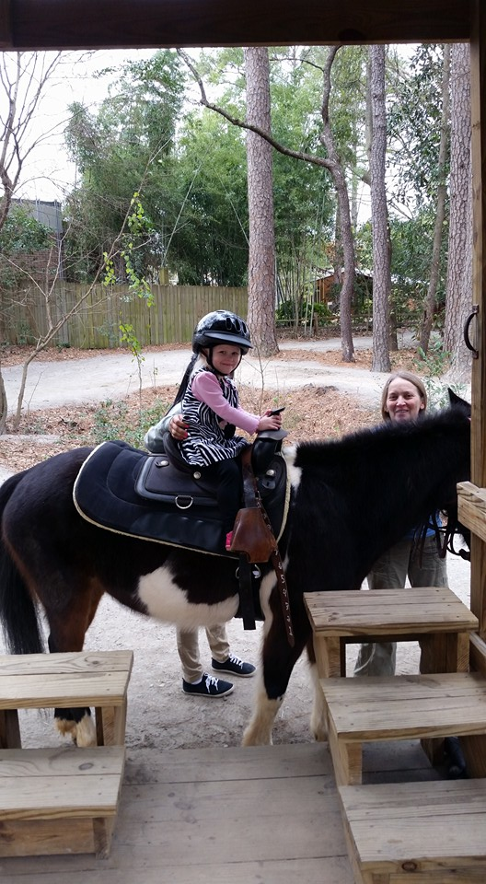

Slide 3
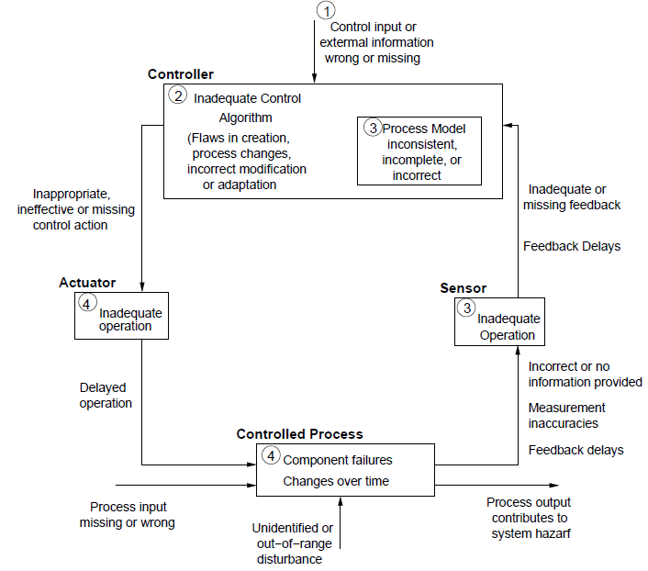
http://ocw.mit.edu/courses/aeronautics-and-astronautics/16-63j-system-safety-fall-2012/lecture-notes/MIT16_63JF12_Class10STPA.pdf

Slide 4
Risk
An adverse event that has a probability of occurring >0 and less than <100.
Probability of potential event actually occurring
Consequences – cost when it becomes a problem
Example – There is a risk that we will not be able to achieve the required latency for a specific flow. The probability of this occurring can be reduced by removing part of the controller. The consequence would be that a faster processor will be required costing $0.10 more per unit.

Slide 5
Hazard
EMV2::hazard =>
[ crossreference => "1.1.1";
failure => "Loss of sensor readings";
phase => "all";
description => "No position readings due to sensor failure";
comment => "Becomes major hazard, if no redundant sensor";
]
applies to ef1.Failed;

Slide 6
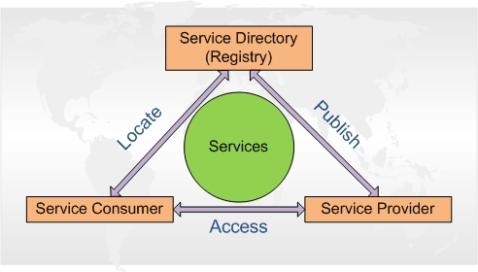
SOA
https://msdn.microsoft.com/en-us/library/aa480021.aspx

Slide 7
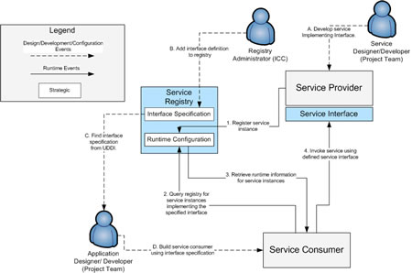
Service Oriented Architecture style

Slide 8
Design principles
Standardized service contract
Service Loose Coupling
Service Abstraction
Service Reusability
Service Autonomy
Service Composability
Service Discoverability
Service Statelessness
Service Granularity
Service Interpretability

Slide 9
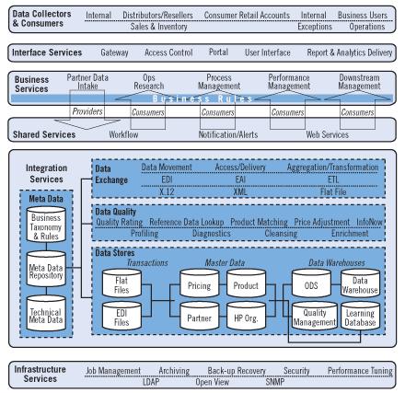
Layers of services

Slide 10
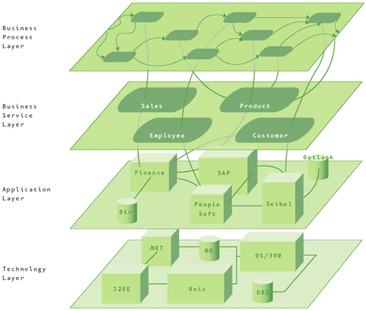
Layered SOA
http://msdn.microsoft.com/en-us/library/aa480028.aspx

Slide 11
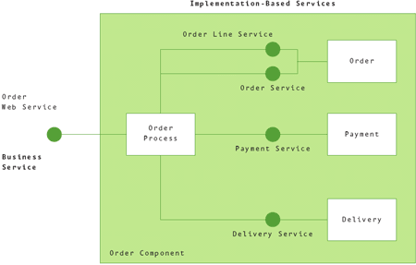
Abstraction
Expose a business service abstracted from its implementation.

Slide 12
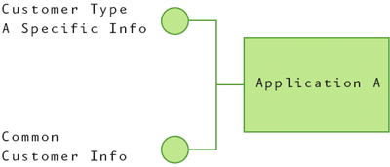
Generalization
Separate specific information from general to promote reuse

Slide 13
Standards compliance
Standards are stable
Change very slowly
Use for:
  Business semantics and schemas.
  Data values such as reference data.
  Business processes, such as the sequencing of messages.

Slide 14
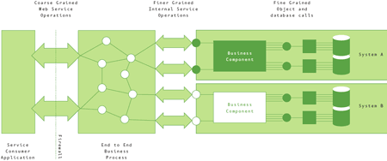
Granularity

Slide 15
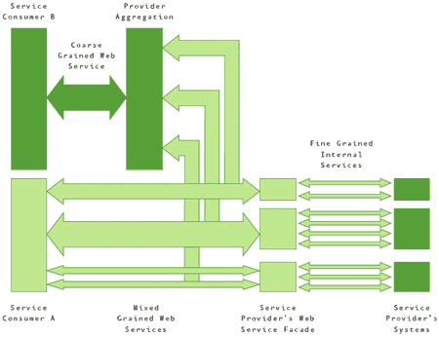
Variable granularity

Slide 16
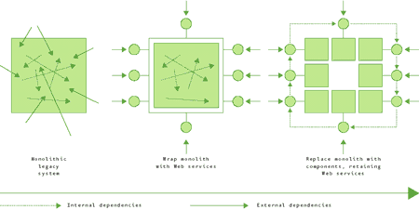
Migrating applications to services

Slide 17
Governance support
Governance process for SOA
Change management
Policies for publishing, using and retiring services
Infrastructure to help organize and discover services assets and govern access

Slide 18
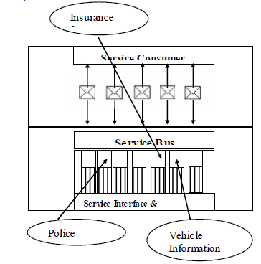
Service Bus

Slide 19
Service Level Agreements
http://resources.sei.cmu.edu/asset_files/TechnicalNote/2008_004_001_14951.pdf
A properly specified SLA describes each service offered and addresses
• how delivery of the service at the specified level of quality will become realized
•which metrics will be collected
•who will collect the metrics and how
•actions to be taken when the service is not delivered at the specified level of quality and who is responsible for doing them
•penalties for failure to deliver the service at the specified level of quality
•how and whether the SLA will evolve as technology changes (e.g., multi-core processors improve the provider’s ability to reduce end-to-end latency)

Slide 20
Abstract for an IBM service from the catalog
The IBM WSRP Version 2.0 Producer for IBM WebSphere Application Server is a lightweight WSRP Producer that supports the WSRP 1.0 and WSRP 2.0 standards. It provides JSR 286 and JSR168 compliant portlets that are deployed on IBM WebSphere Application Server to remote WSRP Consumer portals. All WSRP compliant Consumer portals can consume and integrate portlets that are provided by the WSRP Producer. The WSRP Producer is available for IBM WebSphere Application Server Full Profile Version 7.0, Version 8.0, Version 8.5 and Version 8.5.5, and for IBM WebSphere Application Server Liberty Profile Version 8.5.5.
The WSRP Producer documentation is available online: http://www-10.lotus.com/ldd/portalwiki.nsf/xpDocViewer.xsp?lookupName=IBM%20WSRP%202.0%20Producer%20for%20WebSphere%20Application%20Server#action=openDocument&content=catcontent&ct=prodDoc

Slide 21
Documentation of update
The update of January 2014 contains the following features and changes:
The WSRP Producer adds support for IBM WebSphere Application Server Version Full Profile 8.5 and Version 8.5.5 and IBM WebSphere Application Server Liberty Profile Version 8.5.5
The WSRP Producer supports the IBM Portlet Container for IBM WebSphere Application Server Liberty Profile and enables WSRP Consumer portals to integrate and use portlets that are deployed on IBM WebSphere Application Server Liberty Profile.
The WSRP Producer is now based on the JAX-WS standard for Java based web services. It takes advantage of the improvements of the state of the art JAX-WS based webservices stack in IBM WebSphere Application Server. The WSRP services are implemented as JAX-WS compliant service providers and can be managed in the WebSphere Application Server Integrated Solutions Console by using policy sets to configure web service security and quality of service.

Slide 22
Properties that can be specified in a SLA
Accuracy is concerned with the error rate of the service. It is possible to specify the average
number of errors over a given time period.
Availability is concerned with the mean time to failure for services, and the SLAs typically
describe the consequences associated with these failures. Availability is typically measured by the
probability that the system will be operational when needed. It is possible to specify
−the system’s response when a failure occurs
−the time it takes to recognize a malfunction
−how long it takes to recover from a failure
−whether error handling is used to mask failures
−the downtime necessary to implement upgrades (may be zero)
−the percentage of time the system is available outside of planned maintenance time
Capacity is the number of concurrent requests that can be handled by the service in a given time
period. It is possible to specify the maximum number of concurrent requests that can be handled
by a service in a set block of time.

Slide 23
Properties that can be specified in a SLA - 2
Cost is concerned with the cost of each service request. It is possible to specify
−the cost per request
−the cost based on the size of the data
−cost differences related to peak usage times
Latency is concerned with the maximum amount of time between the arrival of a request and the completion of that request.
Provisioning-related time (e.g., the time it takes for a new client’s account to become operational)
Reliable messaging is concerned with the guarantee of message delivery. It is possible to specify
−how message delivery is guaranteed (e.g., exactly once, at most once)
−whether the service supports delivering messages in the proper order
Scalability is concerned with the ability of the service to increase the number of successful
operations completed over a given time period. It is possible to specify the maximum number of such operations.

Slide 24
Unmeasurable qualities
Interoperability is concerned with the ability of a collection of communicating entities to share specific information
Interoperability is concerned with the ability of a collection of communicating entities to share specific information
Security is concerned with the system’s ability to resist unauthorized usage, while providing legitimate users with access to the service.

Slide 25
Web Service Level
Agreement (WSLA) language
Web Services protocol for establishing agreement between two parties, such as between a service provider and consumer, using an extensible XML language for specifying the nature of the agreement, and agreement templates to facilitate discovery of compatible agreement parties. The specification consists of three parts which may be used in a composable manner: a schema for specifying an agreement, a schema for specifying an agreement template, and a set of port types and operations for managing agreement life-cycle, including creation, expiration, and monitoring of agreement states

Slide 26
Portion of an SLA
<Parties>
<ServiceProvider name="ACMEProvider">
<Contact>
<Street>PO BOX 218</Street>
<City>Yorktown, NY 10598, USA</City>
</Contact>
<Action xsi:type="WSDLSOAPOperationDescriptionType"
name="notification" partyName="ZAuditing">
<WSDLFile>Notification.wsdl</WSDLFile>
<SOAPBindingName>SOAPNotificationBinding</SOAPBindingName>
<SOAPOperationName>Notify</SOAPOperationName>
</Action>
</ServiceProvider>
<ServiceConsumer name="XInc">
<Contact>
<Street>19 Skyline Drive</Street>
<City>Hawthorne, NY 10532, USA</City>
</Contact>
. . .
</ServiceConsumer>
<SupportingParty name="ZAuditing“ role="ConditionEvaluationService">

Slide 27
Portion of an SLA - 2
<ServiceDefinition name="DemoService">
. . .
<Operation name="GetQuote" xsi:type="WSDLSOAPOperationDescriptionType">
<SLAParameter name="Availability_UpTimeRatio" type="float" unit="">
<Metric>UpTimeRatio</Metric>
<Communication>
<Source>YMeasurement</Source>
<Push>ZAuditing</Push>
</Communication>
</SLAParameter>
. . .
<Metric name="UpTimeRatio" type="long" unit="">
<Source>YMeasurement</Source>
<Function xsi:type="Minus" resultType="double">
<Operand>
. . .
<Function xsi:type="ValueOccurs"
resultType="long">
<Metric>StatusTimeSeries</Metric>
. . .
</Function>
. . .
</Operand>
</Function>
</Metric>

Slide 28
http://msdn.microsoft.com/en-us/library/aa480027.aspx
http://msdn.microsoft.com/en-us/library/aa480061.aspx

Slide 29
TOGAF
http://pubs.opengroup.org/architecture/togaf8-doc/arch/
A Business (or Business Process) Architecture - this defines the business strategy, governance, organization, and key business processes.
A Data Architecture - this describes the structure of an organization's logical and physical data assets and data management resources.
An Applications Architecture - this kind of architecture provides a blueprint for the individual application systems to be deployed, their interactions, and their relationships to the core business processes of the organization.
A Technology Architecture - this describes the logical software and hardware capabilities that are required to support the deployment of business, data, and application services. This includes IT infrastructure, middleware, networks, communications, processing, standards, etc.

Slide 30
Enterprise architecture
A blend of hardware, software, and organizational aspects
It covers the entire enterprise
Provides guidance for a complete enterprise for software and business processes
http://www.oracle.com/technetwork/topics/entarch/oracle-ea-governance
-1697085.pdf?ssSourceSiteId=ocomen

Slide 31
Enterprise architecture - 2
The second law of thermodynamics indicates any closed, biological system will suffer from entropy – or degradation -unless new energy is introduced. All biological life forms are subject to this principle.
Place a banana on top of a refrigerator and a few weeks later it will blacken all on its own. Animal life - especially human life - is no different - deprived of food and water and eventually animal life perishes.

Slide 32
Enterprise architecture - 3
Analogously, the idea of the second law carries over to Enterprise Architecture. Over the past five or six decades organizations have embarked on introducing new and exciting IT components with the intention of automating business processes, gaining new efficiencies, lowering operating costs, and simply beating competition. These motivators are coupled with innovations in IT as well as multitudes of independent projects incentivized to behave with a silo mentality.

Slide 33
Enterprise architecture - 4
Enterprises will also need to define where in their software development lifecycle (SDLC) opportunities for service development and reuse will be investigated. Additional approval gates in the process will be necessary to enforce any SOA-related standards. Finally, internal communication will be necessary to instill the SOA mindset throughout the organization.

Slide 34
Here is what you are going to do
Perform a hazard analysis on your system
Determine which other driving requirements require specific analysis methods
Read https://insights.sei.cmu.edu/sei_blog/2014/06/architecture-analysis-using-aadl-a-beginners-perspective.html
Add information needed to perform these analyses to your AADL model

