Slide 1

CPSC 875
John D. McGregor
C8 - Tactics

Slide 2
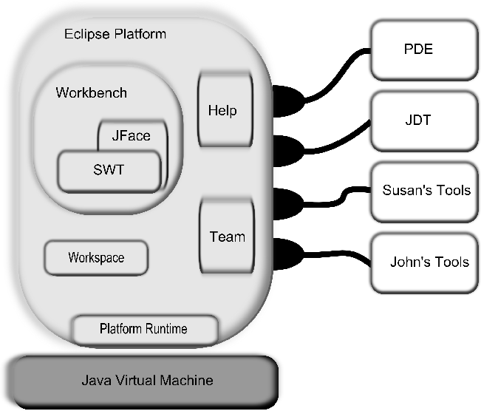
Everything is a plugin

Slide 3
Early dependency mechanisms between plugins
Requires
Extension points
  Menus
  Help system
  Views
  Perspectives
Plugins -> CGI bundles

Slide 4
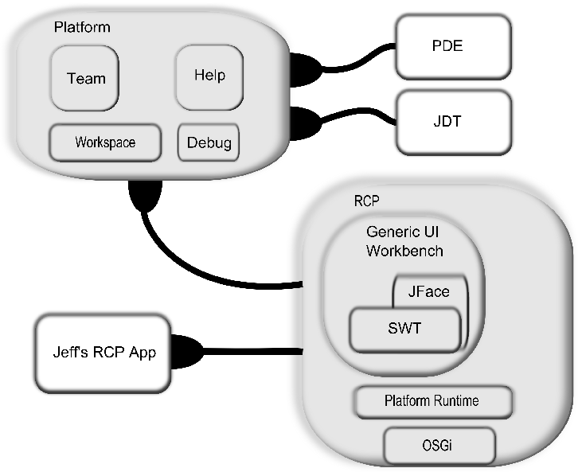
3.0

Slide 5
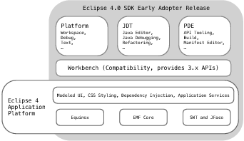
4.0

Slide 6
Objectives of 4.0
simplify the Eclipse programming model
attract new committers and
enable the platform to take advantage of new web-based technologies while providing an open architecture.

Slide 7
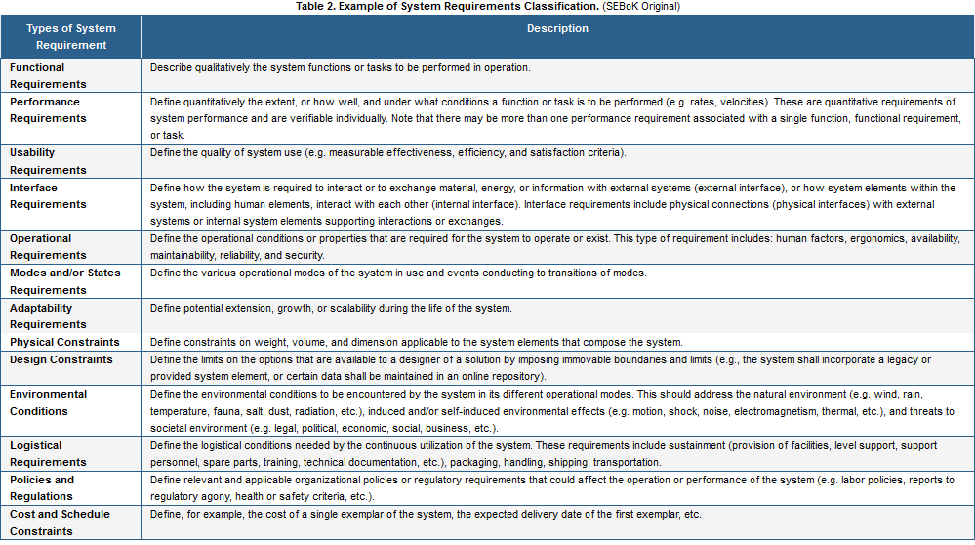
Requirements classification

Slide 8
Logical/Physical Design
Logical design focuses on concepts. Separation of concerns divides into separate entities.
Physical design focuses on “concrete” entities such as processes, threads, and subprograms.

Slide 9
Tactics
A tactic is a transformation
Given that the pre-condition of the tactic is true
The tactic defines changes that should be made to the as-is architecture to get the will-be architecture
The tactic description explains the corresponding changes to quality attributes

Slide 10
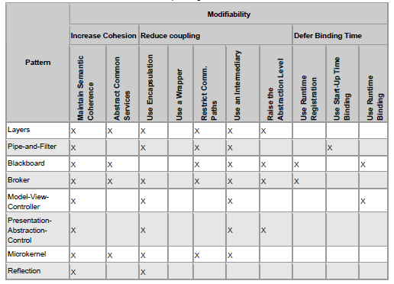
Modifiability tactics
This and other diagrams from http://www.sei.cmu.edu/library/abstracts/reports/07tr002.cfm

Slide 11
Baldwin’s Modularity Operators
Modularity reduces complexity and enhances maintainability
Baldwin and Clark define 6 operators
Any system
  Splitting
  Substitution
Assumes a modular system
  Augmenting
  Excluding
  Inversion
  Porting

Slide 12
  Splitting
AKA decomposition
A monolithic system or a module is divided into two or more modules
Client/server is a split that enhances value by allowing multiple clients to access a single server – the assumption being that not all clients want to access the server at the same time

Slide 13
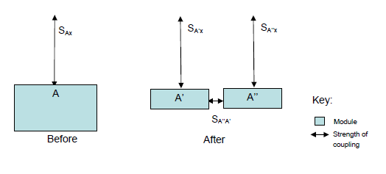
Splitting
Reducing cost of modifying a single responsibility

Slide 14
  Substitution
AKA plug compatible
One module is replaced by another with equivalent behavior but presumably a different implementation
A desktop, laptop, and mobile device all have a bluetooth connection that obeys the bluetooth protocol but each has a different implementation; substituting will allow one system to be used on all three platforms but with a different driver for each platform

Slide 15
  Augmenting
An additional module is added to the system
Perhaps a new type of communication connection such as USB is added to the system

Slide 16
  Excluding
A module is removed from the system.
A low cost version of a product might remove several connectors such as HDMI or a DVD player
A generic software system may be tailored for a specific installation. The standard stereo module is excluded and the system is augmented with a vehicle’s surround sound module

Slide 17
Inversion (refactoring)
Two or more modules are modified
The result is a third module that captures the commonality among the initial modules
A stereo sound system module and a surround sound module are analyzed and their common behavior made into a sound system module which is then related to the reduced stereo and surround sound modules
Enhances the maintainability and extensibility

Slide 18
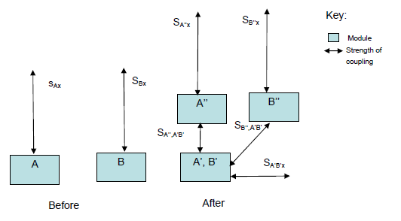
Inversion
Increases cohesion

Slide 19
Porting
A module is divided into a module that is more tightly coupled to the system under design and a module that is free from the single system
Making a system easily used by multiple OSs is a typical example. System calls are limited to the tightly coupled module
Some new module may be needed in between the tightly coupled module and the free one

Slide 20
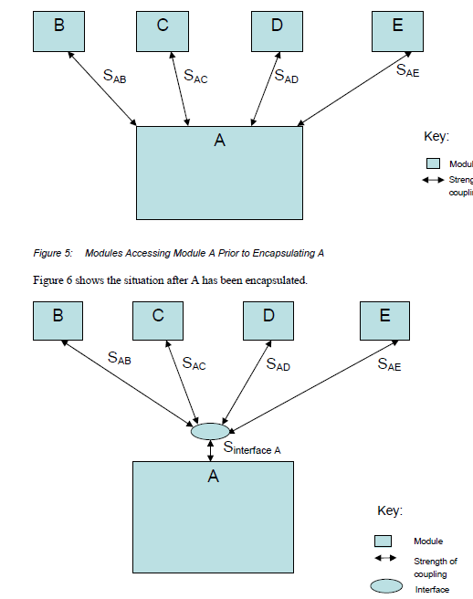
Encapsulation

Slide 21
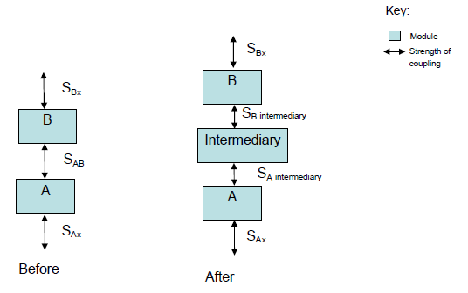
Intermediary

Slide 22
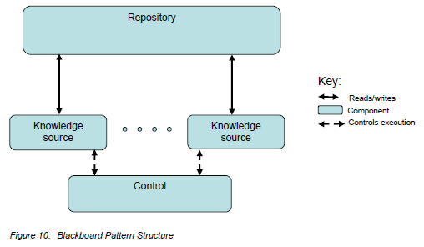
Blackboard

Slide 23
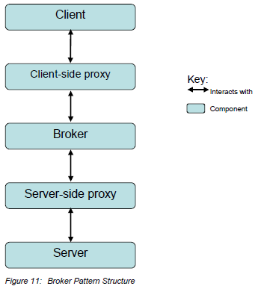
Proxy

Slide 24
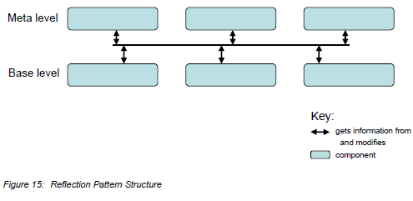
Reflection

Slide 25
Modifiability tactics

Slide 26
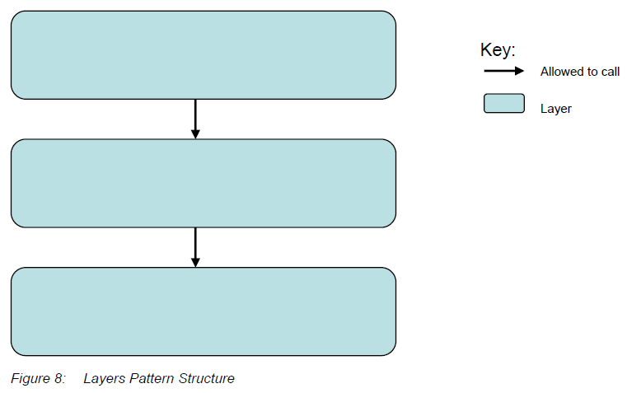
Layers via tactics

Slide 27
Layers - 2
Maintain Semantic Coherence. The goal of ensuring that a layer’s responsibilities all work together without excessive reliance on other layers is achieved by choosing responsibilities that have some sort of semantic coherence.
Raise the Abstraction Level. Layers represent an abstract ladder of services.

Slide 28
Layers - 3
Abstract Common Services. Typically the responsibilities of a layer are grouped together into services.
Use Encapsulation. There are two design considerations of the Layers pattern with respect to interfaces: (1) each layer may have its own interface and (2) particular layers may act as an interface (e.g., API, façade) for another layer.

Slide 29
Layers - 4
Restrict Communication Paths. Layers define an ordering and only allow a layer to use the services of its adjacent lower layer.
Use an Intermediary. Particular layers may act as an interface (e.g., API, façade) for another layer.

Slide 30
Layers - 5
Relaxed layered system. A relaxed layered system is one in which layer N can invoke any layer below it rather than exclusively layer N-1, which is achieved by removing the Restrict Communication Paths tactic (i.e., removing an intermediary).
Layering through inheritance. This variant refers to how the layers are packaged and, consequently, the binding time between them.

Slide 31
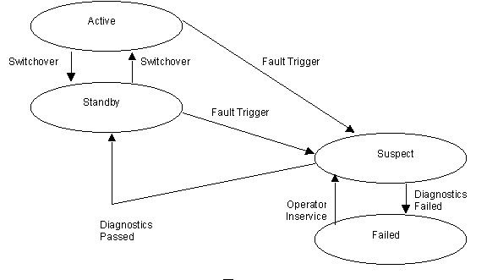
State Machines

Slide 32
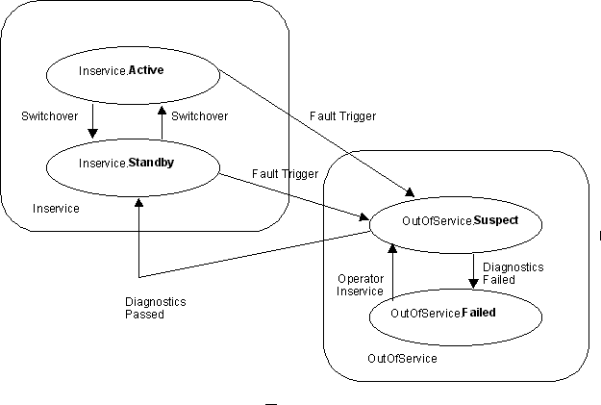
Hierarchical

Slide 33
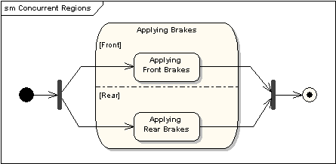
Concurrent

Slide 34
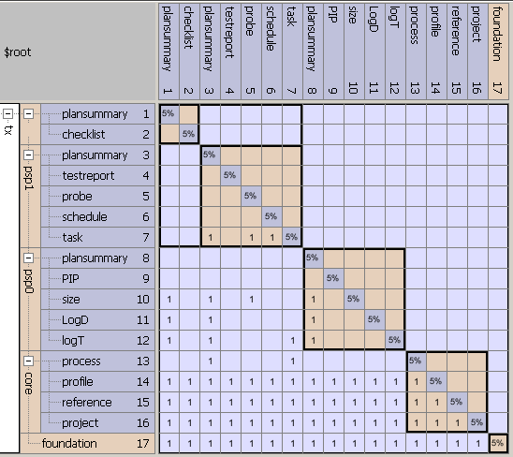
Design Structure Matrix

Slide 35
MVC
 | model | view | controller
model | x
view | 1 | x
controller | 1 | 1 | x
Controller
View
Model

Slide 36
Reading
Read this SEI tech report:
http://www.sei.cmu.edu/library/abstracts/reports/07tr002.cfm
http://www.sparxsystems.com/resources/uml2_tutorial/uml2_statediagram.html

Slide 37
Here is what you are going to do
Use the design tactics to refine your pacemaker design
Identify places 2 tactics can be used
Modify your design
Go as deep as possible; at least the thread level if not the subprogram level
Submit the model and a description of the design changes
Commit your model by 11:59pm Monday Feb 13th

