Slide 1

CPSC 875
John D. McGregor
Reference Architectures
C9

Slide 2
Mid-term exam
March 14th
Sample exams online

Slide 3
https://www.google.com/url?sa=t&rct=j&q=&esrc=s&source=web&cd=1&ved=0ahUKEwihqYmo7oHSAhUB6CYKHbggCU0QFggaMAA&url=https%3A%2F%2Fwww.opengroup.us%2Fface%2Fdocuments%2F17640%2F4Feb_FACE_TIM_Keynote_DrLewis__PAO_1888_.pptx&usg=AFQjCNFHNWmcC-woSuf1yt7p4JwK-PBwAA&bvm=bv.146496531,d.eWE&cad=rja

Slide 4
Reference architecture-1
An architecture that covers a set of products rather than a single product
Supports variation across products
Supports abstraction in several ways
abstract
In data port {no type}
“refines to”

Slide 5
Reference architecture-2
abstract cacc
end cacc;
abstract implementation cacc.devices
subcomponents
radar_sensor: abstract sensor::generic_sensor.impl;
radar_handler:abstract sensor::generic_sensor_handler.impl;
gps:abstract sensor::generic_sensor.impl;

Slide 6
connections
radar_handler_conn: port radar_sensor.sensor_data_out->radar_handler.sensor_data_in;
radar_conn: port radar_handler.sensor_data_out->vehicle_controller.sensor1_data_in;
camera_handler_conn: port camera_sensor.sensor_data_out->camera_handler.sensor_data_in;
camera_conn: port camera_handler.sensor_data_out->vehicle_controller.sensor2_data_in;
gps_handler_conn: port gps.sensor_data_out->gps_handler.sensor_data_in;
gps_conn: port gps_handler.sensor_data_out->vehicle_controller.sensor3_data_in;

Slide 7
Refined to
system implementation cacc_rt.devices extends abstracts::cacc.devices
subcomponents
vehicle_controller: refined to process control_rt.impl {Classifier_Substitution_Rule => Type_Extension;};
interface_controller:refined to process interface_controller_rt.impl;
radar_sensor: refined to device devices::radarSensor_rt.impl {Classifier_Substitution_Rule => Type_Extension;};
radar_handler:refined to system devices::radar_handler.impl;

Slide 8
flows
-- sensor's info to logger
etef0 : end to end flow radar_sensor.sensor_source -> radar_handler_conn -> radar_handler.sensor_logger_path -> logger_radar_conn-> logger.logger_sink;
etef1 : end to end flow camera_sensor.sensor_source -> camera_handler_conn -> camera_handler.sensor_logger_path-> logger_camera_conn -> logger.logger_sink;
etef2 : end to end flow gps.sensor_source -> gps_handler_conn -> gps_handler.sensor_logger_path -> logger_gps_conn -> logger.logger_sink;

Slide 9
properties
latency => 5 ms .. 10 ms applies to etef0, etef1, etef2, etef3, etef4;

Slide 10
Abstract sensor
abstract generic_sensor
features
sensor_data_out: out data port;
flows
sensor_source : flow source sensor_data_out;
properties
latency => 1 ms .. 3 ms applies to sensor_source;
SEI::PowerBudget=> 5.0W;

Slide 11
annex EMV2 {**
use types error_library;
error propagations
sensor_data_out : out propagation {NoValue};
flows
ef0 : error source sensor_data_out{NoValue};
end propagations;
properties
emv2::hazards => ([failure => "Novalue";
description => "No data from the sensor";
])
applies to sensor_data_out.novalue;
**};

Slide 12
abstract
abstract implementation generic_sensor.impl
end generic_sensor.impl;
abstract generic_sensor_handler
features
sensor_data_in: in data port;
sensor_data_out: out data port;
logger_out: out data port data_types::file;

Slide 13
Property set
property set Bus_Properties is
Bandwidth : Data_Volume applies to (bus);
Bandwidth_Range : type range of Data_Volume;

Slide 14
Standards
Few greenfield projects
CVRIA
Autosar
AADL

Slide 15
CVRIA
Connected Vehicle Reference Implementation Architecture
Dept of Transportation
Reference vs Reference Implementation

Slide 16
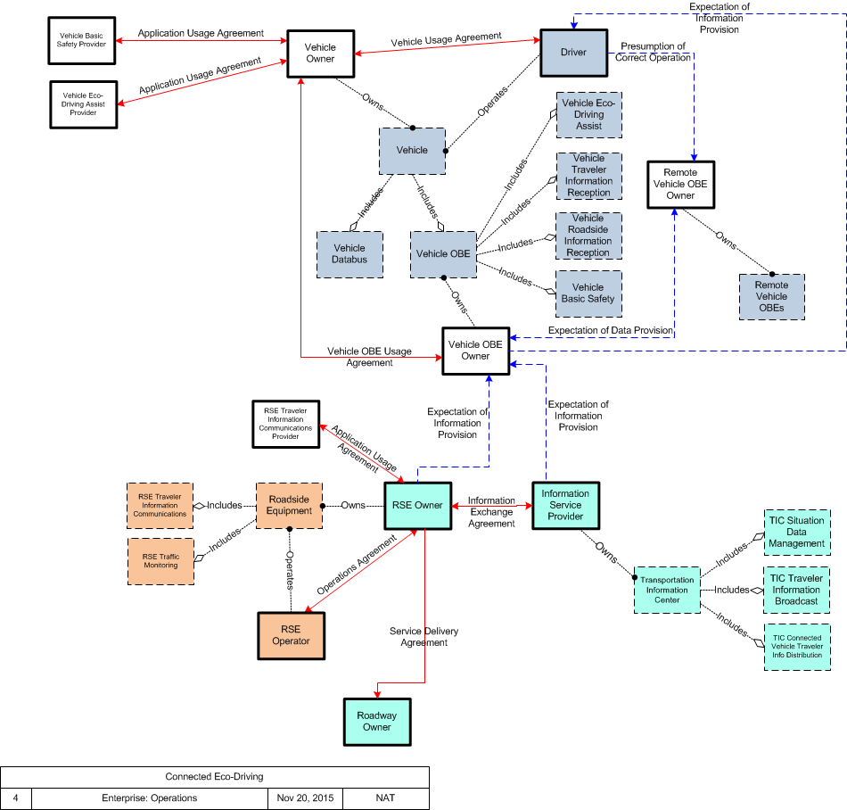
Connected Eco-system driving
Enterprise
view

Slide 17
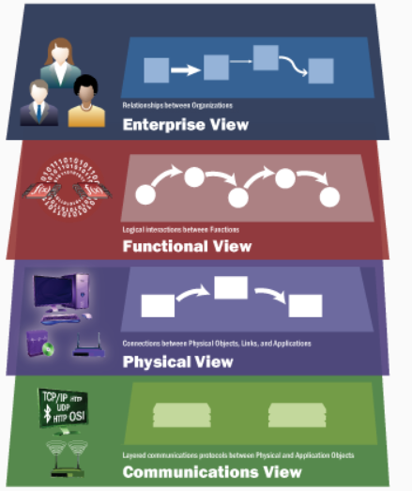
CVRIA-Provide Traffic Surveillance
Functional processes
1) Process Sensor Data (1.1.1) 2) Process and Store Traffic Data (1.1.2) 3) Generate Predictive Traffic Model (PSpec 1.1.3) 4) Display and Output Traffic Data (1.1.4) 5) Exchange Data with Other Traffic Centers (PSpec 1.1.5) 6) Collect Vehicle Traffic Probe Data (PSpec 1.1.6) 7) Collect Vehicle Environmental Data (PSpec 1.1.7)

Slide 18
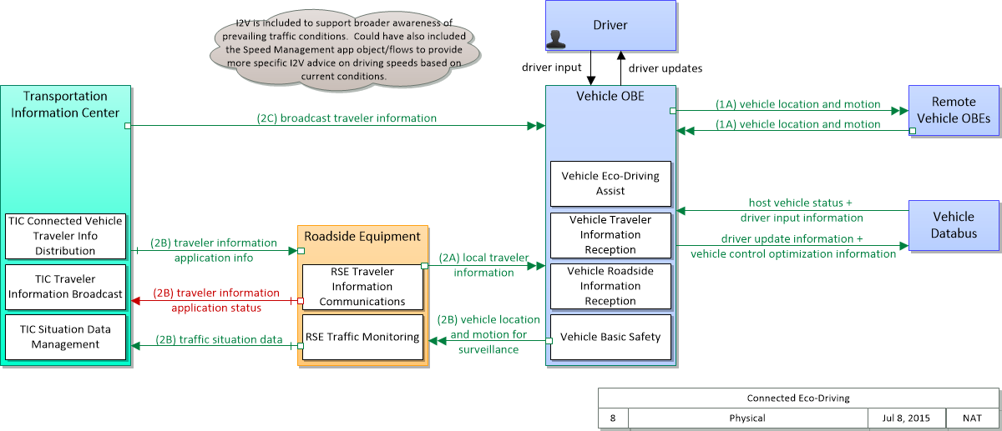
Physical view

Slide 19
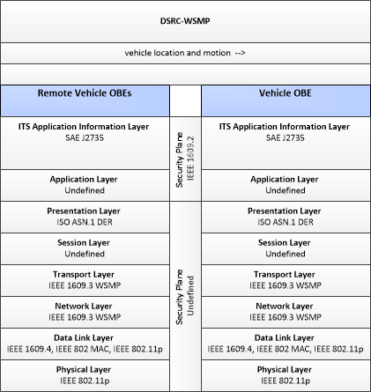
Communication view

Slide 20
Standards Development Organizations
The following organizations participate in ITS standards activities:
AASHTO (American Association of State Highway and Transportation Officials)
ANSI (American National Standards Institute)
APTA (American Public Transportation Association)
ASTM (American Society for Testing and Materials)
IEEE (Institute of Electrical and Electronics Engineers)
ITE (Institute of Transportation Engineers)
NEMA (National Electrical Manufacturers Association)
SAE (Society of Automotive Engineers)

Slide 21
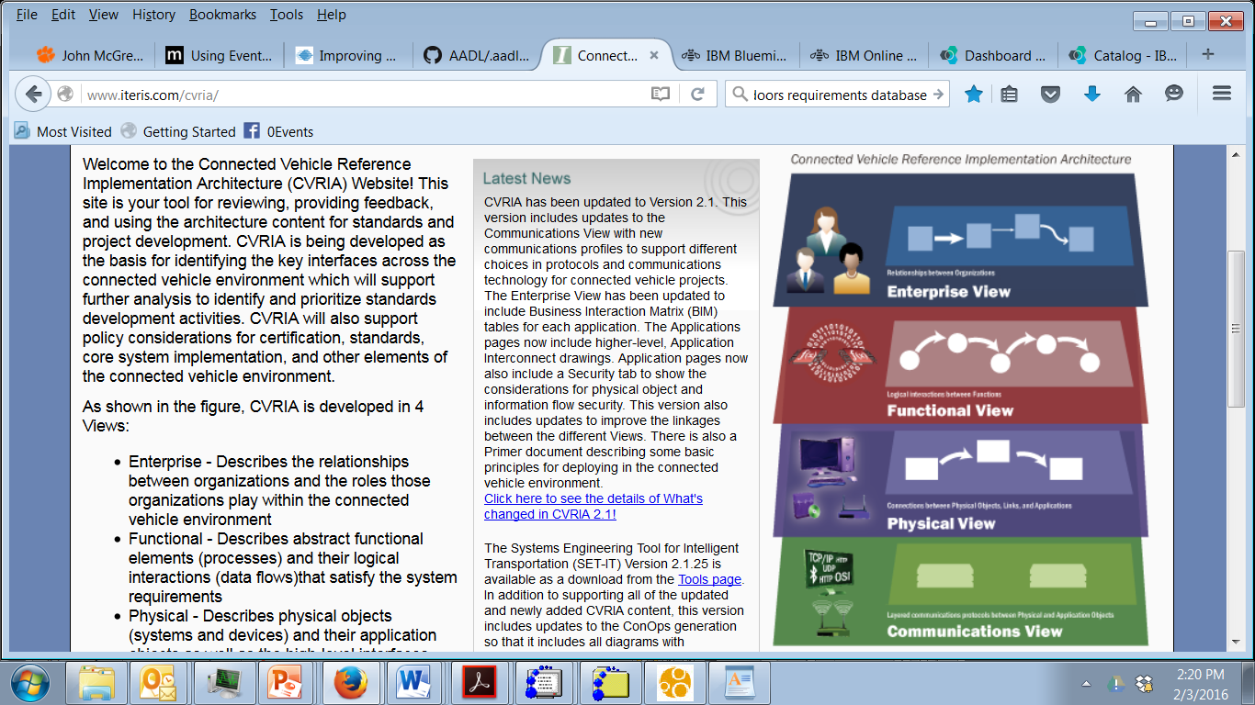
Documentation

Slide 22
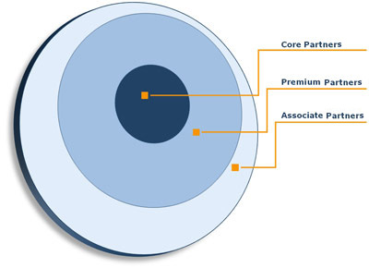
Autosar
Structured membership

Slide 23
Document Lifecycle
The following specifications change their life cycle status with this release.
New Specifications The following specifications are added to this release: • Supplementary material of general blueprints for AUTOSAR (UID 682, TR, aux) • Functional Safety analysis of an exemplary system using AUTOSAR (UID 641, EXP, aux)
Obsolete Specifications The following specifications are set to status “obsolete” in this release: • Requirements on Debugging in AUTOSAR (UID 332, SRS, aux) • Specification of Debugging in AUTOSAR (UID 315, SWS, std) These specifications are scheduled for cancellation, i.e. removal from standard with the next minor release. In case of objections against the planned cancellation of any of the specifications listed above, please submit your objections to AUTOSAR by an e-mail to request@autosar.org.
Canceled The following specifications are set to status “canceled” in this release: • Example for a Serialization Protocol (SOME/IP) (UID 637, TR, aux) The content of this technical report will be merged into a new specification of a future release.

Slide 24
Sensor/Actuator Design Pattern
Problem
The Sensor/Actuator Design Pattern describes how to handle sensors or actuators that are connected to an ECU in the context of an overall architecture. The Sensor/Actuator Design Pattern focuses on aspects of:
Independence of application software from concrete sensors and actuators connected to a specific ECU.
Reusable code between different sensors and actuators.
Different code sharing cooperation models (software sharing), thus supporting
different business models.
Deployment of functionality to different ECUs.

Slide 25
Example

Slide 26
ECU mapping

Slide 27
AADL
1 REFERENCES
1.1 Normative References
1.2 Informative References
1.3 Method of Description and Syntax Notation
ANNEX DOCUMENT E ERROR MODEL
Annex E.1 Scope
Annex E.2 Concepts and Terminology
Annex E.3 Error Model Libraries
Annex E.4 Error Model Subclauses
Annex E.5 Error Types, Type Products, Type Sets, and Type Hierarchies
Annex E.6 A Common Set of Error Types
E.6.1 Service Related Errors
http://standards.sae.org/as5506b/

Slide 28
http://standards.sae.org/as5506b/
Systems and software engineering — Architecture description
ISO/IEC/IEEE 42010

Slide 29
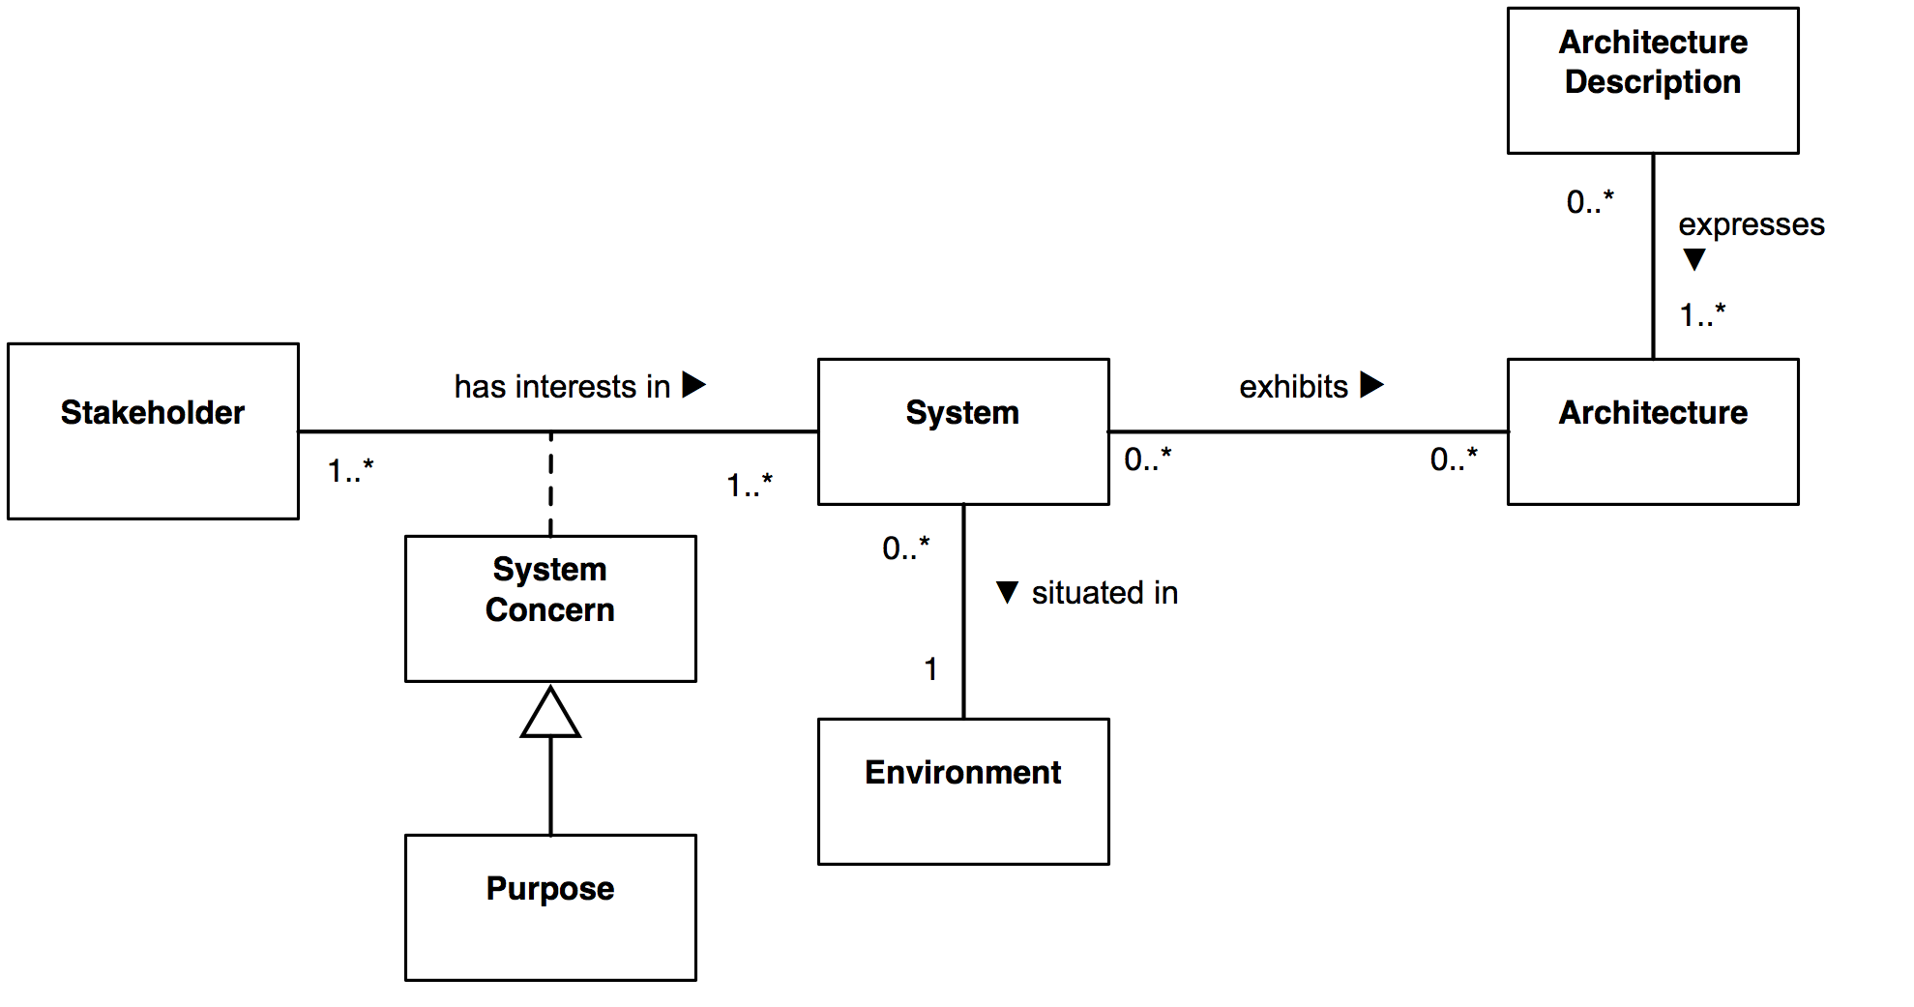
Description

Slide 30
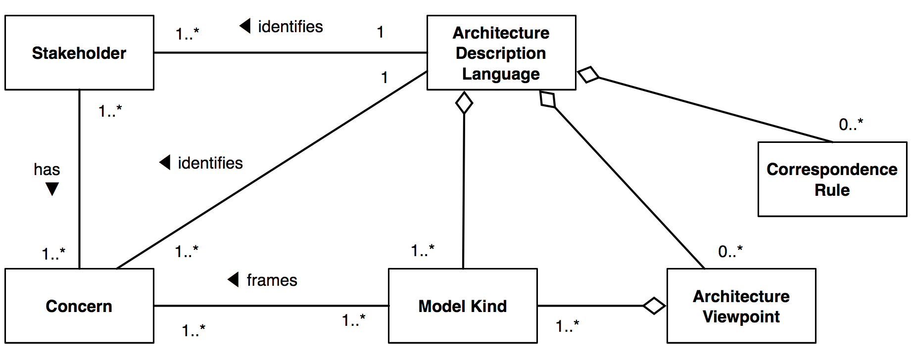
ADL

Slide 31
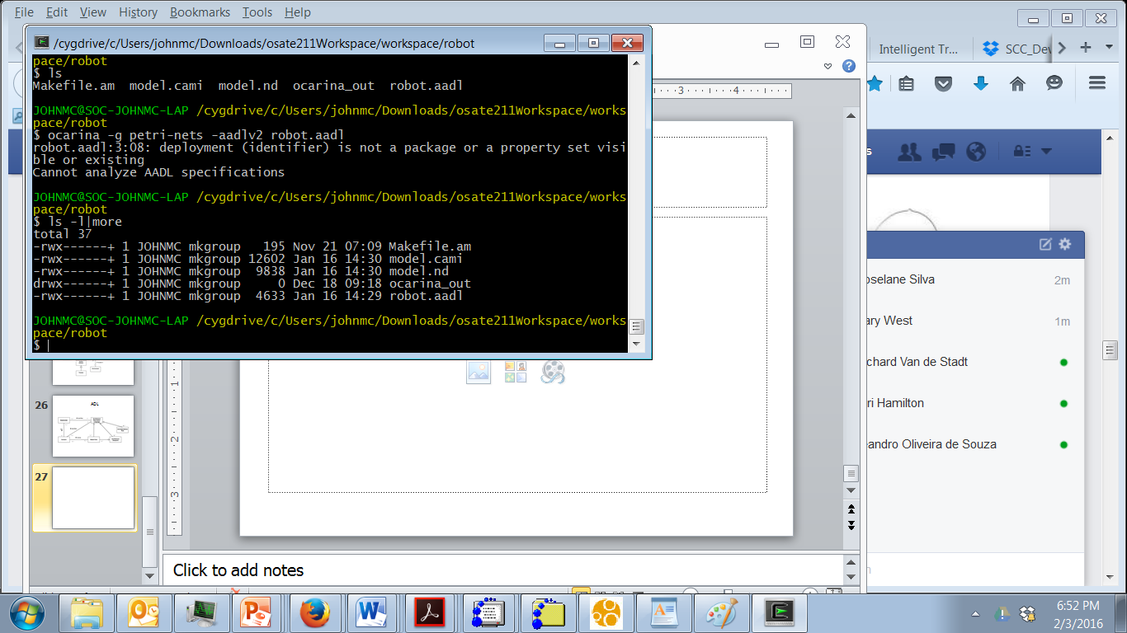
Install ocarina

Slide 32
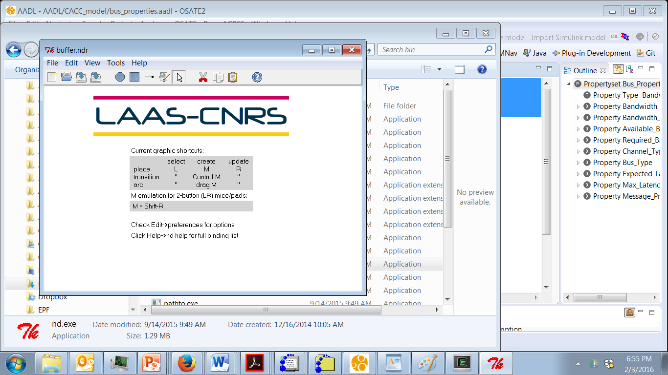
tina

Slide 33
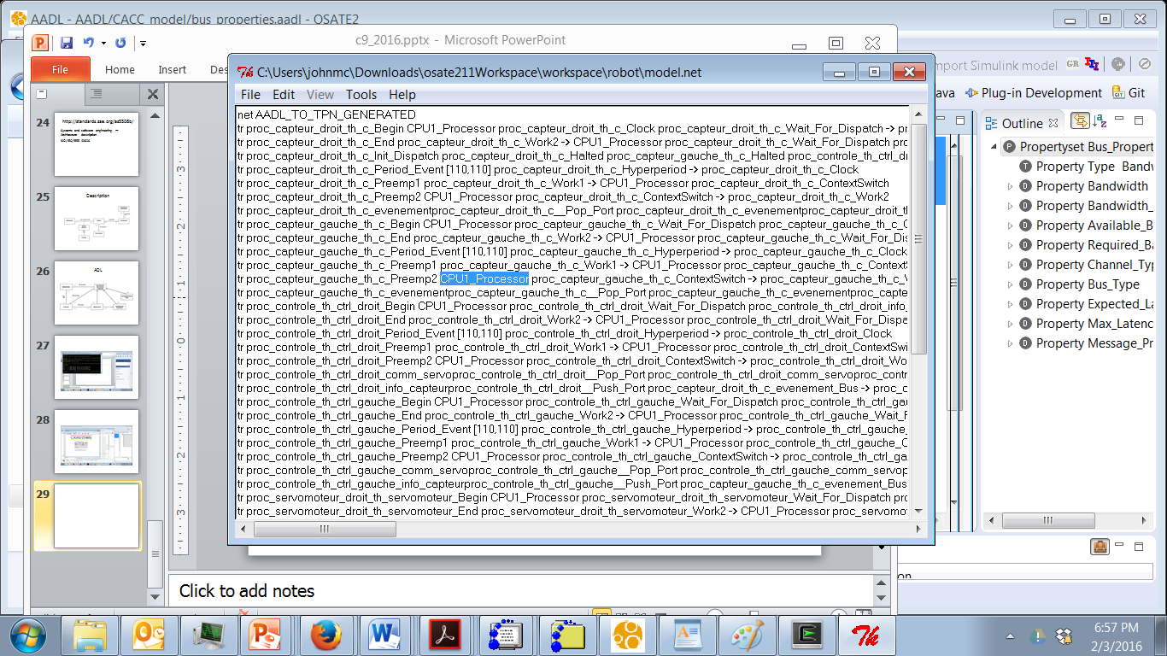
Output from ocarina

Slide 34
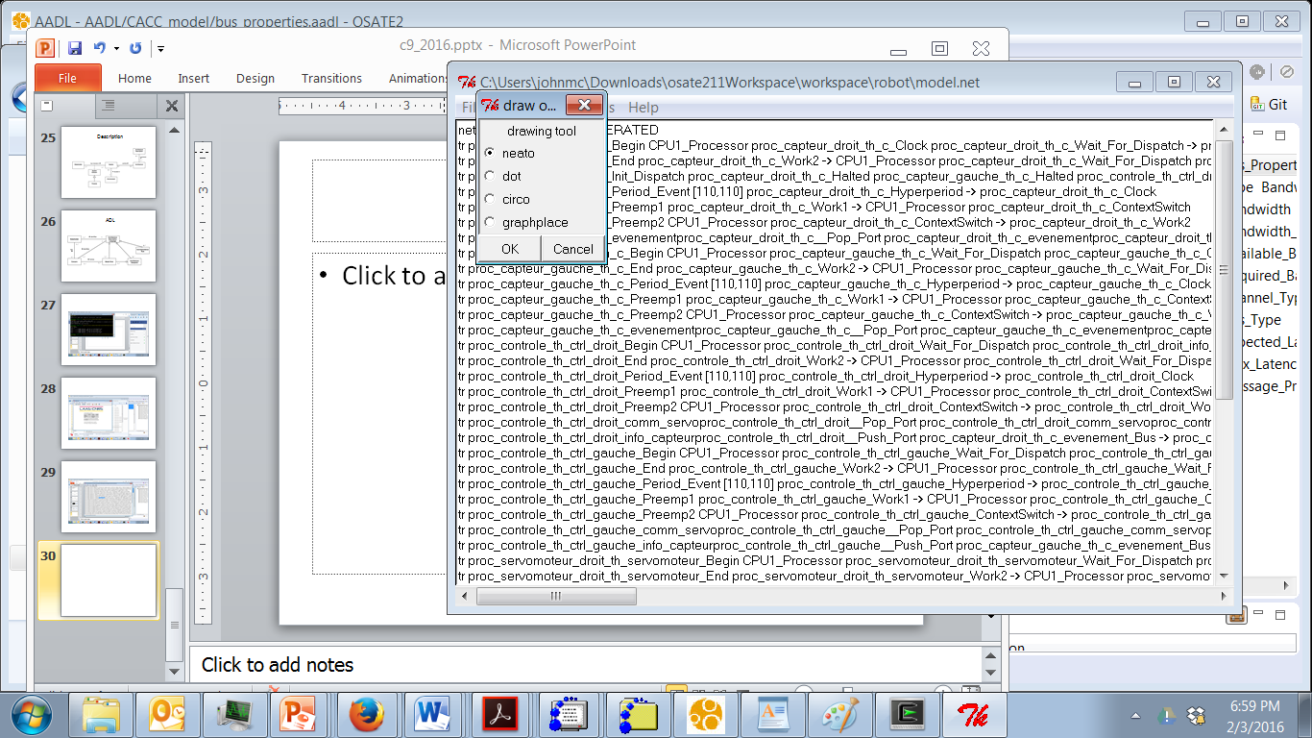
Graphviz has dot and neato

Slide 35
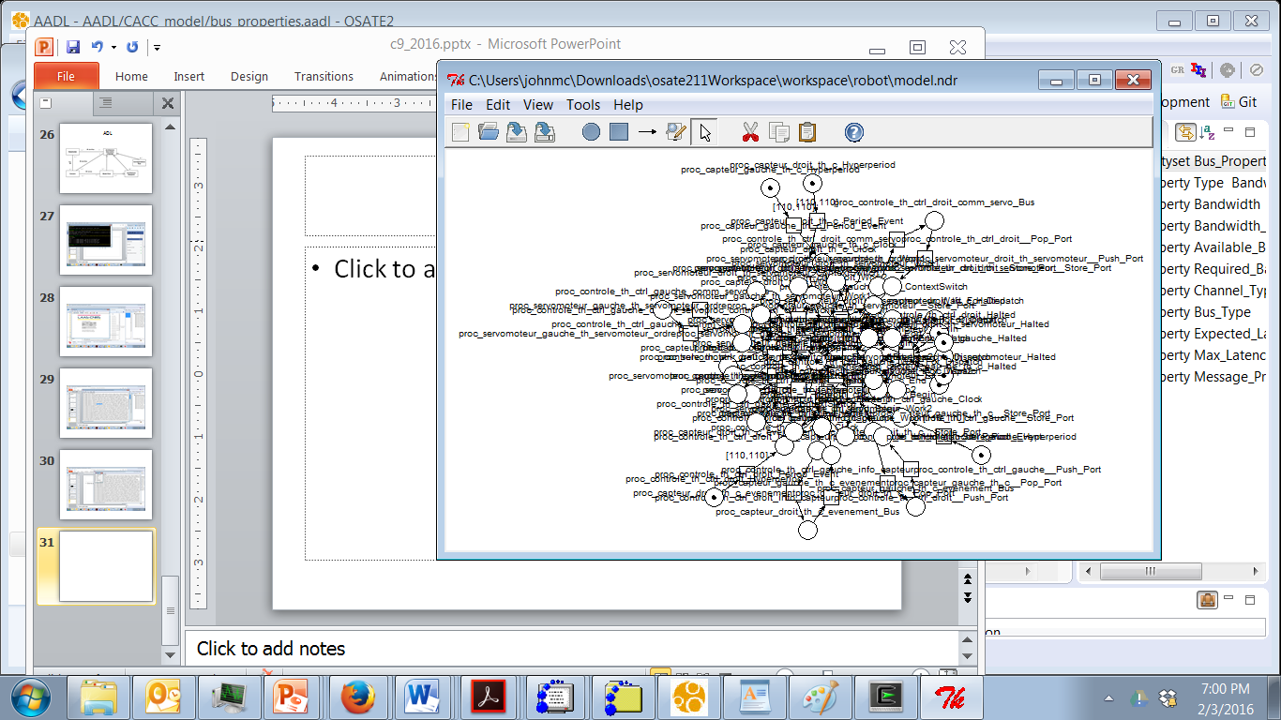
Drawn petri net

Slide 36
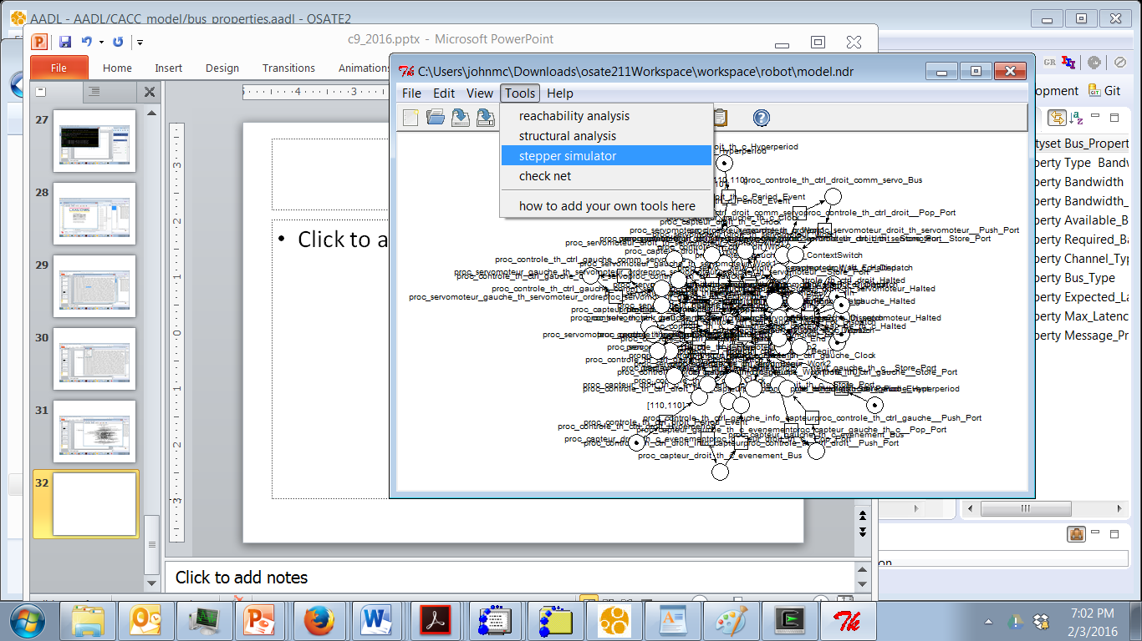
Activate simulator

Slide 37
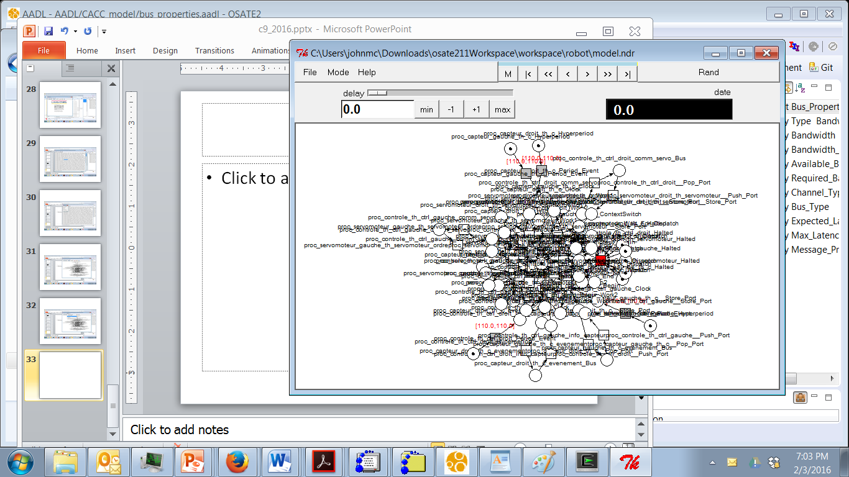

Slide 38
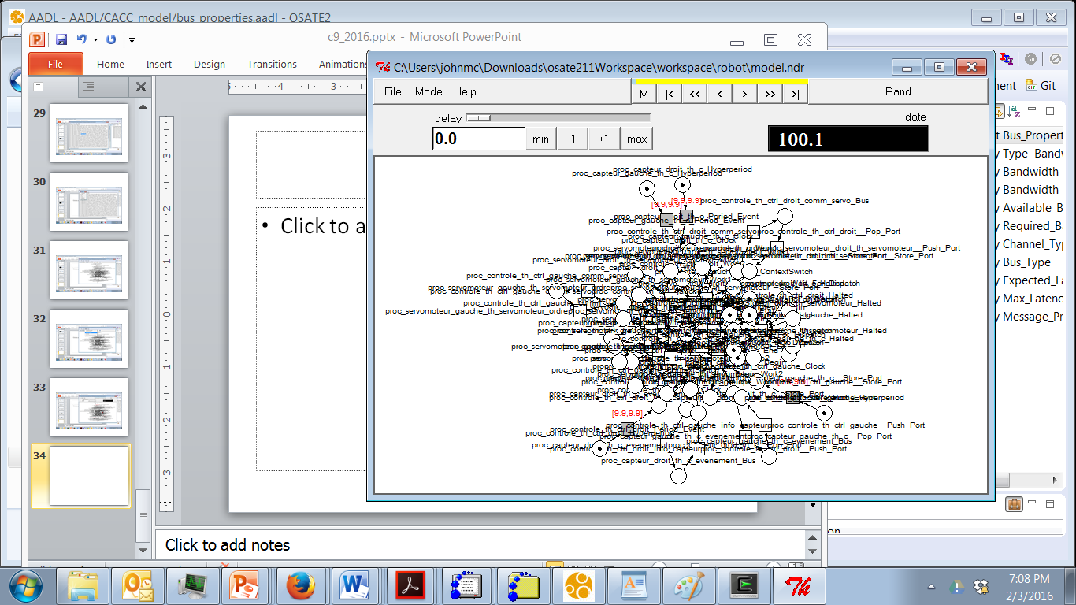
Click on Rand, then Stop, then use the forward and reverse keys

Slide 39
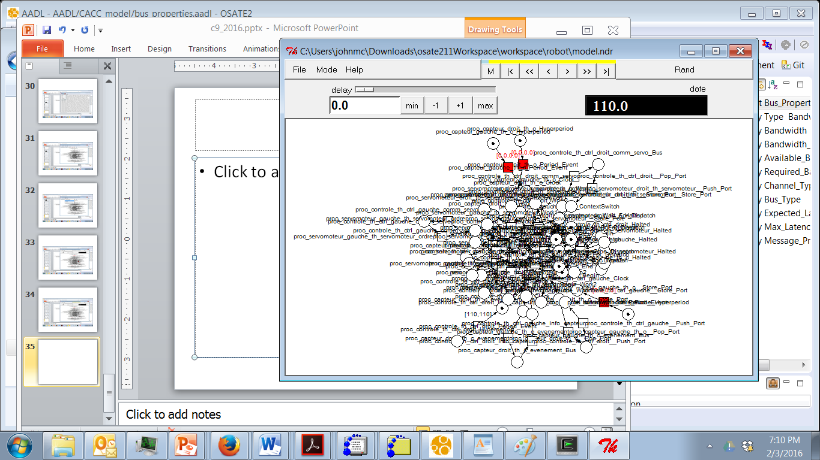

Slide 40
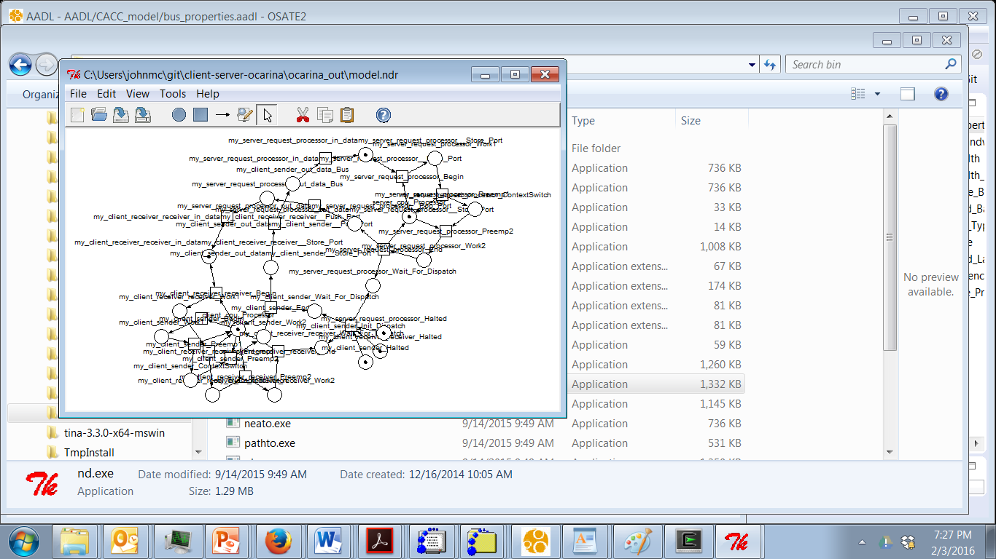
Client/server example

Slide 41
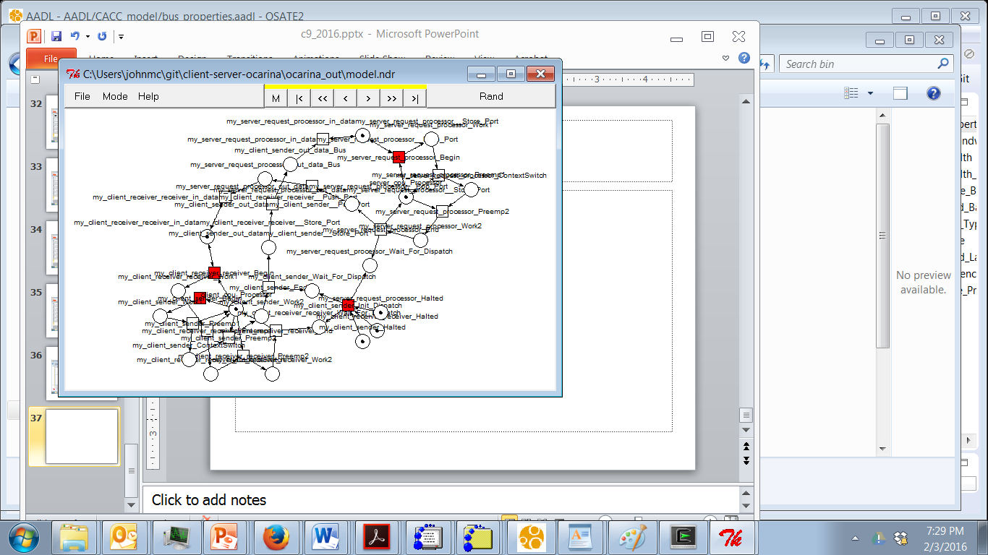
Walk thru execution

Slide 42
Here’s what you are going to do…
You need to conduct a QAW for your product
Create scenarios using the card format
Create a presentation about the product you are building that describes the market/context
In class on Tuesday we will create teams where one group will present and the other team will vote/and then we reverse roles
By 11:59 pm Feb 20th you will submit your utility tree as well as refined scenarios

