Slide 1

CpSc 875
John D. McGregor
AADL

Slide 2
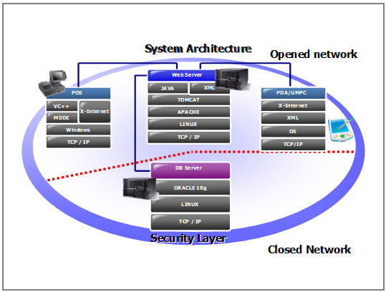
Point of sale system

Slide 3

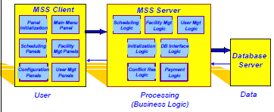
3-tier

Slide 4
MVC
Model
View
View
View
View
Controller
Controller
HAL
HAL
HAL

Slide 5
C/S

Slide 6
Integrating styles
View
Model
Controller
View
Model
Controller
View
Model
Controller

Slide 7
Here’s what you are going to do…
Find two sources that describe the Model-View-Controller architecture
Build an AADL model of MVC to the extent that you can using the parts of the language we have learned so far.
Submit the AADL code as a text file via email by 6am Jan 28th, 2014.

