Slide 1

CpSc 875
John D. McGregor
AADL-2

Slide 2
Example system

Slide 3
Web server service delays
The increasing diversity of applications supported by the World Wide Web and the increasing popularity of time critical Web-based applications (such as online trading) motivates building QoS-aware Web servers. Such servers customize their performance attributes depending on the class of the served requests so that more important requests receive better service. From the perspective of the requesting clients, the most visible service performance attribute is typically the service delay. Different requests may have different tolerances to service delay. For example, one can argue that stock trading requests should be served more promptly than recreational browsing requests. Similarly, interactive clients should be served more promptly than background software agents such as Web crawlers and prefetching proxies. Some businesses may also want to provide different service delays to different classes of customers (e.g., depending on their monthly fees).

Slide 5
Control system

Slide 6
Peter Feiler’s representation

Slide 7
Peter Feiler’s representation

Slide 10
Cruise control

Slide 11
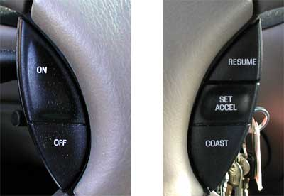

Slide 13
Cruise Control as Control system

Slide 14
State machine

Slide 15
http://auto.howstuffworks.com/cruise-control1.htm
http://www.autosar.org/download/AUTOSAR_LayeredSoftwareArchitecture.pdf
http://www.autosar.org/download/R4.1/AUTOSAR_EXP_AIChassis.pdf

