Slide 1

CpSc 875
John D. McGregor
Class 21
Ocarina/Navigation

Slide 2
You should read this
http://www.computerweekly.com/blogs/public-sector/2010/02/eds-software-report-that-went.html

Slide 3
Navigation
http://ieeexplore.ieee.org/stamp/stamp.jsp?tp=&arnumber=4913075
http://www.aaai.org/Papers/Symposia/Spring/1995/SS-95-02/SS95-02-022.pdf
http://ieeexplore.ieee.org/stamp/stamp.jsp?tp=&arnumber=1087458
https://hal.inria.fr/inria-00150375v3/document

Slide 4
Petri nets
http://cc.ee.ntu.edu.tw/~farn/courses/FMV/formal.methods.09.Petri.nets.pdf
http://www.researchgate.net/publication/224587004_From_AADL_Architectural_Models_to_Petri_Nets_Checking_Model_Viability
http://www.informatik.uni-hamburg.de/TGI/PetriNets/introductions/aalst/
http://www.ulb.ac.be/di/ssd/ggeeraer/Tutorial-Perti-Nets-Geeraerts.pdf

Slide 5
Ocarina
www.openaadl.org
I use pc-cygwin version
Then you need Tina
http://projects.laas.fr/tina/

Slide 6
Ocarina command line

Slide 7
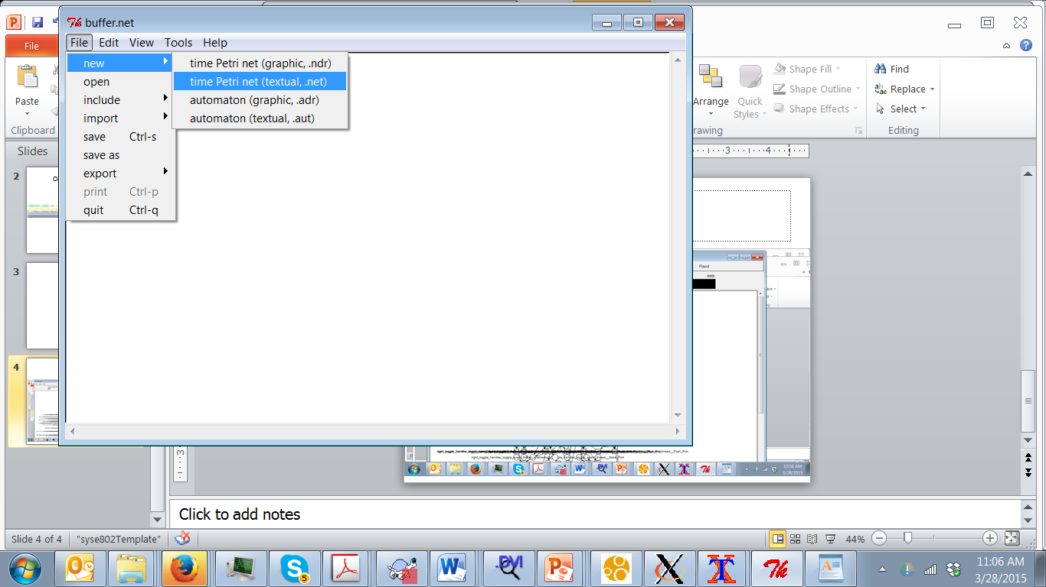
Tina toolkit

Slide 8
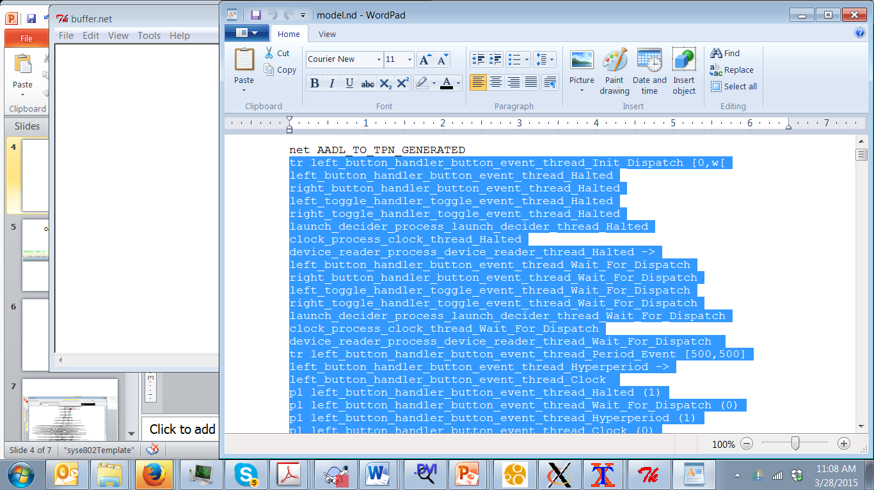
Copy all but first line

Slide 9
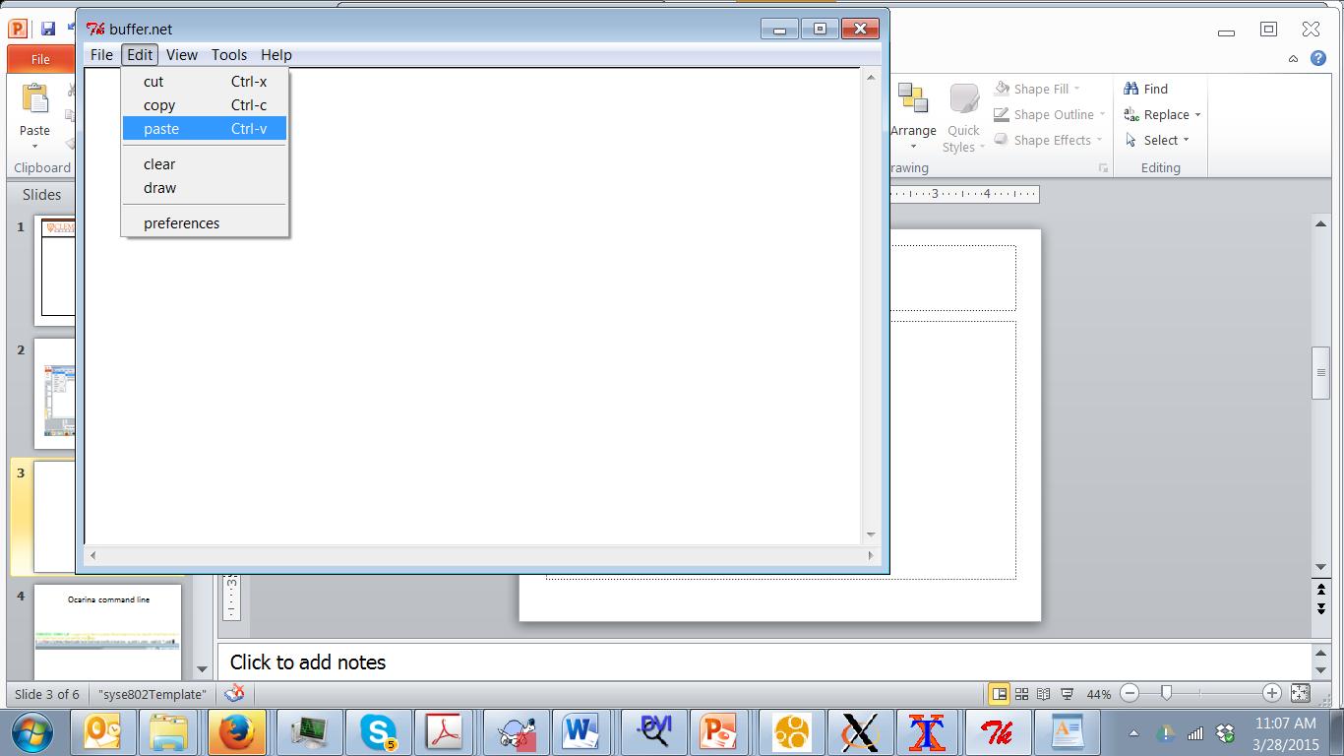
Paste text into Tina editor

Slide 10
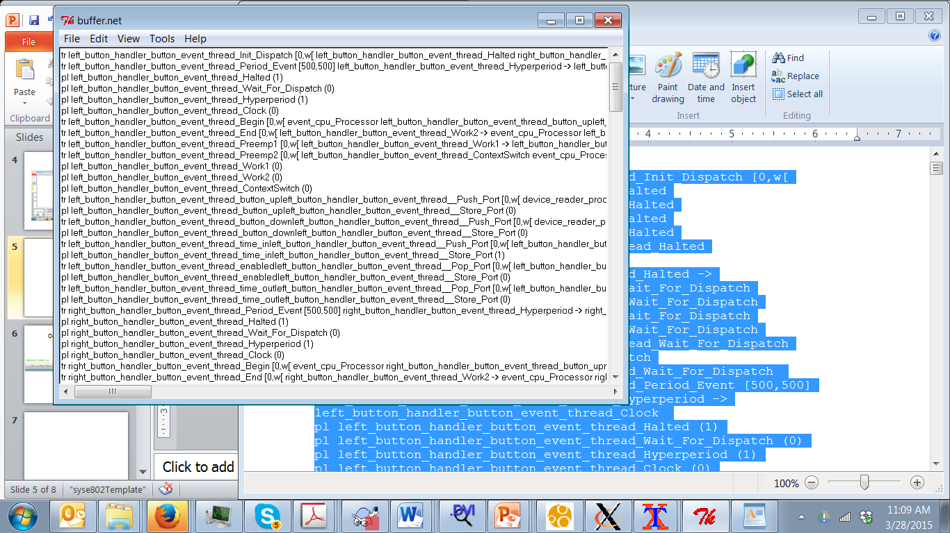
Paste

Slide 11
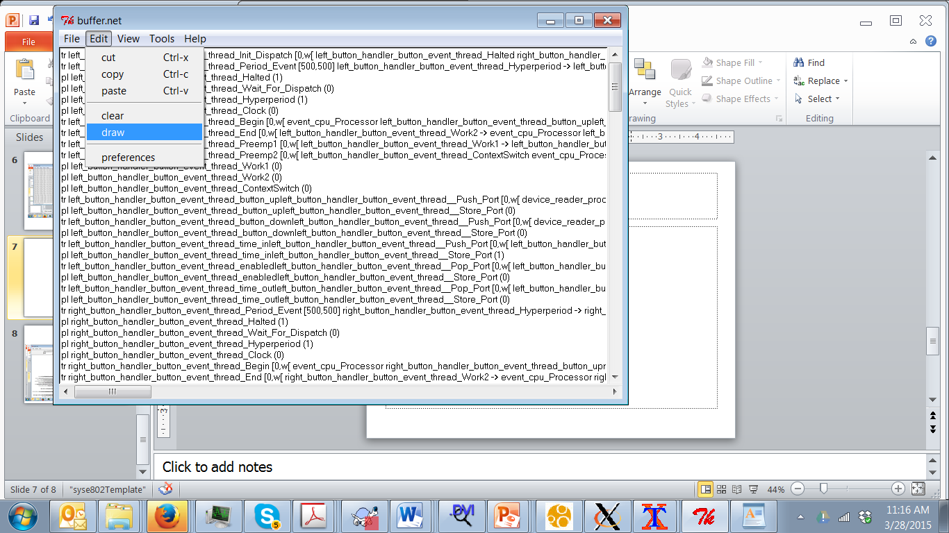
Draw the net

Slide 12
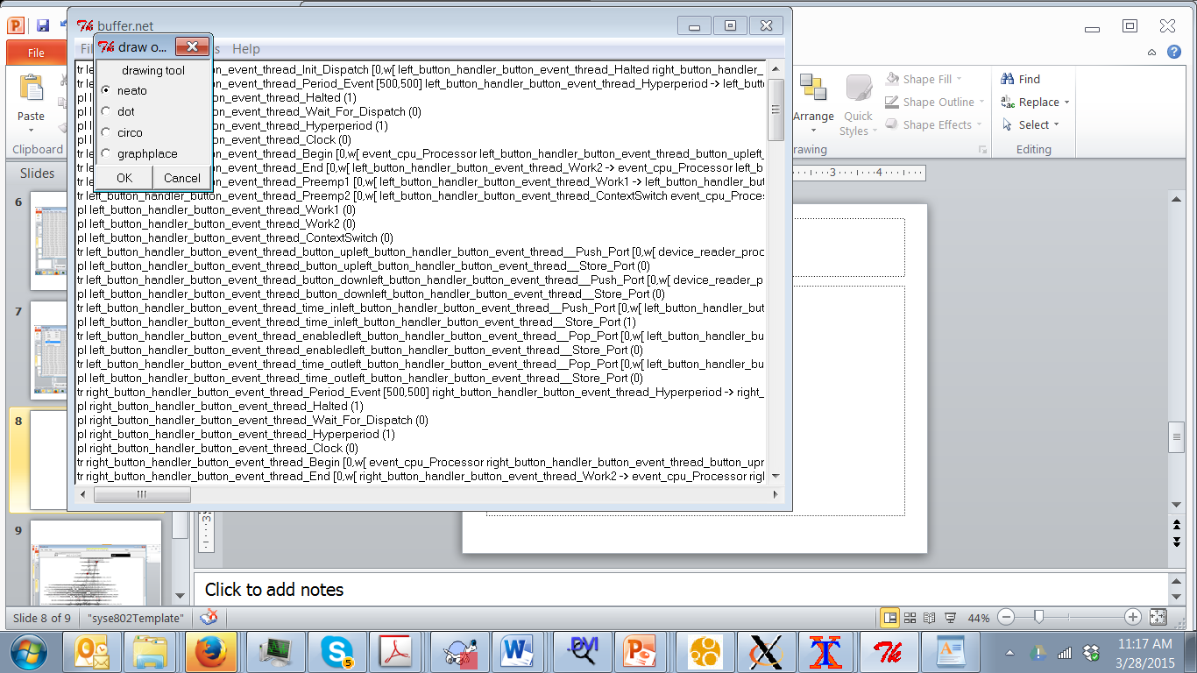
Need dot to draw the net

Slide 13
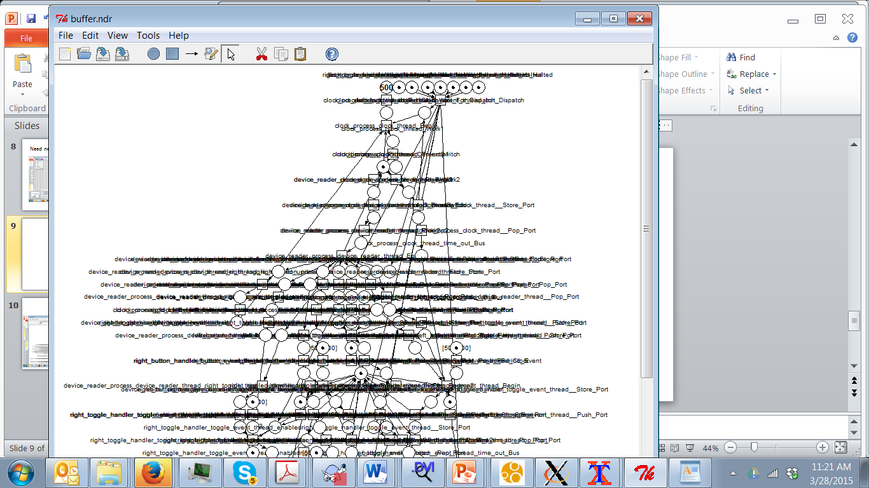
Petri net

Slide 14
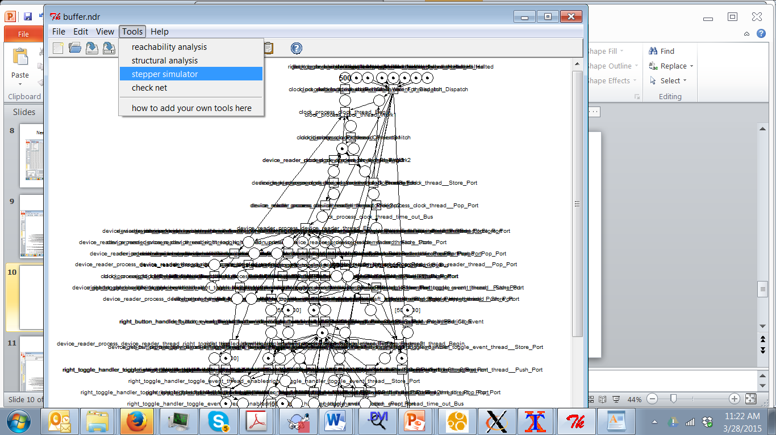

Slide 15
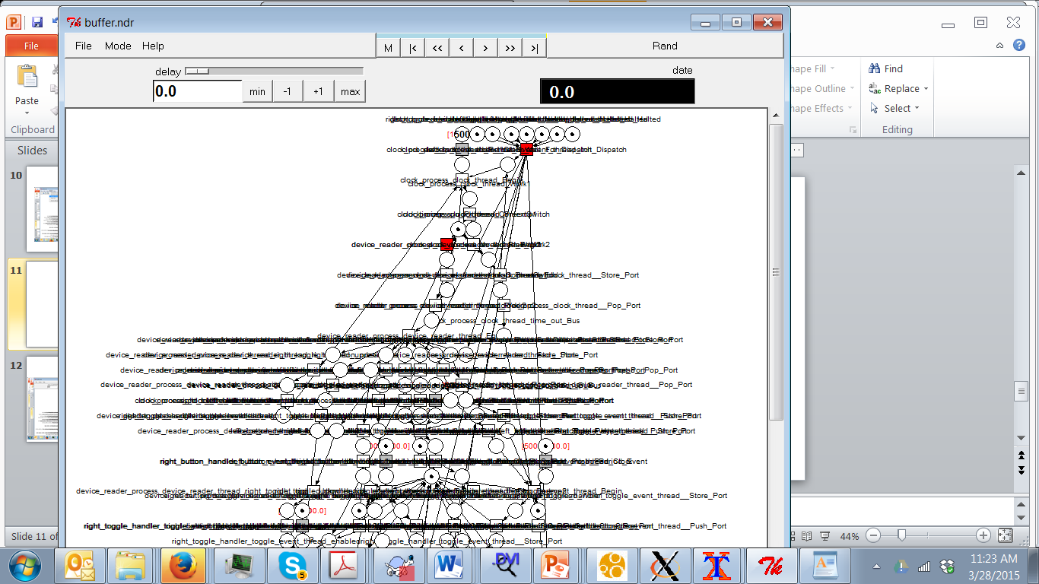

Slide 16
Basic interaction between threads
http://ieeexplore.ieee.org/xpls/abs_all.jsp?arnumber=5232029&tag=1

Slide 17
Thread

Slide 18
Thread life cycle

Slide 19
Event port pattern

Slide 20
Simulator commands
First, press RAND
Then press STOP
Rewind to simulation
Then press > or >|

Slide 21
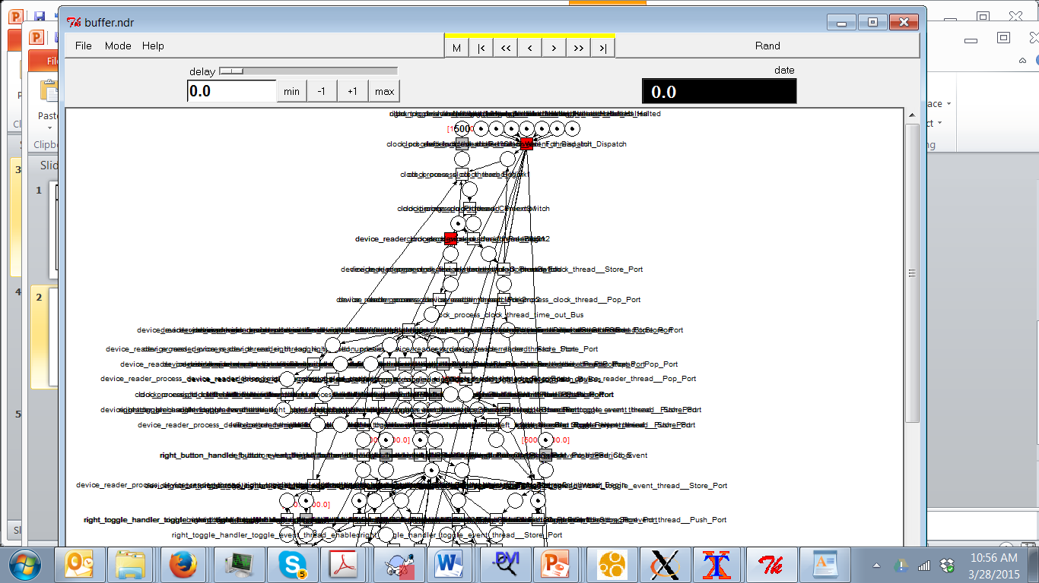

Slide 22
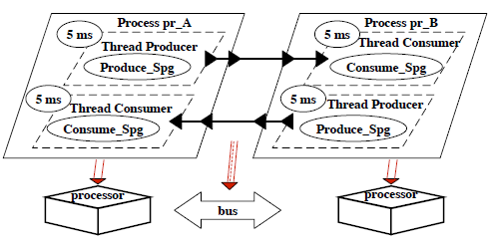
Producer/Consumer

Slide 23
Resulting petri net

Slide 24
Navigation architecture
http://ieeexplore.ieee.org/stamp/stamp.jsp?tp=&arnumber=4913075

Slide 25
Reference architecture for Module

Slide 26
Pub/sub

Slide 27
Specific experiment

Slide 28
Properties
Latency/performance
Testability
Maintainability
Modifiability

