Slide 1

CPSC 875
John D. McGregor
Ocarina

Slide 2
What you will need
Ocarina - http://penelope.enst.fr/aadl
Cygwin – if you are using windows you will need this implementation of Linux because Tina runs in Linux
Tina - http://projects.laas.fr/tina/download.php

Slide 3
Step 1
Install everything

Slide 4
Step 2
Generate code using ocarina
ocarina –b –g petri_nets my_file.aadl >model.net
See the ocarina documentation for various options
I am using csMore.aadl and Data_Model.aadl

Slide 5
Step 3 – Edit temp
------------------------------------------
------ Ocarina Petri Nets Generator ------
------------------------------------------
~~~~~~~~~~~~~~~~~~~~~~~~~~~~~~~~~~~~~~~~
~~~~~~~~~~~ Timed Petri Nets ~~~~~~~~~~~
~~~~~~~~~~~~~~~~~~~~~~~~~~~~~~~~~~~~~~~~
net AADL_TO_TPN_GENERATED
tr clientProcess1_clientThread_Init_Dispatch [0,w[ clientProcess1_clientThread_Halted serverProcess1
…
…
pl clientProcess1_clientThread_requestData_Bus (0)
pl serverProcess1_serverThread_requestData_Bus (0)
~~~~~~~~~~~~~~~~~~~~~~~~~~~~~~~~~~~~~~~~~~
~~~~~~~~~~~ Colored Petri Nets ~~~~~~~~~~~
~~~~~~~~~~~~~~~~~~~~~~~~~~~~~~~~~~~~~~~~~~
CN(3:net,1)
CM(11:declaration,1,1,1,5:Class)
Erase the red text (it will not be red in your file)
Scroll down til you see “~~~~”
Erase the red text to the end of the file

Slide 6
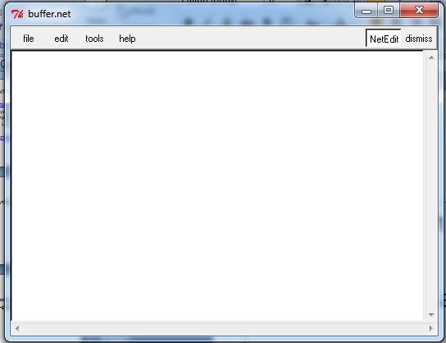
Step 4
Run nd which will be in the bin directory of the Tina
This brings up a GUI

Slide 7
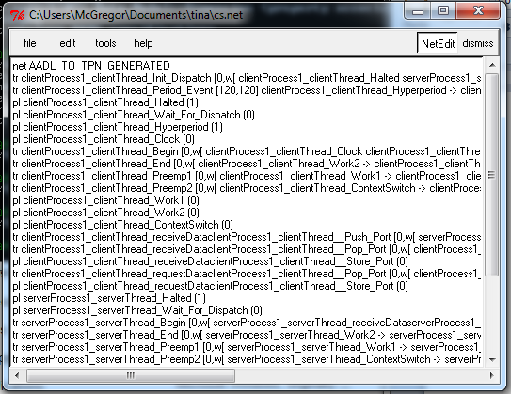
Step 5

Slide 8
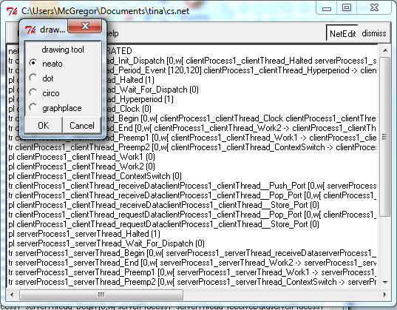
Step 6

Slide 9
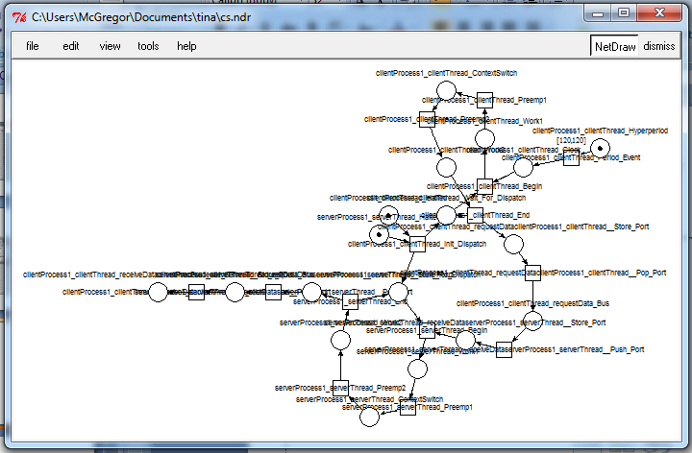
Step 7

Slide 10
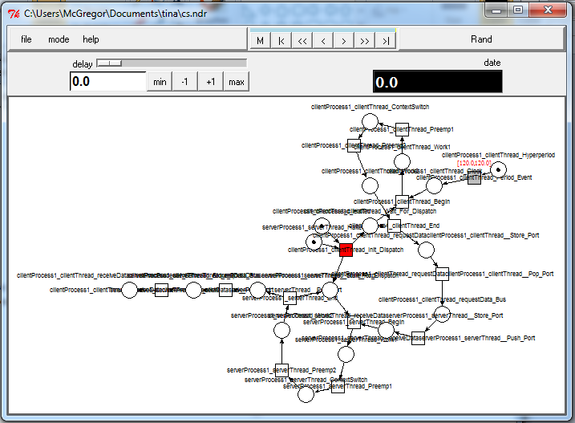
Step 8

Slide 11
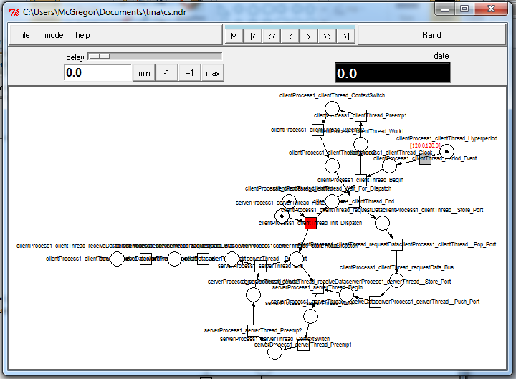
Click on Rand the click on |< --this is a workaround – just do it

Slide 12
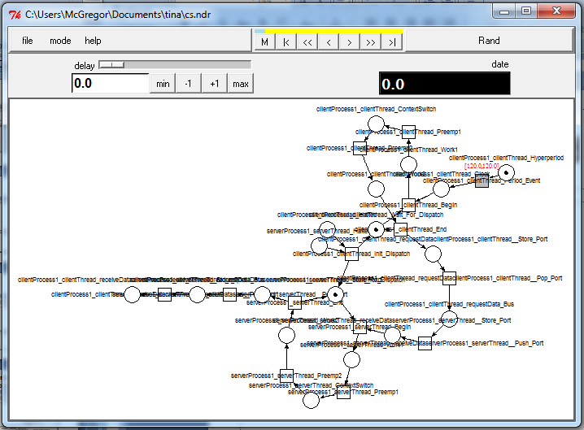
Click on > and the simulation will advance one step; continue clicking

Slide 13
Steps
Read the labels on the places in the petri net so that you can understand the flow of the program

Slide 14
Here is what you are going to do
There is an example aadl file on the course resource page.
Do this analysis on your robotic surgery model
Submit a print of your petri net and the .net file

