Slide 1
Designing in the Pacemaker Ecosystem
John D. McGregor

Slide 2
example architecture

Slide 3
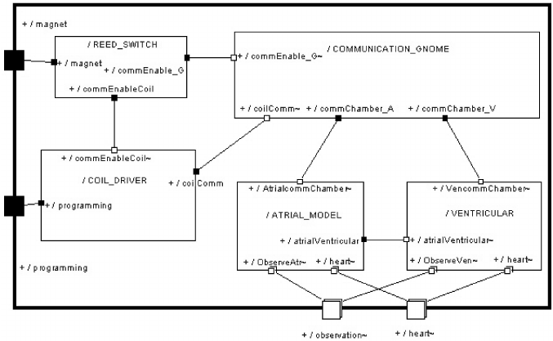
UML version

Slide 4
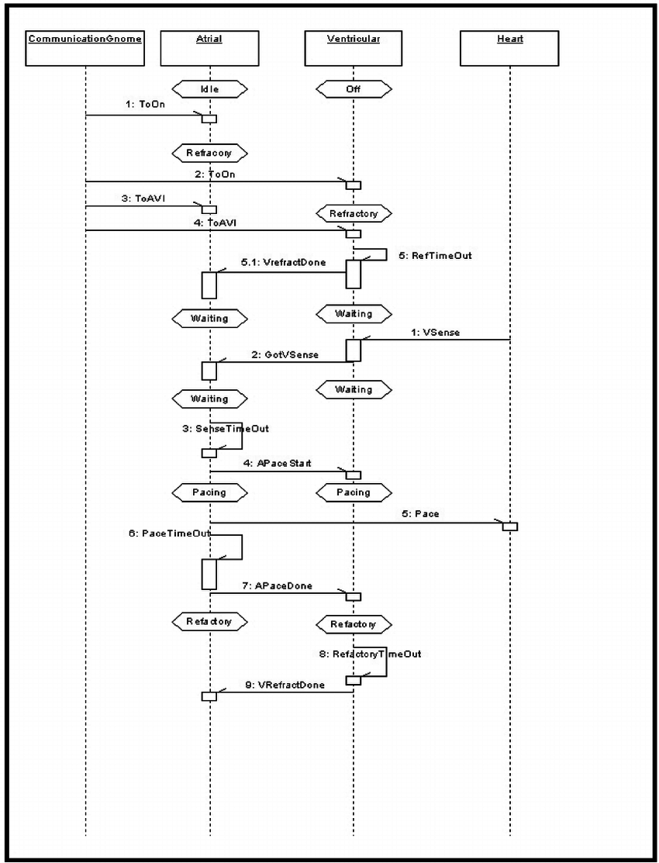

Slide 5
A complete pacemaker system
Developed by Fryad Rashad

Slide 6
Decompose into 2 subsystems
Onboard patient
Off-board
Distributed architecture techniques require synchronization.
This is a closed system so no need to translate between systems.

Slide 7
Look for pattern – feedback control loop for the Pulse Generator
Identify the controller, sensors, actuators, controlled process
Control unit is a finite state machine that controls timing and strength of pulse
Actuators/Pacing Unit – uses leads to “actuate” the heart when needed
Sensing Unit – same leads are used to administer shock

Slide 8
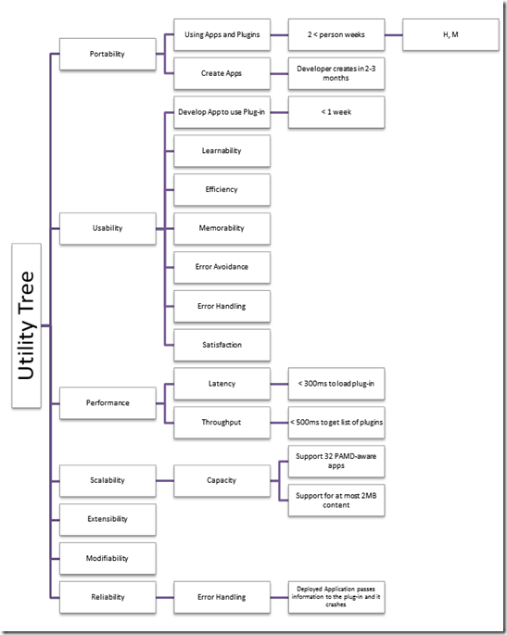
Implications

Slide 9
Model-View-Controller/Feedback-control loop
MVC
Display
Continuous display of heart activity
Human controller
Electronic controller
Model uses one of the accepted mode to define needed data
Feedback Loop
The DCM forms a controller in the feedback loop

Slide 10
Here’s What You Are Going To Do
Describe, in a narrative, at least 3 design decisions you have made in previous assignments. Why did you decide on the action that you took? What were the alternatives that you considered but did not select?
Commit by 11:59PM on Monday Feb 20

