Slide 1
Formal representations
John D. McGregor
C13_2019

Slide 2
07tn043
The link from the previous slide set for technical note 43 in 2007 is broken. Here is a different link to it. https://resources.sei.cmu.edu/library/asset-view.cfm?assetID=8277

Slide 3
Structures
We characterized an architecture as a graph
Modules are the nodes in the graph
A module encapsulates a concept
Each module has responsibilities related to the concept
Therefore, one criteria for defining modules is identifying the boundaries of concepts

Slide 4
Flows-1
A flow is a path through a module from one input port to an output port or a sink
Our job is to identify all of the flows that are necessary to satisfy all of the requirements for that module
At the module level we don’t care about the internal structure only from input to output
It is an estimate

Slide 5
Flows-2
Each segment of a flow takes a finite amount of time
Experience helps in estimation of latency
Each source, sink, and flow path has a latency value
As a module is decomposed we make estimates of the latency of each part adding up to the original estimate for the total

Slide 6
Connections
Work gets done by data flowing from module to module through the graph
A connection is a flow from an output port of one module to an input port of another module
Latency on a connection is due largely to
Technologies used
Amount of data to be transferred

Slide 7
Connections
Work gets done by data flowing from module to module through the graph
A connection is a flow from an output port of one module to an input port of another module
Latency on a connection is due largely to
Technologies used
Amount of data to be transferred

Slide 8
Connections - 2
Security, as a property, is viewed as whether info from one module should be seen in the connected module
In AADL Security has an integer value from 1 to 5

Slide 9
Analyses
Create an instance of the system
Click on the instance in the AADL Navigator
Right click on Analyses and then on the analysis you wish to run
Select that analysis and check the reports folder under the Instances folder

Slide 10
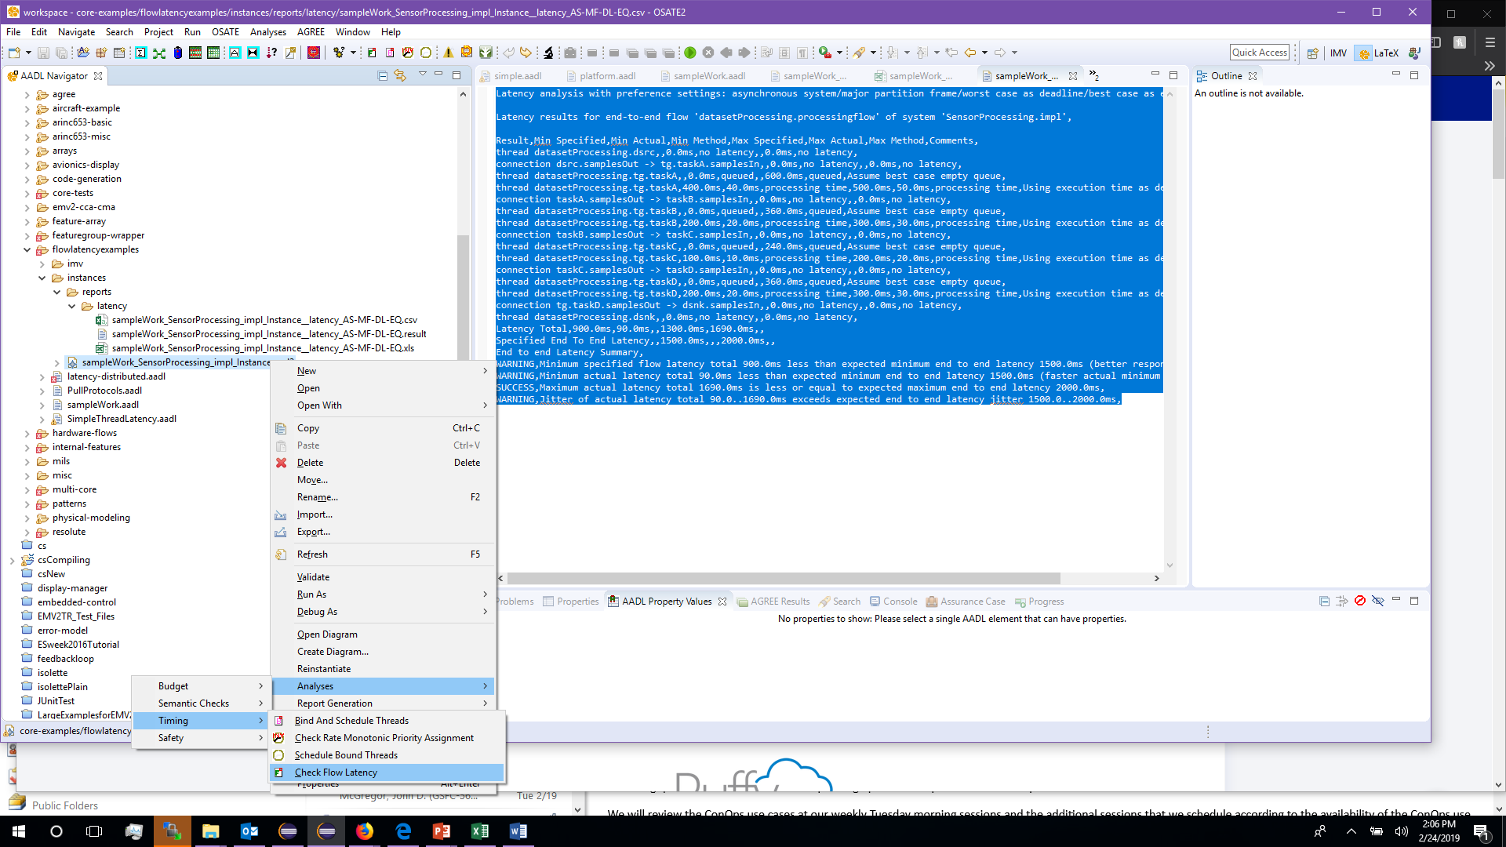

Slide 11
OSATE Latency Analysis – 1
Latency analysis with preference settings: asynchronous system/major partition frame/worst case as deadline/best case as empty queue
Latency results for end-to-end flow 'datasetProcessing.processingflow' of system 'SensorProcessing.impl',
Result,Min Specified,Min Actual,Min Method,Max Specified,Max Actual,Max Method,Comments,
thread datasetProcessing.dsrc,,0.0ms,no latency,,0.0ms,no latency,
connection dsrc.samplesOut -> tg.taskA.samplesIn,,0.0ms,no latency,,0.0ms,no latency,
thread datasetProcessing.tg.taskA,,0.0ms,queued,,600.0ms,queued,Assume best case empty queue,
thread datasetProcessing.tg.taskA,400.0ms,40.0ms,processing time,500.0ms,50.0ms,processing time,Using execution time as deadline was not set,
connection taskA.samplesOut -> taskB.samplesIn,,0.0ms,no latency,,0.0ms,no latency,
thread datasetProcessing.tg.taskB,,0.0ms,queued,,360.0ms,queued,Assume best case empty queue,
thread datasetProcessing.tg.taskB,200.0ms,20.0ms,processing time,300.0ms,30.0ms,processing time,Using execution time as deadline was not set,
connection taskB.samplesOut -> taskC.samplesIn,,0.0ms,no latency,,0.0ms,no latency,
thread datasetProcessing.tg.taskC,,0.0ms,queued,,240.0ms,queued,Assume best case empty queue,

Slide 12
OSATE Latency - 2
thread datasetProcessing.tg.taskC,100.0ms,10.0ms,processing time,200.0ms,20.0ms,processing time,Using execution time as deadline was not set,
connection taskC.samplesOut -> taskD.samplesIn,,0.0ms,no latency,,0.0ms,no latency,
thread datasetProcessing.tg.taskD,,0.0ms,queued,,360.0ms,queued,Assume best case empty queue,
thread datasetProcessing.tg.taskD,200.0ms,20.0ms,processing time,300.0ms,30.0ms,processing time,Using execution time as deadline was not set,
connection tg.taskD.samplesOut -> dsnk.samplesIn,,0.0ms,no latency,,0.0ms,no latency,
thread datasetProcessing.dsnk,,0.0ms,no latency,,0.0ms,no latency,
Latency Total,900.0ms,90.0ms,,1300.0ms,1690.0ms,,
Specified End To End Latency,,1500.0ms,,,2000.0ms,,
End to end Latency Summary,
WARNING,Minimum specified flow latency total 900.0ms less than expected minimum end to end latency 1500.0ms (better response time),
WARNING,Minimum actual latency total 90.0ms less than expected minimum end to end latency 1500.0ms (faster actual minimum response time),
SUCCESS,Maximum actual latency total 1690.0ms is less or equal to expected maximum end to end latency 2000.0ms,
WARNING,Jitter of actual latency total 90.0..1690.0ms exceeds expected end to end latency jitter 1500.0..2000.0ms,

Slide 13
AGREE
http://mys5.org/Proceedings/2014/Day_1_S5_2014/2014-S5-Day1-13_Backes.pdf
Examples:
https://github.com/osate/examples/blob/master/core-examples/agree/agree_basic1.aadl

Slide 14
Resolute
https://www.slideserve.com/evelyn-oneal/resolute-an-assurance-case-language-for-architecture-models
https://github.com/osate/examples/tree/master/core-examples/resolute

