Slide 1

CPSC 875
John D. McGregor
Wrap-up

Slide 2
Model-driven development (MDD)
Model-driven development refers to a development approach that focuses on models as the basic elements from which products are built.
When a change is required it is the model that is changed not the detailed source code.

Slide 3
Tool chain
MDD involves a sequence of tools that transform information from one form to another.
This involves two types of languages:
Primary modeling languages – SysML and UML
Transformation languages such as Xtext and Xpand

Slide 4
Requirements management
A database of requirements statements is developed in Word or Excel or DOORS
There is a standard format for each requirement statement such as:
Id (standard form such as L1-00n)
Statement
Attributes such as “priority”
These requirements are imported into a Topcased model

Slide 5
Requirements management - 2
The set of requirements that are imported are referred to as the upstream requirements.
The new requirements we will model are the “current” or “downstream” requirements.
The downstream requirements are derived from the upstream requirements and made more specific in the process.
In the DoD this is named L1 and L2 respectively.

Slide 6
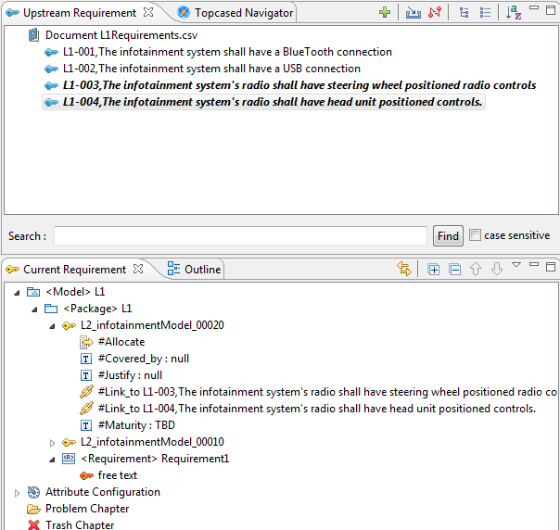
Requirements management - 3
An upstream requirement can be dragged into the current requirement list.
There is a link attribute that points back to the upstream requirement.
The new L2_infotainmentModel_00020 requirement is linked to L1-003.
Note that in the upstream L1-003 is italicized.

Slide 7
Requirements management - 4
Instead of dragging into the bottom box you could drag into a requirements diagram.
You now have a traceable set of requirements so that changes can be rippled back up the hierarchy.
DoD projects will derive L3 and L4 level requirements, each becoming more specific

Slide 8
Documentation generation
DocGen2 is a tool that takes a templated Word file and a Topcased model as input and produces a Word file as output.
The template in the Word file is defined using the Acceleo language – an Eclipse project.

Slide 9
Configuring the document
<config>
<param key=’workspace’ value=’c:/Users/McGregor/workspace’ />
<param key=’project’ value=’${workspace}/infotainmentModel’ />
<param key='model' value='${project}/Models/infoUses.sysml' />
<output path='${project}/infoUses.docx' />
</config>
Then context clauses are used to direct the tool:
<context model=’${model}’ importedBundles=’topcased’ searchMetamodels=’true’/>
Bundles are libraries of routines that will be called later
searchMetamodels indicates if multiple meta-models are used

Slide 10
Setup
The <gendoc> </gendoc> pair encompasses all processing.
Actors
[for (p.ownedElement->filter(Actor)->sortedBy(name))]
[self.name/]
[/for]
Becomes
Actors
Installer
Mechanic
driver
driver

Slide 11
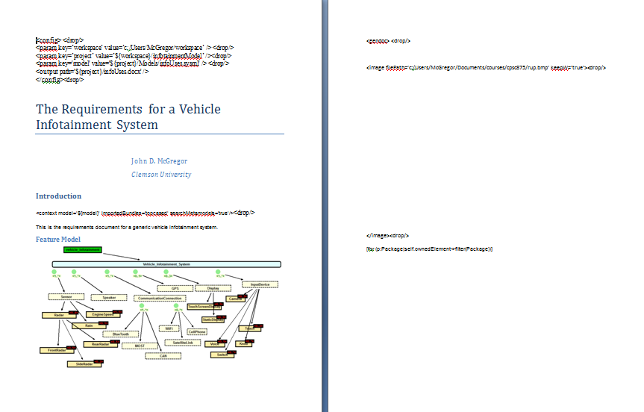
Template

Slide 12
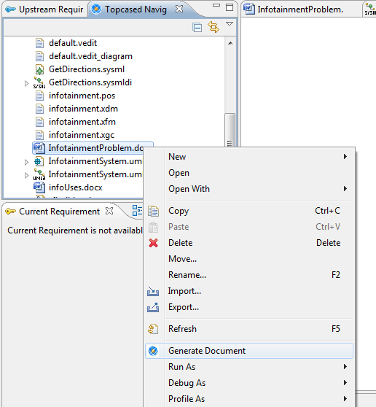
Processing
Right click on the templated Word file and select “Generate Document”
The Acceleo generator produces the new Word document infoUses.docx

Slide 13
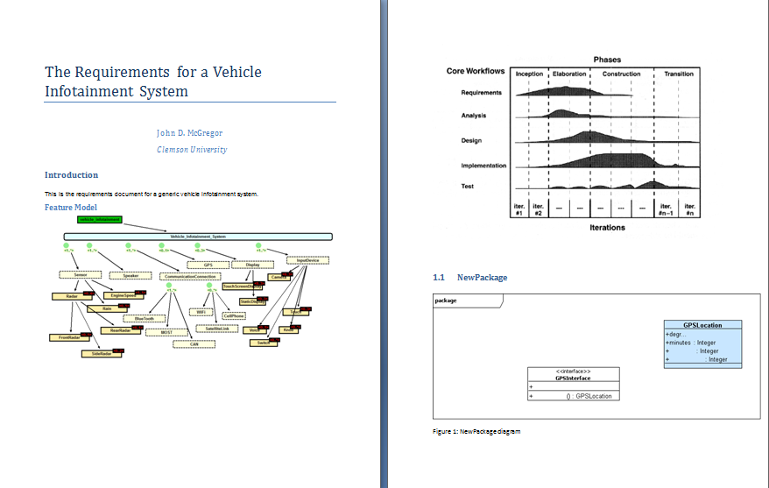
Producing

Slide 14
Left hand turn

Slide 15
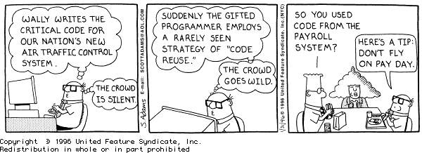
Getting the code

Slide 16
DSL Grammar
grammar org.xtext.example.HelloLanguage.MyDsl with org.eclipse.xtext.common.Terminals
generate myDsl "http://www.xtext.org/example/HelloLanguage/MyDsl"
Messages:
(messages+=Message)*;
Message:
HelloWorld|HappyFourthOfJuly;
HelloWorld returns HelloWorld:
'Hello_World' name=STRING;
HappyFourthOfJuly:
'Happy_Fourth_Of_July' name=STRING;

Slide 17
Sample program
Hello_World "John"
Hello_World "Reed"
Happy_Fourth_Of_July "Jim"
Happy_Fourth_Of_July "Jill"

Slide 18
Main.xpt
«IMPORT myDsl»
«DEFINE main FOR Messages-»
«EXPAND Template::main FOREACH (this.types.typeselect(HappyFourthOfJuly))»
«EXPAND DAO::dao FOREACH (this.types.typeselect(HappyFourthOfJuly))»
«EXPAND Template::main FOREACH (this.types.typeselect(HelloWorld))»
«EXPAND DAO::dao FOREACH (this.types.typeselect(HelloWorld))»
«ENDDEFINE»

Slide 19
HappyFourthofJuly.xpt
«IMPORT myDsl»
«DEFINE main FOR HappyFourthOfJuly»
«FILE "Greeting_"+name+".java"»
public class «"Greeting_"+name» {
public static void main(String[] args) {
System.out.println("«"Happy Fourth of July "+ name»");
}
}
«ENDFILE-»
«ENDDEFINE»

Slide 20
*.java
public class Greeting_Jill {
public static void main(String[] args) {
System.out.println("Happy Fourth of July Jill");
}
}

Slide 21
Right hand turn

Slide 22
Using what you have learned
You show up for a new project as the lead of the architecture team
What do you do?
Requirements
Constraints
Work the process

Slide 23
Requirements
Functional
What the system must do
What the system should do
Non-functional
Sets required levels of quality attributes
Prioritize

Slide 24
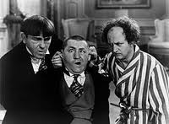
Constraints
Time
Results mean code
Culture
Agile or process heavy
Training/experience
Who do you have to work with
Your team

Slide 25
Quality
ies
IEEE Std. 1061 subfactors: Efficiency Portability • Time economy • Hardware independence • Resource economy • Software independence Functionality • Installability • Completeness • Reusability • Correctness Reliability • Security • Non-deficiency • Compatibility • Error tolerance • Interoperability • Availability Maintainability Usability • Correctability • Understandability • Expandability • Ease of learning • Testability • Operability • Comunicativeness

Slide 26
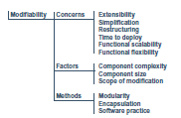
Factors
What do we measure?

Slide 27
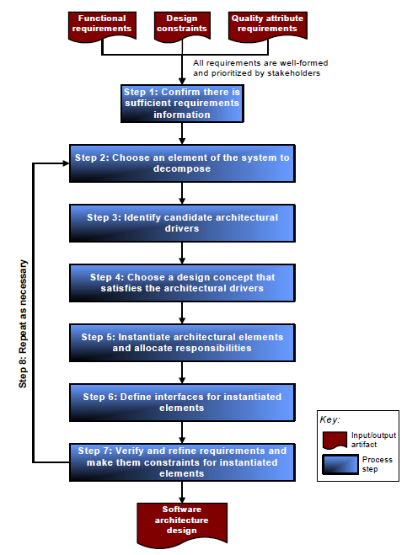
Steps

Slide 28
Module structures
Decompose – module into sub modules. Pieces related to the whole
Uses – one module expects another to be present
Layered – decomposition in which there is an ordering
Class – specialization relationships
module
decomposition
class
uses
layered

Slide 29
Component and Connector
Client/server – multiple modules go to a common module for the same action
Concurrency – logical threads
Process – actual threads/ processes of the system
Shared Data – how is data stored and accessed
Component and Connector
Client/server
Shared data
process
concurrency

Slide 30
Allocation structures
work assignment– module assigned to a team
deployment – which processor has which threads
implementation – where in CM are the files for this module
allocation
Work
assignment
implementation
deployment

Slide 31
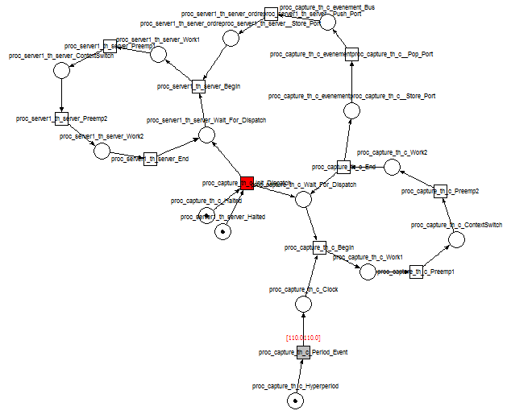
Ocarina
Petri net shows complexity
This representation supports simulation

Slide 32
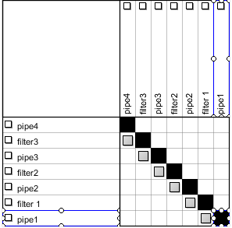
Pipe and Filter DSM

Slide 33
Conceptual Flow of ATAM
Business
Drivers
Quality
Attributes
Scenarios
Analysis
Software
Architecture
Architectural
Approaches
Architectural
Decisions
Tradeoffs
impacts
Sensitivity Points
distilled
into
Non-Risks
Risk Themes
Risks

Slide 34
Mirroring
The architecture of a software product will closely resemble the architecture of the organization that built it.
So, structure the organization the way you want the product to look
For example, using an SOA design? Services should be written by small disconnected groups.

Slide 35
The Premise
Simple architectures have conceptual integrity
Architectures that are simple are better than those that are more complex
A process of continuous architectural refactoring helps to converge a system to its practical and optimal simplicity
Next few slides are from Grady Booch

Slide 36
Attending to Simplicity
The fundamentals
Define crisp abstractions
Employ a good separation of concerns
Have a balanced distribution of responsibilities
Insofar as a system embraces these fundamentals, it is simple; when and where it strains these fundamentals, it is complex

Slide 37
From Complexity to Simplicity
Complexity masks the essential elements of a system
Insofar as we have to expend energy to brush away the surrounding crud that obscures that essence, we’ve lost something in the message and we’ve hidden the
Underlying purpose
Uniqueness
Elegance
Beauty

Slide 38
On Architectural Failure
Sometimes, systems fail because their architects have chosen a fundamentally wrong architecture
Most of the time, projects
Die the death of a thousand cuts
Are nibbled to death by ducks

Slide 39
On Architectural Failure
A thousand cuts
Collapse happens because of the accumulated weight of well-intentioned and reasonable local decisions that assemble over time at the expense of global optimization and simplicity
Nibble to death by ducks
You rarely see the end coming, until some factor pushes your fragile, complex system over the edge into collapse

Slide 40

Architects have to be ever vigilant

