Slide 1
Infotainment architecture
John D. McGregor

Slide 2
views
Business logic server
Database server
model
controllers
client
client
client

Slide 3
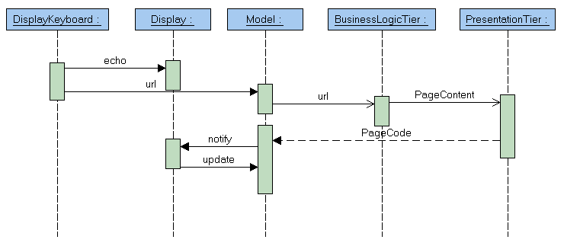
Handling a url request

Slide 4
Browser

Slide 5
views
Business logic server
Database server
Browser
model
controllers
client
client
client

Slide 6
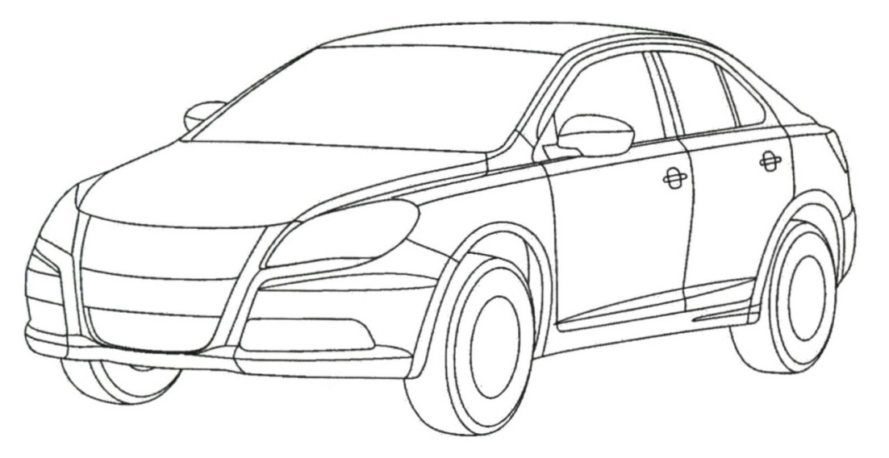
Wheel rotation sensing
CAN bus
views
model
controllers
client

Slide 7
Blackboard architecture
bus
views
model
controllers
Shift power between wheels
client

Slide 8
Logging
Business logic server
Database server
views
Browser
logging
model
controllers
client
client
client
client

Slide 9
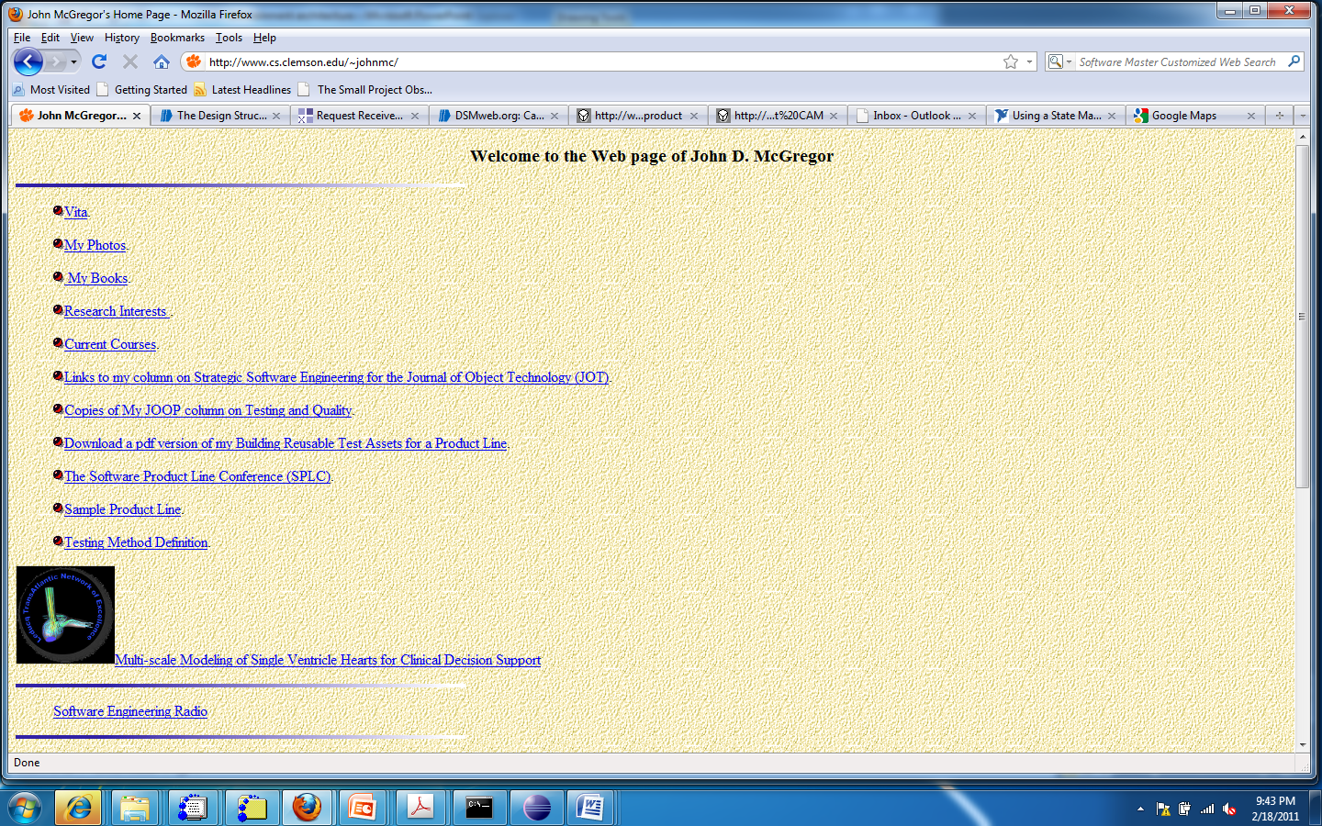
Browser
views
Browser
model
controllers
client
client
What travels between a controller and model in the browser?
What does the model do about it?
What happens about the view?

Slide 10
Integration
The browser cuts across our MVC architecture but we will buy the browser so how is the browser integrated? What options do we have?
Do we want all displays to use a browser approach? Only the head unit display?

Slide 11
How to access info on the fly?
We need to be able to get information such as traffic reports, weather, flight status on the fly. How do we do it? Options?

Slide 12
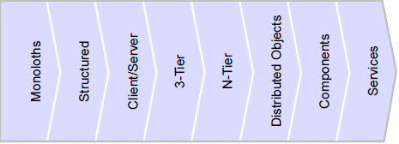
Service Oriented Architecture

Slide 13
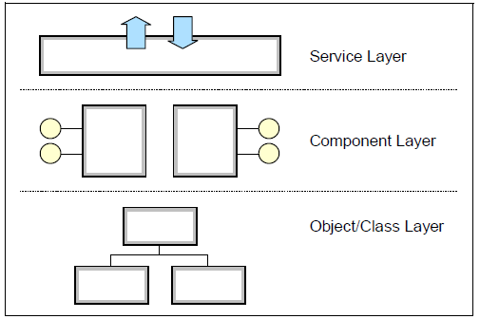
Service Oriented Architecture - 2

Slide 14
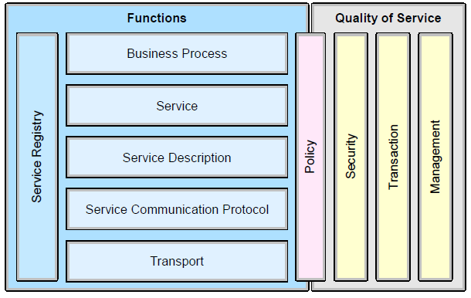
Service Oriented Architecture - 3

Slide 15
Service Oriented Architecture - 4
Service
Service
GPS
Business logic server
Database server
views
Browser
logging
model
controllers
client
client
client
client
cell

Slide 16
Quality Attributes
Where do we stand?
How have we done relative to our priorities?

Slide 17
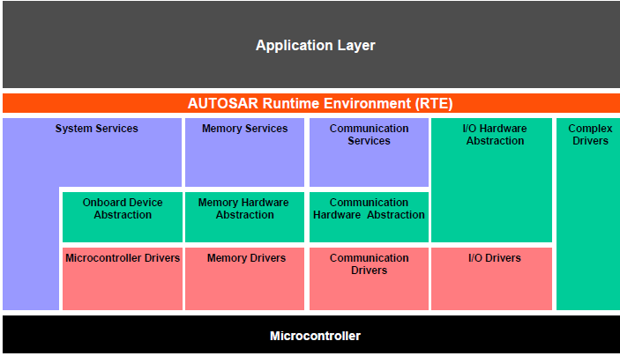
AUTOSAR

Slide 18
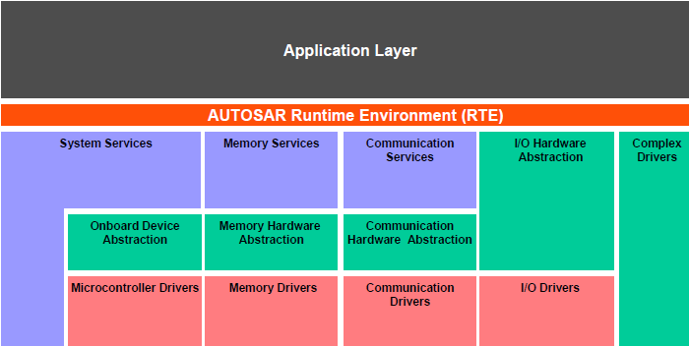
Business logic server
Database server
Browser
views
Browser
logging
model
controllers
client
client

