Slide 1

CpSc 875
John D. McGregor
Class 1
Overview

Slide 2
Syllabus
Important consideration – this course meets at 8am 2 days a week – can you manage that?
No textbook – we will use original sources
Note the date of the final
Questions?

Slide 3
You probably didn’t know when you registered that
This is really several courses in one:
  Design
  Business strategy
  Organizational theory
  Economics
  Psychology
  Computer science

Slide 4
Tools
OSATE
  Download from the course resources page
Have this installed and running by next class
AADL tutorial information
  http://www.openaadl.org/post/2013/07/11/aadl-esweek/ (keep looking there are copies of the slides)

Slide 5
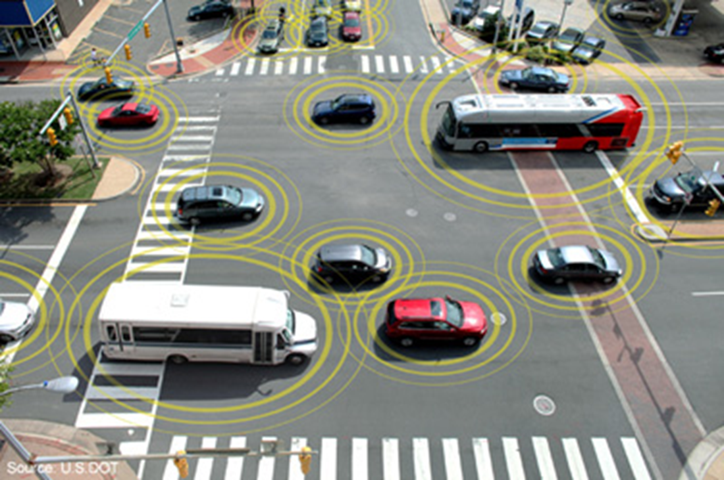
Connected, Smart Vehicles

Slide 6
Running example
READ BEFORE Jan 13 - Alexander Pretschner, Manfred Broy, Ingolf H. Kruger, and Thomas Stauner. 2007. Software Engineering for Automotive Systems: A Roadmap. In 2007 Future of Software Engineering (FOSE '07). IEEE Computer Society, Washington, DC, USA, 55-71. DOI=10.1109/FOSE.2007.22 http://dx.doi.org/10.1109/FOSE.2007.22
http://www.volpe.dot.gov/advanced-transportation-technologies/technology-innovation-and-policy/connected-vehicle-policy

Slide 7
Definition of software architecture
The software architecture of a program or computing system is the structure or structures of the system, which comprise software elements, the externally visible properties of those elements, and the relationships among them.
Software Architecture in Practice (2nd edition), Bass, Clements, Kazman; Addison-Wesley 2003

Slide 8
Course Threads
Designing the architecture
  A process
  Decisions and trade-offs
Communicating the architecture
  Notations
  Content
Optimizing business value

Slide 9
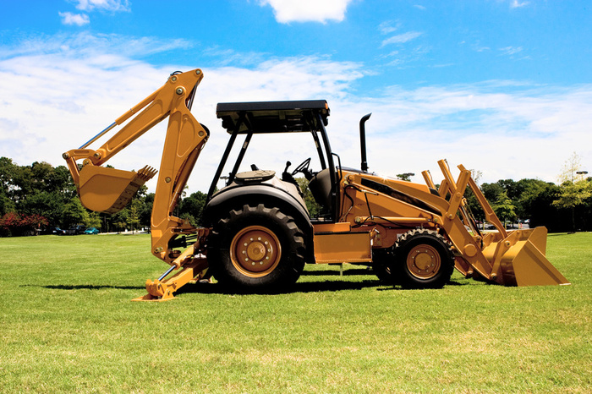
Starting the process
Don’t just start digging the foundation
Few “green field” projects
Have some domain experience and architectural background
www. http://www.iteris.com/cvria/index.html
www.autosar.com

Slide 10
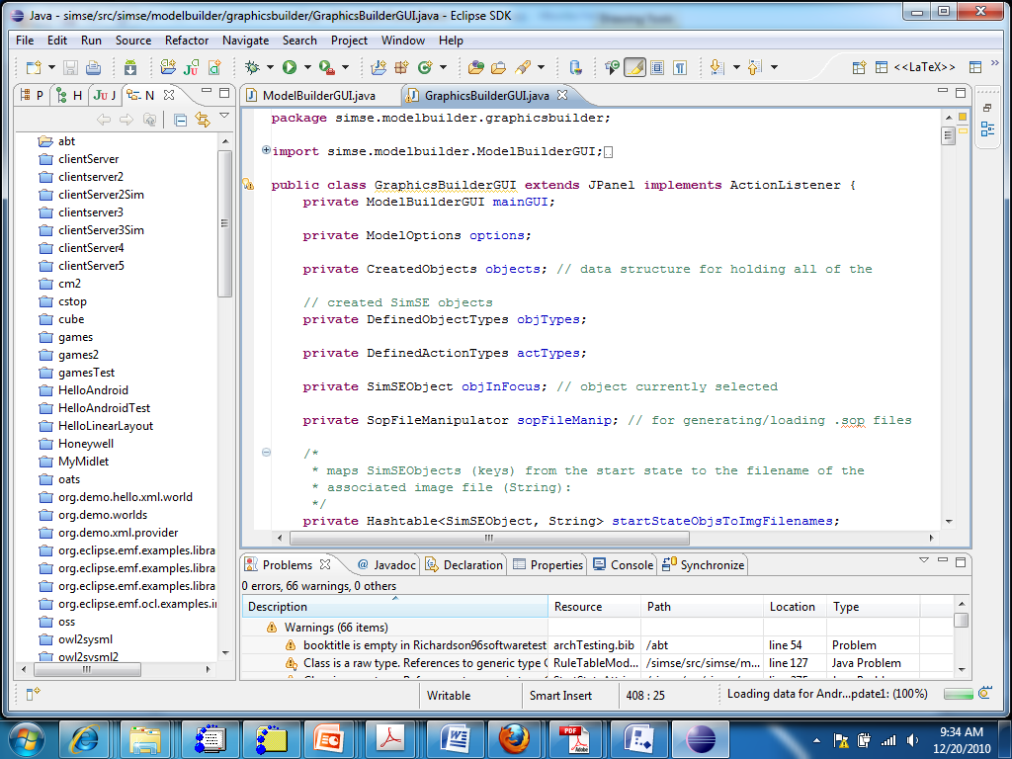
Eclipse

Slide 11
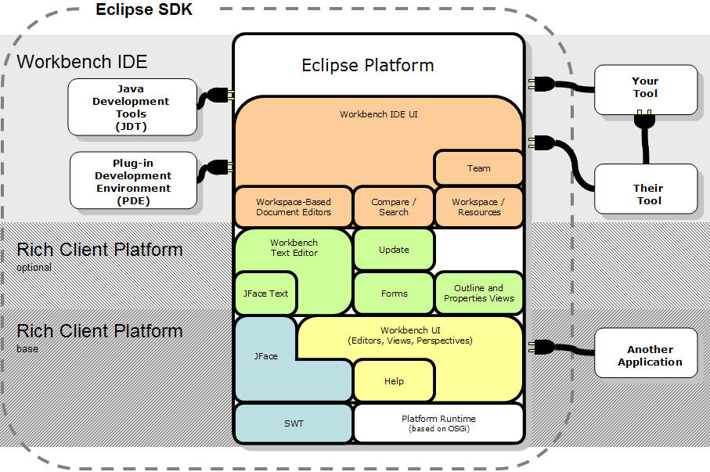
Eclipse architecture cartoon

Slide 12
Pieces
Modules, subsystems, …
These are pieces of a system and entities with which the architect works.
Determining what a particular module does is the job of the architect
How a particular module does its assigned job is a detailed design issue not an architecture issue
Architectural issues cross module boundaries

Slide 13
Orchestration/choreography
The architect creates pieces for certain reasons
And connects certain pieces to achieve specific objectives.
The architect orchestrates the interactions of the pieces of the system but leaves the details to the engineers.

Slide 14
System/software
A system is the complete package needed to solve a problem. It will usually include:
  Hardware – stand-alone computer; an electronic controller embedded in an assembly such as a brake assembly; an integrated multi-function device such as a cell-phone
  Software – an operating system or an end-user application
Some people even include the users and other non-computing elements as part of the system

Slide 15
Classes of systems
System
System of systems
Cyber-physical system
Complex adaptive systems
Ultra-large scale system

Slide 16
Types of architectures
Software architecture
System architecture
Reference architecture
Enterprise architecture

Slide 17
Stakeholders
A stakeholder is any person with an interest in the system.
We will listen harder to some stakeholders than others.
In our techniques often we will give stakeholders differing numbers of votes based on their priority.
The architect is a diplomat but also a dictator.

Slide 18
Business Goals
The goals of the business must be reflected in the architecture of its software-intensive products.
Business strategy is used to set the business goals and influence the architecture.
Do you want to dominate the market? Become part of a community? Be the center of that community?

Slide 19
Porter’s 5 Forces Strategy Development Technique
Potential Entrants
Suppliers
Competitors
Buyers
Substitutes

Slide 20
Strategy/architecture
Today many products are designed to work with other products. For example, our infotainment system will allow cell phones, ipods, etc. to be connected to our product.
Our strategy is to
  establish an ecosystem of companies that work with auto OEMs.
  expand our market by accommodating a variety of technologies.
  Ride the crest of the wave of change in vehicles
Our architecture will be a domain-specific architecture that emphasizes
  Light weight, small footprint hardware
  Flexible, and
  Easily modified software.

Slide 21
Platform
This term has many meanings.
Some people see it as
  an operating system
  An operating system and processor instruction set
  But it may be a software platform.
Essentially a “platform” is a dividing line below/ beyond which product builders have no control.
A product may be intended for many platforms but each will have some unique characteristics.

Slide 22
Platform - 2
Microsoft windows/Intel-compatible processor is considered a platform
The software architect has to understand the characteristics of the platform.
In organizations that manufacture platforms, the software architect may be part of an architecture team that covers both hardware and software.

Slide 23
Ecosystem
A platform is often the basis for an ecosystem.
An ecosystem is a group of systems or companies that enhance or degrade each other.
There may be several accounting packages all within the same ecosystem.
A company may deploy their products in multiple ecosystems with different sets of features.

Slide 24
Ecosystem - 2
An ecosystem encompasses a wide range of types of companies and every member of the ecosystem is a stakeholder (although of varying priorities).
The ecosystem can control directions of the marketplace if it is sufficiently large and influential
http://advice.cio.com/thomas_wailgum/11248/apples_ipad_ecosystem_suppliers_and_developers_hard_at_work

Slide 25
Requirements
This is not a course on requirements but they are a necessary input into the architecting process
We will use a hybrid of use cases, features, a language referred to as reqspec.
A use case is a description of an actual “use” of the system to be developed.
An actor is the source of the stimulus from outside the system.
The use is a set of stimulus/response pairs.
There are relationships between uses: extends, generalizes, includes.

Slide 26
Functional requirements
These are the things that the system must be able to do:
  Example: The brake system reduces the velocity of the vehicle
Typically 80% of project problems are related to the requirements

Slide 27
Non-functional requirements
“How” a functional requirement is carried out
  How fast must it be carried out
  How reliably
A quality attribute is a characteristic of a piece of software
A non-functional requirement sets a bound on the value of a quality attribute for the system under design
“The addition of a new feature must be done in 5 days or less” – non-functional requirement on the modifiability quality attribute
“The velocity of the vehicle must be reduced to zero within seconds” – stopability quality attribute
A quality attribute is sometimes termed an “ility”

Slide 28
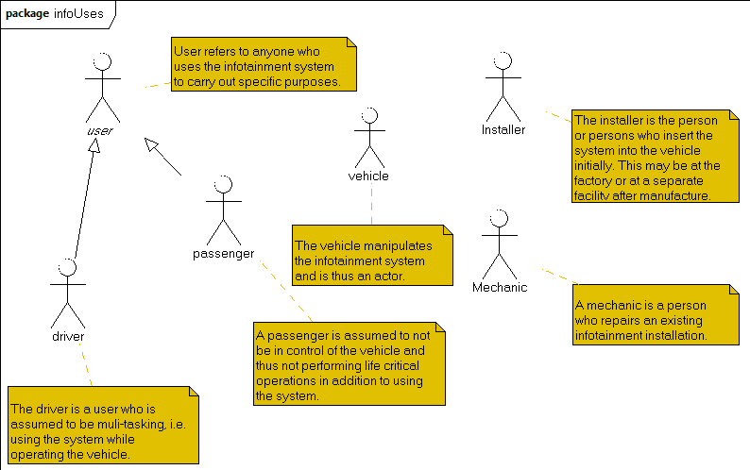
Use case diagram
Actor is a stimulus from outside the system
Actors are a subset of stakeholders

Slide 29
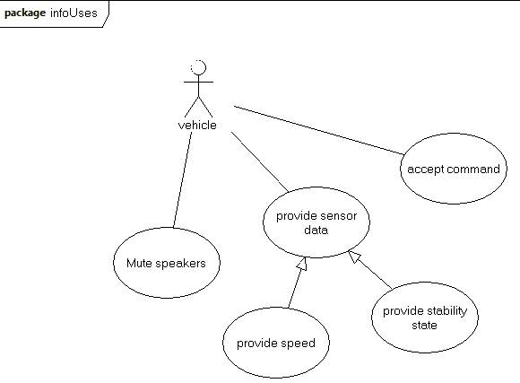
Use case diagram - 2
Use case is a single use of the system triggered by an actor.
Association relates an actor to a use
Extends relates a use to a use by adding on.
Generalizes relates a use to a use by resolving abstractions.
Reference: www-edlab.cs.umass.edu/cs520/OMG-Tutorials/Tut2BehaviorModeling.ppt

Slide 30
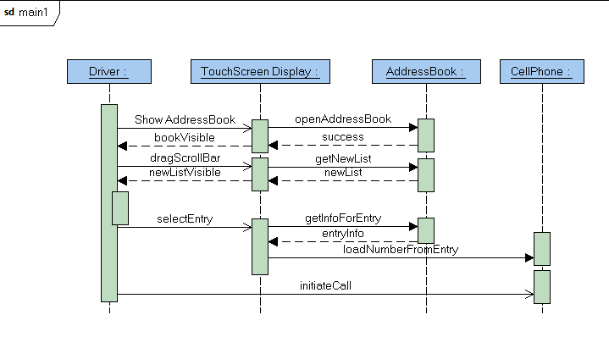
Sequence Diagram
Shows the sequence of interactions.
Each “life line” – the vertical line – is the life of an object – an instance of a class.
Closed arrows are synchronous and open arrows are asynchronous messages.

Slide 31
Specification/Interface
A specification defines the public methods (functions) that a module provides.
An interface defines the interaction of two or more modules through provided and required methods.
An architecture defines modules, their specifications, and interfaces and determines which modules should be associated in the interface.

Slide 32
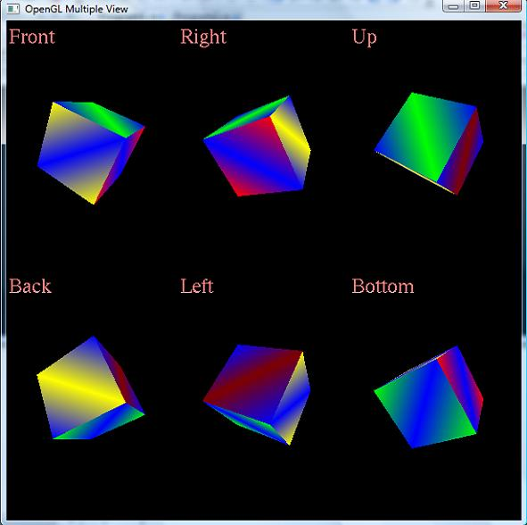
Views
Different ways of looking at the same thing.

Slide 33
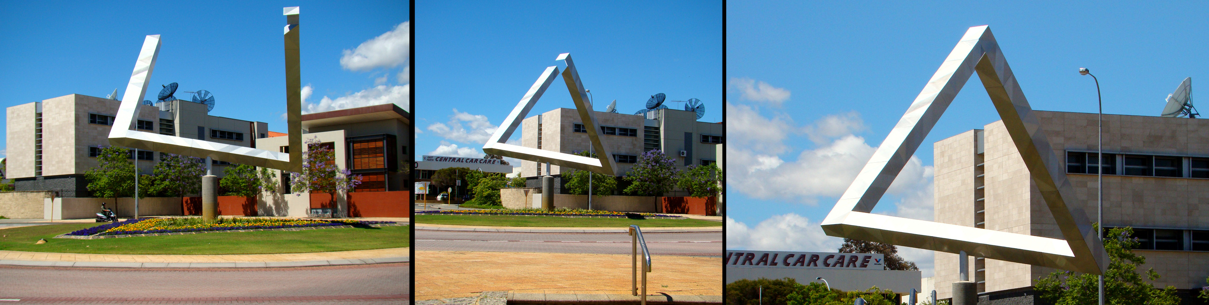
One entity, 3 views

Slide 34
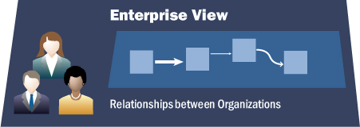
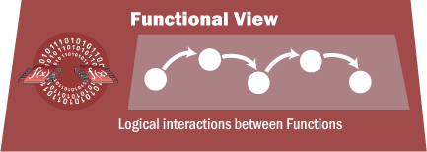
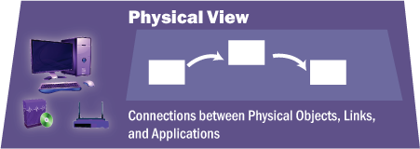
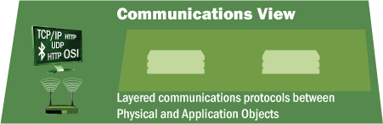
Multiple views
CVRIA views

Slide 35
Reading – original sources
Creating
  http://www.sei.cmu.edu/reports/06tr023.pdf
  http://www.sei.cmu.edu/reports/07tr005.pdf
Communicating
  http://www.sei.cmu.edu/architecture/tools/viewsandbeyond/index.cfm
  http://www.sei.cmu.edu/reports/05tn017.pdf

Slide 36
Action list for next class
Install and test the required software
Read the first reference for the running example
Read the first tech report on the previous slide
Scan http://www.autosar.org/fileadmin/files/releases/4-2/software-architecture/general/auxiliary/AUTOSAR_EXP_LayeredSoftwareArchitecture.pdf
And
http://standards.its.dot.gov/DevelopmentActivities/CVReference
Get enough sleep to last the entire semester

