Slide 1

CPSC 875
John D. McGregor
C10 – Error Design

Slide 2
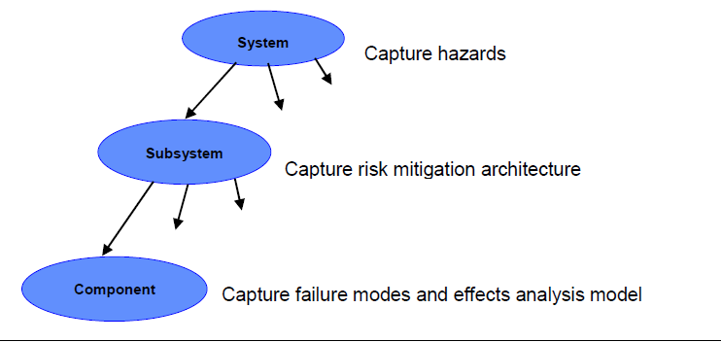
Error design

Slide 3
Exception handling
Always clean up after yourself
Never use exceptions for flow control
Do not suppress or ignore exceptions
Do not catch top-level exceptions
Log exceptions just once

Slide 4
PrimaryBackupPattern
system implementation PrimaryBackupPattern.impl
subcomponents
primary: system sys in modes (Primarymode);
backup: system sys in modes (Backupmode);
connections
inprimary: data port insignal ->
primary.insignal in modes (Primarymode);
inbackup: data port insignal -> backup.insignal
in modes (Backupmode);
outprimary: data port primary.outsignal ->
outsignal in modes (Primarymode);
outbackup: data port backup.outsignal ->
outsignal in modes (Backupmode);
modes
Primarymode: initial mode;
Backupmode: mode;
end PrimaryBackupPattern.impl;

Slide 5
Error design
error model Example1
features
ErrorFree: initial error state;
Failed: error state;
Fail, Repair: error event;
CorruptedData: out error propagation
{Occurrence => fixed 0.8};
end Example1;
error model implementation Example1.basic
transitions
ErrorFree-[Fail]->Failed;
Failed-[out CorruptedData]->Failed;
Failed-[Repair]->ErrorFree;
properties
Occurrence => poisson 1.0e-3 applies to Fault;
Occurrence => poisson 1.0e-4 applies to Repair;
end Example1.basic;

Slide 6
Using error model
system computer
end computer;
system implementation computer.personal
subcomponents
CPU: processor Intel.DualCore;
RAM: memory SDRAM;
FSB: bus FrontSideBus;
annex Error_Model {**
Model => My_ErrorModels::Example1.basic applies to CPU;
Occurrence => fixed 0.9 applies to error CPU.CorruptedData;
**};
end computer.personal;

Slide 7
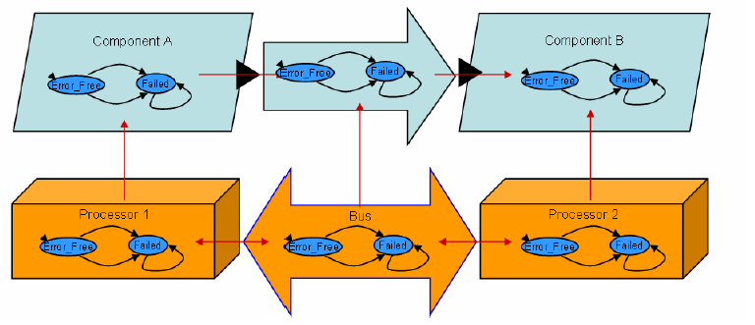
Propagation

Slide 8
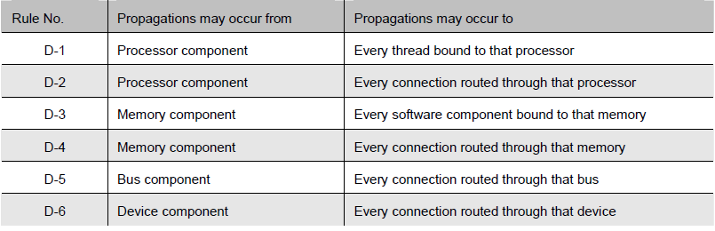
Error Propagation

Slide 9
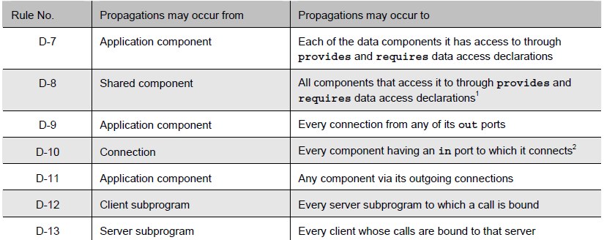
Propagations

Slide 10
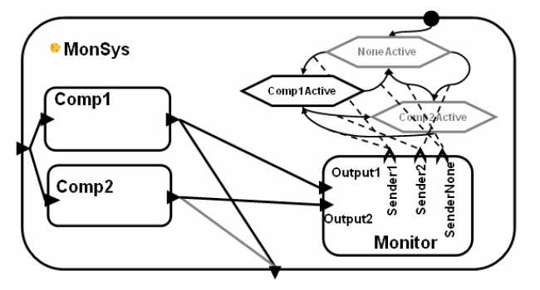
Full spec

Slide 11
Next steps
Read:
http://hbswk.hbs.edu/item/5699.html At the bottom of the page there is a place to download “Full Working Paper Text”
http://www.sei.cmu.edu/reports/07tn043.pdf
Continue to expand your AADL model
Add at least one state machine
Define and bind to a platform
Identify at least one type of error and add to your model

Slide 12
Next steps – Mar 3rd
individual
Bring EPF up to date and submit
Team
Identify at least one type of error and add to your model and submit

