Slide 1

CpSc 875
John D. McGregor
C 12 – Architecture Evaluation

Slide 2
Architecture adds value
Value is a synonym for desirableness
If the value of something increases it is because it has become more desirable for some reason
A “value chain” represents a sequence of stages, each of which makes the “thing”, for which this is the value chain, more desirable.
The value chain for a software product is the series of activities that craft a solution.

Slide 3
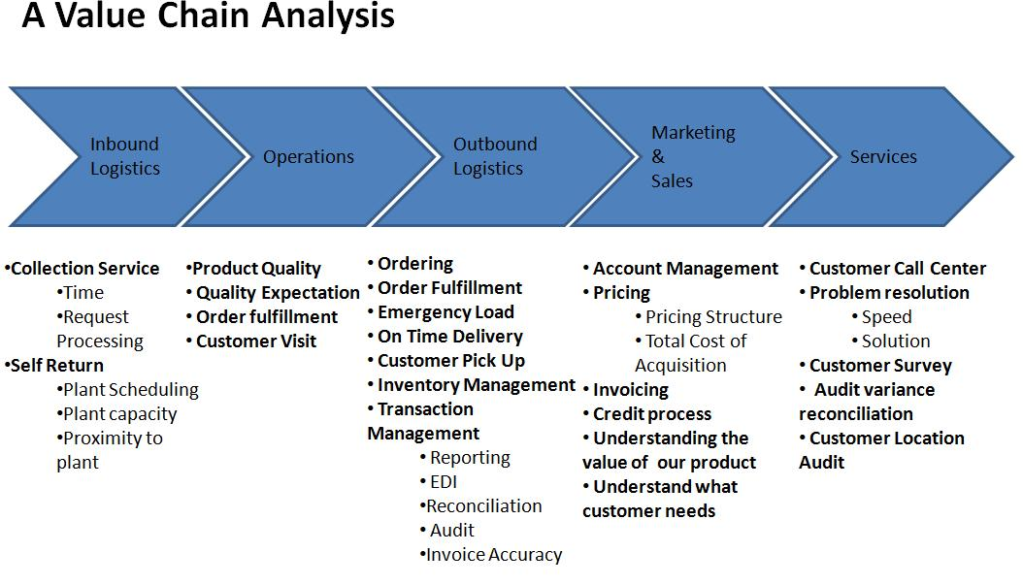
Porter’s Value Chain

Slide 4
Adding value
How does architecture add value? (How does it make the product more desirable?)
  Increased probability that customers like the product
  Increased probability of highly reliable operation
  Increased probability that the product will have the qualities desired
  Increased predictability of implementation

Slide 5
Adding value - 2
Even architecture evaluation adds value
It removes defects making the architecture more desirable as a basis for building a product
Question: How do we measure these increases in value?

Slide 6
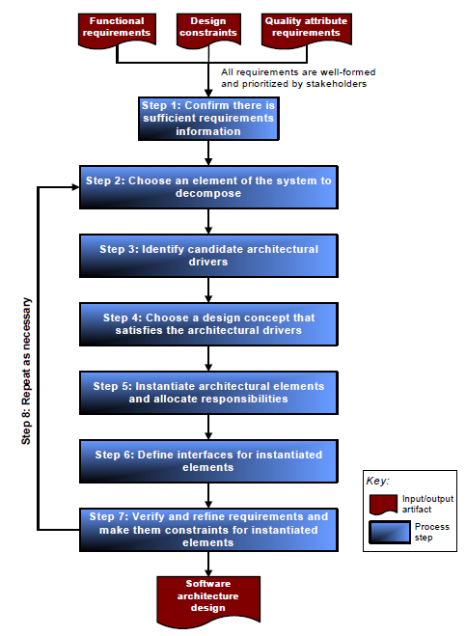
Where are we?

Slide 7
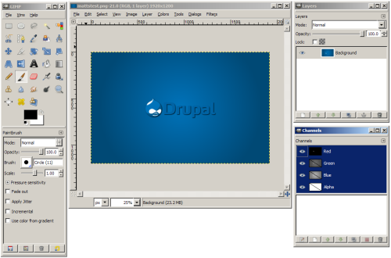
Architecture of the day
GIMP – multiple windows that share state
Could use MVC but need a more efficient communication and a more structured communication

Slide 8
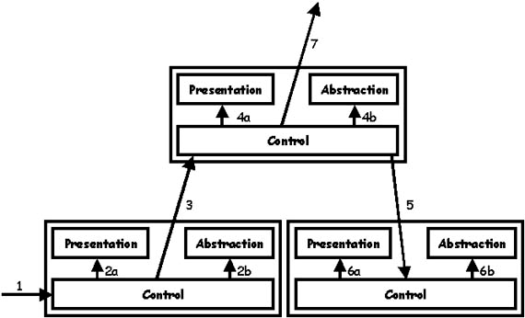
PAC
Escalates up hierarchy and then back down

Slide 9
http://www.vico.org/pages/PatronsDisseny/Pattern%20Presentation%20Abstra/
http://www.dossier-andreas.net/software_architecture/pac.html
http://www.innovatingtomorrow.net/2008/04/04/pac-software-architecture

Slide 10
Architecture TradeOff Analysis Method (ATAM)
The purpose of the ATAM is to assess the consequences of architectural decisions in light of quality attribute requirements.
http://www.sei.cmu.edu/reports/00tr004.pdf

Slide 11
Use web slides about ATAM

