Slide 1

CPSC 875
John D. McGregor
C13 – ATAM exercise

Slide 2
Petri nets
http://www.aadl.info/aadl/documents/AADL-PNets-62009.pdf
www.cise.ufl.edu/~fishwick/cap4800/pn1.ppt

Slide 3
Parts list
We need
  Prioritized list of QAs
  Scenarios
  stakeholders

Slide 4
Prioritized QAs
resource economy
correctness
time economy
testability
buildability
maintainability

Slide 5
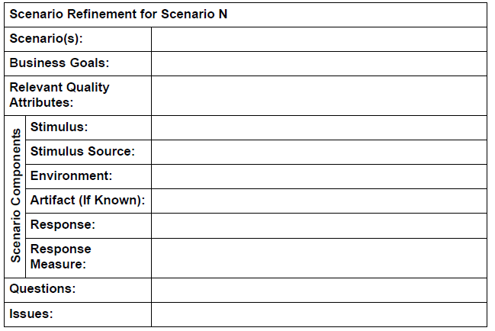

Slide 7
Next steps
Provide the evaluation team with a copy of your documentation.
Give a brief overview of the architecture to the evaluation team.
The evaluation team will create some scenarios and use the ones we create in class to walk through the architecture under evaluation. You should participate to help them trace through. Do enough scenarios to occupy 2 – 3 hours
List
  Tradeoffs
  Sensitivity points
  Non-risks
  Risks
Risk themes
Remember you will be evaluated and will evaluate
Submit a copy of your report including the scenarios and the list (There is a sample in the pedagogical product line.)

