Slide 1

CpSc 875
John D. McGregor
C14 - Analysis

Slide 2
Architecture Analysis
We have focused on quality attributes
We need ways to measure each attribute
First latency based on SEI report CMU/SEI-2007-TN-010
Then a small example for security
Finally, Modifiability

Slide 3
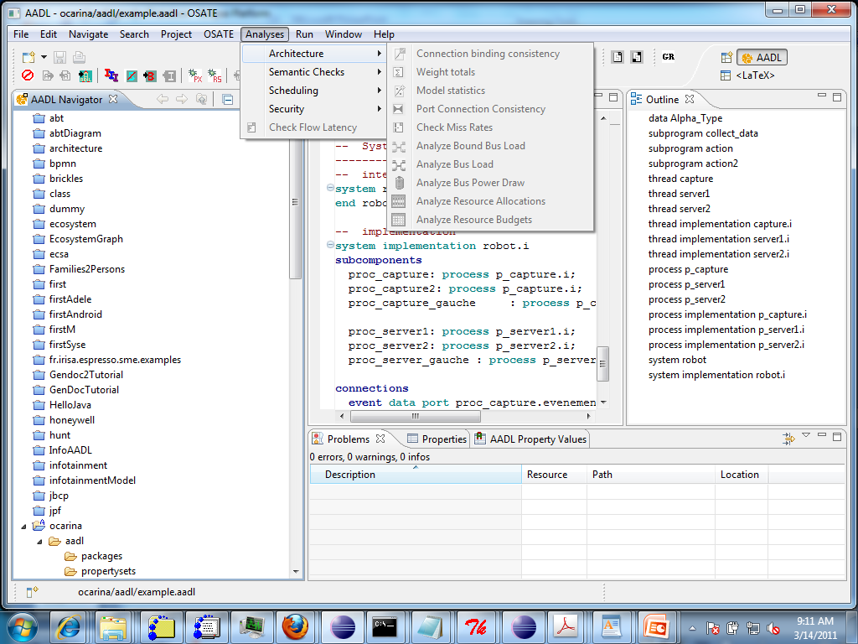
OSATE Analyses

Slide 4
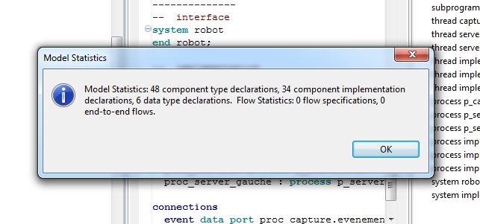
Instantiation
Analyses of static properties can be done using the systems as types without instantiation

Slide 5
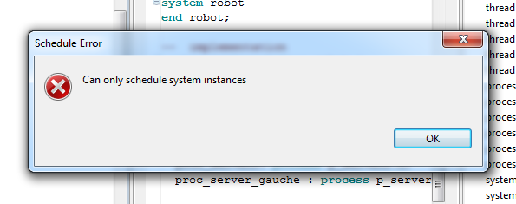
Instantiation
Dynamic qualities must have an instance.

Slide 6
Latency – performance – time economy
Factors for real-time embedded systems
  Execution time
    Varies between a minimum and maximum but events such as cache refresh introduce additional latency
  Completion time
    Depends upon other tasks sharing processor/resources
  Sampling latency
    Programs handling streams of data do clock-driven sampling which increases latency

Slide 7
Latency – performance – time economy - 2
  Sampling jitter
    Can cause old data to be processed twice and a new data element to be skipped
  Globally (a)synchronous systems
    For synchronous systems task dispatches are aligned
    For asynchronous systems sampling latency is added to execution time and the time is rounded to the next dispatch
  Partitioned systems
    Limits the jitter but adds to end-to-end latency

Slide 8
AADL
signal streams as end-to-end flows
sampling and data-driven processing as periodic and aperiodic threads that communicate through sampling data ports and queued event data ports
partitioned and time-triggered architectures

Slide 9
Flow specification
Flow specifications represent
  flow sources—flows originating from within a component
  flow sinks—flows ending within a component
  flow paths—flows through a component from its incoming ports to its outgoing ports

Slide 10
Flow sequence
A flow sequence takes one of two forms:
  A flow implementation describes how a flow specification of a component is realized in its component implementation.
  An end-to-end flow specifies a flow that starts within one subcomponent and ends within another subcomponent.

Slide 11
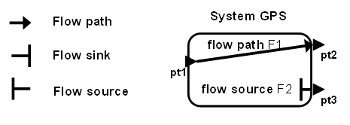
Flow spec
A flow spec is the information contained in the system specification that contains the flow.

Slide 12
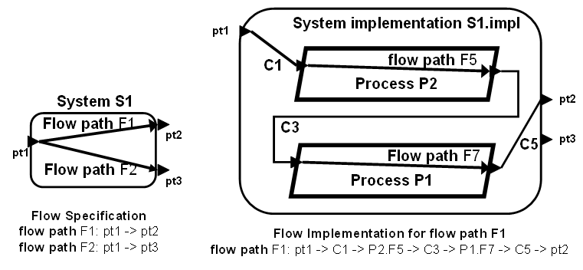
Flow thru component

Slide 13
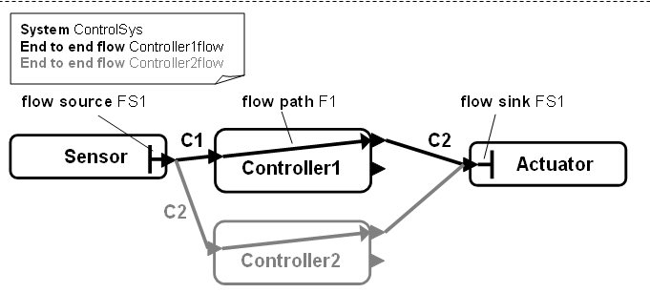
End-to-end flows
The inclusion of flow latency information in the specification allows very early assessment of the end-to-end low (although at low fidelity)

Slide 14
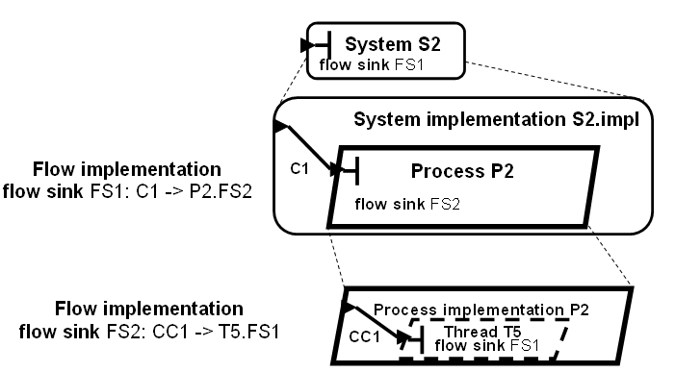
Instantiation hierarchy
Instantiation is a recursive process until a base definition is found.

Slide 15
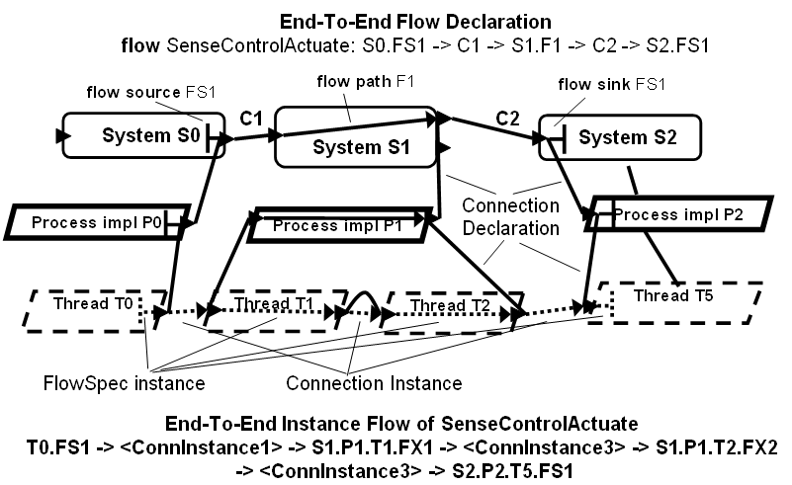
More complex hierarchy

Slide 16
Pre-declared latency properties
The Latency property can be specified for end-to-end flows, flow specifications, and connections. It represents the “maximum amount of elapsed time allowed between the time the data or [event] enters a flow or connection and the time it exits” [SAE AS5506 2004, p. 209].
The Expected_Latency property specifies “the expected latency for a flow specification” [SAE AS5506 2004, p.207].
The Actual_Latency property specifies “the actual latency as determined by the implementation of the end-to-end flow” [SAE AS5506 2004, p.189].

Slide 17
System latency
Often only interested in missed deadlines but if interested in the entire system
Sample over the operational profile (see next slide)
Get latency for each distinct branch of profile
Use probabilities to identify best/worst case latency and determine how often each might occur.

Slide 18
Operational profile
.1
Gives the frequency with which each flow is used.
.8
.2
.1
.6
.2
.4
.03
.04
.03

Slide 19
More for latency
The first reference gives a detailed explanation of different types of computation depending upon the types of connections and sampling procedures.
An appendix also gives the AADL code for an architecture illustrating many of the situations.

Slide 20
Security
A simple example for security is to:
  Define a property for each component called “security_level”
  Then define a plug-in that walks an end-to-end flow checking as it goes whether data from a component ever flows to a component with a lower security level.
  Any violation is added to the security report
property set CUSE is
readAuthorization: aadlinteger 1 .. 9 applies to (all);
writeAuthorization: aadlinteger 1 .. 9 applies to (all);
end CUSE;

Slide 21
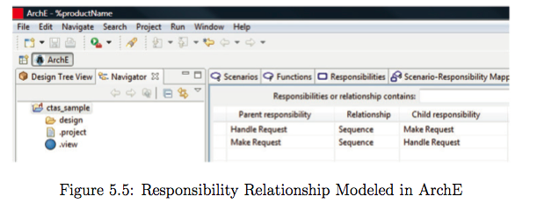
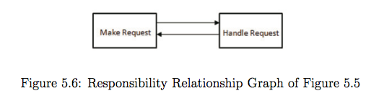
Non-Conformance to a Pattern
Non-conformance to an architectural pattern
  Map components of the architecture to responsibilities and verify they match
Kungsoo Im

Slide 22
Non-Conformance to a Pattern
Inner connections are connections between modules inside a responsibility
  cohesive as the modules inside a responsibility are highly dependent on each other to perform the task of that responsibility
Outer connections are connections between the responsibilities realized by connections from a module in one responsibility to another module in a different responsibility
  loosely coupled as each responsibility is responsible for one logical task and have little dependency with others
Kungsoo Im

Slide 23
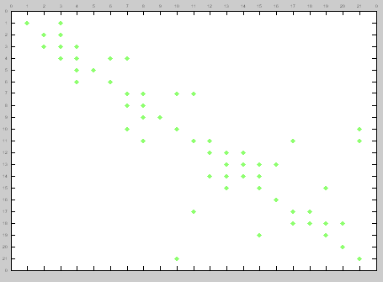
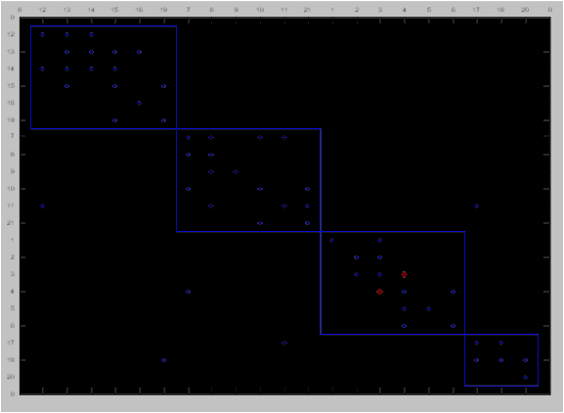
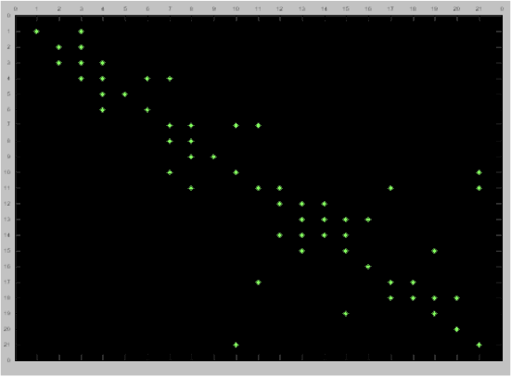
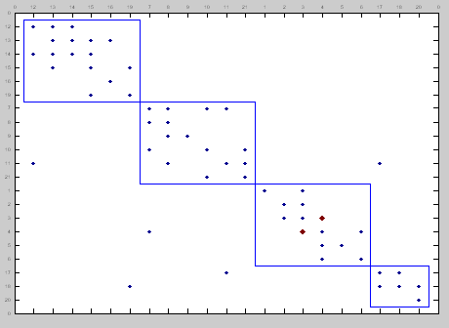
DSM Clustering
Architecture as intended
Architecture as represented
Kungsoo Im

Slide 24
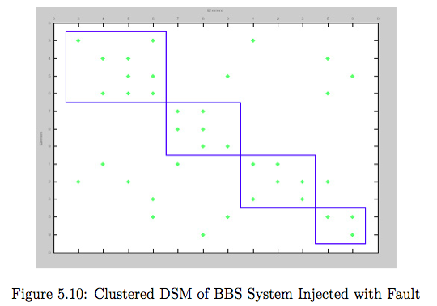
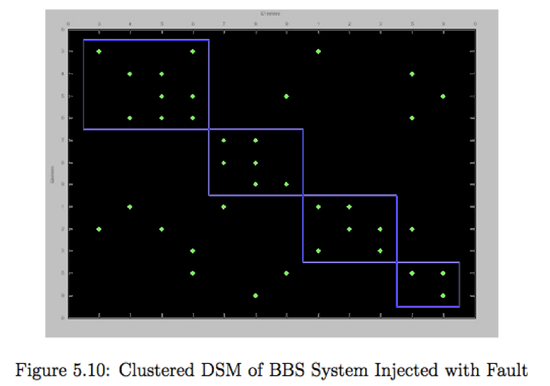
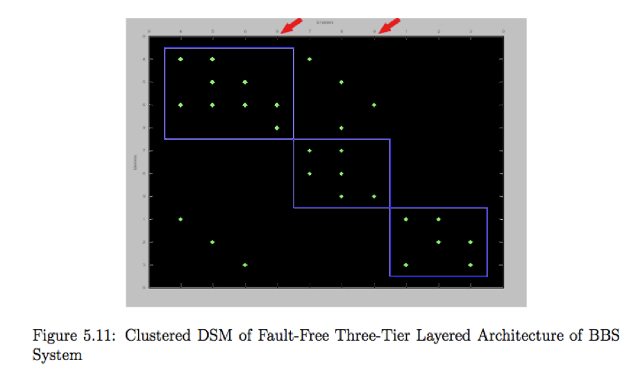
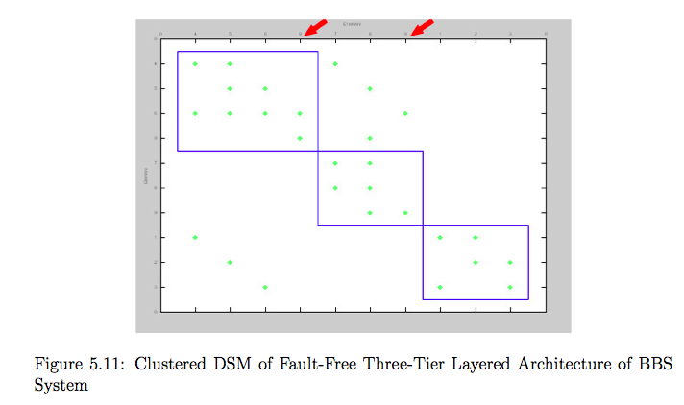
Case Study - BBS
Three-tier layered system
  Presentation layer, application layer, database server
  Can only communicate with its immediate upper layer
Kungsoo Im

Slide 25
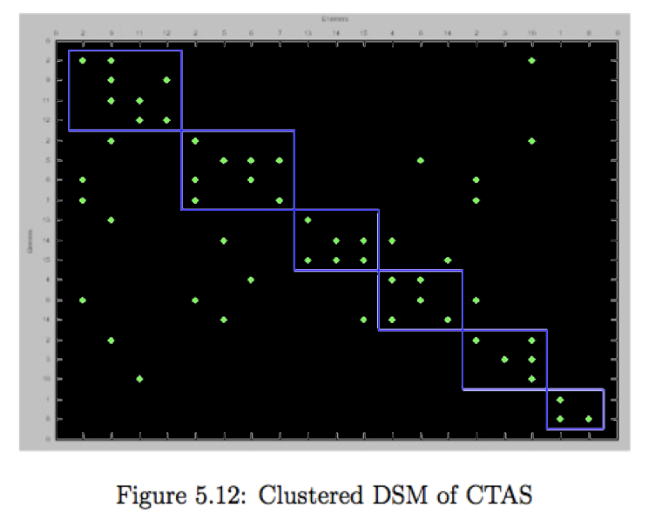
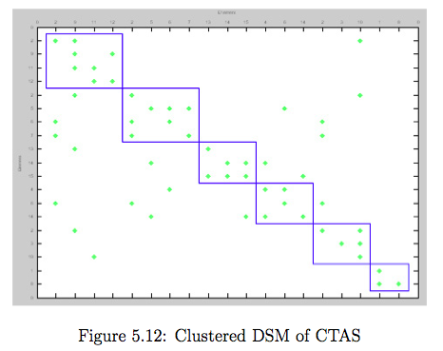
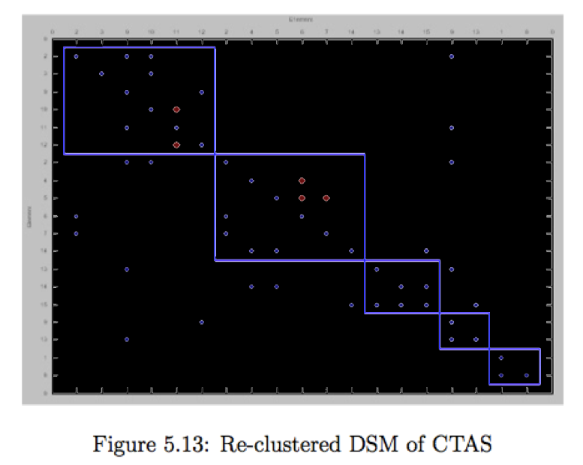
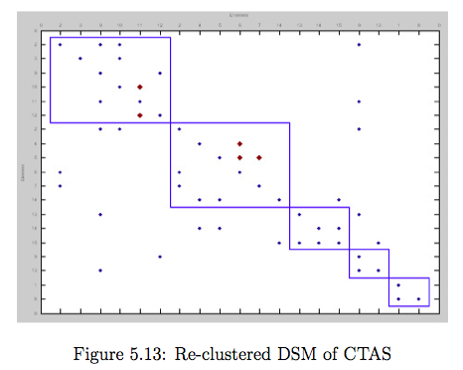
Case Study - CTAS
Model-View-Controller pattern
CTAS model has some parts that are rarely used (relies on a framework architecture)
  Not cohesive with other modules that make up a single responsibility
Specify a connection strength to improve clustering
Kungsoo Im

Slide 26
Qualitative Reasoning Framework (cont’d)
Safety
  Some safety hazards lead to accidents because certain quality requirements of the software system are not satisfied
  Certain architectural designs reduce the likelihood of a hazardous event from occurring
  Safety hazards can come from the system’s inability to satisfy certain quality attributes
Tacksoo Im

Slide 27
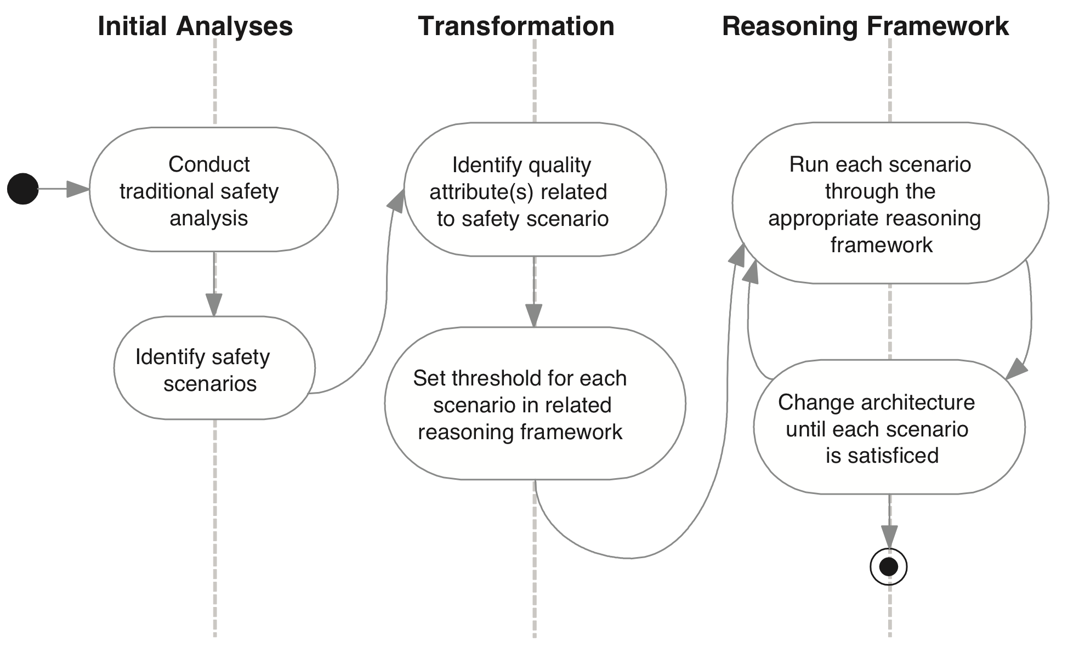
Qualitative Reasoning Framework (cont’d)
Safety Analysis Process
Tacksoo Im

Slide 28
Qualitative Reasoning Framework (cont’d)
Initial Safety Analyses
FHA (Functional Hazard Analysis) reveals hazards that can lead to safety problems
Function | User Data Management
Failure Condition: | Disclosure of private data to unauthorized user
Phase: | Run-time
Effect: | Disclosure of data is undetectable to the system
Class: | Medium Criticality
Verification: | User is harmed by the abuse of the disclosed private data
Results of a Function Hazard Analysis
Tacksoo Im

Slide 29
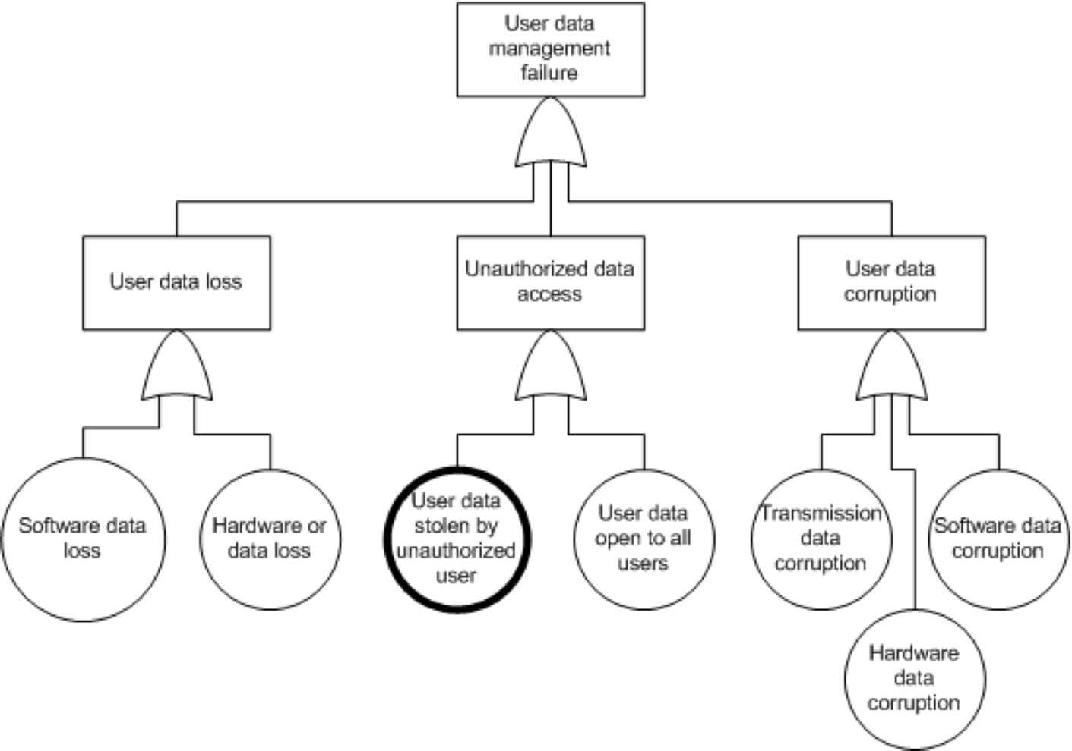
Qualitative Reasoning Framework (cont’d)
Initial Safety Analyses
FTA (Fault tree analysis) is performed on safety critical hazards identified from the FHA.
Root cause of the undesired event
Root causes related to quality attributes are inputs to the reasoning framework
Tacksoo Im

Slide 30
Qualitative Reasoning Framework (cont’d)
Identifying Safety Scenarios
Quality Attribute | Hazard-affecting events
Reliability | Incorrect output is generated
Availability | A system element that was supposed to be in service is not ready for use when needed
Confidentiality | Information of highly sensitive nature is visible to unauthorized persons
Example of Quality Attributes that can affect Safety
The architect is responsible for judging which quality attributes are a safety concern for the system under consideration
Similar to ATAM (Architecture Trade-off Analysis Method) which relies on domain experts
Tacksoo Im

Slide 31
Qualitative Reasoning Framework (cont’d)
Translate into Safety Scenario
Stimulus | Access of confidential data
Source of the Stimulus: | Unauthorized user
Environment: | Normal mode
Artifact: | Personal Data of User
Response: | End user’s personal data is accessed
Response Measure: | The loss of privacy the user experiences due to the unauthorized access
Tacksoo Im
Safety Scenario related to potential confidentiality failure
Faults from the FTA pertaining to QA’s are turned into safety scenarios
Focus on qualities and the dependence on the architecture representation and not on functional req (analytic constraint)

Slide 32
Qualitative Reasoning Framework (cont’d)
Analytic Theory for Safety
Semantic matching of words in the description of a safety scenario, such as fault, missed deadline, is used to map safety to other quality attributes
Any extra information to calculate the scenario is acquired and the target reasoning framework is applied
Since the outcome of the analysis tells us that the scenarios have reached a threshold, we use the term “satisficed”
Tacksoo Im

Slide 33
Qualitative Reasoning Framework (cont’d)
Confidentiality scenario after mapping from the safety scenario
Stimulus | Attempt to read CTAS user’s social security number
Source of the Stimulus: | Unauthorized person
Environment: | End user’s hand-held CTAS device
Artifact: | CTAS database
Response: | The social security number is read
Response Measure: | The amount of physical harm that comes to the user whose SS number was read
Safety scenarios are transformed into framework specific forms
Mapping to confidentiality scenario because of the word “unauthorized”
Architect provides the stimulus, response, and response measure goal for the new scenario
Tacksoo Im

Slide 34
Qualitative Reasoning Framework (cont’d)
Interpretation
Usability
Scenario
Satisficed y/n
Safety
Scenario
Add usability parameters
Usability reasoning framework
Safety reasoning framework
Confidentiality
Scenario
Add confidentiality parameters
Satisficed y/n
Confidentiality reasoning framework
Tacksoo Im

Slide 35
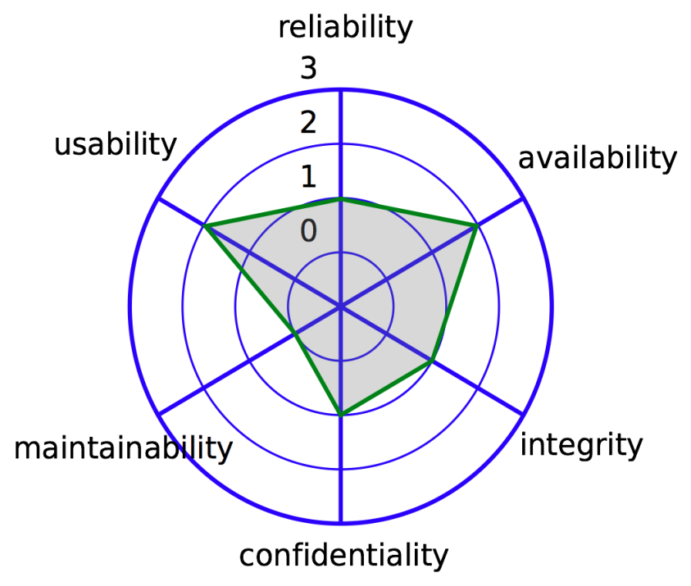
Qualitative Reasoning Framework (cont’d)
Confidence Interval Calculation
  We assume that scenarios represent a “sampling” of system usage. Assumption is usually valid because it is usually possible to vary values and derive many more scenarios
  A non-parametric test, the sign test, is used due to the sample size.
  From response values (from availability scenarios) of 0.8, 0.8, 0.95, 0.95, 0.97, 1, 1, 1, 1. Since c = 2, starting from each end of the response values, the second value is selected, and the confidence interval is (0.8, 1).
0
Star plot of safety analysis
0 – Unsatisficed
1 – Minimum level satisficed
2 – Good level satisficed
3 – Max level satisficed
Tacksoo Im
Notes:
Determine a representative sample of scenarios that provide good coverage of the system. Using a reasoning framework, determine response value for each scenario
- Set a confidence level for the median of the availability scenarios values (usually 95%)
- For the number of scenarios and p = 0.50 (since the median is where 50 percent of the values lie above and 50 percent lie below), read from the binomial distribution table the value for which the summed probabilities surpass 0.05 (assuming a 95% C.L.). This value is 2 for n = 9 and will be denoted as c = 2.

Slide 36
Modifiability
is the ability of a system to be changed after it has been deployed
The measure of modifiability is usually in terms of the time/resources required to make a specific proposed change
Measures are more relative (comparing one architecture to another) than absolute (it will take x days to make this change)

Slide 37
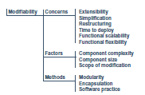
Factors
What do we measure?

Slide 38
Look to the tactics
Localize changes
  Measures of cohesion
  More likely to have everything you need
Prevent ripples
  Measures of coupling
  More coupling the longer than analysis will take
Defer binding time
  Measures of flexibility
  Easier to add

Slide 39
Cyclomatic complexity
Mathematically, the cyclomatic complexity of a structured program is defined with reference to a directed graph containing the basic blocks of the program, with an edge between two basic blocks if control may pass from the first to the second (the control flow graph of the program). The complexity is then defined as:
M = E − N + 2P where
  M = cyclomatic complexity
  E = the number of edges of the graph
  N = the number of nodes of the graph
  P = the number of connected components

Slide 40
Control flow
The end-to-end flows can be used.

Slide 41
Measuring in AADL
Control flow are the end-to-end flows
Usually not just one as in a functional program
Use change model and probabilities of each change being requested and combine
Average modifiability =

Slide 42
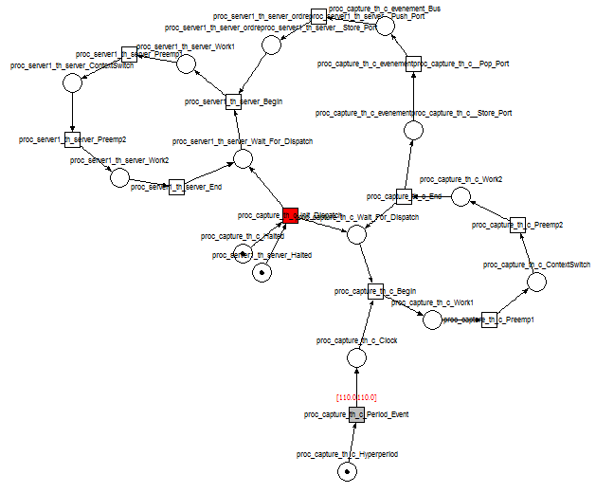
Ocarina
Petri net shows complexity
This representation supports simulation

Slide 43
Next steps
Read http://repository.cmu.edu/cgi/viewcontent.cgi?article=1315&context=sei
http://www.sei.cmu.edu/reports/00tn017.pdf
http://www.ieee.org.ar/downloads/Barbacci-05-notas1.pdf

Slide 44
More next steps
Submit a new version of the architecture that addresses the results of the ATAM on April 7th
Pay particular attention to variation in quality attributes
Include a readme file that describes the changes you make
By April 26th a final release of you architecture should include complete 2 volume documentation and the documentation should include quantitative evidence for the quality of the architecture

