Slide 1

CPSC 875
John D. McGregor
C15 – Variation in architecture

Slide 2
Goal
The goal of variability in a software product line is to maximize return on investment (ROI) for building and maintaining products over a specified period of time or num-ber of products.

Slide 3
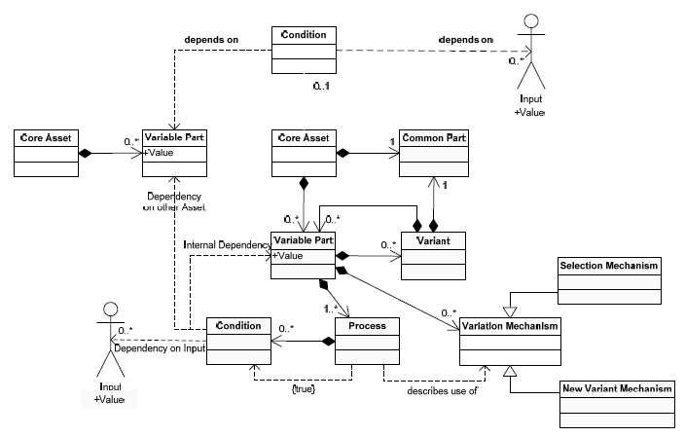
Management of variation

Slide 4
Software Product Line
Multiple products, each a bit different from the others
The differences are encapsulated in variation points
A variation point is not a single location in the code
Corresponds to a subset of the requirements

Slide 5
Variation mechanisms
An instance of the architecture resolves certain variations
Mechanisms
  One system definition extends another
  A system definition is included or excluded
  Subprograms have parameters

Slide 6
Binding time
The reason that some variation is not resolved is because the binding time for the variation is after architecture instantiation time
The binding time is partially determined by the architect
To do this
  Who will do the binding?
  When do they touch the system?
  For example, a marketing person decides a feature is included – can only happen at requirements time

Slide 7
Eliminating variability
Some apparent variability can be reduced to commonality
  A standard interface can be placed between the commonality and the apparent variability with the result that we don’t care what is on the other side of the interface. The BlueTooth interface for example.

Slide 8
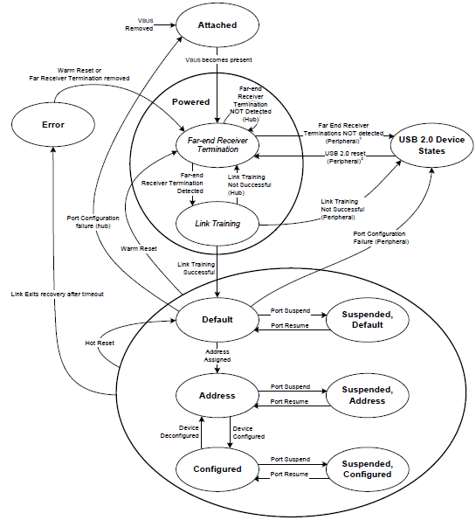
USB state machine from standard spec

Slide 9
Infotainment variations
Various GPS devices
Various brands of cell phones
Optional engines, transmissions
Various state regulations?
Luxury designation – adds memory, different processor

Slide 10
But what about variations in quality attribute levels?
One product needs to be airworthy certified but others do not
One needs real-time performance another does not
One must be secure another one does not

Slide 11
What to do?
Would you
  Make everything meet the toughest standard?
  Re-implement all the assets?
Tactic: reduce and isolate – encapsulate the section that differs among products; refactor when possible to reduce the area; hide behind interfaces

Slide 12
Use cross cutting techniques
Aspects as we have already discussed cut across the system decomposition
Other language idioms such as “mix-ins” also cross cut
Look for a technique where fragments are maintained separately

Slide 13
Next steps
Additional Slides: http://www.vamos-workshop.net/2007/files/VaMoS07_Paper_5_Slides.pdf
Submit a new version of the architecture that addresses the results of the ATAM on April 7th
Pay particular attention to variation in quality attributes
Include a readme file that describes the changes you make
By April 26th a final release of you architecture should include complete 2 volume documentation and the documentation should include quantitative evidence for the quality of the architecture

