Slide 1

CPSC 875
John D. McGregor
C16 - DSMs

Slide 2
Partitioning
http://money.cnn.com/2011/03/28/autos/vw_jetta_horn_recall/index.htm?hpt=T2
Honking the horn can stop the car
Those wires should be logically and physically separated

Slide 3
Partitioning
Architecture tactic
Divides independent flows of computation
May be a physical separation on different processors
May be a logical separation in different packages
May be both

Slide 4
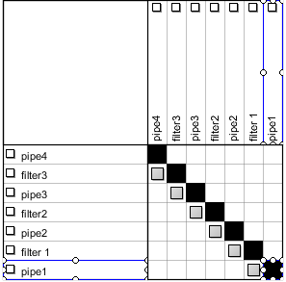
Pipe and Filter DSM

Slide 5
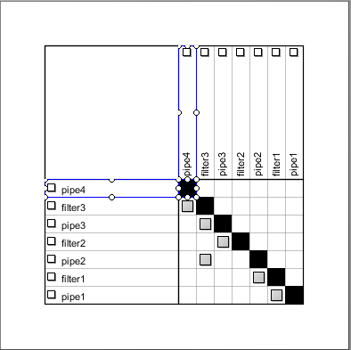
Fault in pipe and filter
An incorrect dependency

Slide 6
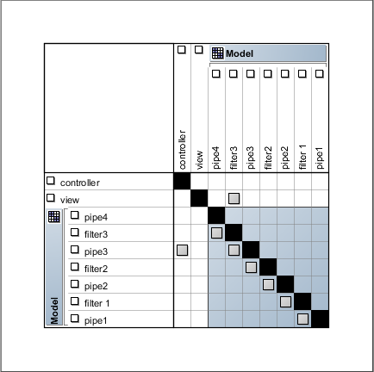
Quantifying modularity
Remember coupling and cohesion
These show up in a DSM as connections

Slide 7
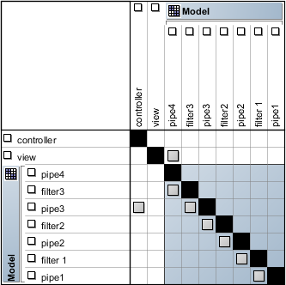
Corrected connection
Can think of view->pipe4 as a module
that encapsulates that interaction

Slide 8
Looking for patterns
Feedbackward
Flow forward

Slide 9
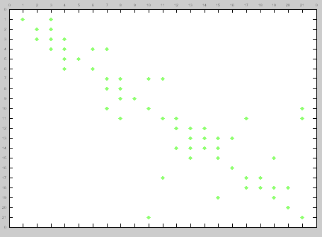
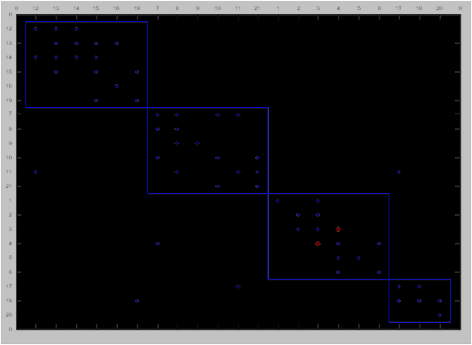
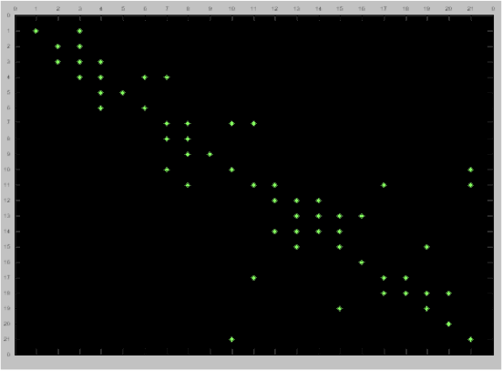
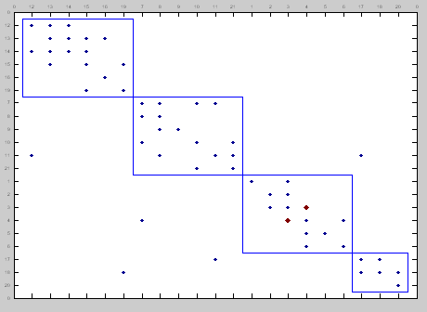
DSM Clustering
Architecture as intended
Architecture as represented

Slide 10
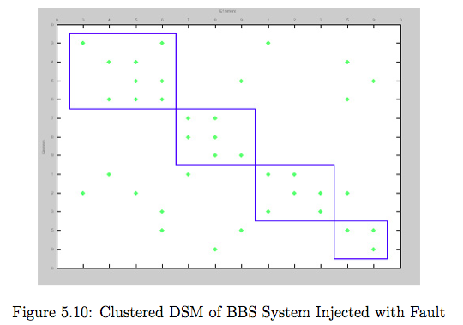
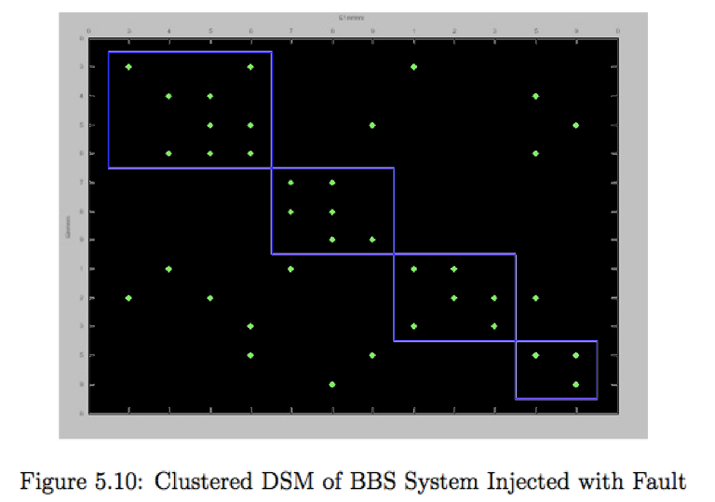
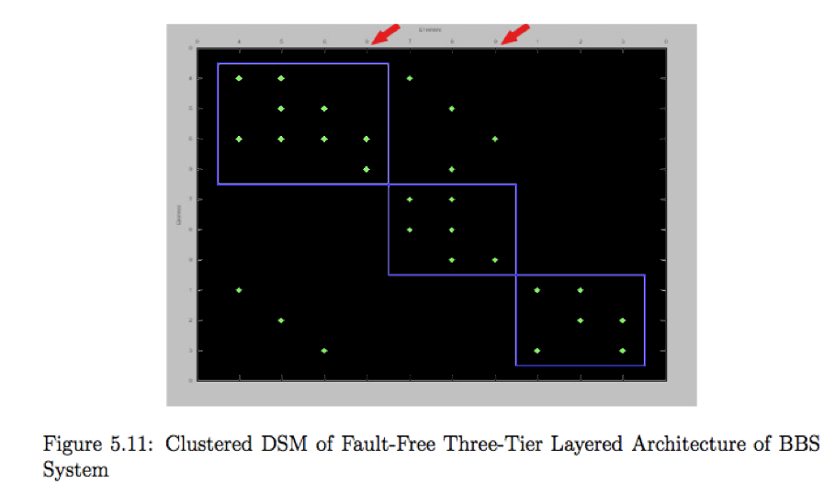
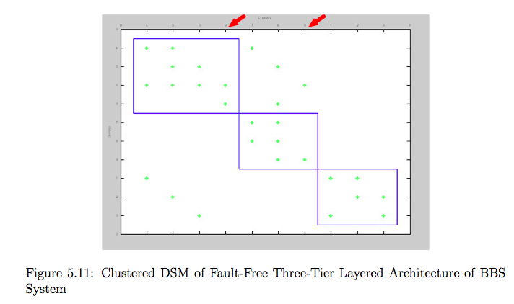
Case Study - BBS
Three-tier layered system
Presentation layer, application layer, database server
Can only communicate with its immediate upper layer

Slide 11
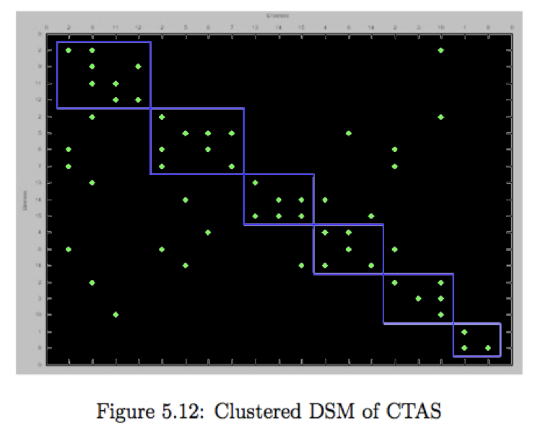
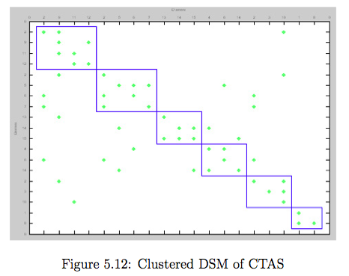
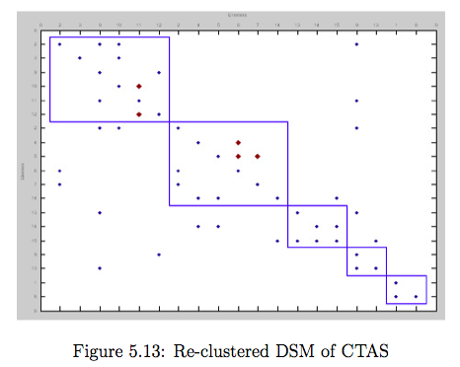
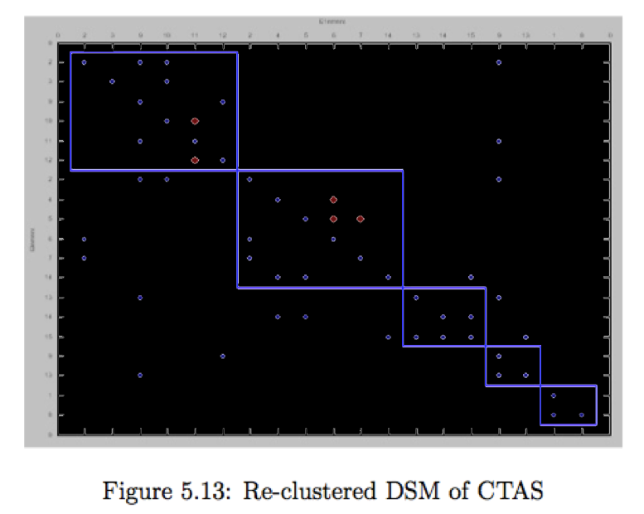
Case Study - CTAS
Model-View-Controller pattern
CTAS model has some parts that are rarely used (relies on a framework architecture)
Not cohesive with other modules that make up a single responsibility
Specify a connection strength to improve clustering

Slide 12
DSM tutorial
DSM tutorial
http://users.ipfw.edu/reddpv01/DSMTutorial.pdf
DSM tool
http://www-edc.eng.cam.ac.uk/cam

