Slide 1

CPSC 875
John D. McGregor
C17 – Tool Chains

Slide 2
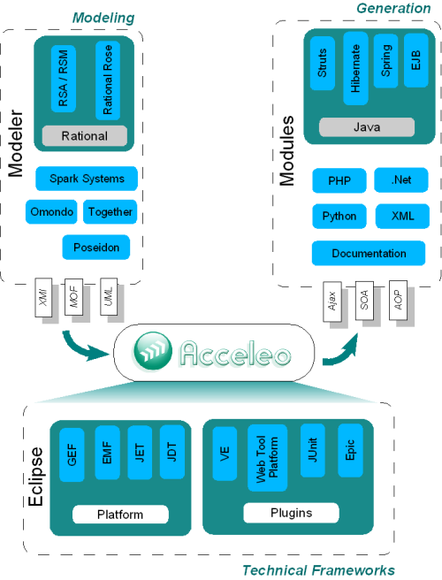

Slide 3
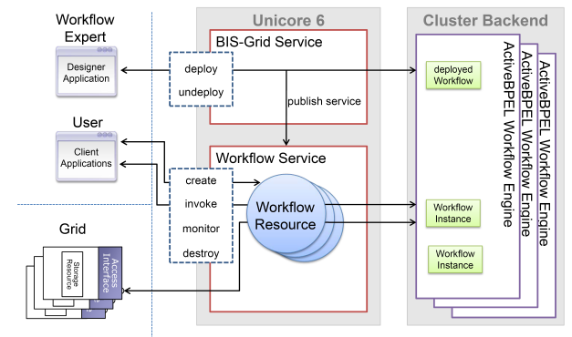
Workflow engine
Uses grid

Slide 4
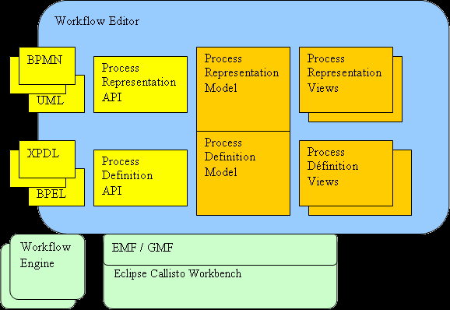

Slide 5
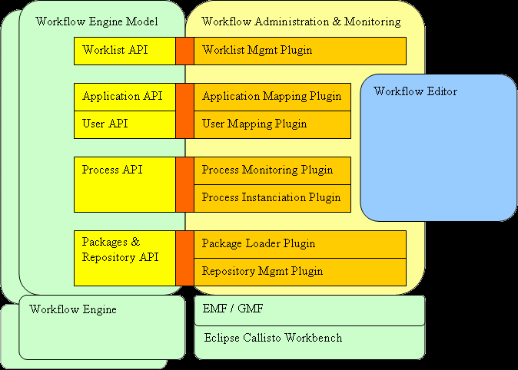

Slide 6
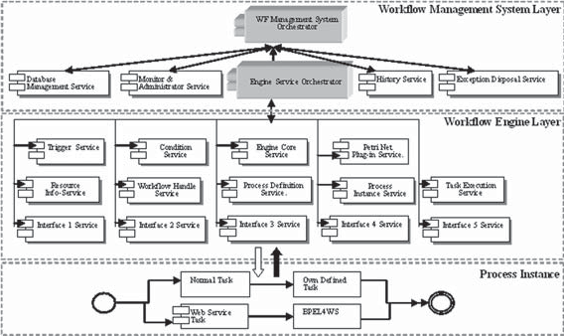

Slide 7
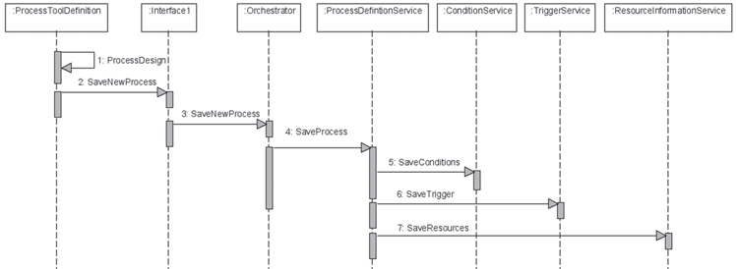

Slide 8
Model-driven development (MDD)
Model-driven development refers to a development approach that focuses on models as the basic elements from which products are built.
When a change is required it is the model that is changed not the detailed source code.

Slide 9
Tool chain
MDD involves a sequence of tools that transform information from one form to another.
This involves two types of languages:
Primary modeling languages – SysML and UML
Transformation languages such as Xtext and Xpand

Slide 10
Requirements management
A database of requirements statements is developed in Word or Excel or DOORS
There is a standard format for each requirement statement such as:
Id (standard form such as L1-00n)
Statement
Attributes such as “priority”
These requirements are imported into a Topcased model

Slide 11
Requirements management - 2
There are several tutorials about this so I will not reinvent them, but I will add to it
The set of requirements that are imported are referred to as the upstream requirements.
The new requirements we will model are the “current” or “downstream” requirements.
The downstream requirements are derived from the upstream requirements and made more specific in the process.
In the DoD this is named L1 and L2 respectively.

Slide 12
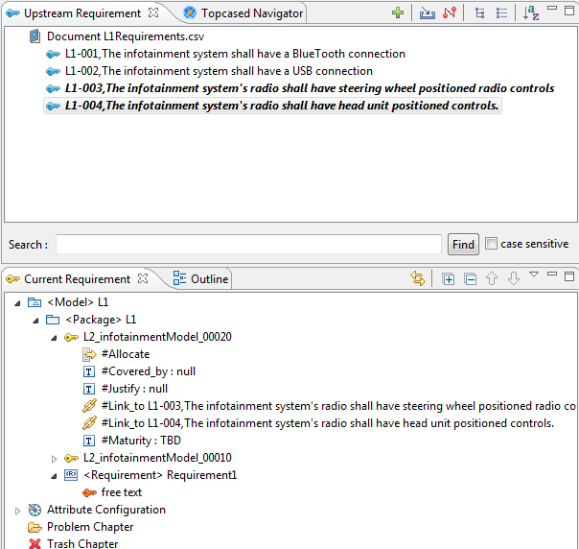
Requirements management - 3
An upstream requirement can be dragged into the current requirement list.
There is a link attribute that points back to the upstream requirement.
The new L2_infotainmentModel_00020 requirement is linked to L1-003.
Note that in the upstream L1-003 is italicized.

Slide 13
Requirements management - 4
Instead of dragging into the bottom box you could drag into a requirements diagram.
You now have a traceable set of requirements so that changes can be rippled back up the hierarchy.
DoD projects will derive L3 and L4 level requirements, each becoming more specific

Slide 14
Documentation generation
DocGen2 is a tool that takes a templated Word file and a Topcased model as input and produces a Word file as output.
The template in the Word file is defined using the Acceleo language – an Eclipse project.

Slide 15
Configuring the document
<config>
<param key=’workspace’ value=’c:/Users/McGregor/workspace’ />
<param key=’project’ value=’${workspace}/infotainmentModel’ />
<param key='model' value='${project}/Models/infoUses.sysml' />
<output path='${project}/infoUses.docx' />
</config>
Then context clauses are used to direct the tool:
<context model=’${model}’ importedBundles=’topcased’ searchMetamodels=’true’/>
Bundles are libraries of routines that will be called later
searchMetamodels indicates if multiple meta-models are used

Slide 16
Setup
The <gendoc> </gendoc> pair encompasses all processing.
Actors
[for (p.ownedElement->filter(Actor)->sortedBy(name))]
[self.name/]
[/for]
Becomes
Actors
Installer
Mechanic
driver
driver

Slide 17
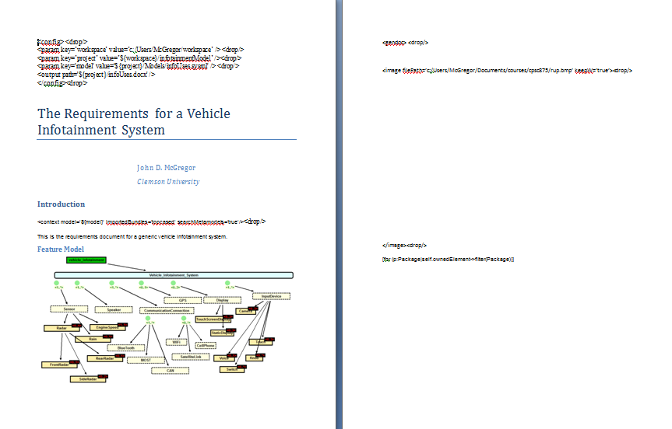
Template

Slide 18
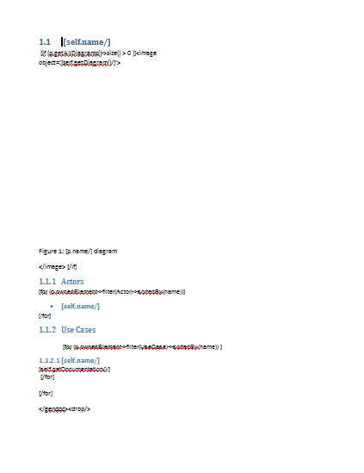
Template - 2

Slide 19
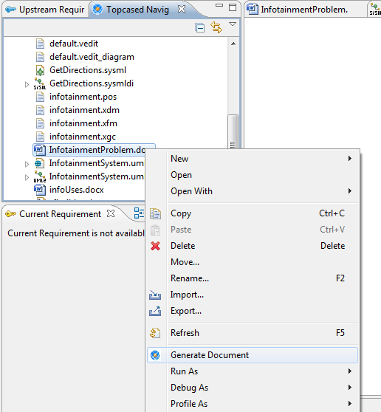
Processing
Right click on the templated Word file and select “Generate Document”
The Acceleo generator produces the new Word document infoUses.docx

Slide 20
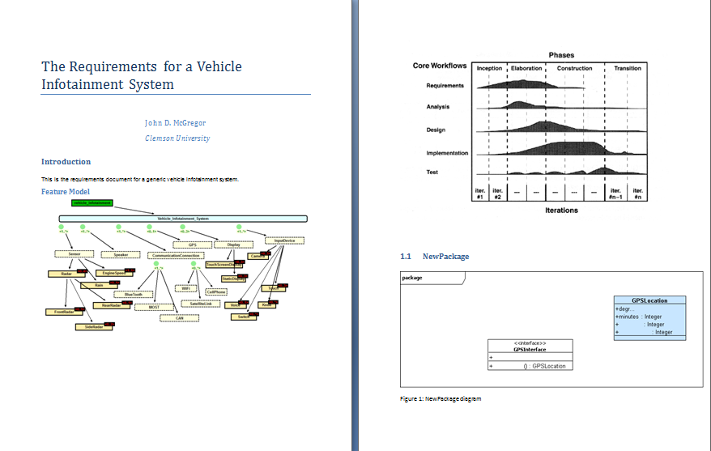
Producing

Slide 21
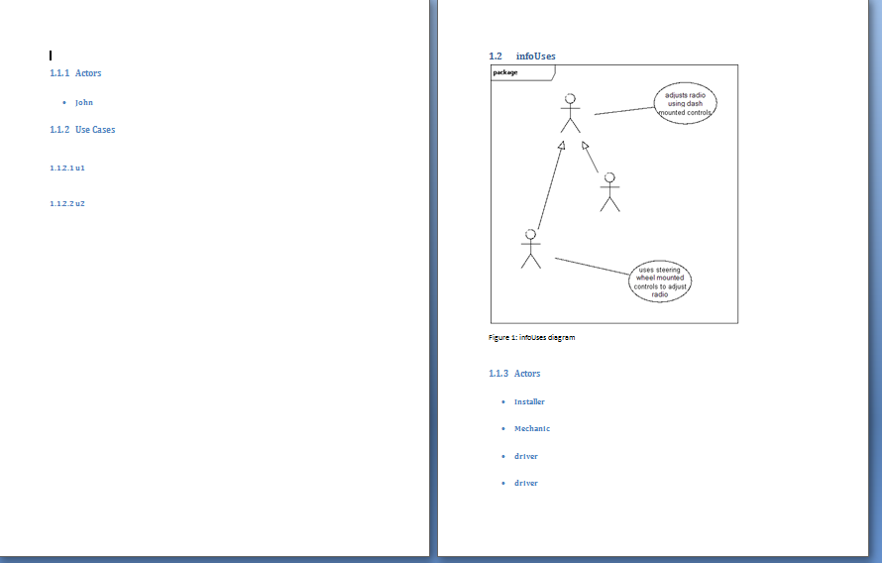
Producing - 2

Slide 22
On going
When a change is made:
Update the model, and
Run the generator again.

Slide 23
Code generation
Another day …

