Slide 1

CPSC 875
John D. McGregor
C21 – Computing quality levels

Slide 2
Manage technical debt
Don’t accumulate too much. Properly size the organization to meet the needed schedule.
Keep track of technical debt.
Have a clear definition of “done”
Plan to payoff debt regularly.
Share knowledge across the organization.
Plan testing to support win-win.

Slide 3
http://blogs.construx.com/blogs/stevemcc/archive/2007/11/01/technical-debt-2.aspx

Slide 4
Avoiding technical debt
We often avoid debt by saving before we need something.
Training is one way of avoiding debt. Getting better at what we do so we don’t make as many mistakes.
Realistic schedules

Slide 5
A Reasoning Framework for Dependability in Software Architectures
Dissertation Defense
Tacksoo Im
School of Computing, Computer Science Division
Clemson University
13 August 2010

Slide 6
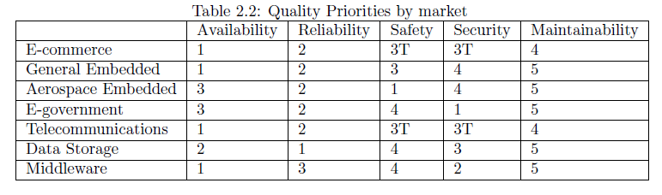
Rationale

Slide 7
Background (cont’d)
Definition of Dependability
Dependability is the ability of a system to deliver
service that can justifiably be trusted [63]
Availability: readiness for usage
Maintainability: aptitude to undergo repairs and evolution
Dependability
Integrity: non-occurrence of improper alterations of information
Reliability: continuity of service
[IFIP 10.4]
Safety: non-occurrence of catastrophic consequences on the environment
Confidentiality: non-occurrence of unauthorized disclosure of information

Slide 8
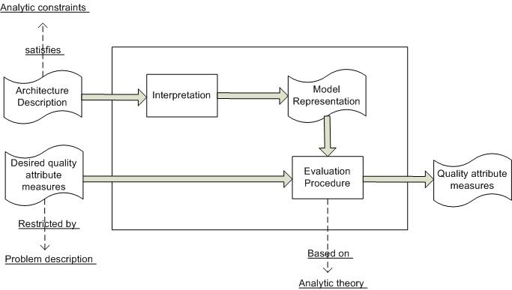
Background (cont’d)
Reasoning Framework Diagram
AADL Architectural Description of Apache http server
Dependability reasoning framework is built on ArchE which follows the standard the six elements of the reasoning framework
ArchE takes a Quality Attribute Scenario and returns analysis

Slide 9
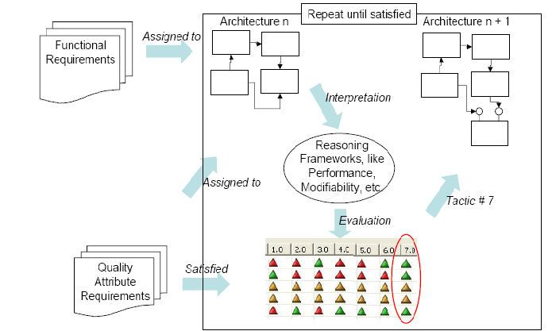
Background (cont’d)
Architecture Definition using ArchE
Functional requirements become responsibilities
As a starting point, all functional requirements are translated 1-1 into responsibilities

Slide 10
Quantitative Reasoning Framework
Quantitative Reasoning Frameworks are based on models that produce quantitative results based on well established analytic theories
Analytic theory for each quantitative quality attribute
  Reliability: software architecture based reliability analysis [30]
  Availability: software architecture based availability analysis [86]
  Maintainability: cost model based analysis [15]
Relies on an interval scale (eg. 0.5 < 0.7)

Slide 11
Quantitative Reasoning Framework (cont’d)
Reliability
  Measure of the probability of failure-free operation for a specified time
  Can be represented in terms of failures per hour (failure intensity)
  Perceived reliability and an actual reliability
  Parameters are defect density, number of critical defects, and execution time
  A reliability scenario: “A client accesses a piece of information served by an Apache content generator with at least 99.5% reliability
Notes:
We are calculating the perceived reliability of the system using software architecture based reliability analysis by Gokhale et al.
The reliability of each scenario can be calculated by taking the product of the reliability of each possible path that can be taken to fulfill the scenario. Calculate the reliability of the system by taking the product of the reliabilities of the scenarios. The reliabilities of the scenarios are also multiplied with the probability of operating that scenario

Slide 12
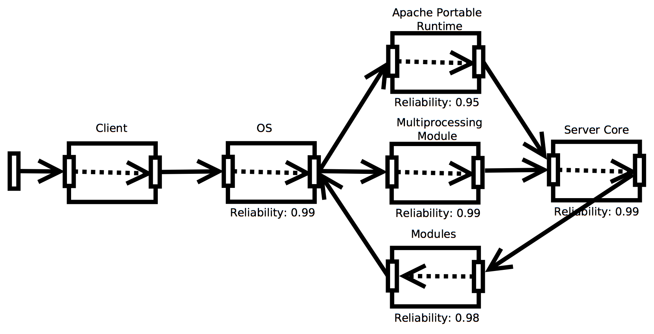
Quantitative Reasoning Framework (cont’d)
Reliability
  The perceived reliability of the system is described with the following equation:
  The reliabilities of the scenarios are also multiplied with the probability of operating that scenario.

Slide 13
Reliability
Mathematically reliability R(t) is the probability that a system will be successful in the interval from time 0 to time t:
R(t) = P(T > t), t => 0
where T is a random variable denoting the time-to-failure or failure time.
Unreliability F(t), a measure of failure, is defined as the probability that the system will fail by time t.
F(t) = P(T =< t), t => 0.
In other words, F(t) is the failure distribution function. The following relationship applies to reliability in general. The Reliability R(t), is related to failure probability F(t) by:
R(t) = 1 - F(t)

Slide 14
Reliability-2
For a parallel circuit.

Slide 15
Technical debt
A=.95;B=.95 system = .9 – required level
A=.95;B=.9 system=.85
A=.99;B=.9 system=.89
When even one component has a technical debt the other components must be pushed to extreme limits to almost catchup

Slide 16
Quantitative Reasoning Framework (cont’d)
Availability
  Expresses the degree to which a system is “operational and accessible” when required for use
  Related to maintainability but notion of recovery is added
  Parameters are MTTR (mean time to repair) and MTBF (mean time between failures)
  An availability scenario: A client uploads a file to the Apache server, with at least an availability rate of 98% (POST method)

Slide 17
Availability formula
Technical debt – Availability is affected by reliability and modifiability
Owing in reliability then affects both reliability and availability
Owing in modifiability affects both modifiability and availability

Slide 18
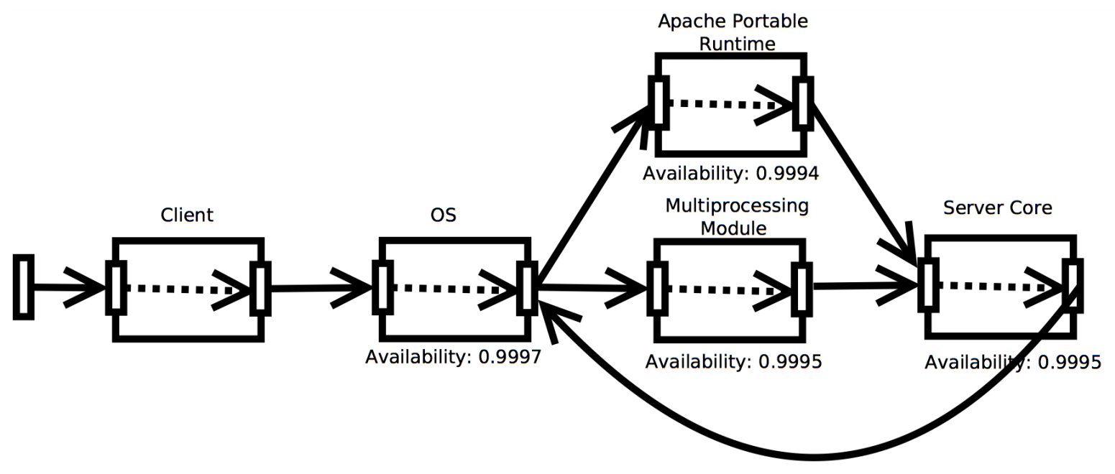
Quantitative Reasoning Framework (cont’d)
Availability
  The availability of the system is described with the following equation:
  The availabilities of the scenarios are also multiplied with the probability of operating that scenario.

Slide 19
Quantitative Reasoning Framework (cont’d)
Maintainability
  Defined as the capability of the software product to be modified
  Related to modifiability but includes correction of errors [11]
  Four types of maintenance activities: preventive, perfective, adaptive, and corrective
  Measured in man-hours that indicate effort needed to carry out the task
  Parameter: Size of responsibility, Change percentage, productivity
  A maintainability scenario: An organization modifies the multiprocessing module in order to adapt to the new hardware configuration of the server
Notes:
Productivity depends on maintenance activity, point out redundancy in “corrective”

Slide 20
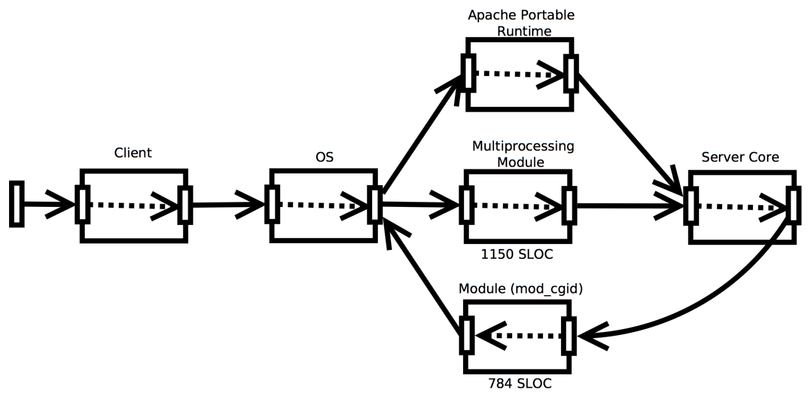
Quantitative Reasoning Framework (cont’d)
Maintainability
  Productivity varies depending on the maintenance type and measured in man-hours
  SLOC is used as the measure of change size

Slide 21
Maintainability
Complexity – Cyclomatic complexity
Coupling – How many other types must our type know about?
Cohesion – How many interconnections among the methods in a class?
Technical debt – If the design is not refactored sufficiently then these measures are degraded

Slide 22
Qualitative Reasoning Framework (cont’d)
Confidentiality/Integrity
  Authorization scheme is used by architects to assign values to the authorization level of each responsibility in the architecture
  Use of authorization scheme aids in controlling access to a resource and determining what authorization level is required to get to the resource
  Authorization level determined by sensitivity of data
  Measured in whether a scenario can be carried out or not
  Ordinal scale represents authorization level required to invoke read/write operations in a particular responsibility in software architecture

Slide 23
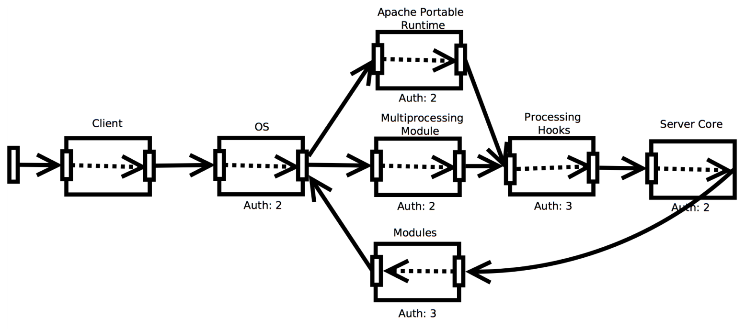
Qualitative Reasoning Framework (cont’d)
Confidentiality/Integrity
  In analyzing a scenario, identify responsibilities where authorization required is greater than the authorization level for the specific scenario
  Determine if the sequence of activities are allowable by checking authorization levels specified in the responsibilities

Slide 24
Confidentiality/Integrity
The binary nature of the relationship makes it easy to compute.

Slide 25
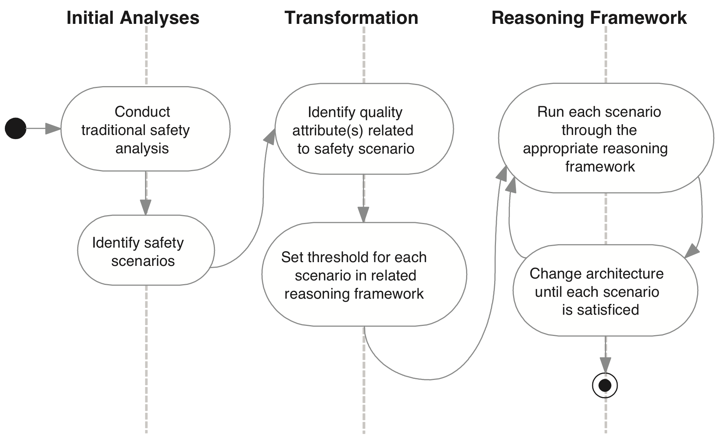
Qualitative Reasoning Framework (cont’d)
Safety Analysis Process

Slide 26
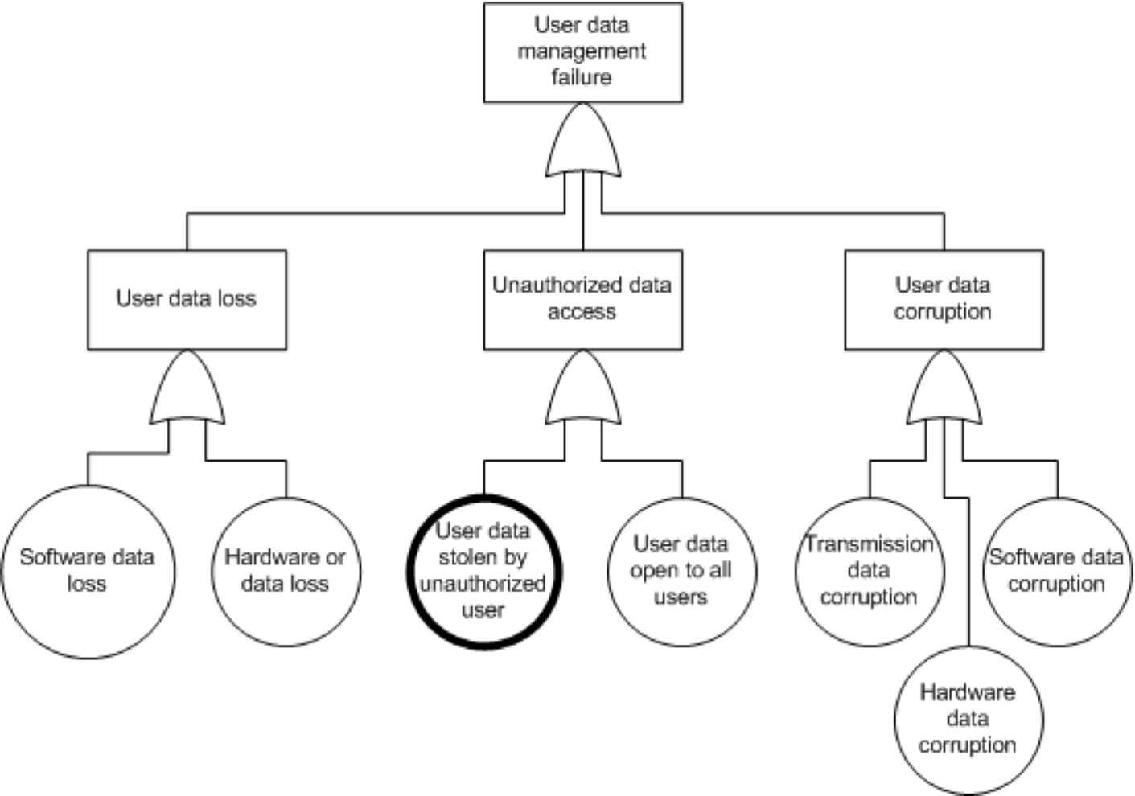
Qualitative Reasoning Framework (cont’d)
Initial Safety Analyses
FTA (Fault tree analysis) is performed on safety critical hazards identified from the FHA.
Root cause of the undesired event
Root causes related to quality attributes are inputs to the reasoning framework

Slide 27
Qualitative Reasoning Framework (cont’d)
Identifying Safety Scenarios
Quality Attribute | Hazard-affecting events
Reliability | Incorrect output is generated
Availability | A system element that was supposed to be in service is not ready for use when needed
Confidentiality | Information of highly sensitive nature is visible to unauthorized persons
Example of Quality Attributes that can affect Safety
The architect is responsible for judging which quality attributes are a safety concern for the system under consideration
Similar to ATAM (Architecture Trade-off Analysis Method) which relies on domain experts

Slide 28
Qualitative Reasoning Framework (cont’d)
Translate into Safety Scenario
Stimulus | Access of confidential data
Source of the Stimulus: | Unauthorized user
Environment: | Normal mode
Artifact: | Personal Data of User
Response: | End user’s personal data is accessed
Response Measure: | The loss of privacy the user experiences due to the unauthorized access
Safety Scenario related to potential confidentiality failure
Faults from the FTA pertaining to QA’s are turned into safety scenarios
Focus on qualities and the dependence on the architecture representation and not on functional req (analytic constraint)

Slide 29
Qualitative Reasoning Framework (cont’d)
Confidentiality scenario after mapping from the safety scenario
Stimulus | Attempt to read CTAS user’s social security number
Source of the Stimulus: | Unauthorized person
Environment: | End user’s hand-held CTAS device
Artifact: | CTAS database
Response: | The social security number is read
Response Measure: | The amount of physical harm that comes to the user whose SS number was read
Safety scenarios are transformed into framework specific forms
Mapping to confidentiality scenario because of the word “unauthorized”
Architect provides the stimulus, response, and response measure goal for the new scenario

Slide 30
Qualitative Reasoning Framework (cont’d)
Interpretation
Usability
Scenario
Satisficed y/n
Safety
Scenario
Add usability parameters
Usability reasoning framework
Safety reasoning framework
Confidentiality
Scenario
Add confidentiality parameters
Satisficed y/n
Confidentiality reasoning framework

Slide 31
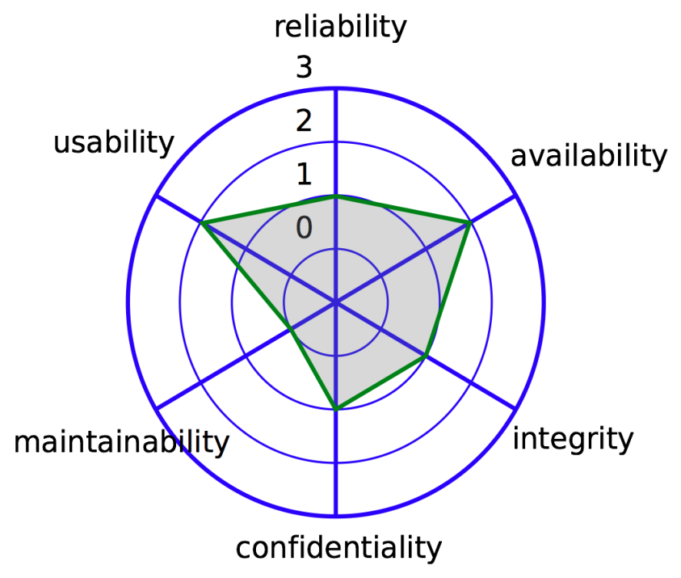
Qualitative Reasoning Framework (cont’d)
Confidence Interval Calculation
  We assume that scenarios represent a “sampling” of system usage. Assumption is usually valid because it is usually possible to vary values and derive many more scenarios
  A non-parametric test, the sign test, is used due to the sample size.
  From response values (from availability scenarios) of 0.8, 0.8, 0.95, 0.95, 0.97, 1, 1, 1, 1. Since c = 2, starting from each end of the response values, the second value is selected, and the confidence interval is (0.8, 1).
0
Star plot of safety analysis
0 – Unsatisficed
1 – Minimum level satisficed
2 – Good level satisficed
3 – Max level satisficed
Notes:
Determine a representative sample of scenarios that provide good coverage of the system. Using a reasoning framework, determine response value for each scenario
- Set a confidence level for the median of the availability scenarios values (usually 95%)
- For the number of scenarios and p = 0.50 (since the median is where 50 percent of the values lie above and 50 percent lie below), read from the binomial distribution table the value for which the summed probabilities surpass 0.05 (assuming a 95% C.L.). This value is 2 for n = 9 and will be denoted as c = 2.

Slide 32
Assembling the Reasoning Frameworks (cont’d)
Attribute Architectures
Reliability
Availability
Confidentiality
?
Integrity
Maintainability
Notes:
Before formal definition: Figures represent optimized architectures for respective quality attribute

Slide 33
Assembling the Reasoning Frameworks (cont’d)
Attribute Architectures
+
=
Reliability Attribute Architecture
Confidentiality Attribute Architecture
Combined Architecture
Notes:
Optimized attribute architectures but by combination it can be compromised because new connections are introduced

Slide 34
Assembling the Reasoning Frameworks (cont’d)
Symbolism
Attribute architecture consists of a finite set of responsibilities
And connections among the responsibilities
Connection found in an attribute architecture for reliability are expressed as the following:

Slide 35
Assembling the Reasoning Frameworks (cont’d)
Symbolism
Attribute architectures for reliability can be expressed in the following
The goal is to derive an aggregate architecture
A composition operator is required
where
and

Slide 36
Assembling the Reasoning Frameworks (cont’d)
Connector Types
Quality Attribute | Related Parameters | Connector Type | Symbolism
Reliability | Defect Density | Control Flow
Availability | MTTR & MTBF | Control Flow
Confidentiality | Authorization Level | Data Flow
Integrity | Authorization Level | Data Flow
Maintainability | Man hour per KLOC | Dependency
Notes:
Control flow expresses the flow of execution from one responsibility to another
Data flow expresses passage of data from one responsibility to another
Dependencies show that a responsibility relies on some other responsibility for its operation

Slide 37
Assembling the Reasoning Frameworks (cont’d)
Observation
  Parent is a delegate for the child responsibility
  Parent is an observer and the child responsibility is a subject
  Mirrors template method pattern where parent is a template and the child is the implementation
Notes:
skip

Slide 38
Assembling the Reasoning Frameworks (cont’d)
Observation
  Same as binding with control but instead of control, data is sent to the parent
  Resembles the factory method pattern, where the parent defines an interface and the child implements it
  Same as dependency realization with control but instead of control, data is sent to the parent
Notes:
skip

Slide 39
Assembling the Reasoning Frameworks (cont’d)
Observation
  Resembles the protection proxy pattern where child is substituted for the parent as a proxy
  Dependency connector subsumes the control flow connector as usage is a type of control flow
  Dependency connector subsumes the data flow connector as usage is a type of data flow
Notes:
skip

Slide 40
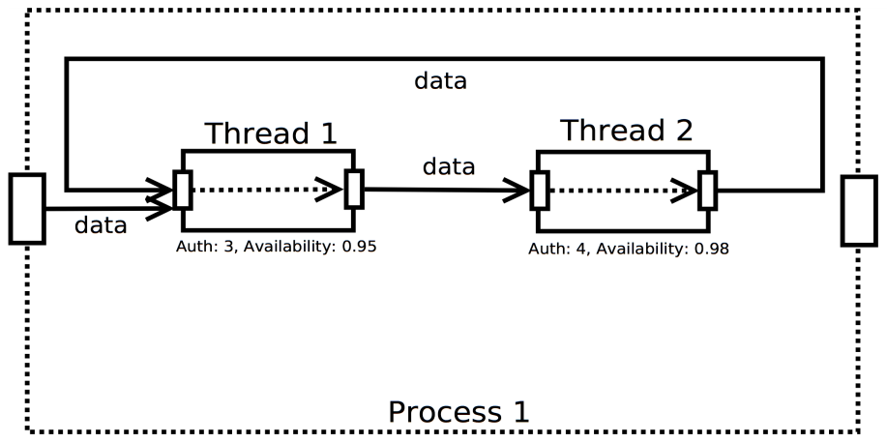
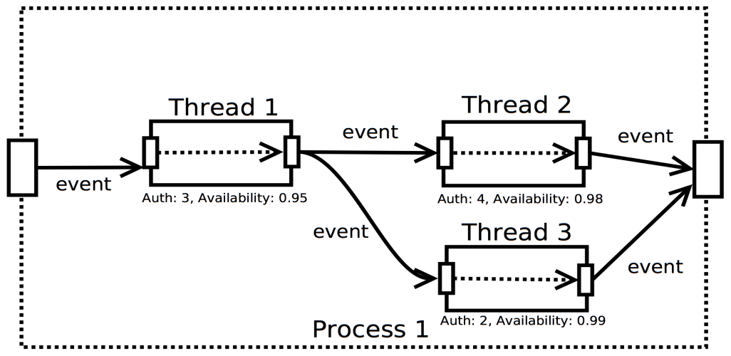
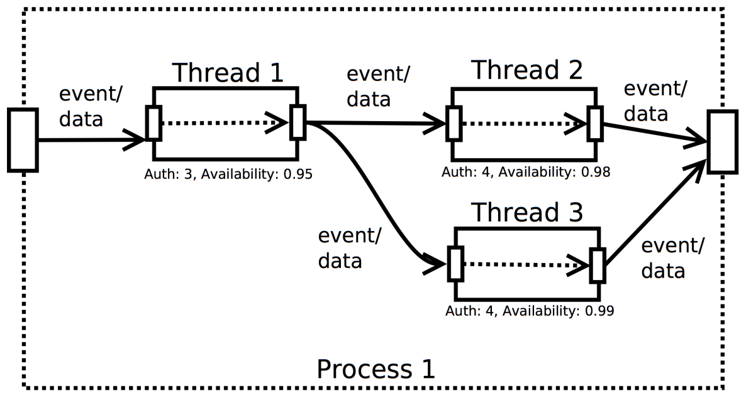
Assembling the Reasoning Frameworks (cont’d)
+
Confidentiality Attribute Architecture
Availability Attribute Architecture
=
Combined Attribute Architecture
Notes:
Don’t forget to run through the diagrams and show explicitly the combination of connectors

Slide 41
Architecture of reuse
Domain
pervasive
reuse
Architected
reuse
Managed
reuse
Planned
reuse
Informal code
reuse
No
reuse
Structured
programming
Object-oriented
programming
Component-based
programming
Agent-based
programming

Slide 42
Next steps
Repay technical debt
Add detail to your model
Add content to your model
Add evidence to your model – don’t forget you need some hard numbers for some aspect of your system

