Slide 1

CPSC 875
John D. McGregor
C22 - Misc

Slide 2
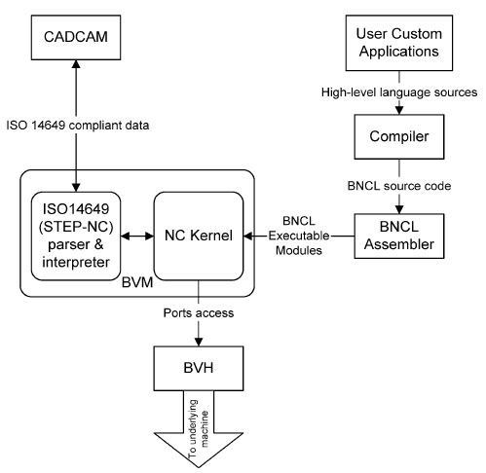
CAD/CAM - NC
http://www.sciencedirect.com/science?_ob=MImg&_imagekey=B6V27-4CNGN01-1-1&_cdi=5695&_user=590719&_pii=S0360835204000646&_origin=gateway&_coverDate=07%2F31%2F2004&_sk=999539995&view=c&wchp=dGLbVlz-zSkzS&md5=6da4b33eb3b9a3fc52c4892dae002f59&ie=/sdarticle.pdf

Slide 3
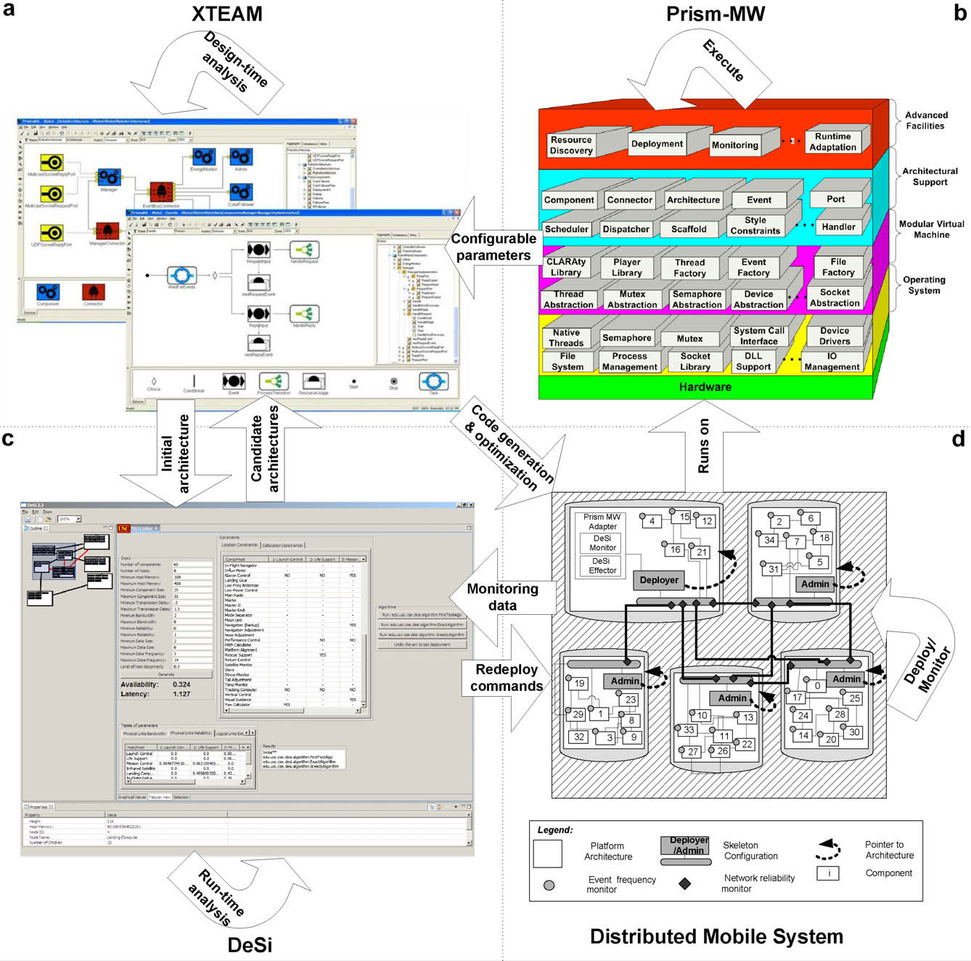
http://www.cs.washington.edu/homes/brun/pubs/pubs/Malek10.pdf

Slide 4
Products and organizations
We started the semester using the analogy of building architecture to understand software architecture
Many factors shape the architecture of a building including the land upon which it is built, the nature of the enterprise that will inhabit the building, and the budget.
The main influences we have examined this semester are the qualities. What else is there?

Slide 5
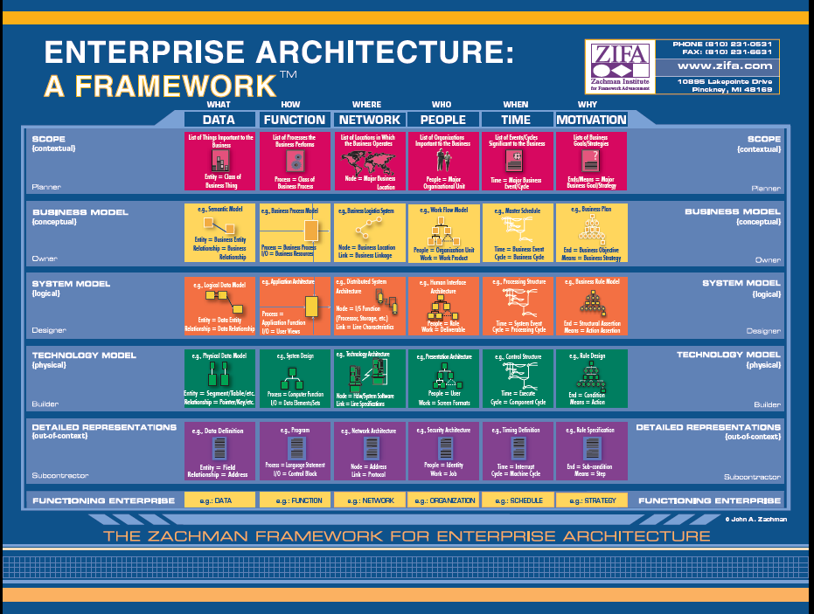
Enterprise architecture

Slide 6
Mirroring
The architecture of a software product will closely resemble the architecture of the organization that built it.
So, structure the organization the way you want the product to look
For example, using an SOA design? Services should be written by small disconnected groups.

Slide 7
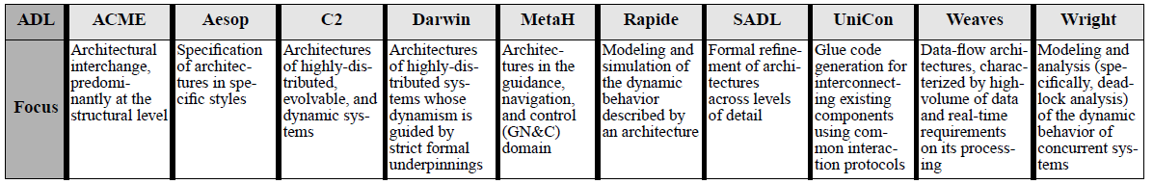
Comparison of ADLs

Slide 8
Alternative representations
UML – use a profile which restricts the size of the language
http://www.cis.gsu.edu/~dtruex/courses/CIS8090/Cases-Articles/ADLbased-on-UML2.0%20.pdf

Slide 9
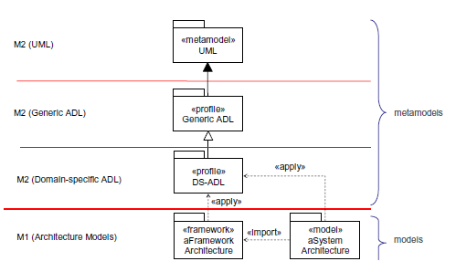

Slide 10
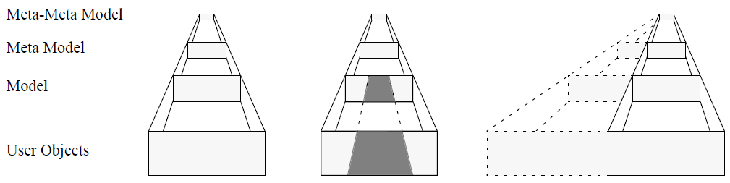
UML options

Slide 11
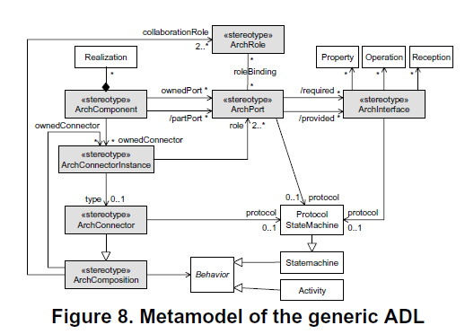

Slide 12
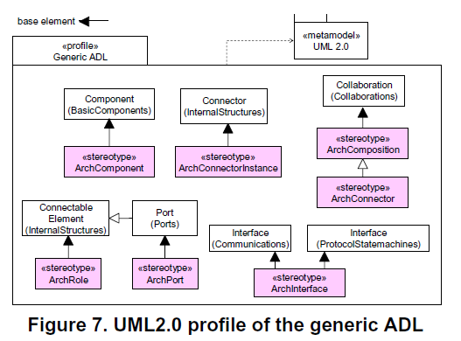

Slide 13
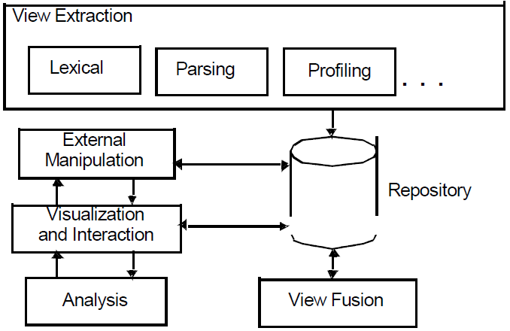
Architecture recovery
http://users.ece.utexas.edu/~perry/prof/wicsa1/final/goa.pdf

Slide 14
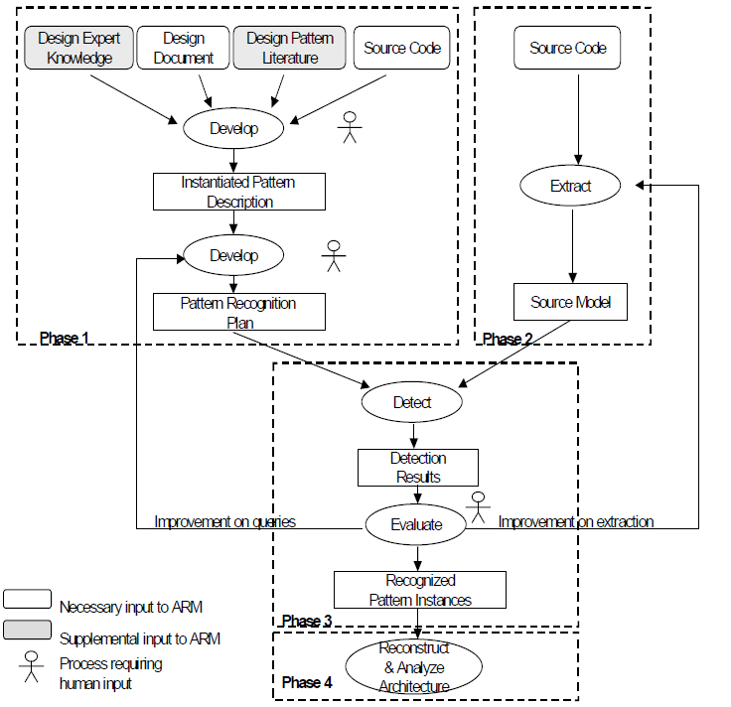
Architecture recovery

Slide 15
The Defenestration of Superfluous Architectural Accoutrements
Grady Booch
A few of the slides from one of Grady’s talks.

Slide 16
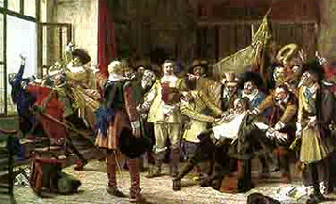
Defenestration
The act of throwing a person or an object out of a window
The Defenestration of Prague (1618)

Slide 17
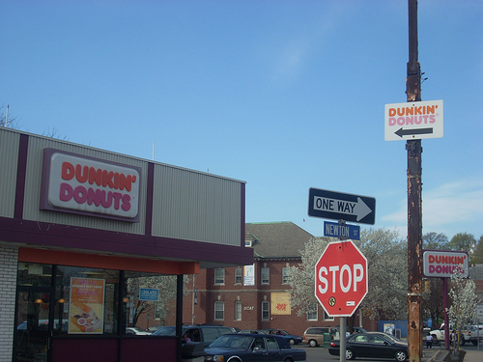
Superfluous
Exceeding what is sufficient or necessary; marked by wastefulness

Slide 18
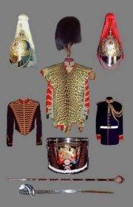
Accoutrement
An accessory item of clothing or equipment

Slide 19
The Premise
Simple architectures have conceptual integrity
Architectures that are simple are better than those that are more complex
A process of continuous architectural refactoring helps to converge a system to its practical and optimal simplicity

Slide 20
On Measuring Architectural Complexity
Mass (calculated in SLOC)
Regularity (measured in patterns/view)
States
Boulder: few states spread across geological time
Software-intensive system: combinatorial explosion of states
Real world: non-discrete, non-continuous

Slide 21
Attending to Simplicity
The fundamentals
Define crisp abstractions
Employ a good separation of concerns
Have a balanced distribution of responsibilities
Insofar as a system embraces these fundamentals, it is simple; when and where it strains these fundamentals, it is complex

Slide 22
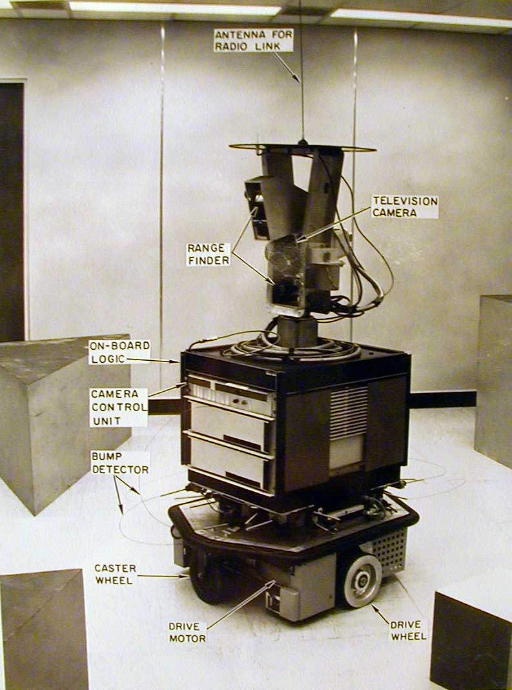
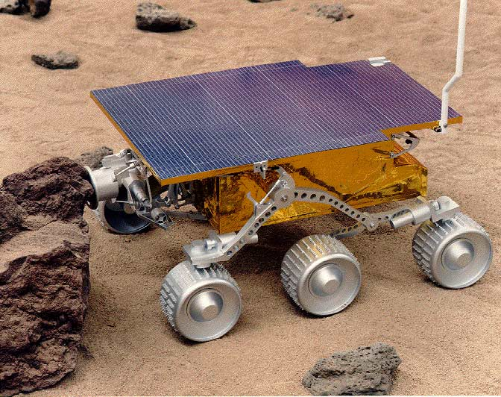
From Control To Chaos

Slide 23
From Complexity to Simplicity
Complexity masks the essential elements of a system
Insofar as we have to expend energy to brush away the surrounding crud that obscures that essence, we’ve lost something in the message and we’ve hidden the
Underlying purpose
Uniqueness
Elegance
Beauty

Slide 24
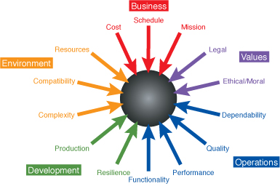
On Finding Simplicity
Simplicity doesn’t just happen
Despite the best intentions
Many forces eat away

Slide 25
On Architectural Failure
Sometimes, systems fail because their architects have chosen a fundamentally wrong architecture
Most of the time, projects
Die the death of a thousand cuts
Are nibbled to death by ducks

Slide 26
On Architectural Failure
A thousand cuts
Collapse happens because of the accumulated weight of well-intentioned and reasonable local decisions that assemble over time at the expense of global optimization and simplicity
Nibble to death by ducks
You rarely see the end coming, until some factor pushes your fragile, complex system over the edge into collapse

