Slide 1

CPSC 875
John D. McGregor
C 23 – Wrap-up

Slide 2
Role/process
The architect
  What is their place in the organization
  How do they earn their keep?
The architecture process
  What are the different processes?
  What is the value of each?

Slide 3
Definition
The software architecture of a program or computing system is the structure or structures of the system, which comprise software elements, the externally visible properties of those elements, and the relationships among them.
Software Architecture in Practice (2nd edition), Bass, Clements, Kazman; Addison-Wesley 2003

Slide 4
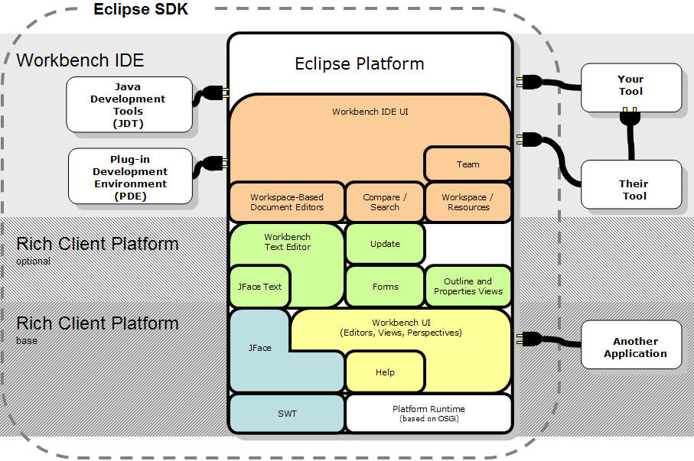
Eclipse architecture cartoon

Slide 5
Pieces
Modules, subsystems, …
These are pieces of a system and entities with which the architect works.
Determining what a particular module does is the job of the architect
How a particular module does its assigned job is a detailed design issue not an architecture issue
Architectural issues cross module boundaries

Slide 6
Orchestration/choreography
The architect creates pieces for certain reasons
And connects certain pieces to achieve specific objectives.
The architect orchestrates the interactions of the pieces of the system but leaves the details to the engineers.

Slide 7
Functional/non-functional
If all we cared about were functional requirements then no structure would be needed. The box below would be the product and the architecture.

Slide 8
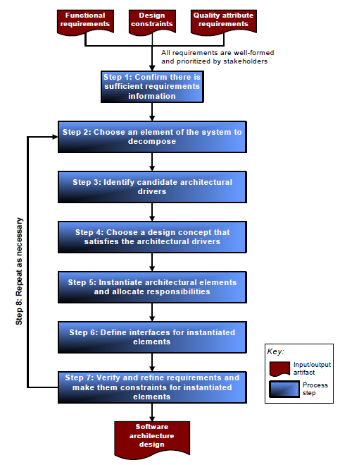
Steps

Slide 9
Who determines priorities
Business goals – set by a dictator or by a consensus building process set a high-level direction
Stakeholders
  Users
  Customers
  Suppliers
  Developers
  Testers
  Etc.

Slide 10
Quality attributes
IEEE Std. 1061 subfactors:
Efficiency Portability
• Time economy • Hardware independence
• Resource economy • Software independence
Functionality • Installability
• Completeness • Reusability
• Correctness Reliability
• Security • Non-deficiency
• Compatibility • Error tolerance
• Interoperability • Availability
Maintainability Usability
• Correctability • Understandability
• Expandability • Ease of learning
• Testability • Operability
• Comunicativeness
http://en.wikipedia.org/wiki/ISO/IEC_9126

Slide 11
Styles and patterns
An architecture style and a pattern are very similar
A pattern may have more information, particularly more information about trade-offs among attributes.

Slide 12
Integrating styles
View
Model
Controller
View
Model
Controller
View
Model
Controller

Slide 13
Error design
error model Example1
features
    ErrorFree: initial error state;
    Failed: error state;
    Fail, Repair: error event;
    CorruptedData: out error propagation
    {Occurrence => fixed 0.8};
end Example1;
error model implementation Example1.basic
transitions
    ErrorFree-[Fail]->Failed;
    Failed-[out CorruptedData]->Failed;
    Failed-[Repair]->ErrorFree;
properties
    Occurrence => poisson 1.0e-3 applies to Fault;
    Occurrence => poisson 1.0e-4 applies to Repair;
end Example1.basic;

Slide 14
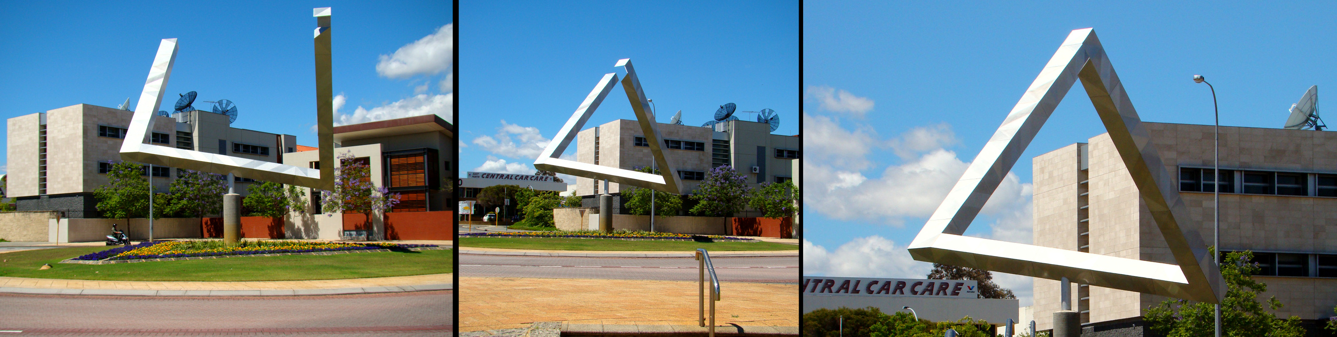
Views and Viewpoints

Slide 15
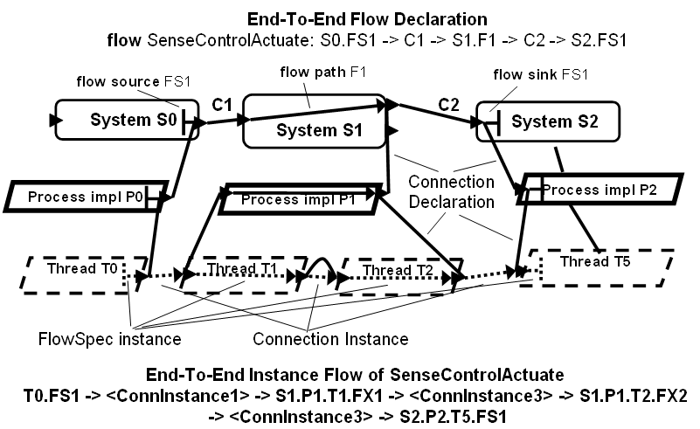
More complex hierarchy

Slide 16
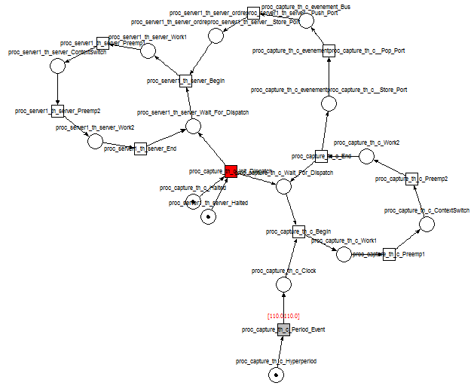
Ocarina
Petri net shows complexity
This representation supports simulation

Slide 17
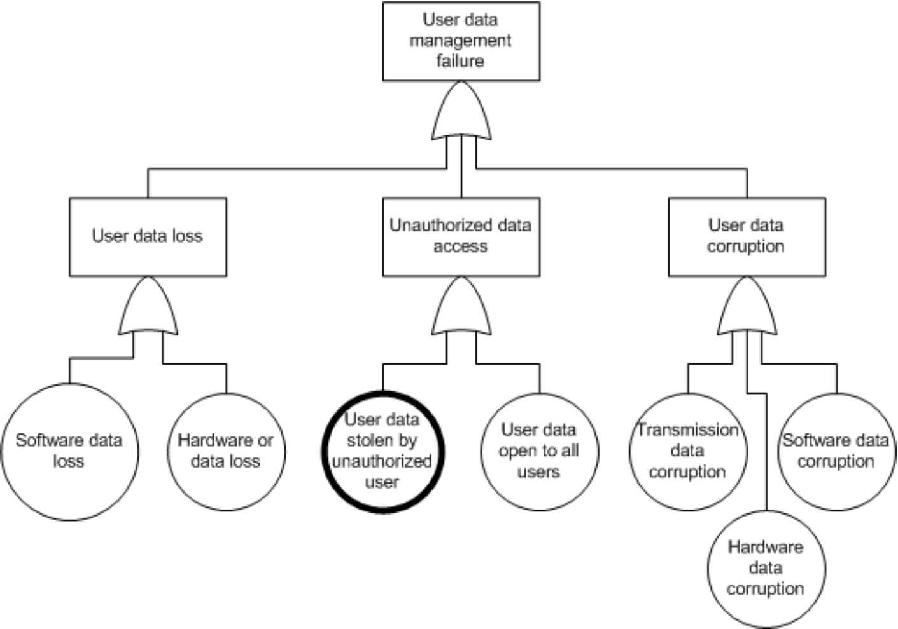
Qualitative Reasoning Framework (cont’d)
Initial Safety Analyses
FTA (Fault tree analysis) is performed on safety critical hazards identified from the FHA.
Root cause of the undesired event
Root causes related to quality attributes are inputs to the reasoning framework
Tacksoo Im

Slide 18
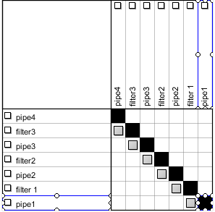
Pipe and Filter DSM

Slide 19
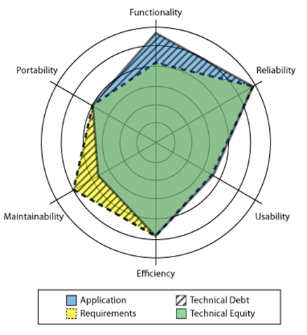
Technical debt is a gap
http://blog.acrowire.com/technical-debt/the-stakeholder-perspective-conclusion/

Slide 20
Background (cont’d)
Definition of Dependability
Dependability is the ability of a system to deliver
service that can justifiably be trusted [63]
Availability: readiness for usage
Maintainability: aptitude to undergo repairs and evolution
Dependability
Integrity: non-occurrence of improper alterations of information
Reliability: continuity of service
[IFIP 10.4]
Safety: non-occurrence of catastrophic consequences on the environment
Confidentiality: non-occurrence of unauthorized disclosure of information

Slide 21
Total cost of ownership
Does not stop at delivery of the first version or the nth version.
On average we spend 80% of total cost on maintenance after first version.
The part of this that goes to repay technical debt (i.e. fixing things) is a drain on the organization.
Think what you could do with the money you pay in interest on your credit cards.

Slide 22
The Goal
Develop software intensive systems that meet the needs of the customer and can be sustained over their intended lifetime.
The software architecture plays a central role in achieving that goal.
The software architect plays an important technical and managerial role in a project.

