Slide 1

CpSc 875
John D. McGregor
Class 5 – Driving requirements

Slide 2
Driving requirements
There are always too many requirements for the team to consider.
The driving requirements are those things that are most important to the most important stakeholders.
We will look at a specific technique: the Quality Attribute Workshop.

Slide 3
NOAA architecture document
This paper presents a software architecture for the Integrated Hydrologic Forecast System (IHFS). The IHFS goal is to support the Hydrologic Research Laboratory mission and vision by the providing a more effective system of tools and techniques for use at River Forecast Centers (RFCs), Weather Forecast Offices (WFOs), and supporting Headquarters Offices to allow the easy introduction of new science that costs less to enhance and maintain.
http://www.nws.noaa.gov/oh/hrl/ihfs/architecture_doc/ihfscnts.php
The next couple of slides give an overview

Slide 4
Table of Contents
Section 1 Introduction
1.1 Purpose
1.2 Characterization of the IHFS Architecture
1.2.1 Interactive Interface Layer
1.2.2 IHFS Applications Layer
1.2.3 IHFS Infrastructure Layer
1.2.4 AWIPS Layer
Section 2 IHFS Architectural Requirements
2.1 Driving Requirements
2.2 Architectural Constraints
2.3 Architectural Requirements
Section 3 Target IHFS Architecture
3.1 Interactive Interface Layer
3.2 IHFS Infrastructure Layer Architecture.
3.2.1 Application Control Services
3.2.2 Application Communication Services
3.2.3 Data Access Services
3.3 IHFS Applications Layer Architecture

Slide 5
Table of Contents
Section 4 Transitional IHFS Architectures and Strategies
4.1 IHFS Infrastructure
4.2 IHFS Interactive Interface
4.3 IHFS Applications
Section 5 Implementation Technologies and Standards
Section 6 Architecture Requirements Satisfaction
Section 7 Open Issues Section
8 Currently Defined IHFS Services Interfaces
8.1 IHFS Infrastructure Layer APIs for Data Access Services
8.2 IHFS Infrastructure Layer APIs for Application Control and Communication
Section 9 Discussion of Other Options Considered
9.1 Data Structure Storage and Synchronization: RFC and WFO
9.2 D2D Architectural Issues
9.3 Informix Architectural Issues
9.4 Application Data Access Services Function Interface
9.4.1 Data Retrieval
9.4.2 Data Storage
9.4.3 Logical Data Storage Organization

Slide 6
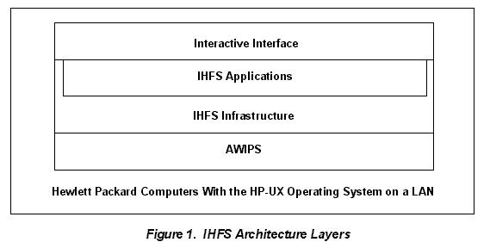
Architecture
At the top level the dominant structure is layers
2.1 Driving Requirements
1. Provide for easy and cost-effective enhancement and maintenance of systems used for river forecasting.
2. Support efficient operations and information sharing between the RFCs and WFOs.
3. Support the current functions of NWSRFS, WHFS, and other functions supporting hydrologic analysis and forecasting.
4. Preserve the current NWSRFS science.
5. Simplify the addition of new science and techniques.

Slide 7
QAW - 1
QAW Steps Description
Step 1 – QAW Presentation
and Introductions
QAW facilitators describe the motivation for the QAW and explain
each step of the method. Next, the facilitators introduce themselves
and the stakeholders do likewise, briefly stating their background,
their role in the organization, and their relationship to the system
being built.
Step 2 –
Business/Programmatic
Presentation
A stakeholder representing the business and/or programmatic
concerns presents the system’s business/programmatic context, highlevel
functional requirements, constraints, and quality attribute
requirements.

Slide 8
QAW - 2
Step 3 – Architectural Plan
Presentation
A technical stakeholder presents the system architectural plans
including (1) plans and strategies for how key
business/programmatic requirements will be satisfied; (2) key
technical requirements, risks, and constraints—such as mandated
operating systems, hardware, middleware, and standards—that will
drive architectural decisions; (3) existing context diagrams, highlevel
system diagrams, and other written descriptions; (4)
operational and system architectures, and architectural frameworks,
tools, and architectural life-cycle processes being used; and (5) the
prototyping and engineering studies underway to mitigate known
risks.

Slide 9
QAW - 3
Step 4 – Identification of
Architectural Drivers
The facilitators share their list of key architectural drivers that
include high-level requirements, business drivers, constraints, and
quality attributes.
Step 5 – Scenario
Brainstorming
The facilitators ask the stakeholders to brainstorm scenarios that are
operationally meaningful with respect to the stakeholders’ individual
roles.
Step 6 – Scenario
Consolidation
Similar scenarios are consolidated when reasonable.

Slide 10
QAW - 4
Step 7 – Scenario
Prioritization
Stakeholders vote to establish the priorities of the scenarios.
Step 8 – Scenario Refinement The high-priority scenarios are refined in more detail. Facilitators
further elaborate each one, documenting the following: the six parts
of the scenario, the business/programmatic goals that are affected by
this scenario, the relevant quality attributes associated with this
scenario, and the questions and issues regarding the scenario.

Slide 11
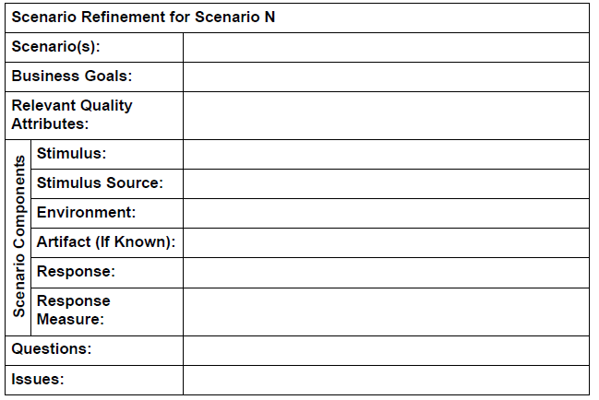
Scenario
Format for a scenario

Slide 12
Output from QAW
a list of architectural drivers
the raw scenarios
the prioritized list of raw scenarios
the refined scenarios

Slide 13
QAW Roles
QAW lead: The lead ensures that the steps of the method are carried out during the workshop.
The lead facilitates discussions, and ensures that the method is carried out in a timely fashion and that the required QAW artifacts are produced.
QAW scribe: The scribe captures the raw scenarios, their prioritization, the refined scenarios, and any relevant issues that emerge during the workshop. The scribe uses the standard
QAW template shown below as a guide during the workshop to ensure that the appropriate information is captured in a consistent manner.

Slide 14
The executive
The executive is trying to achieve business goals
The architecture (and the product) are tools
The executive wants customers satisfied and few repairs

Slide 15
The architect
The architect wants to keep everyone happy (and quiet).
Wants trade-offs to be explicit and widely communicated
Reduces complexity everywhere including desk and home
Wants input but also wants authority

Slide 16
The developer
The developer wants to make progress quickly, to stay interested
Wants to turn out a quality product that will not need lots of testing and debugging
Wants clear direction so that it can be once and done
Wants to focus on new, interesting design problems, not yet another …

Slide 17
The customer
Our customer is the automotive original equipment manufacturer (OEM).
They want several models with different features and different price points
After the features, the most important attribute is cost
They have to install the equipment, repair when necessary, and occasionally add a custom piece.

Slide 18
Next steps
Read about the Quality Attribute Workshop
http://www.sei.cmu.edu/reports/04tn017.pdf
http://www.sei.cmu.edu/reports/03tr016.pdf
Read this last one by Thursday.
Build a capability pattern for the QAW in EPF

